Slide 1
Bachelor of Arts Business Management
The Global Business Environment (LCBB4005_BIRM)
Week 9 – THE GLOBAL STRATEGIES OF MNCs

Slide 2
Learning outcome
Discuss what strategy is
Discuss the value chain of a business, and the global value chain
Discuss International Trade and why organisations engage in it
Discuss various GLOBAL Strategies businesses uses to expand abroad
Strategies use to analyse global businesses competitiveness, and profitability of firms

Slide 3
Business Purpose and Internal Value Chain
Businesses exist mainly to produce, sell and make profit
The entire supply chain is important (see lecture 1)
Key aspect of the supply chain network is the internal value chain, and the external value chain
The internal value chain is the set of internal activities/processes/task that help to create a product (primary and support activities exist internally)
The external or the global value chain is the set of activities that link all business operations globally

Slide 4
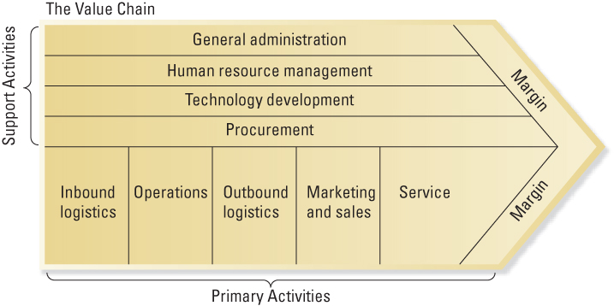
Internal Value Chain
Processes/activities involved in creating a product or perform a service (primary and support activities supports production

Slide 5
The External Value Chain
Sequence of all functional activities required in the process of value creation
Description of the full range of activities needed to create a product or service

Slide 6
The Global Value Chain (GVC)
The value chain becomes global when the sequence and full range of activities to produce or provide a service involves more than one country
Many businesses nowadays have partner suppliers or allow part of their product or service to be produced and assembled abroad
Think about Airbus (European Aerospace manufacturer
Airbus has more than 8000 direct and 18000 indirect suppliers from over 100 countries supply parts, components, systems and services

Slide 7

Evolution of the Value Chain
1977
The Commodity Chain:
2011
Sustainable Value Chain (SVC)
Make business connections and dependencies sustainable (think environment and social impact)
1994
Global Commodity Chain (GCV)
1985
Porters Value Chain (PVC)
2000s
Global Value Chain (GVC)
2007
Global Value Network (GVN)
Businesses more interconnected

Slide 8
Evolution of the Value Chain
s11301-019-00164-7.pdf
Please read about the global value chain

Slide 9
Competition and the Value Chain
Competition in local markets are increasingly fierce due to the market economy principles which states that the private sector is the main source of efficient resource allocation
Hence, domestic markets in some countries are saturated or getting close to saturation due to the entrepreneurial innovations
Hence, many firms have explored other markets or attempting to do so in order to remain competitive and to survive
International Trade and Globalisation has been born out of this

Slide 10
International Trade
International Trade is the movement or exchange of goods and services between countries
Do not confuse with Globalisation which also involves movement of people, services, finance, integration of countries, foreign direct investment (FDI), collaboration and partnership between countries and businesses

Slide 11
Why should organisations engage in International Trade?
Access new markets to expand and remain competitive for success
Expand to increase sales, revenue and profits
Spread risk
Access to foreign goods and services
Improve productivity through learning from others
For customers, competition can lower prices, improve quality and innovation

Slide 12
Competition
Engaging in international trade means firms must remain competitive in terms of cost/price, quality and customer services/after sale service
Two things worth remembering:
Governments providing conducive environment for domestic firm's competitiveness against their international competitors (national competitiveness (good institutions and infrastructure)
Businesses too should have some internal competencies that makes them unique against their competitors which may require
Good PLANNING and STRATEGY

Slide 13
STRATEGY
Two Definitions:
Strategy refers the process or the way a business looks into the future and determines ways in which it can turn goals into reality.
A plan or plans which directs a business through actions and activities in order to achieve the vision and goals of a business

Slide 14
STRATEGY
Strategy requires that the business ask and answer three main questions:
Where do we want to be at X point in the future? For long-term vision.
Where are we now? Strategy requires that some analysis is made of the current position of the business so that it can identify its strengths, weaknesses, opportunities and threats and how far away it is from its long-term aims.
How are we going to achieve our aims? The business may well formulate a plan or set of objectives and activities that will help it to achieve its aims and to monitor and evaluate progress.

Slide 15
Competitive Advantage of Firms
Technically, competitive advantage occurs when the edge the firm has over its rivals fulfils two criteria:
1. Defensibility:
Rivals should not find it easy to simply copy the advantage you have.
2. Distinctiveness:
What you offer should be something that clearly sets you apart from your competitors

Slide 16
Types of generic core competencies
Communication
Teamwork
Problem solving
Personal spirit
Innovation
Design
Customer acquisition
Customer service
New product development
Project management
Empowerment of employees
Leadership throughout the business
Adaptability
The ability to learn and, crucially to ‘unlearn’ (to shake off the shackles of tradition, routine and entrenched views, opinions or perspectives)
Ability to adjust to the changing needs

Slide 17
Strategies to Grow Internationally
Exporting
Mergers and Acquisitions
Form Alliances
Outsourcing
Franchising
Joint Ventures
Diversification
Greenfield (build your own plant abroad)

Slide 18
BUSINESS GROWTH STRATEGIES
Exporting
Mergers & Acquisitions
Breaking into new markets may also mean produce at home and sell the products abroad.
External methods of growth and involve joining together with another firm on an agreed voluntary basis (merger) or acquiring another firm by taking it over (acquisition).

Slide 19
BUSINESS GROWTH STRATEGIES
Diversification
Joint Ventures
Franchising
Finding new products and markets not necessarily related to its core product and markets which it can exploit
Partnership with another firm who may have different opportunities, markets or skills, and which allow the business to develop new products or exploit new markets.
Franchising allows entrepreneurs to set up business independently but with the right to use the franchiser’s brand or logo and support.

Slide 20
Outsourcing
This is the way in which firms contract out some of their operations in order to reduce costs and gain competitive advantage.
The organization who is contracted to carry out the operation takes on the responsibility of carrying out the operation to specified and agreed standards often based on a pre-determined service level agreement.
  Examples of outsourced operations include customer service functions, market research, information technology, accounting and other financial operations such as payroll and marketing functions such as product design and advertising.

Slide 21
Greenfield
Build a new plant or subsidiary in another country in order to reduce cost, logistical issues, overcome some trade barriers, get closer to some of your customers

Slide 22
TOOLS FOR ANALYSING STRATEGY
Porters Diamond
BCG

Slide 23
PORTER'S DIAMOND MODEL THEORY
Explain why certain industries within a particular nation are more competitive internationally
Porter contended that the greater number of trade-related theories have only focused on cost and a new theory was essential that
“should attract a comprehensive understanding of competition that contains segmented markets, differentiated products, the technological differences and economies of scale”.

Slide 24
PORTER'S DIAMOND MODEL THEORY
He suggested that this new theory should be able to define why firms from certain nations implement better strategies than others competing in certain sectors.
The model creates a structure that determines the rules of competition in a sector and makes it important to have a role to play based on the opinion of achieving a long-term competitiveness.

Slide 25
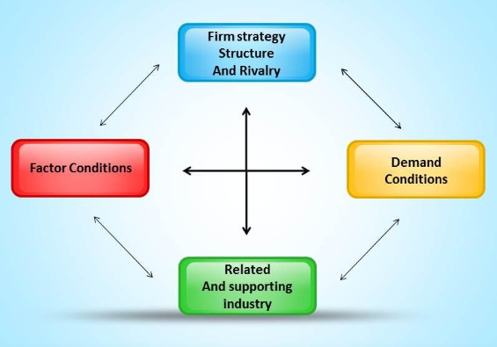
PORTER'S DIAMOND MODEL THEORY

Slide 26
PORTER'S DIAMOND MODEL THEORY
Factor conditions - Factor conditions are values of the firm’s skill to supply those factors of research production that allow a unit to compete. They are the factors of production and infrastructure necessary to compete in a particular industry.
Demand conditions: This is one of the most interesting dimensions as it relates to the nature of consumers in the home market. Demand conditions are the pressures based on buyers‟ requirements about quality, price, and services in a particular industry.

Slide 27
PORTER'S DIAMOND MODEL THEORY
1.Home Demand Conditions:
2.Demand Size and Pattern of Growth:
3.Internationalization of Domestic Demand:

Slide 28
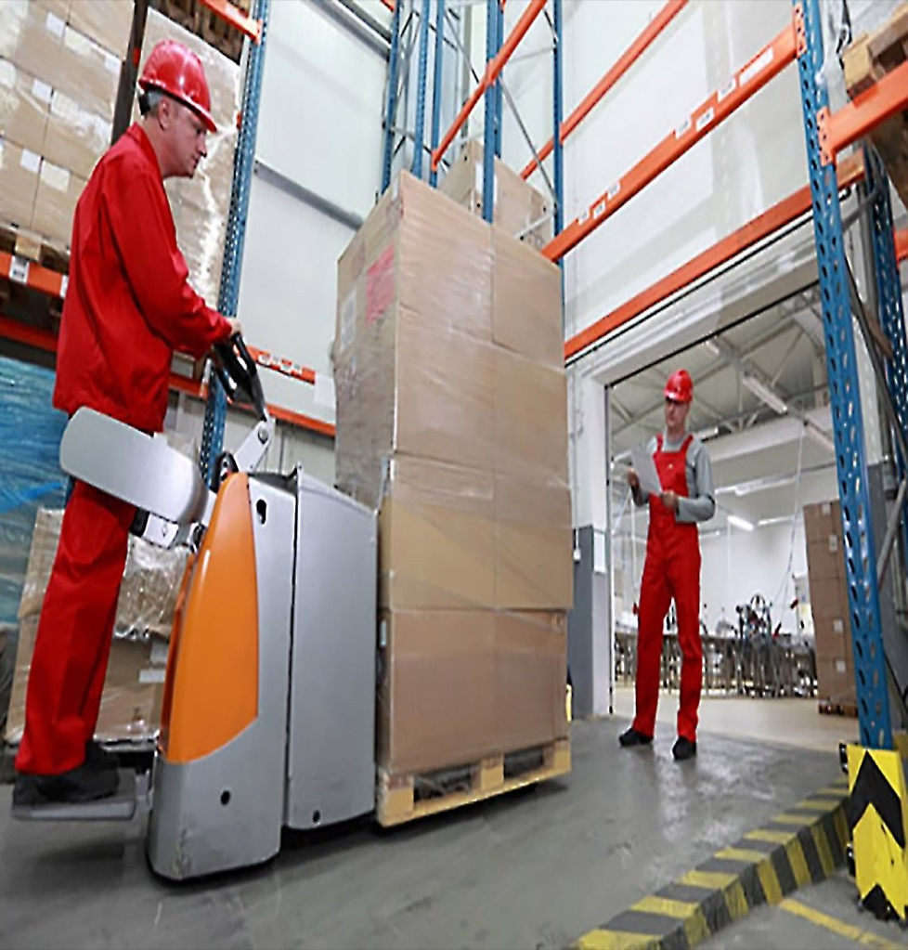
PORTER'S DIAMOND MODEL THEORY
The related and supplier industries: Suppliers are crucial to enhancing innovation through more efficient and higher-quality inputs, timely feedback and short lines of communication. Related industries are those in which organizations can organize or allocate activities in the value chain when competing, or those, that produce complement goods

Slide 29

PORTER'S DIAMOND MODEL THEORY
Firms’ strategy, structure and rivalry: Firms’ strategy, structure and rivalry are measures of situations that explain how a sector is originated, systemized and managed and the nature of domestic competition that could support a nation achieve a sustained competitive advantage.

Slide 30
PORTER'S DIAMOND MODEL THEORY
Government & Chance: Apart from these four, Porter argues that there are two extra determinants that can importantly affect the national system. The first variable is the government effect and the second one is chance events (whether positive or negative effects that cannot be checked by the sector).

Slide 31


Slide 32
The Boston Consulting Group (BCG)
The Boston Consulting Group (BCG) is a renowned organization.
It is a growth share 2×2 matrix.
The matrix is established in 1970 by Bruce Doolin Henderson (1915–1992) for the BCG in Boston, Massachusetts, the USA.
The model/tool helps businesses to appraise their products and services (product portfolio) based on its profitability so that the company can decide whether to keep, sell, or invest a lot more.

Slide 33
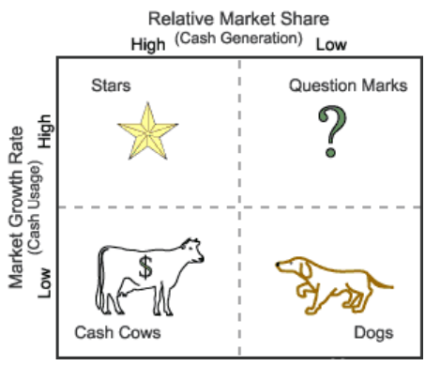
The Boston Consulting Group (BCG)

Slide 34
The BCG matrix divides the business products into four categories as:
‘Question Marks’ indicates the products in high growth markets, and with low market share.
‘Stars’ shows that both, the growth markets and market share are in the highest position.
‘Cash Cows’ predicts that the products are in low growth markets, and high market share
‘Dogs’ displays that both growth and market share are in low position.

Slide 35
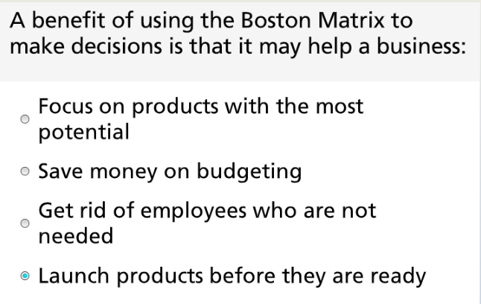

Slide 36
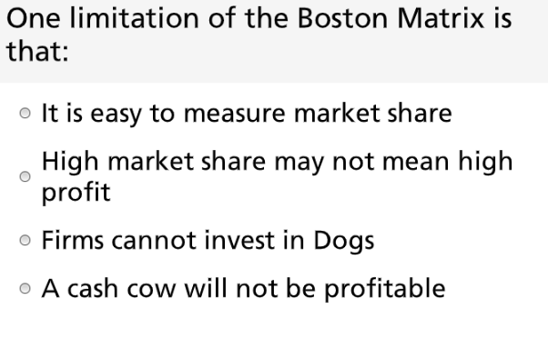

Slide 37
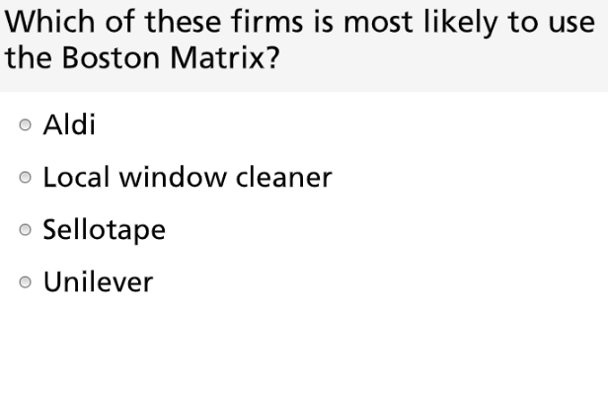

Slide 38
Going Back to Value Chain
We said value chain is;
Sequence or description of all functional activities required in the process of producing a product that fits a particular expectation
Value should be created for all stakeholders especially in international business
For customers, value is created when the product/service consistently meets their needs at an affordable cost/price (benefit higher than price you paid)
For businesses, value is created when the price customers pay is greater than cost of producing it and meets customer expectations
Hence, issues around brands, intangible services, innovations in the product and cost savings become important

Slide 39
Going Back to Value Chain
Cost savings and the need for innovation is one of the reasons why some businesses diversify their operations around the world making…….;
firms more interdependent
Let us look at global value creation of the Ipod

Slide 40
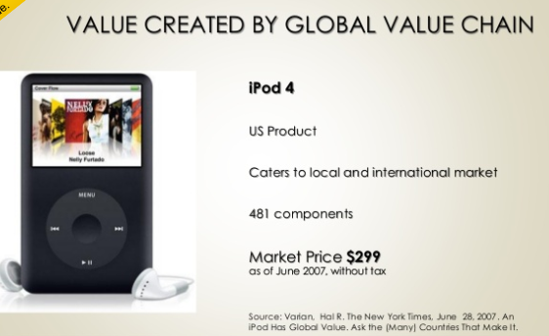
Global Value Chain (VALUE NETWORKS)

Slide 41
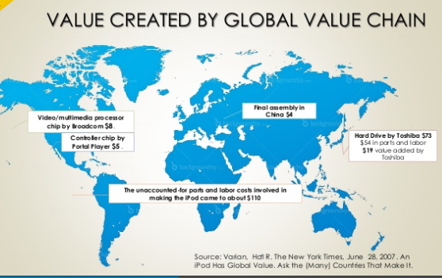
Global Value Chain (VALUE NETWORKS)

Slide 42
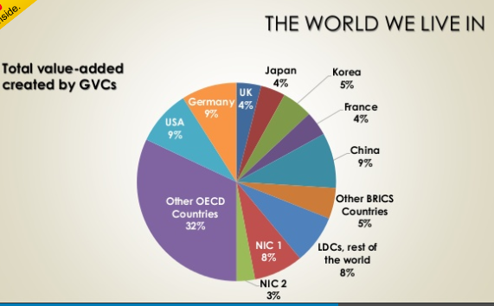
Global Value Chain (VALUE NETWORKS)

Slide 43
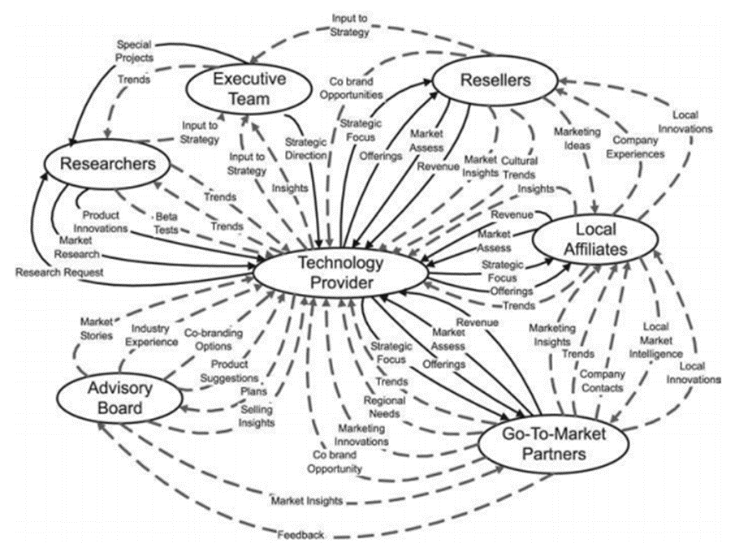
VALUE NETWORKS

Slide 44
VALUE NETWORKS
We view the value network as a set of economic entities (EE) connected through transfer of offerings that yields a structural network whose purpose is to deliver a common value proposition to a specified end consumer or market.
It is a structure where value is created, recognized, and captured.
It provides a systematic analysis of how one type of value is converted into another.
Value network analysis (VNA) links specific interactions within the value creating network directly to financial and non-financial scorecards

Slide 45
Summary
Competition and why firms engage in international trade
Business Strategies uses to go international
Porter’s Diamond Model and the BCG matrix
Global Value Chain or network

Slide 46

1. Explain the meaning of Business Strategy.
2. Discuss two global strategies you recommend for a selected phone company.
3. Use your knowledge and understanding in Global Value Chains/Value Networks & BCG Matrix to discuss the application of the model to a selected phone company.

