Slide 1
Sparta from Tegea to Mantineia
Neither Same nor Different

Slide 2
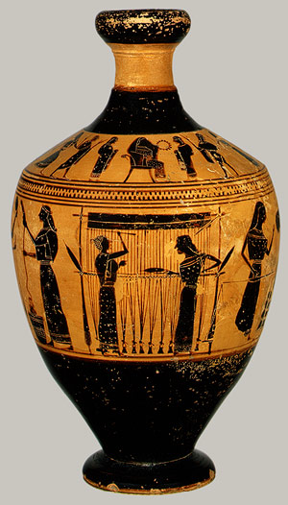
Women in the Greek world
The common image of women in the Greek world is that of the Athenian upper class woman.
This common image is of women who never leave the house and spend their days weaving.

Slide 3
The “Typical” Athenian Upper Class Woman
Hearing that the boy was at my house, he came there at night in a drunken state, broke down the doors, and entered the women's rooms: within were my sister and my nieces, whose lives have been so well-ordered that they are ashamed to be seen even by their kinsmen. Lysias 3.6

Slide 4
Typical and Atypical in Athens
There is no such thing as a typical woman in Athens.
Even within the upper classes, there are differences in how women are treated and how they are presented to other men.
For the lower classes of course, it is impossible to assume that women did not exit the house or did not contribute in the personnel of the oikos.

Slide 5
The Athenian view of Sparta
First, to begin at the beginning, I will take the begetting of children. In other states the girls who are destined to become mothers and are brought up in the approved fashion, live on the very plainest fare, with a most meagre allowance of delicacies. Wine is either witheld altogether, or, if allowed them, is diluted with water. The rest of the Greeks expect their girls to imitate the sedentary life that is typical of handicraftsmen -- to keep quiet and do wool-work. How, then, is it to be expected that women so brought up will bear fine children? [4] But Lycurgus thought the labour of slave women sufficient to supply clothing. He believed motherhood to be the most important function of freeborn woman. Therefore, in the first place, he insisted on physical training for the female no less than for the male sex: moreover, he instituted races and trials of strength for women competitors as for men, believing that if both parents are strong they produce more vigorous offspring. Xenophon Spartan Constitution 1.3-4

Slide 6
The Athenian View of Sparta
Xenophon was pro-Spartan but he was born and raised in Athens.
Interestingly, he considers that the common Athenian upper class attitude towards women is less successful than the Spartan one.
Note, however, that the woman shut in the house doing wool-working is the upper class woman. Lower-class women worked for a living.

Slide 7
Women in Early Sparta
Vendettas end among the gods.
Serenity's against the odds.
But weave and anguish is your thread.
Agido's light I sing instead,
Which is the sun's, and she our sun;
They shine, we cannot tell which one.
And yet I must not praise her so:
One lovelier than Agido
Must have first praise. Choirmaster, she,
Dazzling as when a stallion, he
Runs beside his stateliest mare,
Outshines us all, O no compare!
A race-horse, she, a champion blood
Long-tailed Paphlagonian stud. Alkman 1.39-49
From the little information surviving (mainly the poems of Alkman), in the archaic period, Spartan women appear to be no different from women in other parts of the Greek world.
They take part in religious festivals and have associations of their own; something similar is known for archaic Lesbos.

Slide 8
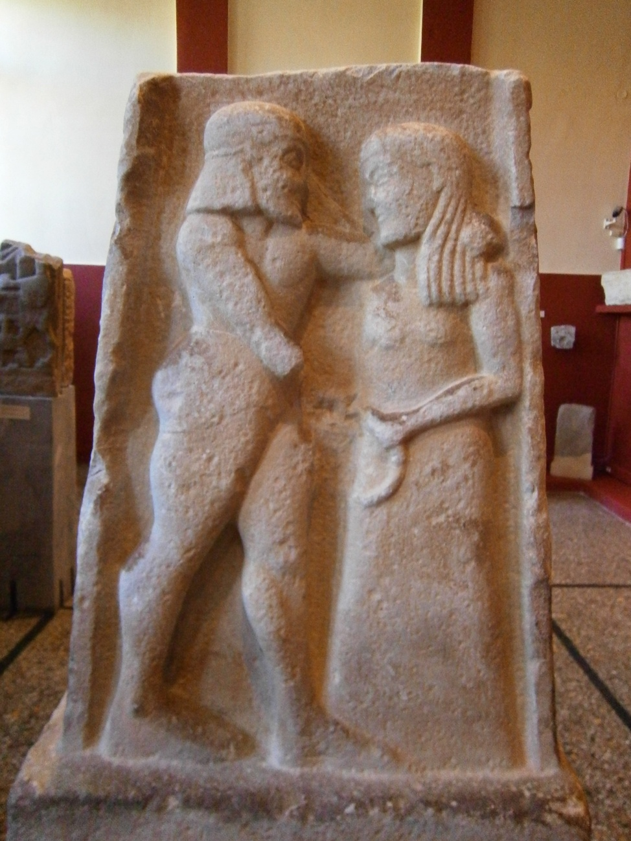
Representations of archaic women
Base of stele, 6th century BCE.
On the one side, man killing woman
(Helen and Menelaus?).
On the other, wedding scene
(Helen and Paris?). Found in Magoula.

Slide 9
Women, Competition and Sport
Bibasis was a kind of Lakonian dance, in which prizes were awarded not only to children but also to girls; one had to leap and touch the buttocks with one’s feet, and the jumps were counted, hence the inscription in honour of one of these girls: “Who once did a thousand at bibasis, the most ever done”. Pollux 4.102
Archidamus left sons when he died, of whom Agis was the elder and inherited the throne instead of Agesilaus. Archidamus had also a daughter, whose name was Cynisca; she was exceedingly ambitious to succeed at the Olympic games, and was the first woman to breed horses and the first to win an Olympic victory. After Cynisca other women, especially women of Lacedaemon, have won Olympic victories, but none of them was more distinguished for their victories than she. Pausanias 3.8.1

Slide 10
Women, Competition and Sport
The encouragement of women to take part in athletic competitions was, as far as we know, unique to Sparta in the Greek world.
In the 4th century, Spartan women even took part in the Olympic Games; until then exclusively the province of men.

Slide 11
Women and Marriage
He noticed, too, that, during the time immediately succeeding marriage, it was usual elsewhere for the husband to have unlimited intercourse with his wife. The rule that he adopted was the opposite of this: for he laid it down that the husband should be ashamed to be seen entering his wife's room or leaving it. With this restriction on intercourse the desire of the one for the other must necessarily be increased, and their offspring was bound to be more vigorous than if they were surfeited with one another. [6] In addition to this, he withdrew from men the right to take a wife whenever they chose, and insisted on their marrying in the prime of their manhood, believing that this too promoted the production of fine children. [7] It might happen, however, that an old man had a young wife; and he observed that old men keep a very jealous watch over their young wives. To meet these cases he instituted an entirely different system by requiring the elderly husband to introduce into his house some man whose physical and moral qualities he admired, in order to beget children. [8] On the other hand, in case a man did not want to cohabit with his wife and nevertheless desired children of whom he could be proud, he made it lawful for him to choose a woman who was the mother of a fine family and of high birth, and if he obtained her husband's consent, to make her the mother of his children. Xenophon Spartan Constitution 1.5-8

Slide 12
Women and Marriage
In their marriages, the husband carried off his bride by a sort of force; nor were their brides ever small and of tender years, but in their full bloom and ripeness. After this, she who superintended the wedding comes and clips the hair of the bride close round her head, dresses her up in man's clothes, and leaves her upon a mattress in the dark; afterwards comes the bridegroom, in his everyday clothes, sober and composed, as having supped at the common table, and, entering privately into the room where the bride lies, unties her virgin zone, and takes her to himself; and, after staying some time together, he returns composedly to his own apartment, to sleep as usual with the other young men. And so he continues to do, spending his days, and, indeed, his nights, with them, visiting his bride in fear and shame, and with circumspection, when he thought he should not be observed she, also, on her part, using her wit to help and find favourable opportunities for their meeting, when company was out of the way. In this manner they lived a long time, insomuch that they sometimes had children by their wives before ever they saw their faces by daylight. Plutarch Lykourgos 15

Slide 13
Women and Marriage
Unlike Athens, women in Sparta married after their teenage years; in Athens girls married around 14.
Similarly, it appears that men married younger than in Athens, where the age of marriage for men was 30.

Slide 14
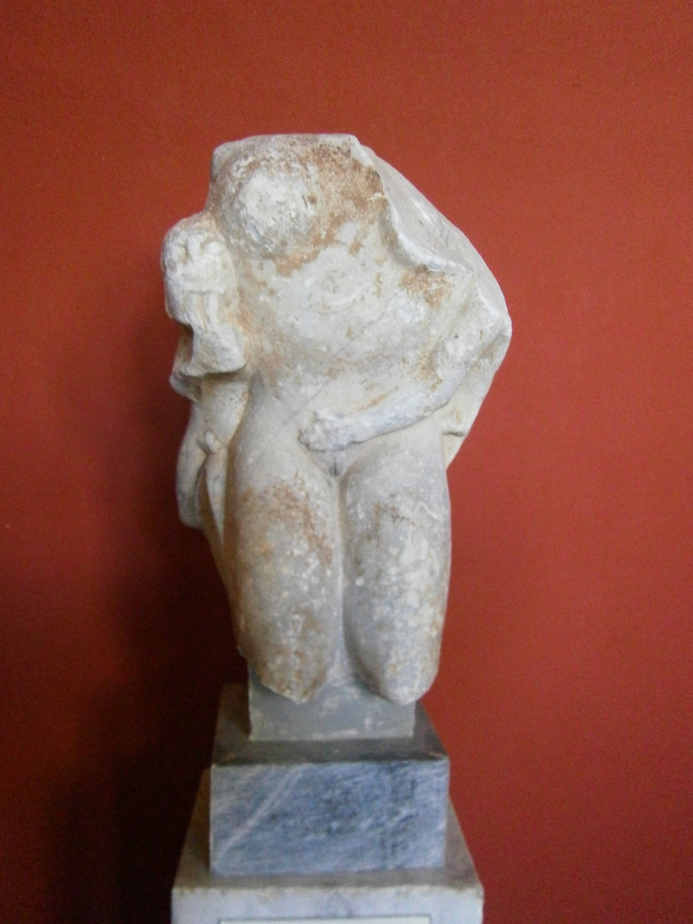
Women and Childbirth
Group of a nude woman kneeling,
550-525 BCE. Male figures on either side.
It is considered to be representing
the goddess of birth-giving,
Eilethyia. Found in Magoula.

Slide 15
The Spartan Family
Nor was it in the power of the father to dispose of the child as he thought fit; he was obliged to carry it before certain triers at a place called Lesche; these were some of the elders of the tribe to which the child belonged; their business it was carefully to view the infant, and, if they found it stout and well made, they gave order for its rearing, and allotted to it one of the nine thousand shares of land above mentioned for its maintenance, but, if they found it puny and ill-shaped, ordered it to be taken to what was called the Apothetae, a sort of chasm under Taygetus; as thinking it neither for the good of the child itself, nor for the public interest, that it should be brought up, if it did not, from the very outset, appear made to be healthy and vigorous. Plutarch Lykourgos 16

Slide 16
The Spartan Family
The Spartan state intervened into the decisions of the family unlike in other poleis, where decisions on upbringing of children were made exclusively by the father.
It is clear from the sources that a large part of Spartan customs relating to marriage and family aimed to ensure healthy children.

Slide 17
Women and Property
And this has taken place in the state under consideration, [20] for the lawgiver wishing the whole city to be of strong character displays his intention clearly in relation to the men, but in the case of the women has entirely neglected the matter; for they live dissolutely in respect of every sort of dissoluteness, and luxuriously. So that the inevitable result is that in a state thus constituted wealth is held in honor, especially if it is the case that the people are under the sway of their women, as most of the military and warlike races are, except the Celts and such other races as have openly held in honor passionate friendship between males. For it appears that the original teller of the legend had good reason for uniting Ares with Aphrodite, for all men of martial spirit appear to be attracted to the companionship either of male associates or of women. Hence this characteristic existed among the Spartans, and in the time of their empire many things were controlled by the women; yet what difference does it make whether the women rule or the rulers are ruled by the women? Aristotle Politics 1269b

Slide 18
Women and Property
So the Spartan women are, it is true, responsible for what took place, and therefore manifestly for this mistake among the rest; although for our own part we are not considering the question who deserves excuse or does not, but what is the right or wrong mode of action. But, as was also said before, errors as regards the status of women seem not only to cause a certain unseemliness in the actual conduct of the state but to contribute in some degree to undue love of money. For next to the things just spoken of one might censure the Spartan institutions with respect to the unequal distribution of wealth. It has come about that some of the Spartans own too much property and some extremely little; owing to which the land has fallen into few hands, and this has also been badly regulated by the laws; [20] for the lawgiver made it dishonorable to sell a family's existing estate, and did so rightly, but he granted liberty to alienate land at will by gift or bequest; yet the result that has happened was bound to follow in the one case as well as in the other. And also nearly two-fifths of the whole area of the country is owned by women, because of the number of women who inherit estates and the practice of giving large dowries; yet it would have been better if dowries had been prohibited by law or limited to a small or moderate amount . . . But as it is he is allowed to give an heiress in marriage to whomever he likes; and if he dies without having made directions as to this by will, whoever he leaves as his executor bestows her upon whom he chooses. Aristotle Politics 1270a

Slide 19
Women and Property
For Aristotle a major reason of Spartan downfall was the property legislation, which allowed women to amass great wealth.
Aristotle, unlike other Greek philosophers, found the Spartan regulation of women to be lacking because it gave them too much power.
However, the Spartan regulations of property do not appear to be unique in relation to the regulations of other Dorian states, ex. Gortyn in Crete.

Slide 20
Women, War and Honour
Argileonis, asking some who came from Amphipolis if her son Brasidas died courageously and as became a Spartan, on their beginning to praise him to a high degree, and saying there was not such another left in Sparta, answered, "Do not say so; Brasidas was a good and brave man, but there are in Sparta many better than he." Plutarch Lykourgos 25.
Another woman, as she was handing her son his shield and giving him some encouragement, said: 'Son, either with this or on this”. Plutarch Moralia 241

Slide 21
Women, War and Honour
There are numerous Spartan saying of women urging the men to war.
In some ways, in the Greek image of Sparta, the women were the keepers of Spartan honour; an image very different from that presented by Aristotle.

Slide 22
Spartan Women
Spartan women lived different lives from the women of the Athenian upper classes.
In some matters, Spartan women appear to have had more freedom than women in other parts of the Greek world.
However, the role of the Spartan woman in the oikos and the polis, was not fundamentally different from than of a woman in any other polis

