Slide 1

My favorite Hobby
Shahboz Nabiev 2335794
Learning in the Digital Era
(ACCA4025_LON)

Slide 2

My favourite hobby is watching football
Liverpool football club is my favourite team
I like to watch every minute of watching my team
I'm supporter sings I was 9 years old

Slide 3
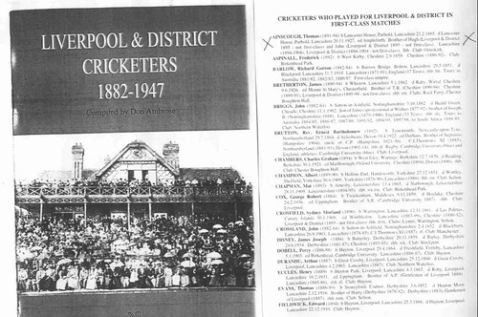
LFC founded in 1892

Slide 4

This is short video about my team

Slide 5
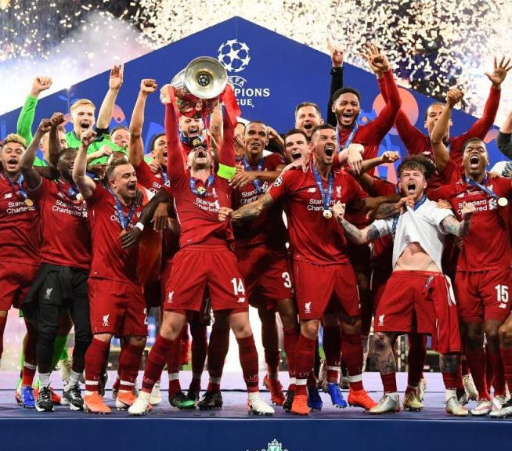
benefits of my hobby
I don't have much free time but by watching them in end of day (high lights) I'm relaxing
Every goal making me happy
By watching in big games can develop dopamine and adrenaline in my body

Slide 6

Fun facts
Football is full of surprises.
Last minute goals
Underdogs winning it's always exciting
Each game has moments that make us feels amazed

Slide 7
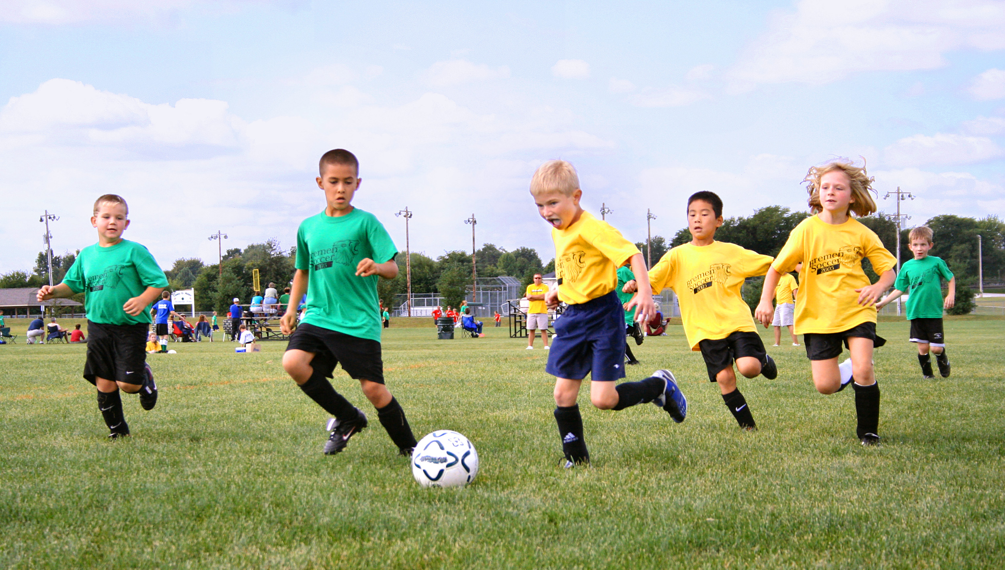
Conclusion
I want my boys to have a healthy and active lifestyle from a young ag
e
Encourage your child to watch football
Once your child has realised how much fun kicking a ball around can be, you can begin to introduce them to the concept of football as a sport. Sit down and watch a game on television with them, explaining what is going on and answering any questions they might have. Talk about the different hairstyles, boots and kits.
Even better would be taking them to a live game. This doesn’t have to be a Premier League clash, but your local Football League or even non-league side. That way they can experience the atmosphere and the magic which comes with competitive football. soursed from google
Thank you verry much for you time and consideration YNWA

