Slide 1
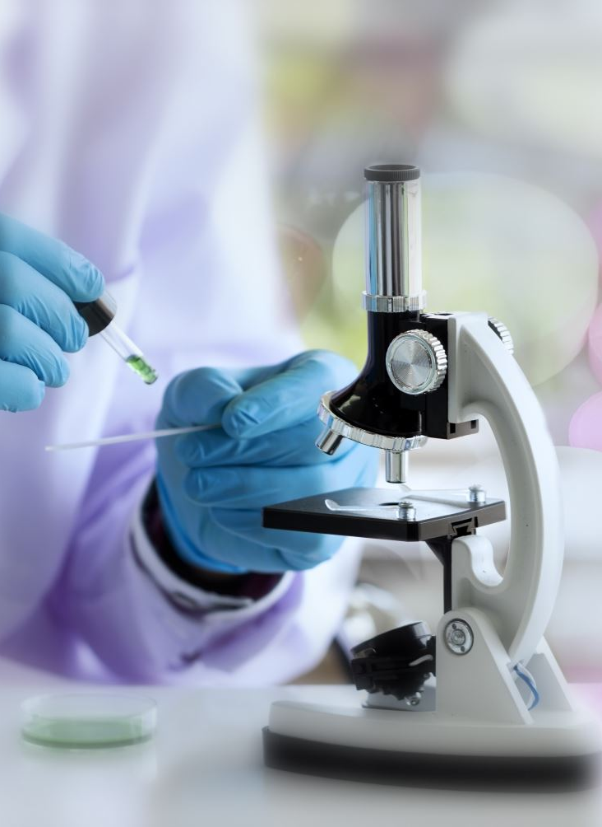

Introduction to health research
Health promotion and prevention on childhood immunisations and vaccines.
Katrina Burman

Slide 2
Introduction
1. Immunisations and vaccines
6. Vaccine Booklet
2. How effective is a vaccine?
7. Vaccine myths
3. World Immunisation week
8. NHS research vaccine information
4. Immunisation posters
9. Questions?
5. Measles campaign
10. References

Slide 3
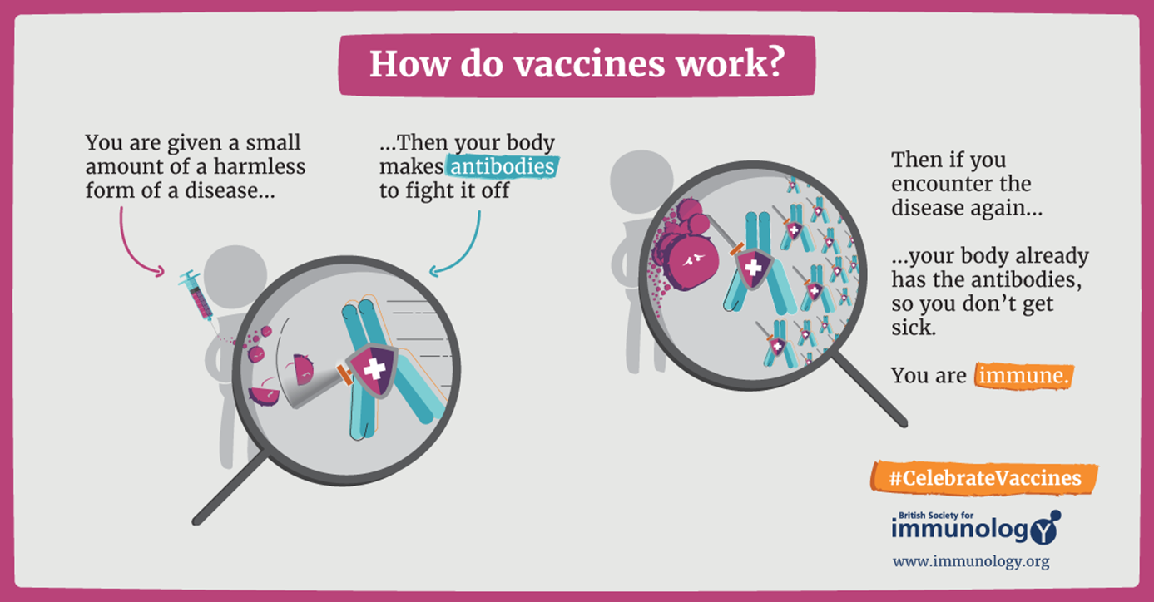

Immunisations and vaccines
Immunization is largely regarded as one of the most successful and cost-effective health initiatives in the world, saving millions of lives.
Up to 800,000 children are not vaccinated each year.
Vaccines save up to 3 million lives every year from infectious disease around the world.
(World Health Organisation, 2022)

Slide 4
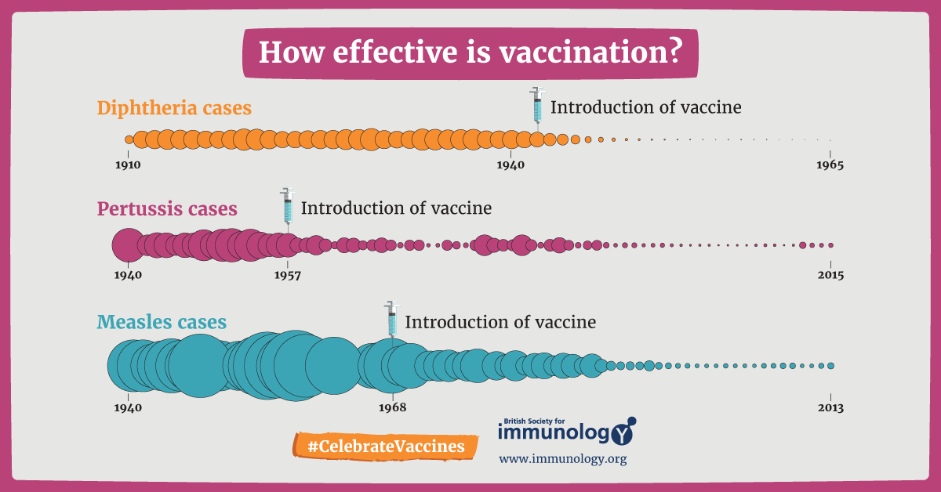
How effective is vaccination and have they made a difference?
Vaccination is extraordinarily successful, according to research, with most childhood vaccines proving effective in 85 percent to 95 percent of children who receive them. It is regarded as one of our biggest achievements in global health, with an estimated annual saving of 2–3 million lives.
From the research the image shows that from introducing vaccines, It is evidently effective.
(British Society for Immunology, 2022)

Slide 5
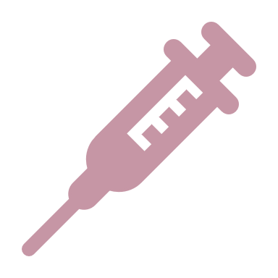
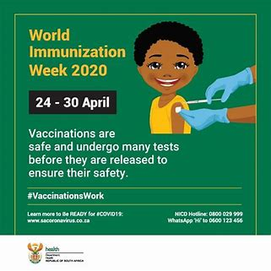
World Health Organization
World Immunization Week is the last week of April.
World Immunization Week is a global public health campaign aimed at increasing vaccine knowledge and immunisation rates against vaccine-preventable diseases. Every year in the last week of April, it takes place.
(World Health Organisation 2022).

Slide 6
The centres for disease, control and prevention issued posters in 2018
CDC's strategic framework, Vaccinate with Confidence, aims to boost vaccination confidence and prevent outbreaks of vaccine-preventable diseases.
(Centers for disease control and prevention, 2016)

Slide 7
Public Health England have made this campaign
The Office of Health Improvement and Disparities (OHID) and the UK Health Security Agency (UKHSA) will launch a new campaign in February 2022 to urge parents to get their children vaccinated against measles, mumps, and rubella.
The campaign uses a multi-channel approach to reach out to parents and caregivers of children aged 0 to 5, including radio, out-of-home, PR, and partnerships. By increasing the risk of measles, mumps, and rubella, the goal is to increase parents' confidence that getting their children vaccinated is the right thing to do.
(Public Health England, 2022)

Slide 8
This booklet was promoted by Julia Deathridge in august 2017 then it was updated in February 2020.
This booklet was authored by Julia Deathridge.(2020)
https://www.immunology.org/sites/default/files/BSI_Guide_Childhood_Vaccinations_FINAL_2020.pdf

Slide 9



Anti-Vaccine stories
The Outcome
Since then, numerous studies with a significant number of participants have been conducted to see if there is a link between the MMR vaccine and autism. No evidence of a relationship between the MMR vaccine and autism has been found in any of these studies.
The Myth
Andrew Wakefield's remarks at a press conference introducing the article, in which he connected the MMR vaccine to an increased risk of autism, sparked a public health concern, with vaccine uptake dropping below 80%.
The Impact
Despite having a high degree of awareness regarding the MMR vaccine, there were concerns about its safety and negative effects, with 29.8% and 13.1 percent of mothers believing that MMR vaccination causes autism.
(National Library of Medicine, 2008)
(UKEssays,2018)
(British Society for Immunology, 2022)

Slide 10
NHS research of Vaccines
Do
Don't
-You and your child will be protected from a variety of serious and potentially fatal infections.
-They go through extensive safety testing before being released, and they're regularly checked for negative effects once they've been released.
-Some diseases can be reduced or even eliminated if enough individuals are immunised.
-no evidence of a link between the MMR vaccine and autism — studies have shown no evidence of a link between the MMR vaccine and autism.
- No mercury in the vaccines
(National Health Service, 2022)

Slide 12
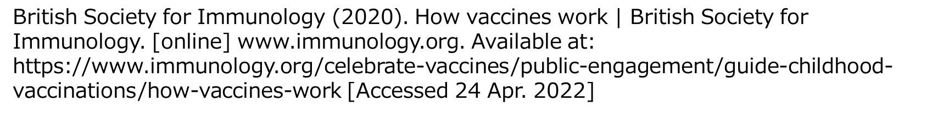
References
Centers for Disease Control and Prevention (2016). Flyers and Posters. [online] Available at: https://www.cdc.gov/vaccines/partners/childhood/print-ads-posters.html [Accessed 24 Apr. 2022].
Dyer, O. (2008). Wakefield admits fabricating events when he took children’s blood samples. BMJ, [online] 336(7649), pp.850.1-850. Available at: https://www.ncbi.nlm.nih.gov/pmc/articles/PMC2323045/ [Accessed 24 Apr. 2022].
National Health Services (2019). Why vaccination is safe and important. [online] nhs.uk. Available at: https://www.nhs.uk/conditions/vaccinations/why-vaccination-is-safe-and-important/?msclkid=b7607a38c24b11eca211845f9ce3d8f5 [Accessed 24 Apr. 2022].

Slide 13
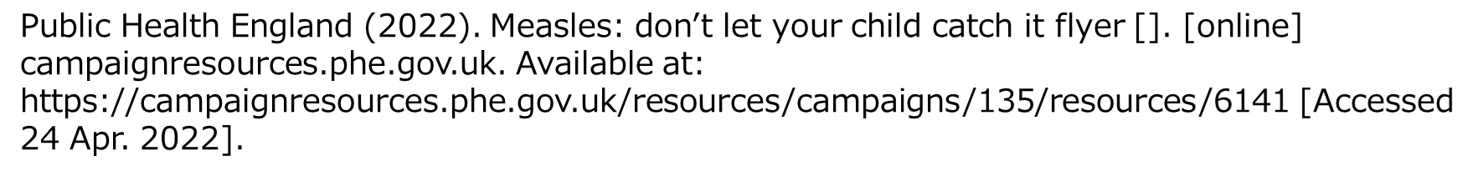
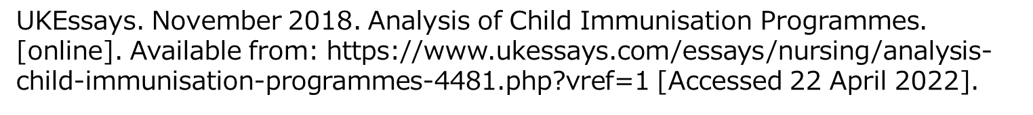
World Health Organisation (2022). World Immunization Week. [online] www.who.int. Available at: https://www.who.int/campaigns/world-immunization-week/?msclkid=c9600dc2c40311ec98beb3704b4d8cea [Accessed 24 Apr. 2022].

