Slide 1
ECES6009/C
Gwneud Gwahaniaeth/
Making a Difference
Sesiwn 7b/ Session 7B

Slide 2

Gorolwg / Overview
Deddfwriaeth a Pholisiau sy’n Datblygu
Agweddau o Arfer Dda
Evolving Legislation and Policy
Examples of Good Practice

Slide 3
Cymru
Wales
Gwlad gynta’r DU i apwyntio Comisiynydd Plant
Gwlad gyntaf y byd i ddeddfu ar chwarae
Gwlad gyntaf y DU i osod Confensiwn y Cenhedloedd Unedig ar Hawliau Plant i gyfraith
The first UK country to appoint a Children’s Commissioner
The first country in the world to legislate on play
The first in the UK to embed the UN Convention on the Rights of the Child into law

Slide 4
Ond: Cymru
But : Wales
Un o’r graddau uchaf o dlodi plant yn y DU
Canlyniadau ar gyfer plant a phobl ifanc bregus ddim yn adlewyrchu ein ymrwymiad i hawliau plant
Ymwybyddiaeth ehangach o gamdrin hanesyddol
Does dim Gweinidog Cabinet ar gyfer plant a phobl ifanc, ond mae gweinidog ar gyfer Iechyd a Gwasanaethau Cymedeithasol – Vaughan Gething
One of the highest rates of child poverty in the UK
Outcomes for some of our most vulnerable children and young people don’t match our commitment to children’s rights
An increasing awareness of historical abuse
We do not have a Cabinet Minister for children and young people, but we do have a Cabinet Minister for Health and Social Services – Vaughan Gething

Slide 5
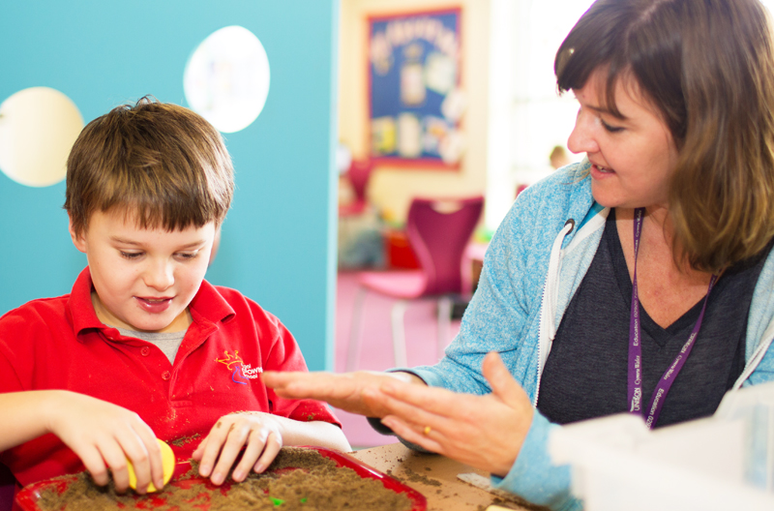
Y sefyllfa gyfredol
The current situation
Comisiynydd Plant Cymru
Adroddiad Blynyddol 2019-2020
Beth yw’r negeseuon allweddol yma?
Children’s Commissioner for Wales
Annual Review 2019 -2020
What are the key messages here?

Slide 6
Bil Senedd ac Etholiadau Cymru Senedd and Elections Bill (2019)
Mae Cynulliad Cenedlaethol Cymru wedi pasio’r Mesur Senedd ac Etholiadau, a fydd yn caniatáu i bobl ifanc 16 a 17 oed bleidleisio dros bwy sy’n eu cynrychioli yn y Senedd.
Y cyfle nesaf sydd ganddyn nhw mae'n debyg fydd Etholiad Cyffredinol Cymru yn 2021.
Pasiwyd y Bil Senedd ac Etholiadau ar 27 Tachwedd 2019, ac yn ychwanegol at ganiatáu i bobl ifanc 16 a 17 oed gymryd rhan mewn etholiadau datganoledig yng Nghymru, newidiodd enw'r Cynulliad i Senedd Cymru a gwneud y Comisiwn Etholiadol yn atebol i'r Cynulliad ar gyfer etholiadau Cymru.
Derbyniodd y ddeddfwriaeth newydd Gydsyniad Brenhinol ym mis Ionawr 2020.
The National Assembly for Wales has passed the Senedd and Elections Bill, which will allow 16 and 17 year olds to vote for who represents them in the Senedd.
The next opportunity that they have will likely be the Welsh General Election in 2021.
The Senedd and Elections Bill was passed on 27 November 2019, and in addition to allowing 16 and 17 year olds to participate in devolved elections in Wales, changed the name of the Assembly to Welsh Parliament or Senedd Cymru and made the Electoral Commission accountable to the Assembly for Welsh elections.
The new legislation received Royal Assent in January 2020.

Slide 7
Senedd Ieuenctid Cymru
Welsh Youth Parliament
Senedd Ieuenctid Cymru
Barn ?
Cyfle ?
Gofidiau?
Materion amlasiantaethol?
Welsh Youth Parliament
Opinion?
Opportunities?
Concerns?
Multiagency perspective?

Slide 8
Darpara Llywdraeth Cymru gyllid ar gyfer prosiect Cymru Ifanc, a hwylusir gan Plant yng Nghymru, sefydliad ymbarel ar gyfer sefydliadau plant
Gweithia Cymru Ifanc gyda grwpiau, fforymau a chynghorau ieuenctid i gasglu llais plant a phobl ifanc er mwyn cael dylanwad ar bolisiau a rhaglenni
(Llywodraeth Cymru, 2016)
Agweddau i ddathlu?
Agweddau o ofid?
The Welsh Government provides funding for the Young Wales project, facilitated by Children in Wales, an umbrella organisation for children’s organisations.
Young Wales works with existing youth groups, forums and councils to gather the collective voice of children and young people to influence legislation, policies and programmes.
(Welsh Government, 2016)
Issues to celebrate?
Issues of concern?

Slide 9
Mae hefyd yn defnyddio cyfryngau cymdeithasol i gyrraedd plant a phobl ifanc sydd wedi eu ymyleiddio, yn swil, dan anfantais, yn ddihyder neu wedi eu neilltuo, i’w galluogi i gael llais
It also uses social media in order to reach children and young people who are marginalised, shy, disadvantaged, unconfident, or secluded, enabling them to also have a voice
(Welsh Government, 2016)

Slide 10
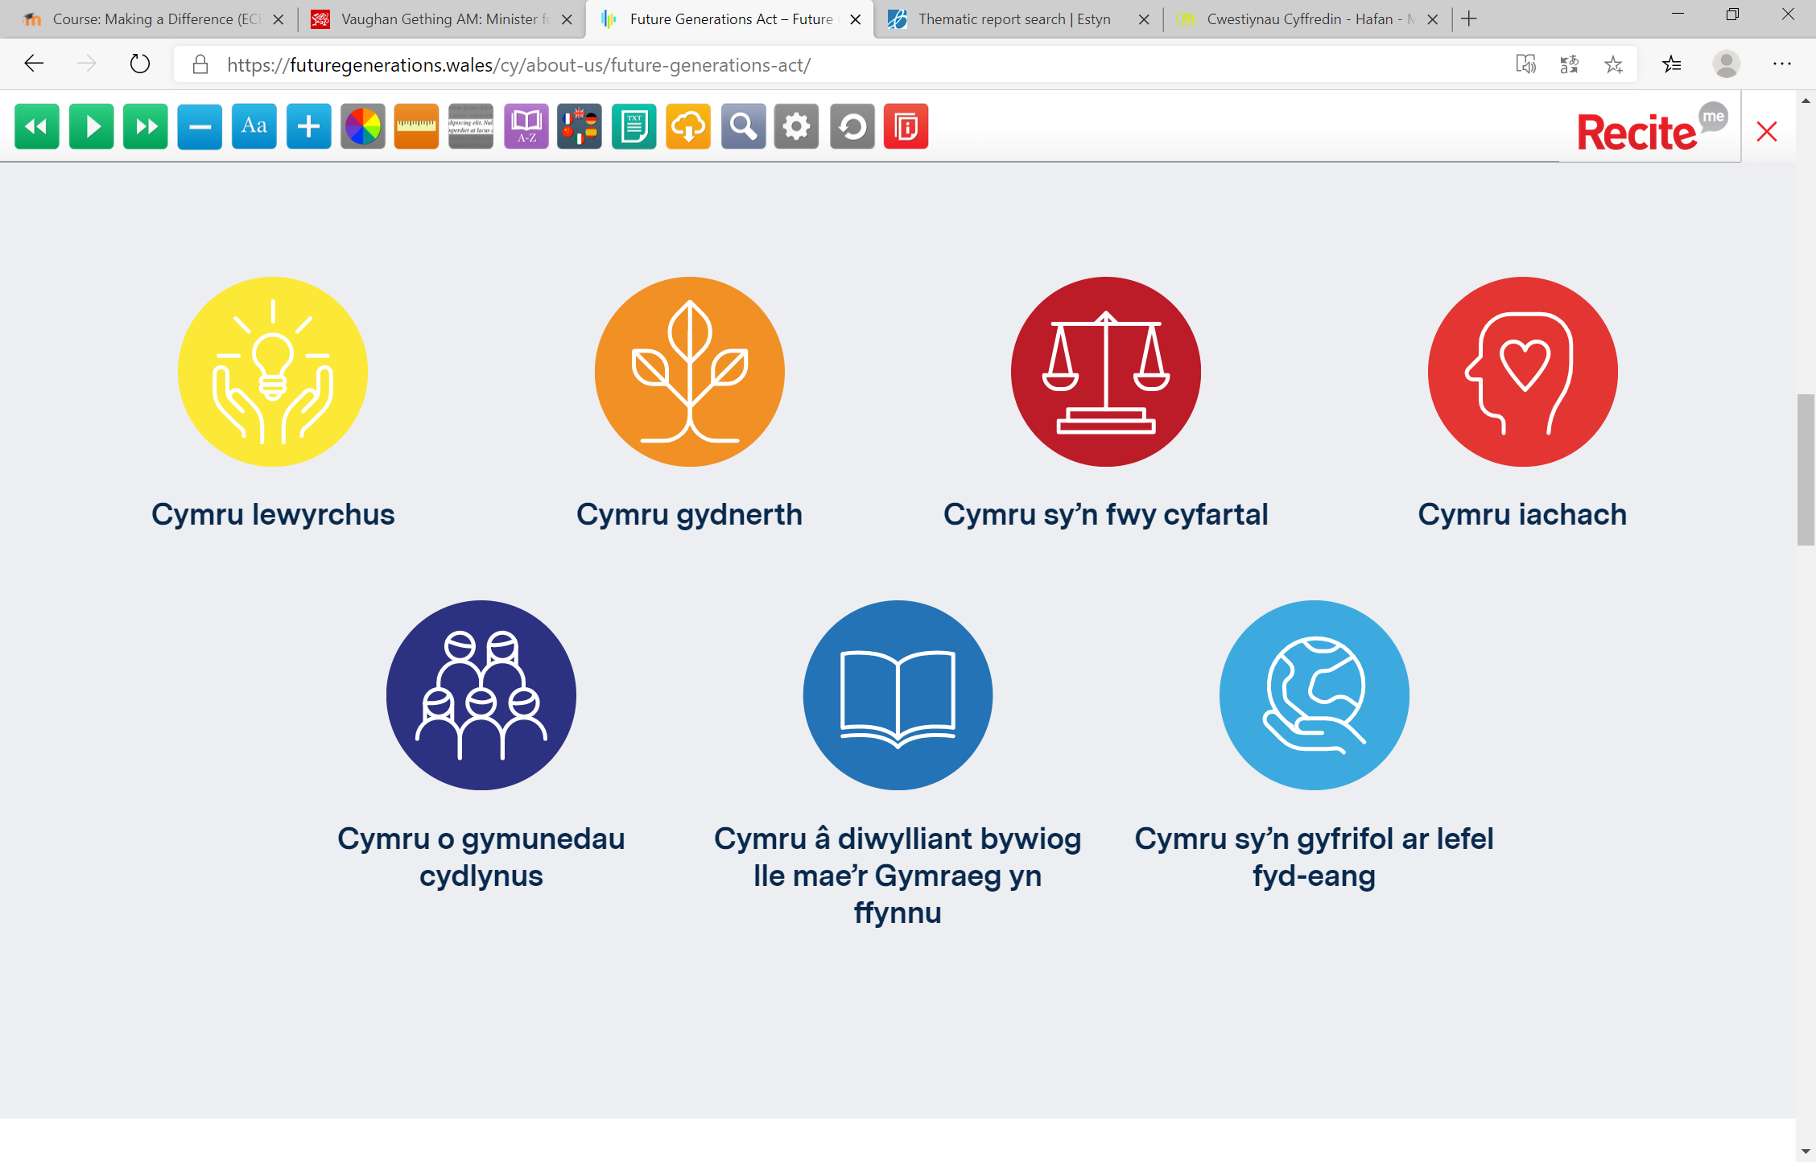
Deddf Llesiant Cenedlaethau’r Dyfodol (Cymru) 2015: Nodau

Slide 11
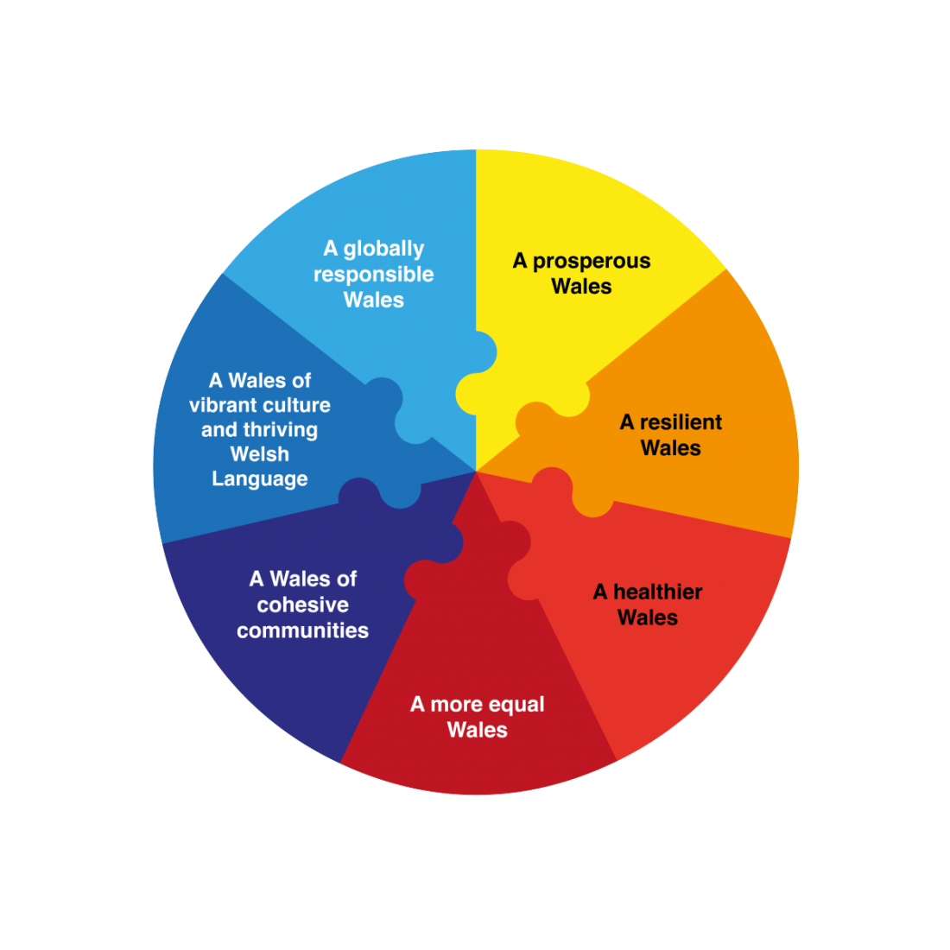
Well- being of Future Generations
(Wales) Act 2015: Goals
www.thewaleswewant.co.uk

Slide 12
Pam y gyfraith hon?
Why do we need this law?
Mae Cymru yn wynebu nifer o heriau nawr ac yn y dyfodol
  Newid hinsawdd
  Tlodi
  Anghyfartaledd iechyd
  Swyddi
  Tyfiant
Er mwyn taclo rhain rhaid i ni weithio gyda’n gilydd
Wales faces a number of challenges now and in the future such as
  Climate change
  Poverty
  Health inequalities
  Jobs
  Growth
To tackle these we need to work together
WAG 2015

Slide 13
Pam y gyfraith hon?
Why do we need this law?
Er mwyn rhoi ansawdd da o fywyd i’n plant ac i’n hwyrion mae angen i ni ystyried sut mae’r penderfyniadau y gwnawn nawr yn mynd i’w heffeithio nhw
Fe fydd y gyfraith hon yn sicrhau fod y sector gyhoeddus yn gwneud hyn
To give our children and grandchildren a good quality of life we need to think about how the decisions we make now will impact them
This law will make sure that our public sector does this
WAG 2015

Slide 14

Egwyddor Datblygiad Cynaladwy
Sustainable Development Principle
Hir dymor
Atal
Integreiddio
Cydweithio
Ymwneud
(Llywodraeth Cymru, 2015)
Long term
Prevention
Integration
Collaboration
Involvement
(WAG, 2015)

Slide 15
Egwyddorion eraill y Ddeddf
Other principles of the Act
Dyletswydd lles
Tryloywder
Comisiynydd Cenedlaethau’r Dyfodol
Dangosyddion a cherrig milltir cenedlaethol
Adroddiad Tueddiadau’r Dyfodol
Byrddau Gwasanaethau Cyhoeddus
Wellbeing duty
Transparency
Future Generations Commissioner for Wales
National indicators and milestones
Future Trends report
Public Services Boards

Slide 16

Tasg / Task
Ystyriwch y Ddeddf newydd
Pa effaith fedr gael ar waith o ddydd i ddydd yng nghyd-destun gweithio amlasiantaethol?
Consider the new Act
What impact could the Act have on day to day working in the context of multi-agency work?

Slide 17
Bil Anghenion Dysgu Ychwanegol a’r Tribiwnlys Addysg (Cymru) (2018)
Additional Learning Needs and Education Tribunal ( Wales) Bill (2018)
Bil Anghenion Dysgu Ychwanegol a’r Tribiwnlys Addysg (Cymru) 2018
Cyflwyno'r termau 'anghenion dysgu ychwanegol' a 'darpariaeth ddysgu ychwanegol' a fydd yn disodli'r termau presennol sef 'anghenion addysgol arbennig' a 'darpariaeth addysgol arbennig
Additional Learning Needs and Education Tribunal (Wales) Bill
Introducing the terms ‘additional learning needs’ and ‘additional learning provision’ to replace the existing terms ‘special educational needs’ and ‘special educational provision

Slide 18
Bil Anghenion Dysgu Ychwanegol a’r Tribiwnlys Addysg (Cymru) (2018)
Additional Learning Needs and Education Tribunal ( Wales) Bill (2018)
Mwy o ffocws ar gynllunio person-ganolog, canlyniadau, gweithio mewn partneriaeth rhwng asiantaethau lleol a mwy o gyfranogiad plant a theuluoedd wrth wneud penderfyniadau.
Roedd i fod i gael ei weithredu o fis Medi 2020 ond bydd yn digwydd nawr o fis Medi 2021.
Bydd y system ddatganiadau gyfredol yn parhau hyd nes y cyflwynir Cynlluniau Datblygiad Unigol (IDP) a fydd yn cael eu cyflwyno'n raddol.
Manteision y Bil ADY
Greater focus upon person centred planning, outcomes, partnership working between local agencies and the greater participation of children and families in decision-making.
It was scheduled to be implemented from September of 2020 but will now take place from September 2021.
The current statementing system will continue until the introduction of Individual Development Plans (IDPs) which will be phased in.
Benefits of the ALN Bill

Slide 19
Esiampl o arfer da
Example of good practice
Defnyddio Cynllunio Person Ganolog ar draws yr ysgol (ESTYN, 2020)
Mae Cynllunio Person Ganolog wrth wraidd adolygiadau o gynnydd disgyblion yn Ysgol Arbennig Crownbridge, Torfaen.
Mae’r model hwn wedi newid ei proses adolygu dysgwyr ac yn cynnwys gwybodaeth o ddisgyblion, rhieni ac ystod o bartneriaid.
Mae’r dull hwn hefyd wedi gwella perfformiad disgyblion.
Using Person Centred Planning across the school (ESTYN, 2020)
Person Centred Planning is central to reviewing pupil progress at Crownbridge Special Day School, Torfaen.
This model has changed their learner review process and includes information from the pupils, parents and a range of partners.
This approach has also improved pupil performance.

Slide 20

Tasg/ Task
Darllenwch adroddiad ESTYN o Ysgol Crownbridge
Nodwch y dulliau allweddol a ddefnyddir i weithredu CPG yn yr ysgol
Ystyriwch y cyfleoedd a’r heriau o wrando ar farn y dysgwyr
Read the ESTYN report for Crownbridge School
Identify the key methods used to implement PCP in the school
Consider the opportunities and the challenges of listening to the views of learners.

Slide 21
Darllen
Reading
Canllaw CPG
PCP guide

Slide 22
Darllen Pellach
Further Reading
How child-centred education favours some learners more than others
Power, S, Rhys, M., Taylor, C. and Waldron, S. (2019) How child-centred education favours some learners more than others. Review of Education, Vol. 7, No. 3, October 2019, pp. 570–592 https://doi.org/10.1002/rev3.3137 [Accessed 28th January 2021]

Slide 23
Cyfeirnodau
References
Cuthbert, J. (2014) Voice of children being heard loud and clear. Available at http://wales.gov.uk/newsroom/childrenandyoungpeople/2014/140911-voice-of-children/?lang=en [ Accessed 28.11.14]
Funky Dragon (2014) Home page. Available at http://www.funkydragon.org/en/
[Accessed 28.11.14]
Wales: Sustainable Development Branch ( 2015) Well-being of Future Generations ( Wales) Act 2015 The Essentials. Cardiff: WG
Welsh Government ( 2016) Children and Young People’s Participation in Wales ... Good Practice 2016. Available at https://gov.wales/docs/dsjlg/publications/cyp/170314-participation-good-practice-2016-en.pdf ( Accessed 07/08/18)

Slide 24
Image : Estyn (2014) Available at http://www.estyn.gov.uk/ [ Accessed 28.11.14]
Image : Funky Dragon(2012) Available at http://conwyyouthcouncil.org.uk/conwy-funky-dragon-reps/ [ Accessed 28.11.14]
Image : Welsh Government ( 2014) Available at http://www.wales.nhs.uk/sites3/home.cfm?orgid=970 [ Accessed 28.11.14]
Image: Well-being of Future Generations ( Wales) Act 2015: Well being goals. Available at http://www.thewaleswewant.co.uk/about/well-being-future-generations-wales-act-2015 ( Accessed 08.09.15)

