Slide 1
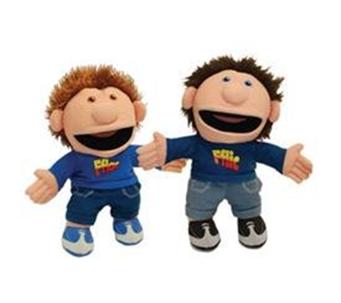

Welsh second language
PTE planning

Slide 2


Welsh Language Development in the Foundation Phase
Notes:
Professor Graham Donaldson CB - Independent review of curriculum and assessment arrangements in Wales - published in February 2015 ‘Successful futures’
QUALIFIED FOR LIFE A Curriculum for Wales – a curriculum for life October 2015
Huw Lewis Minister for Education and Skills – October 2015
We are moving towards our aim - Our new curriculum will embody better learning and higher standards for all.
Building block 5 – enabling the Welsh language to thrive
The Welsh language will remain a compulsory element of the curriculum for all learners up to 16 years old.
There will be a renewed focus on learning Welsh primarily as a means of communication, particularly oral communication and understanding. The use of technology to support language acquisition will be further developed.
He stated that ‘My ambition is for our new curriculum to be available by 2018.’
Our ambition is that by 2021 every school will be using the new curriculum to support learning and teaching.
Enabling the Welsh language to thrive to ensure that those who speak Welsh or acquire the language early can follow all aspects of the curriculum through the medium of Welsh, and those learning the language can progress towards using the language confidently in different contexts.
Requirements.
Page 36 of revised document 2015 Look at Oracy / Reading and Writing – skills and range
Also look at Welsh Language Development Document
These are essential reading as you will need to familiarise yourselves with the content

Slide 3
Welsh Language Development
Children should:
learn to use and communicate in Welsh to the best of their ability
listen to Welsh being spoken and respond appropriately in familiar situations, using a range of patterns
be encouraged to communicate their needs in Welsh and should be increasingly exposed to Welsh
Notes:
The Welsh Assembly Government is committed to developing and promoting the Welsh language. All settings/schools will implement a Welsh language educational programme in the Foundation Phase for children 3 to 7 years
In settings and schools where English is the main medium of communication, children’s Welsh language skills should be progressively developed throughout the Foundation Phase by implementing the Welsh Language Development Area of Learning
Remember the importance of asking if they have a list of the language patterns used in the school?
If not refer to Moodle – ‘Developing Everyday Welsh in the Primary School’ – useful document or Esis ‘Language patterns by school year’

Slide 4
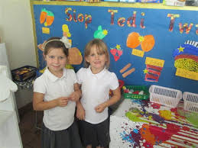
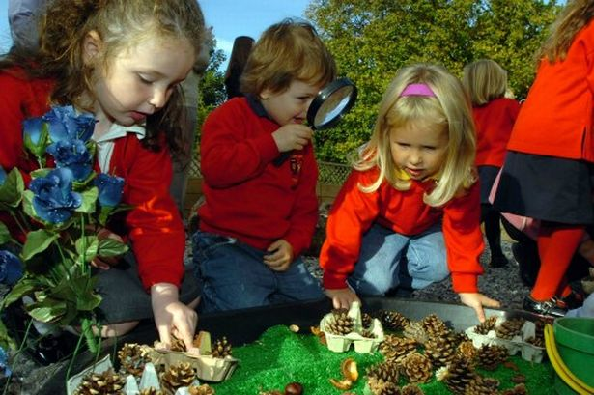
Skills are developed through:
communicating in a range of enjoyable, practical planned activities
using a range of stimuli that build on and increase children’s previous knowledge and experiences, in safe and stimulating indoor and outdoor learning environments
Notes:
We need to avoid Welsh being a bolt on and ensure it is woven throughout all activities
The most effective work draws on opportunities to introduce Welsh in the other six areas of learning of the Foundation Phase curriculum. Estyn Jan 2013

Slide 5

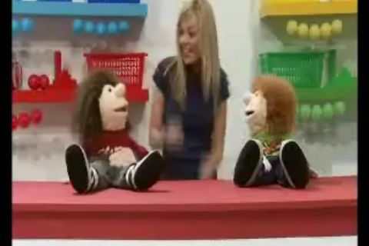
The children’s oral experiences should:
be used to develop their reading skills and they should be encouraged to choose and use Welsh reading materials
They should listen to a range of stimuli:
including audio-visual material
ICT interactive software in Welsh
Notes:
Follow stories read to them and respond as appropriate
Look at books, handling them as a reader
Listen to a story being read
Read aloud their own work and other printed resources
Begin to read independently

Slide 6
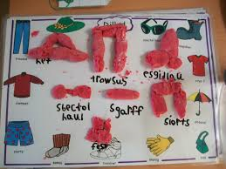
Children should be given:
a range of opportunities to enjoy mark-making and develop their writing skills in Welsh
Language skills learned in one language should support the development of knowledge and skills in another.
Notes:
Experiment with mark-making, using a variety of media, produce emergent writing
Begin to write in a conventional way, communicating by using words, phrases and short sentences, linked to familiar patterns
Write with increasing confidence, fluency and accuracy
Spell simple words correctly and check their spelling by using dictionaries or ICT

Slide 7
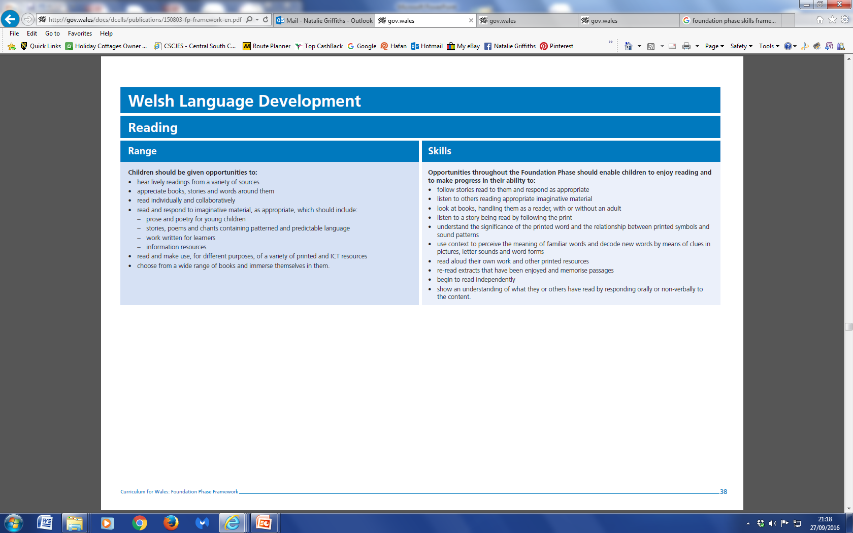
Notes:
Stress the difference between the Range and Skills.

Slide 8
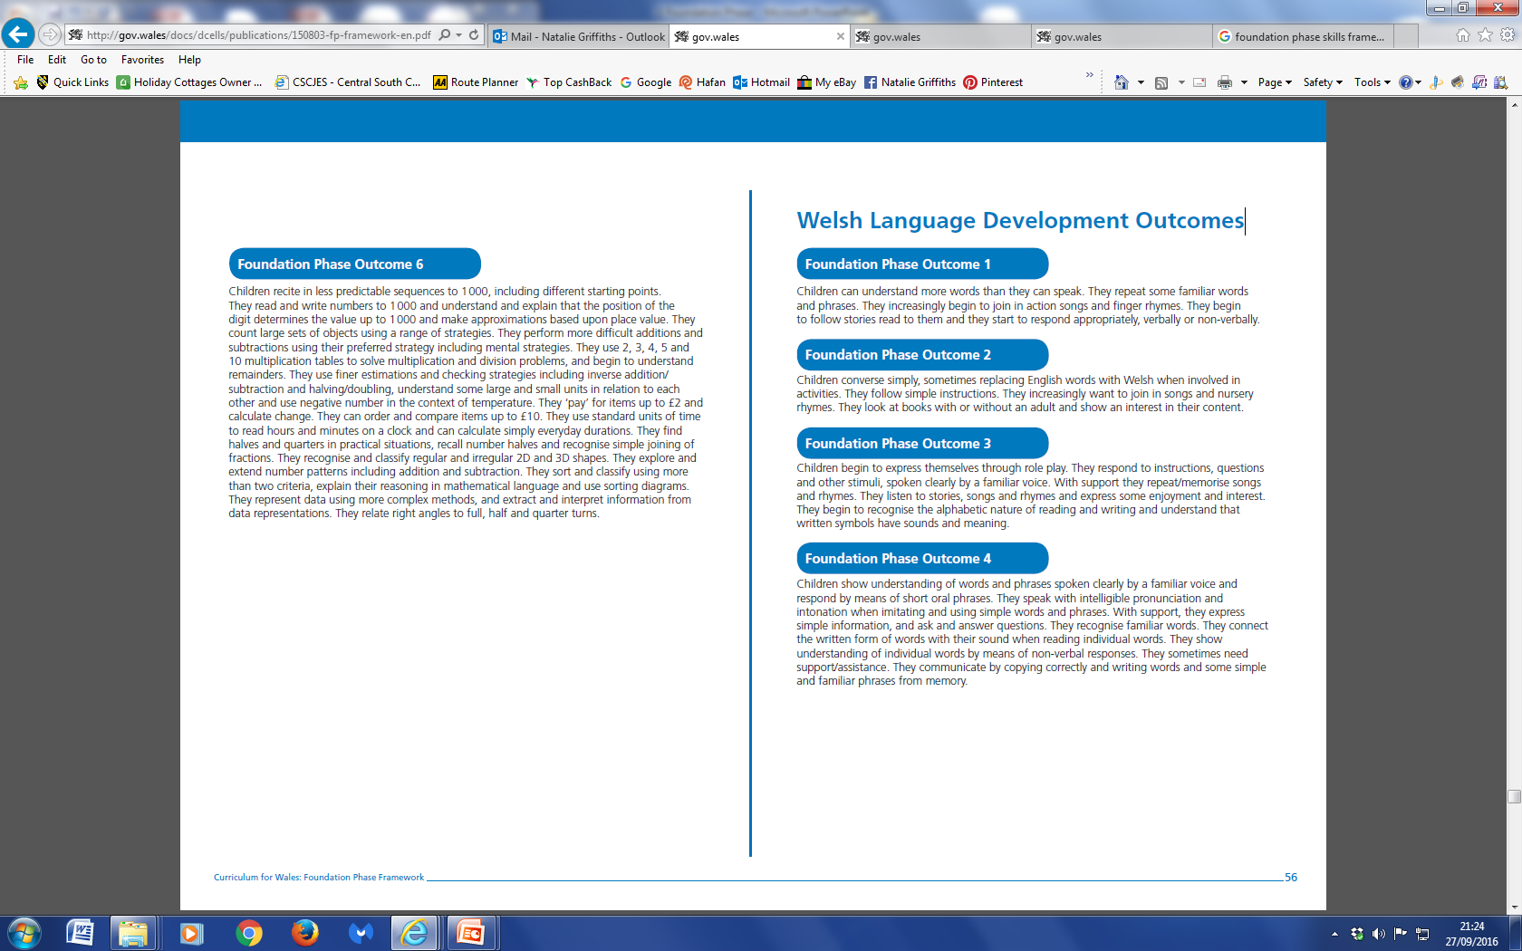
Notes:
Expected Outcome at the end of Year 2 is Outcome 5

Slide 9

Role-play and the use of puppets
Notes:
Anyone seen puppets being used?
Role-play and the use of puppets
Often practitioners use the role-play area in the classroom to enable children to practise phrases introduced in a whole-class session in a fun environment
The use of puppets increases children’s concentration and imagination and encourages a more spontaneous use of Welsh.
Often shy children become more confident and vocal when they can interact with a puppet, rather than with another person, so that even the shyest child is happy to speak Welsh.

Slide 10
Fflic a Fflac
http://www.fflicafflac.com/pack1.html

Slide 11

Welsh rhymes and songs
CSCJES - Central South Consortium Joint Education Service
Notes:
Welsh rhymes and songs
Children in a few settings and schools also say or sing a prayer in Welsh before eating their snack.
Repeating songs helps to reinforce familiarity with words and phrases that can be used in other contexts.
Introducing Welsh hymns, songs and rhymes help to develop young children’s working memory, which is another essential tool in language learning.

Slide 12



Slide 13


Slide 14
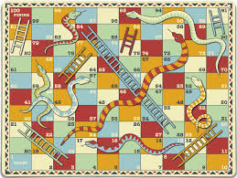
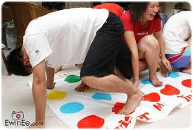
Welsh language games
Central South Consortium
Language games booklet link
Notes:
Welsh language games
In most schools and settings, practitioners often use a range of games with groups of children to reinforce Welsh words and phrases introduced during a whole-class teaching session.
Welsh language games are repeated frequently so children soon become familiar with the rules. When children are confident that they know what to do, these games are played independently as reinforcement activities during the week. Vocabulary is changed regularly to suit the class topic.
Welsh language games also help children to work together in different ways and to develop important social skills, such as turn-taking. Often the motivation to win can be a valuable way of enabling less confident children to participate.

Slide 15
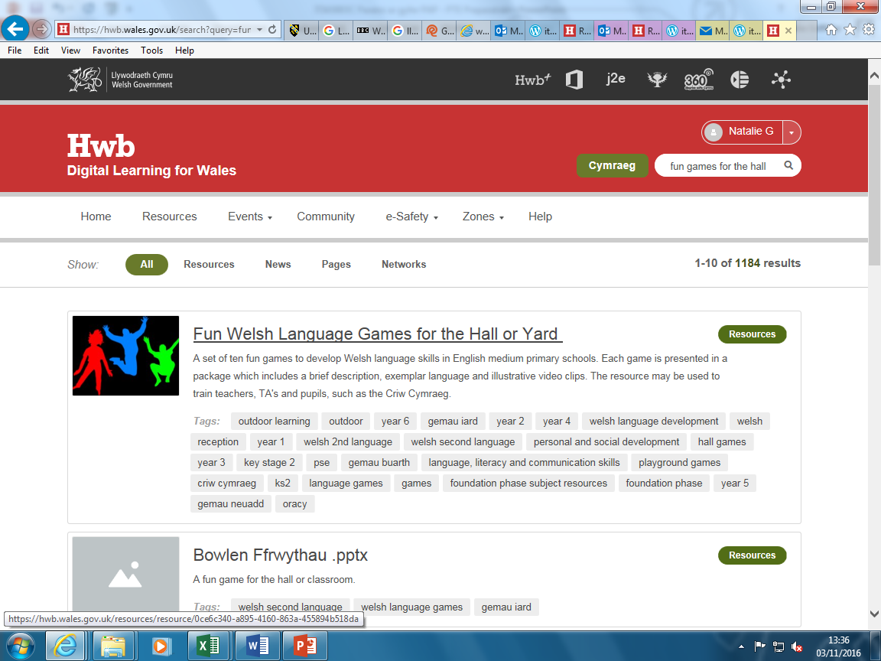
Fun games for the hall or yard

Slide 16
Promoting Welsh
Morning
During the day
Routines
Notes:
Ideas – what do you think?

Slide 17
Promoting Welsh
Morning
Bore da
Pwy sydd yma?
Cinio neu brechdanau?
During the day
Helpwr heddiw
Amser tacluso
Amser chwarae
Tŷ bach
Routines
Gweddio
Arhoswch
Da iawn ti
Gwrandewch
Notes:
Although instructional language is a good place to start it will not encourage the use of Welsh naturally in conversation and during activities
How can we encourage pupils to speak Welsh regularly and naturally?
Think of the planning model and apply your ideas to the three tiers ie Continuous provision..enhanced provision & focused tasks
Continuous and enhanced provision consolidate and extend children’s learning
Clear structure in planning is vital
Remember the Foundation Phase mats on Y Porth – may find these useful?

Slide 18

Welsh second language in the National Curriculum for Wales
Notes:
This is the curriculum document used – Welsh second language in the National Curriculum for Wales.
At Key Stage 2, learners build on the skills, knowledge and understanding acquired during the Foundation Phase
This progress is achieved through an integrated programme of oracy, reading and writing
Learners are presented with experiences and opportunities that interrelate the requirements of the Skills and Range sections of the programmes of study

Slide 19
Welsh in the National Curriculum for Wales
At Key Stage 2, learners build on the skills, knowledge and understanding acquired during the Foundation Phase
This progress is achieved through an integrated programme of oracy, reading and writing
Learners are presented with experiences and opportunities that interrelate the requirements of the Skills and Range sections of the programmes of study

Slide 20
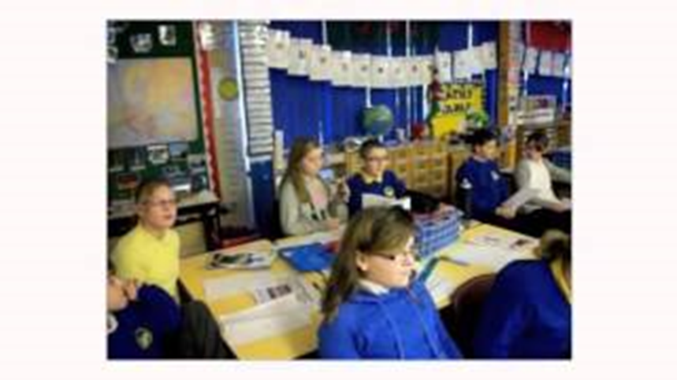
Oracy
Learners speak with confidence, working as individuals and as members of a group and using a range of vocabulary, phrases, sentences and questions
The experiences presented to them include opportunities to take part in drama and role-play activities
Notes:
Learners should be given opportunities to:
e.g. –
3. communicate for a variety of purposes including:
• asking questions and offering simple comments
• giving and following sets of simple instructions
• presenting personal and imaginative experiences and straightforward factual information

Slide 21


Reading
They develop as active and responsive listeners, and experience a wide range of texts, including authentic materials, as they develop as independent and effective readers
Notes:
Make reference to Babs a Benja books usually used in Year 3 & 4
Also Nici a Cris which is usually used in Year 5 & 6
Learners should be given opportunities to:
e.g.-
develop as enthusiastic, independent and reflective readers
3. experience a variety of texts and forms including:
• traditional and contemporary poetry and prose including some material written specifically for learners
• material which is challenging
• material that broadens horizons and expands the mind
• material that presents information and reference material including media texts and computer material

Slide 22



Writing
They write in response to a range of stimuli with a growing understanding of the need to speak and write in a way that is appropriate to the purpose and audience
Notes:
They write in response to a range of stimuli with a growing understanding of the need to speak and write in a way that is appropriate to the purpose and audience
Learners should be given opportunities to:
e.g.
1. write for a variety of purposes including:
• to entertain
• to present information
• to express opinions
• to convey feelings and ideas
Write in a variety of forms e.g. posters, diaries, scripts, notes, reviews, electronic texts such as using ‘book creator’
Check spelling using various methods including ICT Draft and improve work using ICT as required

Slide 23

Y Pod-antur Cymraeg
Y Pod Antur Cymraeg
Notes:
Y Pod-antur Cymraeg - P-aC1
This pack has been designed to teach Welsh Second Language at Key Stage 2. The aim is to build upon language patterns and vocabulary already introduced during the Foundation Phase, to develop them further and to transfer them to different contexts, thus enabling pupils to understand written and spoken Welsh, to speak and write in different situations and for different purposes.

Slide 24
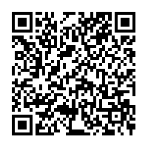
QR codes for reading books
CSCJES - Central South Consortium Joint Education Service
Notes:
Distribute QR codes and encourage them to read books in pairs

Slide 25
Central South Consortium
Central South Consortium a useful website for teachers of Welsh second language.
http://www.cscjes.org.uk/Knowledge-Bank/Welsh/Cymraeg-Ail-Iaith/Welsh-Scheme-of-Work/Songs.aspx

Slide 26
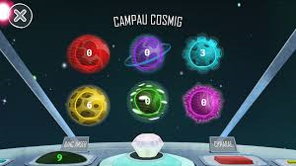
Campau Cosmig
Campau Cosmig has been developed in order for Second Language Welsh learners at Key Stage 2 (7-11 years old) to have fun whilst practising their Welsh.
Hwb
Notes:
Over 60 mini-games in Welsh. Win time to play the arcade game 'Diamond Challenge' by playing the language and mathematics games. A great way of learning, reinforcing and improving your Welsh skills whilst at play. Suitable for Welsh learners as well as those who speak Welsh as their first language.

Slide 27
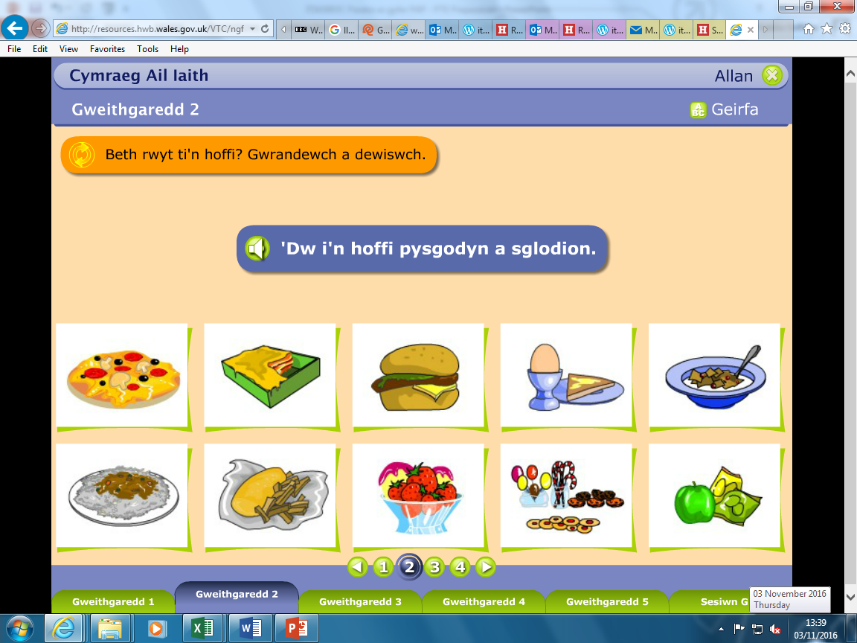
Hwb
http://resources.hwb.wales.gov.uk/VTC/ngfl/wsl/bdag/bwyd-de/apps/simple-projector/index.html

Slide 28

Primary Resources
Primary Resources: Welsh Resources
Notes:
Welsh second language resources available on Primary Resources website

Slide 29
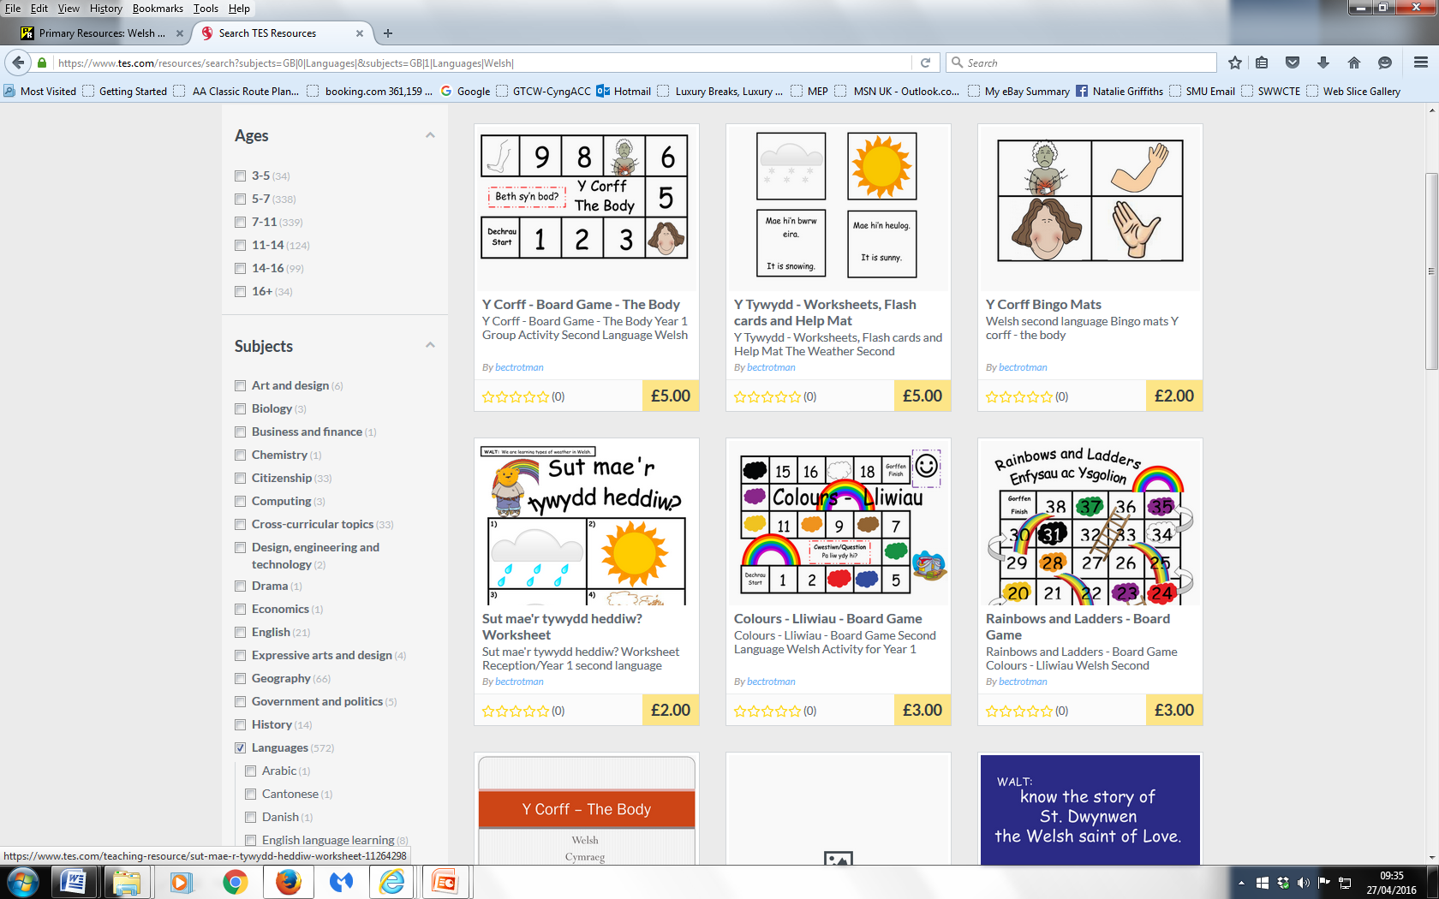
TES
Materials for Welsh Second Language - Resources - TES

Slide 30
Moving learners from level 3 to level 4
Resource WJEC Educational Resources Website
Part 1 contains seven exemplary teaching units:
■ Role play
■ Describing a friend
■ Personal news
■ Personal profile
■ Responding to a poem
■ Discussing a book
■ Leisure time
Notes:
Moving learners from level 3 to level 4
Welsh Support Team
KS2 >
The aim of this training pack is to provide guidance for teachers on how to move learners on from level 3 to level 4.
The pack contains 7 example teaching units and a series of video clips showing the journey from level 3 to level 4 of learners in two schools.
The clips exemplify a number of activities mentioned in the teaching units as well as providing other ideas practitioners can use in the classroom.
Part 1 contains seven exemplary teaching units:
In addition to this, the resource includes video clips of the journey from level 3 to level 4 of learners in two schools.
The clips exemplify a number of activities mentioned above as well as providing other
ideas practitioners can use in the classroom.

Slide 31
Moving learners from level 4 to level 5
Training Packs - Welsh Second Language - KS3/KS4
Seven exemplary teaching units are provided:
Disgrifio ffrind / Describing a friend
Newyddion personol / Personal news
Proffil personol / Personal profile
Ymateb i gerdd / Responding to a poem
Chwarae rôl / Role play
Trafod llyfr / Discussing a book
Trafod amser hamdden / Discussing leisure time.
Notes:
The aim of this training pack is to provide guidance for year 6 and 7 teachers on how to move learners on from level 4 to level 5.
An important element of the pack is the DVD, which includes:
four teaching sessions filmed at St Patrick’s School, Newport and St Peter’s School, Rossett, Wrexham
Follow the link here to training pack and show
number 4 film - Codi Safonau Llythrennedd / Raising Standards of Literacy (4)
Just show a little part of the film showing the use of language mats (bear in mind this was filmed in North Wales, hence the use of certain vocabulary)
There are other ideas students may find useful to watch in their own time to show how they can promote Welsh in their lessons at KS2.
Useful ideas and activities in both documents – advise looking at these in their own time!

Slide 32

Slot Drilio
Helpwr Heddiw

Slide 33
WJEC /CBAC
Welsh across the curriculum film clips
http://adnoddau.cbac.co.uk/Pages/ResourceSingle.aspx?rIid=496

Slide 34
Useful Websites
https://www.cadarn.ac.uk/article/online-resources-learning-and-using-welsh
https://www.learn-welsh.net/welshtopics

Slide 35
Cynllun Sabothol / Sabbatical Scheme
Good practice at Penllergaer School
Julia CardiffCynllun Sabothol - Sabbatical Courses - Experiences on the course

Slide 36
Promoting Welsh Planning Sheet
Date / Dyddiad | Welsh that I will use: | Achieved (√ or x) | Welsh that pupils will use: | Achieved (√ or x)

Slide 37
Promoting Welsh Planning Sheet
Date / Dyddiad | Welsh that I will use: | Achieved (√ or x) | Welsh that pupils will use: | Achieved (√ or x)
 | Bore da Sut wyt ti? Wyt ti’n cael cinio heddiw |  | Bore da, Da iawn diolch, dw i’n hapus Ydw / Nac ydw
 | Wyt ti wedi tacluso? Beth wyt ti eisiau? Afal / oren / banana |  | Ydw / Nac ydw Ga i afal os gwelwch yn dda? Dw i eisiau afal, os gwelwch yn dda.
 | Mae’n amser cinio Cei / Na chei / Wrth gwrs Pwy sy’n cael cinio / brechdanau heddiw? |  | Ga i fynd i’r tŷ bach os gwelwch yn dda? Dw i’n cael cinio /brechdanau heddiw
 | Mae hi’n amser tacluso. Pwy sy’n barod? Dwylo ynghŷd, llygaid ar gau |  | Dw i’n barod. Diolch…….

Slide 38
Welsh that I will use: | Achieved |  |  |  | Welsh that pupils will use: | Achieved
Dwylo i fyny Mae hi’n amser tacluso Pa liw? Wyt ti’n cofio? Commands Sefwch Eisteddwch Gwrandewch Edrychwch Tacluswch ei bwrdd … yn dawel. Nesaf, | M | T | W | Th | Barod! Ydy ydy ydy Gwyrdd/Melyn/Coch Dw i’n barod Ddoe Nesaf, dw i eisiau Ga i …? Ga i fynd i’r ty bach os gwelwch yn da? Ga i ddwr? Diolch yn fawr Dw i’n meddwl … | M | T | W | Th
Notes:
Example of sheet use by third year student who displayed her sheet in the classroom and encouraged a competition between pupils and herself to see who made most use of Welsh during the week and a prize was awarded on Fridays

Slide 39
Promoting Welsh Planning Sheet
Date/ Dyddiad | Welsh that I will use: | Achieved (√ or X) | Welsh that pupils will use: | Achieved (√ or X)
14/11/16 | In the morning sessions, I will say bore da pawb to the students before I start taking the class register. Bore da pawb – Good morning everyone |  | The students will respond by saying bore da miss James, bore da ffrindiau. Bore da miss James, bore da ffrindiau – Good morning miss James, good morning friends.
15/11/16 | When conducting my lesson on text maps from our visit to the Glynn Vivian Art Gallery. I will be asking the students numerous questions so I am going to introduce Dwylo i fyny. Dwylo i fyny – Hands up. |  | The students will begin to understand and recognise the Welsh term dwylo i fyny if I continue to express this term in all my lessons.
16/11/16 | I will be teaching know and use ordinal numbers to the students. Within the introduction we will be participating in a game – I will give the students two number cards from 0 – 100 and when I call out a number the student with the chosen card has to show their card. I am going to state the English term then following it with the Welsh term. In one of the main activity, the students have to identify what colour are certain shapes are so I ask them Pa liw ydy hwn? |  | The students will begin to identify the term with the numbers. They will also start to recognise patterns within the Welsh language when saying the terms. They will repeat the term back to me when I state the Welsh term. The students will respond to “Pa liw ydy hwn?” with Coch – Red Glas – Blue Melyn – Yellow Gwyrdd – Green
17/11/16 | Throughout the learning day, the teacher calls Mae hi’n amser tacluso to get the students to stop what they are doing and to start tidying up. Therefore I have to start using the same vocabulary to ensure the students are receiving the same experience. Mae hi’n amser tacluso – it is time to tidy up |  | Once the students hear me call mae hi’n amser tacluso. They should immediately stop what they are doing and start to tidy up the learning environment and get ready for break or lunch.
18/11/16 | Children in need day: The students will be colouring different Pudsey and Blush drawings. Therefore when I am supporting them I will be discussing colours in the welsh language. |  | The students will begin to identify and understand the colours in Welsh language. Continuing to reinforce the colours, this will help the students to naturally use the vocabarly within the classroom environment.
Notes:
Exemplar where rationale behind selected phrases was included

Slide 40
Year 1 BA(Ed) & PGCE Primary PTE1
Bore da | Good morning
Prynhawn da | Good afternoon
Hwyl fawr | Goodbye
Barod? | Ready?
Eisteddwch | Sit
Gwrandewch | Listen
Tacluswch | Tidy up
Edrychwch arna i | Look at me
Ewch allan | Go out
Bant â chi | Off you go
Dewch i mewn | Come in
Dewch yma | Come here
Diolch | Thank you
Ga i……? | Can I….? / Can I have…?
Ga i fynd i’r ty bach os gwelwch yn dda? | Can I go to the toilet please?
Cei / Na chei | Yes / No
Wrth gwrs | Of course
Ble mae…? | Where is…?
Dyma… | Here is…
…os gwelwch yn dda? | …please?
Dwylo i fyny | Hands up
Pwy sy’n cael cinio?/ brechdanau? | Who is having lunch?/ sandwiches?
Cinio – un deg dau | Lunch - twelve
Sawl un? | How many?
Pa liw ydy hwn? | What colour is this?
Coch, glas, melyn, gwyrdd, du, gwyn | Red, blue, yellow, green, black, white
Sut wyt ti? | How are you?
Da iawn diolch | Very good/well thank you
‘Dw i’n……(hapus) | I am ….(happy)
Sut mae’r tywydd? | What is the weather like?
Mae hi’n…..(heulog) | Is is…… (sunny)
Mae hi’n amser…..(chwarae) | It is…. (playtime)
Dydd……(Llun, Mawrth, Mercher, Iau, Gwener) | ……….day (Mon, Tues, Wednes, Thurs, Fri)
Notes:
Distribute sheets

Slide 41
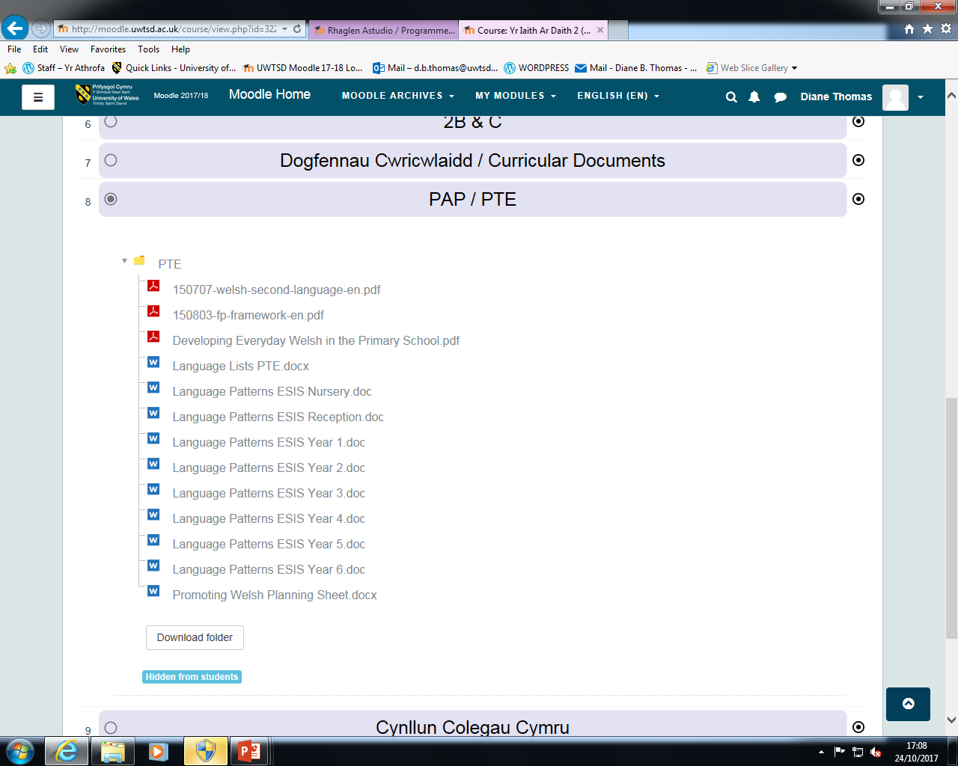
Moodle
Notes:
ESIS language patterns available on Moodle if needed

