Slide 1
Key Debates in Medieval History Part 1

Slide 2
The source of the debate
Pope Gregory the Great to Bishop Serenus of Marseilles (600 CE): “To adore images is one thing; to teach with their help what should be adored is another. What Scripture is to the educated, images are to the ignorant, who see through them what they must accept; they read in them what they cannot read in books.” [emphasis added]

Slide 3
Biblical injunction against images:
“Thou shalt not make unto thee any graven image, or any likeness of any thing that is in heaven above, or that is in the earth beneath, or that is in the water under the earth.”—Exodus 20:4

Slide 4
The iconoclasts:
Tertullian (2nd-3rd century CE): “God is not pleased by what he himself did not produce…Now even if the material out of which something is made is from God, it does not therefore follow that every way of enjoying these things is also of God.”
Bishop Eusebius of Caesarea to the Empress Constantia (early 4th century CE): “What image of Christ are you seeking?...I myself cannot think that you are asking for an image of the divine form.”

Slide 5
To an iconoclast, what kinds of images were permissible?
Miraculous images, like Christ’s face on St Veronica’s veil (acheiropoieta)
Images with authority, like copies of the portrait St Luke painted of the Virgin and Child

Slide 6
Another iconophile:
St John of Damascus (mid 8th century CE): “Often, doubtless, when we have not the Lord's Passion in mind and see the image of Christ's crucifixion, his saving Passion is brought back to remembrance, and we fall down and worship not the material but that which is imaged.”

Slide 7
The source of the debate
Pope Gregory the Great to Bishop Serenus of Marseilles (600 CE): “To adore images is one thing; to teach with their help what should be adored is another. What Scripture is to the educated, images are to the ignorant, who see through them what they must accept; they read in them what they cannot read in books.” [emphasis added]
Gregory is talking specifically about images that tell religious stories.

Slide 8
What does being able to read mean?
Today, being able to read means not only being able to sound out letters and words, but also understanding what those words mean.
In the medieval period, being able to read did not necessarily mean being able to understand. A person could “read” Latin by sounding out the words, but not understand them.
When Gregory talks about the “educated” or the “literate,” he means people who can read and understand Latin.

Slide 9
How did medieval people read?
In the early medieval period (when Gregory was writing), most people were illiterate; they could not read or understand Latin or their native language.
In the early medieval period, reading silently to yourself was unusual. In the late 4th century, St Augustine writes that when St Ambrose read, “his eyes scanned the page…but his voice was silent…for he never read aloud.” (Confessions, Book 6, Chapter 3)
Reading generally involved reading aloud to yourself, to others, or listening to somebody else read aloud. Reading and hearing were thought of as closely linked.

Slide 10
The debate
1989: Lawrence G. Duggan publishes “Was art really the ‘book of the illiterate’?” in Word & Image (reproduced in 2005 in Reading Images and Texts)
Duggan’s argument: Gregory was wrong. The “ignorant” could not and did not “read” images like the “educated” read books.
Central to Duggan’s argument is the assumption that reading (and understanding) a text can communicate new information to a reader: “words are inherently more precise than images and can convey new knowledge.” —Duggan, “Was art really the ‘book of the illiterate’?”, p.96

Slide 11
The debate
Could an “ignorant” or illiterate medieval person, who did not know a particular story depicted in an image, be able to “read” the image to learn what the story was about?
Duggan does not seem to think so: “…imagine what difficulties were presented to an illiterate medieval viewer of a complex scene based on the many stories in the Old Testament and the New? One either knew already what was depicted, or else one could not learn from the image alone anything of elementary value. Imagine a Tuscan peasant coming upon Masaccio’s Tribute Money in the Brancacci Chapel, or a Roman considering The Entry into Jerusalem in Duccio’s Maestà…None of these people could learn from the painting…what it was about.”—Duggan, “Was art really the ‘book of the illiterate’?”, p.95

Slide 12
The debate
So what does Duggan believe happened when a medieval person “read” an image? Duggan observes that “‘Reading’ a book…implied memorizing it…and so by extension reading could remind one in a sense of what one already knew.”
—Duggan, “Was art really the ‘book of the illiterate’?”, p.97
For Duggan, an illiterate medieval person could only “read” an image if they already knew the story.
Duggan concludes (about Gregory and his followers): “they were still wrong insofar as they intended to say that images can do more than remind and deepen what one already knows.”—Duggan, “Was art really the ‘book of the illiterate’?”, p.101

Slide 13
The debate
1989: Herbert L. Kessler publishes “Diction in the ‘Bibles of the Illiterate’”, his refutation of Duggan.
Kessler’s question: “If medieval paintings really were meant for those faithful who could not read, why do almost all of these pictures include words?”
—Kessler, “Diction in the ‘Bibles of the Illiterate’”, p.33
Implied critique: Duggan does not analyze the sort of artworks Gregory was talking about.

Slide 14
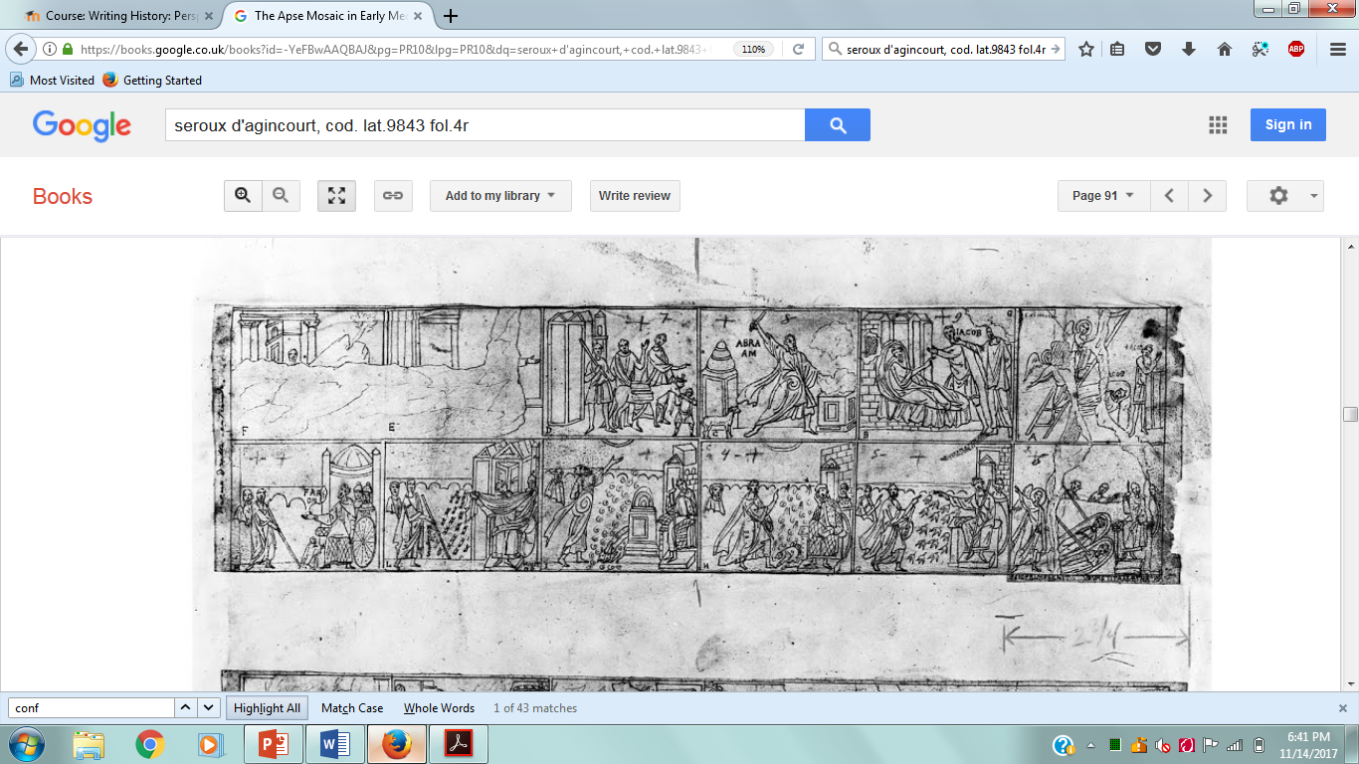
One of Kessler’s examples
Late 18th century-early 19th century drawing of the 5th-century decoration on the nave walls of St Paul’s Outside the Walls, Rome

Slide 15
The debate
Kessler picks up on the words Gregory uses: “For it is one thing to adore a picture, another through a picture’s story to learn what must be adored.” [“Aliud est enim picturam adorare, aliud per picturae historiam quid sit adorandum addiscere.”]—Chazelle, “Pictures, books, and the illiterate”, pp.139-140
Kessler does not assume that “reading” means acquiring new knowledge: “In his very choice of the word ‘addiscere,’ with its suggestion of learning further and with his insistence that picture were but aids for teaching, Gregory hinted that the illiterate audience he had in mind would either have some knowledge of the subjects depicted or could have the depictions explained by someone who did.”—Kessler, “Diction in the ‘Bibles of the Illiterate’”, p.34

Slide 16
The debate
Kessler continues: “Beyond that, one must remember that the viewers for whom such medieval pictures were intended learned what they knew not by reading but by hearing; and it is in terms of the essentially oral nature of medieval culture that the ‘bibles of the illiterate’ are to be understood.”
—Kessler, “Diction in the ‘Bibles of the Illiterate’”, p.34
Implication: Duggan is ignoring or neglecting the link between hearing and reading during the medieval period. An illiterate medieval person could “read” the image by hearing a literate person read the text associated with an image or by hearing an explanation of the image.

Slide 17
The debate
Kessler does acknowledge that words and pictures worked differently. Images were thought to convey only literal meaning, while words could communicate allegorical or metaphorical meaning as well.
Kessler concludes: “Here, as in most medieval images, however, words are privileged elements in the presentation; through them alone, not through the images, the meaning of the story is disclosed. What the diction makes clear is that pictures were Scripture in a basic and essential sense, but words alone gave the faithful access to the Christian mystery.”—Kessler, “Diction in the ‘Bibles of the Illiterate’”, p.38

Slide 18
The debate
1990: Celia M. Chazelle publishes “Pictures, books, and the illiterate” in Word & Image, the same journal Duggan published in
Chazelle appears to agree with Duggan that images cannot convey new information, but disagrees with Duggan’s interpretation of Gregory’s letter: “neither of the two letters seems to offer a solid foundation for the idea that, to Gregory’s mind, the artistic depiction could teach its subject-matter to a viewer who was totally ignorant of what was represented—as though without any previous insight into the identity of the persons or events represented, the beholder could grasp the basic substance of what the artist intended to convey.”—Chazelle, “Pictures, books, and the illiterate”, p.138

Slide 19
The debate
“For it is one thing to adore a picture, another through a picture’s story to learn what must be adored.” [“Aliud est enim picturam adorare, aliud per picturae historiam quid sit adorandum addiscere.”]—Chazelle, “Pictures, books, and the illiterate”, pp.139-140
Chazelle argues that Gregory does not mean that images can convey new information, but that they can teach devotion to God: “The point here is not that a picture educates its viewers about its subject—this is simply not what is stated—but that it inspires them to awareness of the adoration which…is owed solely to God. It does this, Gregory perhaps believed, because while a representation reminds viewers of a sacred event it fills them with awe for the divine power that made the event happen.”—Chazelle, “Pictures, books, and the illiterate”, p.141

Slide 20
The debate
Chazelle does interpret Gregory to mean that illiterate people could engage with images themselves: “In the end, though, he was convinced that there was something about the pictures on church walls that enabled illiterati to engage for themselves in such reading, an activity that when it came to written texts lay beyond their grasp.”—Chazelle, “Pictures, books, and the illiterate”, p.145
Chazelle emphasizes hearing as well, and concludes: “…the sight of pictures could advance and refresh the illiterates’ knowledge of the stories learned from the clergy’s sermons and exhortations, and by setting those events before their eyes the depictions could lead them to be more virtuous as well as to adore God alone.”—Chazelle, “Pictures, books, and the illiterate”, p.148

Slide 21
The debate
2005: Duggan publishes “Reflections on “Was Art Really the ‘Book of the Illiterate’?” in the same volume that his original essay was re-published
Duggan remarks that he has been described as agreeing with Chazelle by some scholars, and as opposing her by other scholars
He reiterates his belief that Gregory was wrong about the illiterate being able to read images.

Slide 22
The debate
Duggan argues that Kessler’s point about most images including words is wrong: “…the kind of association between word and images to which Kessler alludes, which was indeed characteristic of later medieval art, was still infrequent in Gregory’s own age…In short, it is anachronistic to think of a late antique Gregory in this medieval way, and therefore misleading to contextualize and rationalize his words about pictures as “books of the illiterate” in this manner. Kessler’s governing premise in his refutation of my original argument seems wrong.”—Duggan, “Reflections”, p.119

