Slide 1

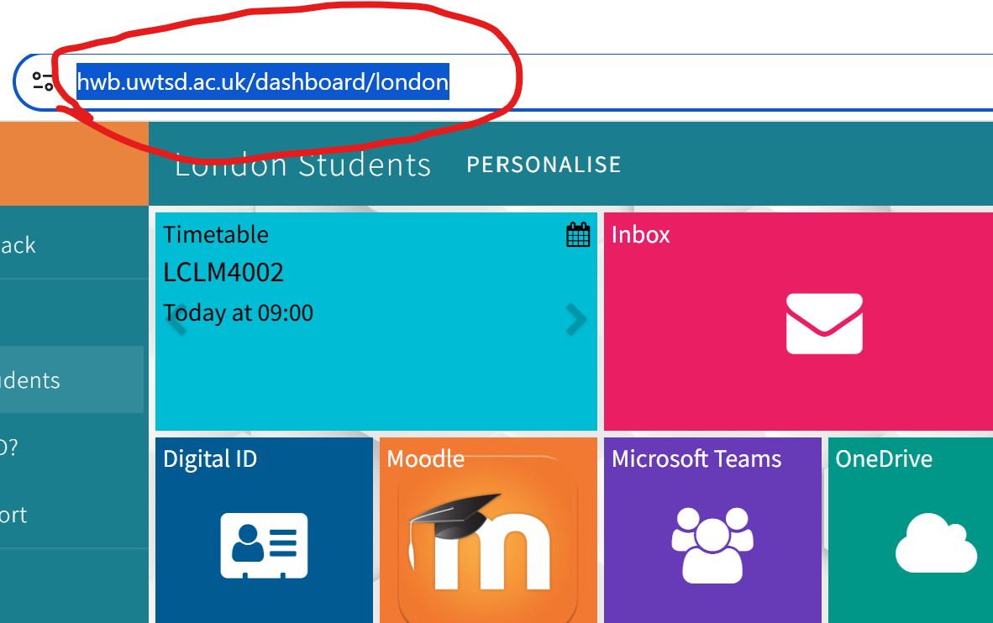
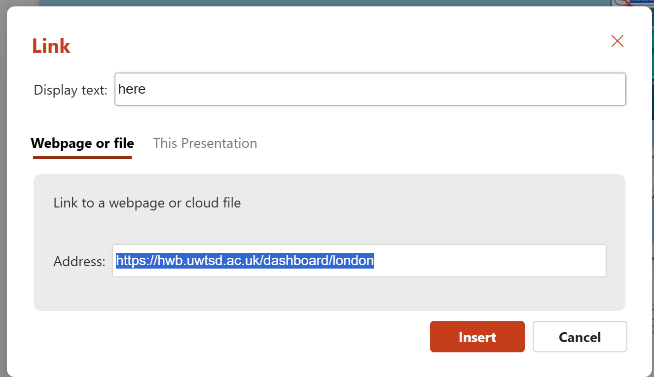
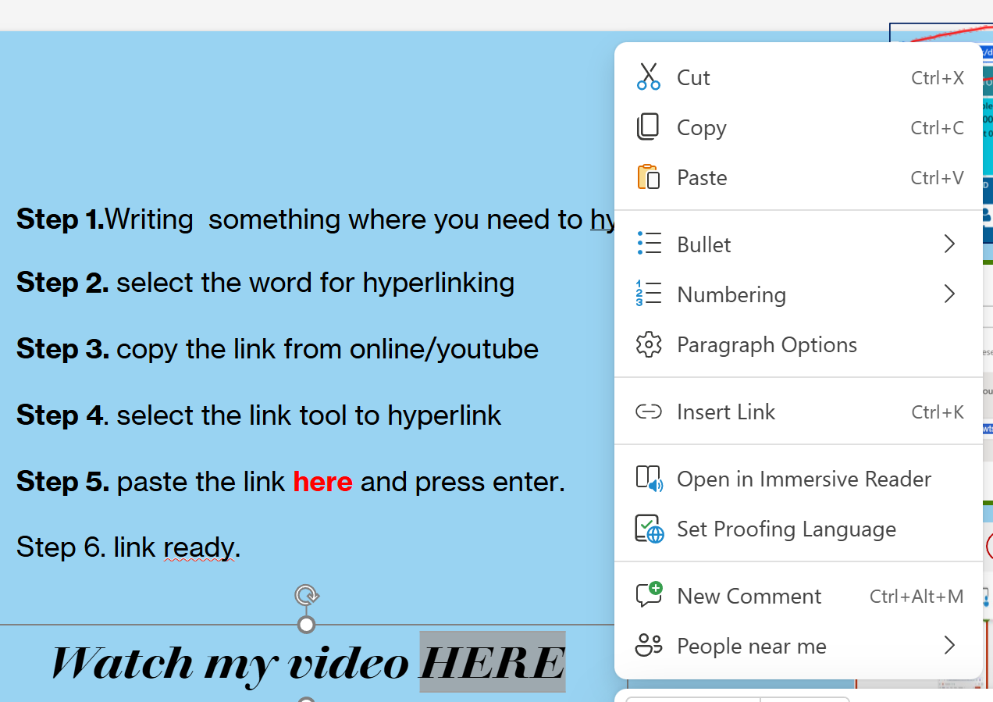
Mihaela Vlas
Digital skills/Business skills
Mr Rejwan Bin Suliman
Step 1.Writing something where you need to hyperlink
Step 2. select the word for hyperlinking
Step 3. copy the link from online/youtube
Step 4. select the link tool to hyperlink
Step 5. paste the link here and press enter.
Step 6. Link ready
Watch my video HERE

