Slide 1
LCBB6004
Strategic Management and Sustainability
Week 9
Strategic Sustainability

Slide 2
Learning Objectives
By the end of this session, students will be able to:
Analyse the Green Strategy Environment
Evaluate Strategic Impacts of Sustainability
Understand the Triple Bottom Line (TBL) Approach
Apply the Green Strategy Value Chain
Appreciate Corporate Values and CSR in Strategy

Slide 3
Strategic Sustainability
Strategic Sustainability examines how organisations can implement environmental sustainability science, theories, and ways of thinking to become more competitive.
Strategic Sustainability offers a comprehensive coverage of firm-natural issues related to the environment, ranging from critical drivers to strategic options at hand.
Leading businesses and corporations are evaluated on many aspects of their performance (e.g., product quality, ethical standards, and reputation in the community).
Corporate policies, involving employees and day-to-day operations, can have positive impacts on sustainability. Other “green” practices (e.g., recycling, purchasing recycled materials, and being a good steward of resources such as freshwater) also contribute to emissions reductions and environmental sustainability.

Slide 4
Green Strategy and Sustainability
Green strategy and the broader topic of sustainability concern those activities of the organisation that are focused on both sustaining the earth’s environment and developing the business opportunities that will arise from such additional activities.
Green strategy delivers positive results for leading companies.
There are three main factors to be addressed in analysing the green strategy environment:
    government legislation and directives;
    business opportunities;
    customer and consumer perceptions and pressure for change.

Slide 5
Green Strategy and Sustainability: The Main Topics
There are seven issues that companies need to consider:
  Effective use of energy with moves towards electrification. Safe and sustainable energy sources are essential. In practice, this will move organisations away from gas and oil towards other ways of generating energy.
  Sustainable use of natural resources. There is a need both to use renewable resources where possible and to use non-renewable resources in a careful and planned way.
  Protection of the biosphere and the development of carbon neutral organisations. Many companies are targeting the lower use of carboniferous fuels like oil and gas over the next few years.
  Country self-sufficiency. Countries need to become less reliant on importing energy where possible.
  Greater energy and resource efficiency. In both the production and the use of energy, many national governments and individual companies are researching and investing in more efficient sources of power generation.
  Reduction and disposal of waste. Green strategy needs to include waste minimisation, recycling where possible and special strategies with regard to hazardous waste.
  Change of attitudes and lifestyles. To achieve major change, a major shift in public attitudes is essential.

Slide 6
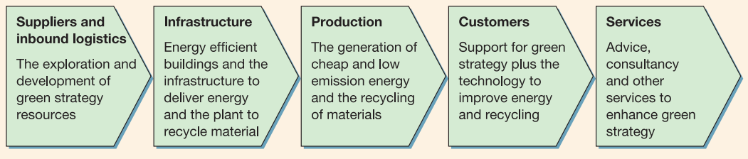
The Green Strategy Value Chain
The green strategy value chain seeks out ways of reducing energy, lowering carbon content and adopting recycling policies, not only within the organisation but also with suppliers and customers. In addition, the green strategy value chain will involve every element and function, including those that perhaps do not always feature highly in many value chain analyses.

Slide 7
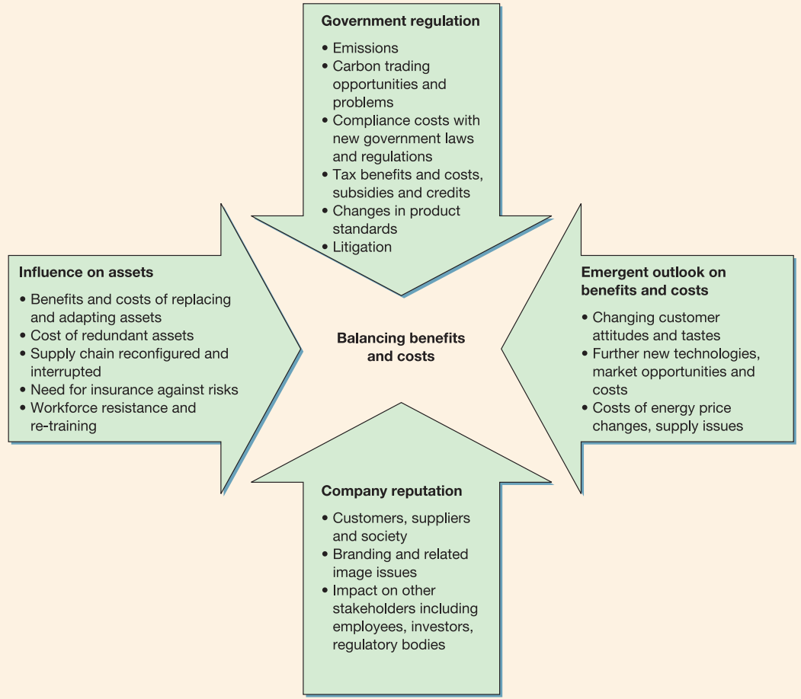
Green Strategy Value Chain: Benefits and Costs
From a green strategy perspective, green strategies will bring benefits both for the organisation and for its wider stakeholders – for example, employees, shareholders and the local community.
It is important to be realistic about the adoption of green strategy policies: there will be costs as well as benefits to the organisation.

Slide 8
The Triple Bottom Line (TBL) Approach
The TBL framework evaluates business performance across three dimensions: People, Planet, and Profit.
Encourages companies to go beyond financial metrics and consider their social and environmental impact.
Three Pillars:
People: Social responsibility (e.g., fair labor practices, community engagement)
Planet: Environmental sustainability (e.g., waste reduction, energy efficiency)
Profit: Economic viability (e.g., revenue generation, cost management).

Slide 9
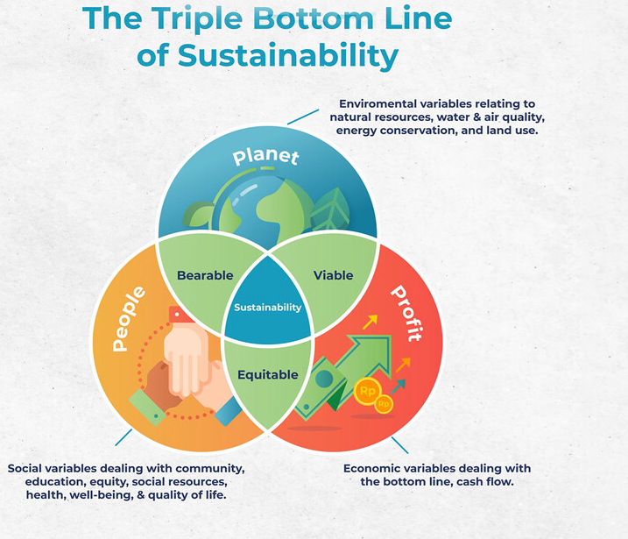

Slide 10
Benefits of Adopting the Triple Bottom Line
Enhanced Brand Reputation: Companies adopting TBL practices build a positive brand image, attracting consumers who value sustainability.
Risk Management: Reduces risks related to environmental regulations, supply chain disruptions, and reputational damage.
Long-Term Profitability: Sustainable practices can lead to cost savings (e.g., energy efficiency) and open new revenue streams (e.g., eco-friendly products).
Stronger Stakeholder Relationships: Demonstrates a commitment to ethical practices, improving relationships with employees, communities, and investors.

Slide 11
Using the Triple Bottom Line (TBL) in Strategic Management
Holistic Approach to Strategy:
  The TBL framework guides companies to balance People, Planet, and Profit when forming strategic goals.
  Encourages long-term thinking by integrating social, environmental, and economic considerations.
Aligns with Stakeholder Interests:
  Helps companies address the needs of diverse stakeholders, including customers, employees, communities, and investors.
  Enhances brand reputation and stakeholder trust through responsible business practices.
Supports Sustainable Growth:
  Promotes sustainable resource management, ethical supply chains, and fair labour practices.
  Leads to innovation in products and processes, creating competitive advantages.
Example: IKEA’s Sustainability Strategy: IKEA uses the TBL approach to focus on sustainable sourcing, energy efficiency, and social equity, aligning these pillars with its business growth strategy.

Slide 12

Case Study: Triple Bottom Line in Action - The Case of IKEA’s Sustainability Strategy
Background:
IKEA, the world’s largest furniture retailer, has integrated sustainability into its core business strategy, focusing on People, Planet, and Profit.
The company aims to become a fully circular and climate-positive business by 2030.
This case study explores IKEA's initiatives to reduce environmental impact, improve social responsibility, and drive profitable growth.

Slide 13
Case Study: Triple Bottom Line in Action - The Case of IKEA’s Sustainability Strategy
Activity Instructions:
Divide participants into groups of 2-5 members.
Task 1: Analyse the Triple Bottom Line Components
  Each group should identify and discuss how IKEA’s strategy aligns with the Triple Bottom Line (People, Planet, Profit).
  Focus on specific initiatives that IKEA has implemented in each category.
Task 2: Identify Challenges and Solutions
  What challenges might IKEA face in maintaining its sustainability goals while remaining profitable?
  Suggest strategies or solutions IKEA could adopt to overcome these challenges (e.g., balancing cost with eco-friendly practices).
Task 3: Presentation
  Each group will present their analysis and solutions to the class.
  Include the following in your presentation:
    How does IKEA’s strategy benefit the People, Planet, and Profit dimensions?
    What are the main challenges IKEA faces in this strategy?
    What recommendations would you give IKEA to improve or sustain its Triple Bottom Line strategy?

Slide 14
Corporate Social Responsibility
Corporate social responsibility (CSR) is the commitment by organisations to behave ethically and contribute to economic development while improving the quality of life of the workforce and their families as well as the local community and society at large.
Three reasons why CSR might also be in the interests of a company:
  The sustainability argument - CSR is in firms’ interests due to a mutual interest in sustaining the ecosystem.
  The reputation argument - CSR enhances a firm’s reputation with consumers and other third parties.
  The license-to-operate argument - to conduct their businesses firms need the support of the constituencies upon which they depend.

Slide 15
Corporate Social Responsibility
CSR involves a company's commitment to act ethically, contribute to economic development, and improve the quality of life of employees, the community, and society. Integrating CSR into strategic management aligns business goals with broader social responsibilities.
Why CSR Matters in Strategy:
  Enhances brand reputation and trust.
  Helps manage risks related to regulatory compliance, reputation, and stakeholder relationships.
  Drives long-term sustainability and competitive advantage.

Slide 16
Carroll’s Pyramid of Corporate Social Responsibility
Four Layers of CSR:
Economic Responsibilities: The foundation of the pyramid; businesses must be profitable to survive and grow.
Legal Responsibilities: Companies must comply with laws and regulations.
Ethical Responsibilities: Businesses should act fairly, ethically, and avoid harm, even beyond legal requirements.
Philanthropic Responsibilities: Voluntary actions to improve society, such as charitable donations and community engagement.
Hierarchy Importance: Companies should meet their economic and legal obligations before pursuing ethical and philanthropic initiatives.

Slide 17
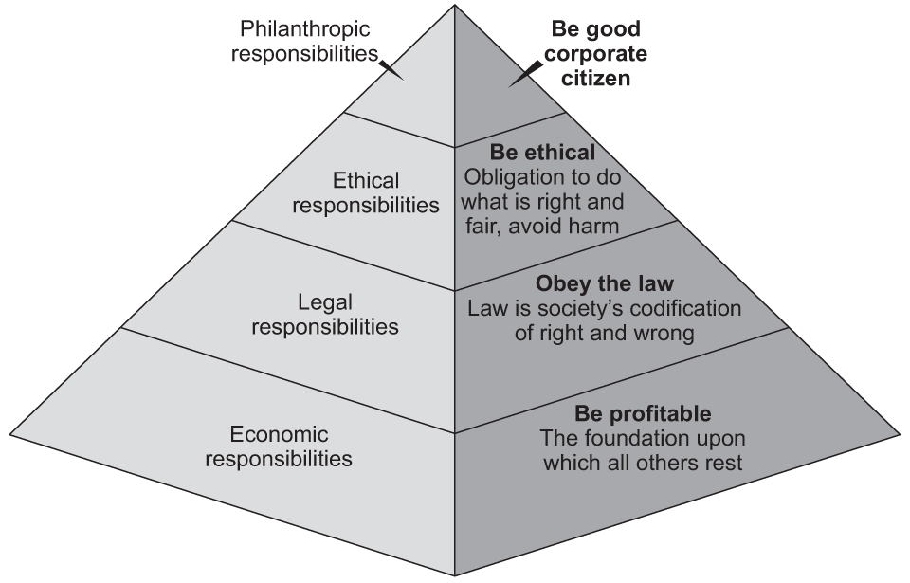
Carroll’s Pyramid of Corporate Social Responsibility

Slide 18
Strategic Integration of CSR
Aligning CSR with Business Strategy:
  Integrating CSR into core strategy ensures it is not just an afterthought but a key component of business success.
  Examples include sustainable product development, ethical supply chain management, and employee well-being programs.
Strategic Benefits of CSR:
  Enhances brand loyalty and customer trust.
  Attracts and retains top talent who seek purpose-driven workplaces.
  Opens new market opportunities, particularly among socially-conscious consumers.
Example: Unilever’s Sustainable Living Plan: Aligns CSR initiatives like reducing environmental footprint with core business strategies to drive growth.
.

Slide 19
Case Study: CSR Driving Strategic Success - Patagonia
CSR as a Core Business Strategy:
  Patagonia embeds environmental sustainability into its strategic management, not just as a responsibility but as a market differentiator.
  Initiatives include eco-friendly product lines, supply chain transparency, and activism against environmental degradation.
Outcomes:
  Strong brand reputation and customer loyalty.
  Reduced environmental impact and contribution to sustainability movements.
  Profitable growth aligned with social and environmental goals.

Slide 20


Good & Poor CSR Practices

Slide 21

How Adidas Turns Plastic Bottles Into Shoes
https://www.youtube.com/watch?v=pJBRqespiOA

Slide 22

Walk in My Shoes: Nike's Sweatshops
https://www.youtube.com/watch?v=2no2L-5-yfI

Slide 23

1. Since long-run profitability requires that a firm is sensitive to the interests of its customers, employees, suppliers, and society-at-large, whether a firm is run in the interests of its shareholders or its stakeholders makes no real difference. Do you agree? Are there situations where shareholder and stakeholder interests diverge?
Question?

Slide 24

Case Study
Coca Cola Sustainability
Why does Coca Cola keep preparing sustainability report?
How does Coca-Cola integrate sustainability into their operations?

Slide 25

Any Questions?
Thank You ☺

Slide 26
Sources:
Fogel, D. S., 2016. Strategic Sustainability: A Natural Environmental Lens on Organizations and Management. New York: Routledge.
Grant, R. M., 2018. Contemporary Strategy Analysis. 10 ed. NJ : John Wiley & Sons, Inc.
Hill, C. W. L., Schilling, M. A. & Jones, G. R., 2017. Strategic Management, Theory. 12 ed. Boston: Cengage Learning.
Johnson, G. et al., 2017. Exploring Corporate: Text and Cases. 11 ed. Harlow: Pearson Education Limited.
Lynch, R., 2015. Strategic Management. 7 ed. Harlow: Pearson Education Limited.
Whittington, R. et al., 2020. Exploring Strategy. 12 ed. Harlow: Pearson Education Limited.

