Slide 2
Storing Data
Monitoring
Troubleshooting
Network Operating Systems and Services
(ACCA5023)
Applied Computing - WISA
Nitheesh Murugan Kaliyamurthy & Lee Cobley

Slide 3
Announcements
Extra Sessions
Face to Face: Monday 04th April 2022 10.00 am @ IQ108
Online Session: Thursday 07th April 2022 11.00 am (Team Link will be sent to all students)

Slide 4

Objectives
To understand
Storage
Disk Types
RAID
Performance Monitoring
Troubleshooting
Storing Data
Monitoring
Troubleshooting

Slide 5
Storage
1890 PUNCH CARDS
1932 MAGNETIC DRUM
1947 1st RAM (Very small memory)
1951 Magnetic Tape Drive
1956 Hard Disk Drive (HDD)
1967 Floppy Disk Drive
1982 Compact Disc
1994 Zip Drive
1995 Digital Video Disc (DVD)
1999 SD Card
1999 USB Flash Drive
2003 Blu-ray Optical Disc
2006 Cloud Data Storage
So far, we were discussing various services of Network Operating Systems. DHCP, DNS, Webserver, Mail server, e.t.c
Regardless of the above aspects, STORAGE SPACE is also a vital requirement to consider.
Technologies like SCSI,USB DAS, NAS, SAN, RAID are some of the storage technology options.

Slide 6
Qualities/Characteristics of a Server
The ability to update hardware and software without a restart or reboot.
Need to operate 24/7, reliable, with little to no downtime
Advanced backup capability for frequent backup of critical data.
Advanced networking performance. (NOS e.g Win Server 2019 to support concurrent connections as they are stable and robust)
Automatic (invisible to the user) data transfer between devices.
High security for resources, data and memory protection.
Robust hardware

Slide 7
Hardware Components
Motherboard (Designed for Servers)
main printed circuit board in a computing system
It holds the CPU,Provides firmware (BIOS), slots for memory modules,
expansion slots for networks cards/graphics adapters
interfaces storage devices
Processor (e.g Intel Xeon, and not intel core i7)
performs basic arithmetic ,logic, controlling, and input/output(I/O) operations specified by the instructions in the program. Should be fast and be able to execute a lot of tasks/instructions simultaneously. Most of the time are designed to work with other processors)
Random access memory (special with ECC Error-Correcting Code(expensive))
-holds the software instructions and data needed by the processor, along with any output from the processor, such as data to be moved to a storage device.

Slide 8
Hardware Components continue….
Hard disk drive /Solid State Drives
-SSDs are more expensive than hard disks, so organizations often use a mix of hard drive and solid-state storage in their servers to meet the unique performance demands of different workload.
-Support hot swappable hard drives
Network connection
depend on at least one network connection to maintain communication between the server and a data center LAN
Power Supply
In poor design the PS is a single point of failure in the server, therefore there is need of redundant power supplies where a backup power supply can take over if the main power supply fails.

Slide 9
Storage Protocols
-enables applications, servers and other systems to interface with storage across the network
-Provide a standard set of rules that define how data is transmitted between devices
Server Message Block(SMB)
  -client-server communication protocol that enables users and applications to access storage and other network resources on a remote server.
  It operates at the application layer and can run on TCP/IP networks
iSCSI: (Internet Small Computers System Interface)
  Transport layer protocol that provides block-level access to storage devices over TCP/IP network
  It describes how to format SCSI across LANS, and WANs and enables IT to set up a shared storage network e.g SAN
HTTP:( Hypertext Transfer Protocol)
  Besides being used to request web pages, also embedded in APIs that supports access to cloud storage services
Fibre Channel over Ethernet:
  Extends across Ethernet Networks achieving longer distances coverage
  Factors for choosing storage network protocols include, performance, Reliability, complexity, cost

Slide 10
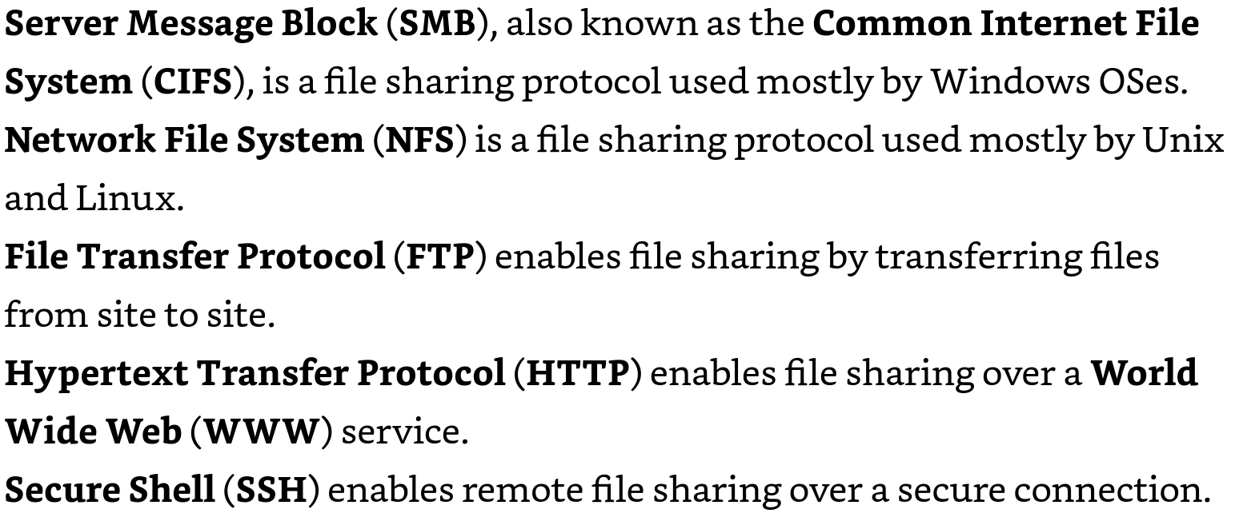
File Sharing Protocols
File Sharing Protocols enable data sharing over LAN’s, WAN’s and Internet…

Slide 11
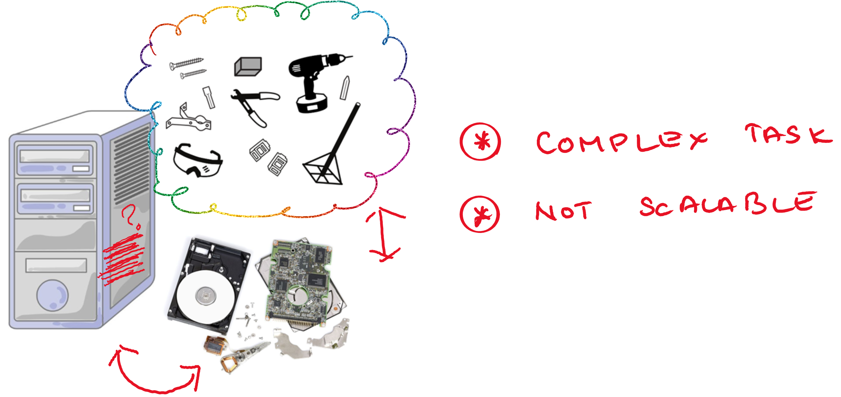
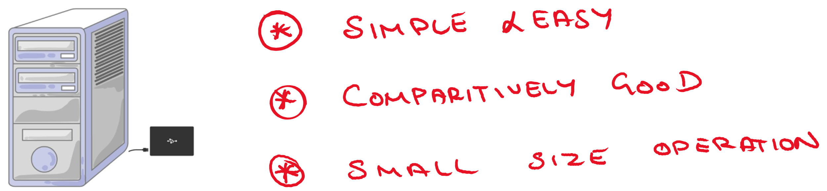
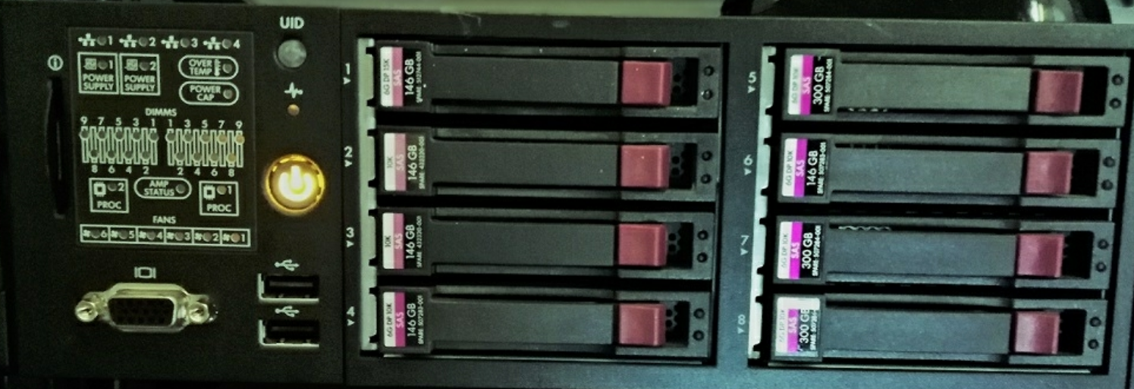
Direct – Attached Storage
Block Storage
Single Machine
No Resource Management
No Sharing
Limited Scalability
Reboot during installation/ troubleshooting – Prominent to Downtime.
Suitable for High Data Availability Environment.
DAS

Slide 12
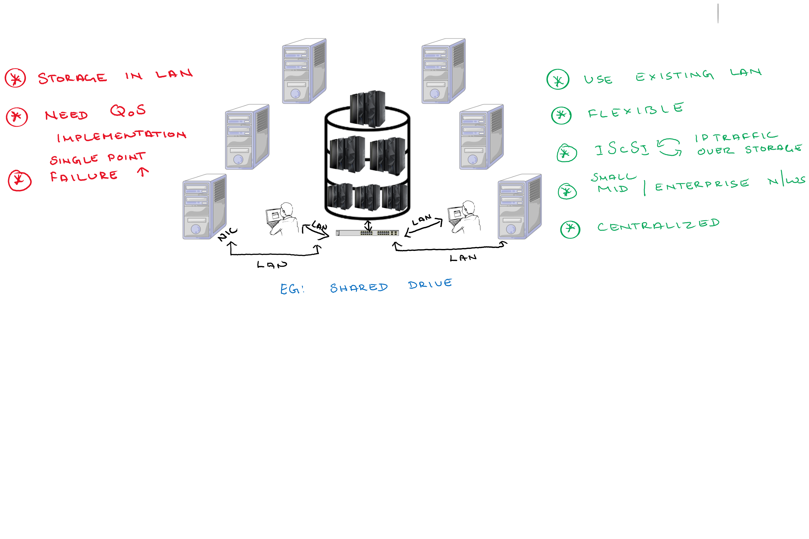
Network – Attached Storage
Concept of File Sharing : File access method
Uses Ethernet (Connected via NIC)
Layer over TCP/IP protocol
Connected to Workstations
Comparatively efficient enough to DAS
Capable of Sharing and Managing

Slide 13
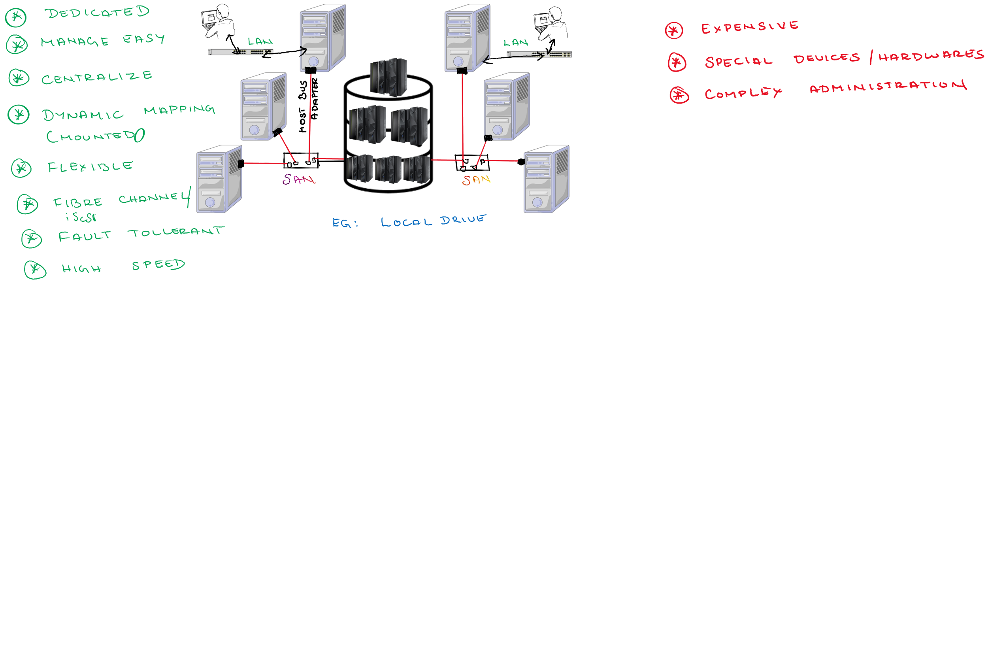
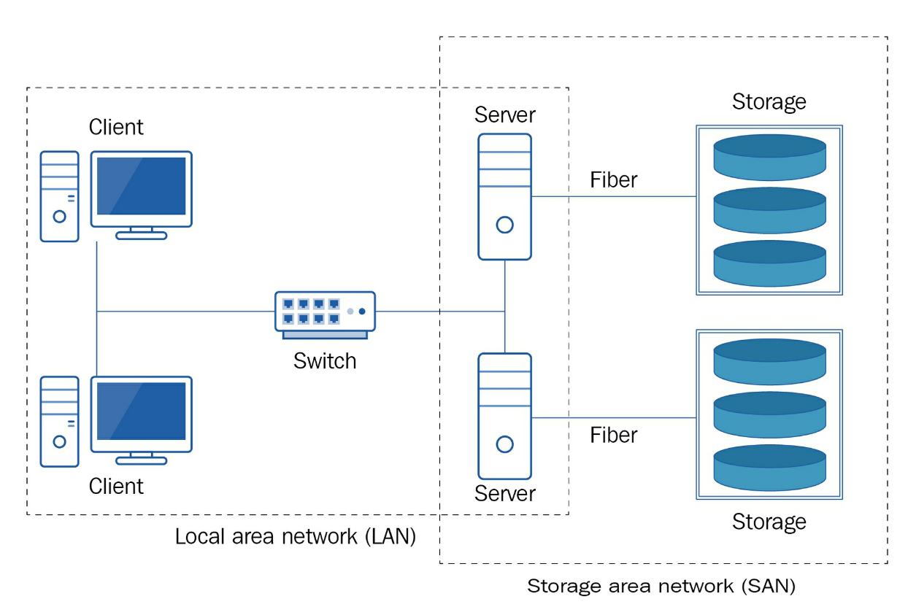
Storage Area Network
Block Storage Sharing
Uses Fiber Channel
Proprietary Protocols or Simple Network Management Protocols
Connected to Servers
Highly efficient of other storage techniques
High Integrity
Dedicated Storage System

Slide 14
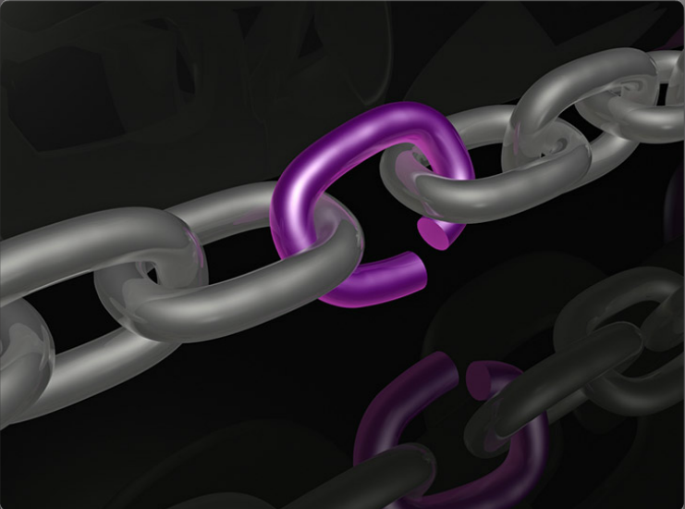
Redundant Array of Independent Disks (RAID)
Redundancy
  A single point of failure must be identified and addressed. A single point of failure can be a specific piece of hardware, a process, a specific piece of data, or even an essential utility.
  Single points of failure are the weak links in the chain that can cause disruption of the organization's operations.
  Generally, the solution to a single point of failure is to modify the critical operation so that it does not rely on a single element.
  The organization can also build redundant components into the critical operation to take over the process should one of these points fail.

Slide 15
Redundancy (Cont.)
Redundant Array of Independent Disks (RAID)
A redundant array of independent disks (RAID) combines multiple physical hard drives into a single logical unit to provide data redundancy and improve performance.
RAID takes data that is normally stored on a single disk and spreads it out among several drives. If any single disk is lost, the user can recover data from the other disks where the data also resides.
RAID can also increase the speed of data recovery.
Using multiple drives makes retrieving requested data faster, instead of relying on just one disk to do the work.
A RAID solution can be either hardware-based or software-based. The following terms describe how RAID stores data on the various disks:
  Parity - Detects data errors.
  Striping - Writes data across multiple drives.
  Mirroring - Stores duplicate data on a second drive.

Slide 16
Redundant Array of Independent Disks (RAID)
There are a lot of different ways a RAID may be configured.
  These are numbered, from 0 to 6, with it also being possible to combine RAID 1 and RAID 0, usually named 1 + 0, or just RAID 10 (said “ten”).
  We usually only ever see configurations of RAID 0, 1, 5, and 10. 2, 3 , 4 and 6 fill specific purposes which don’t come up that often – we won’t look at them, but feel free to investigate if especially interested.
Different RAID levels suit different circumstances, have different levels of performance in different situations, in addition to added implied risk.
Some assumptions about hard drives and RAID to be aware of:
  They fail, a lot.
  They fail more the older they are. Multiple hard drives bought simultaneously and used evenly have a reasonable chance of crashing quite close to one another.
  They’re usually the “slowest” component in a computer.

Slide 17
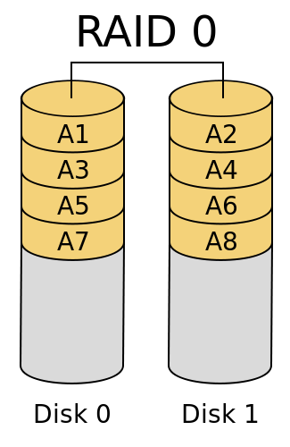
RAID levels – RAID 0 (striped)
RAID 0 is strange, because it isn’t actually redundant. In fact, it’s sort of the opposite of what we’re trying to achieve.
  Some people argue it shouldn’t be considered a RAID level at all because its not fault-tolerant
  No parity calculation overhead is involved (simple design easy to implement)
When we write blocks of data to a RAID 0 configuration, it’s evenly split across each disk. So, in the picture on the right, 50% of the data is written to disk 0, 50% to disk 1.
  This is called “striping”
  Files are split across both disks.
  I/O performance is greatly improved by spreading the I/O load across many channels and drives
  Also extremely risky – if any disk in a RAID 0 configuration fails, the entire RAID fails. If you don’t have a backup, your data is permanently lost, and cannot be recovered from the remaining functional disk(s).

Slide 18
RAID levels – RAID 0 (striped)
Minimum of two disks required
Speed of writing to, or reading from, a RAID 0 array scales fairly linearly with the number of disks.
The failure of just one drive will result in all data in an array being lost
Should never be used in mission critical environments
Recommended Applications
Video Production and Editing ,Image Editing
Any application requiring high bandwidth

Slide 19
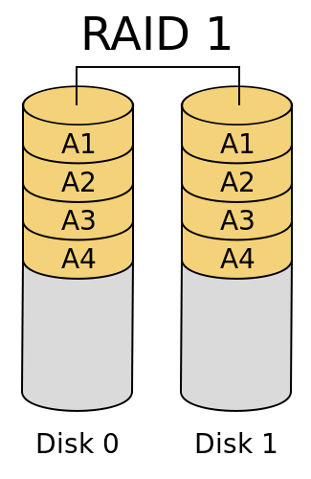
RAID levels – RAID 1 (mirrored)
All data written to the array is written to all disks in the array simultaneously.
  Writing is as slow as writing to 1 disk.
  Reading scales reasonably well with the number of disks/Twice the Read transaction rate of single disks
  This is called mirroring.
  Highest disk overhead of all RAID types (100%) - inefficient
Sometimes considered the opposite of RAID 0 – true, absolute redundancy.
In a 4 disk array, all 4 have to fail before you lose your data.
  Array rebuilds unlikely to result in data loss for large RAID 1 arrays.

Slide 20
RAID levels – RAID 1 (mirrored)
Recommended Applications
Accounting
Payroll
Financial
Any application requiring very high availability

Slide 21
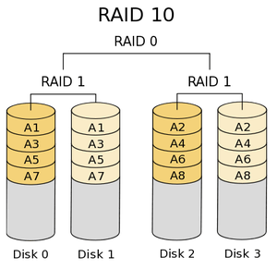
RAID levels – RAID 10 (striped + mirrored)
This applies mirroring AND striping. The image on the right shows mirroring then striping (which is by far the most normal approach), but it can happen either way, and has some subtle differences when done in reverse.A good combination of performance and redundancy – most of the benefits of RAID 0 and RAID1.
  Fast write times (due to striping).
  Fast read times (due to mirroring and/or striping).
Requires a minimum of 4 disks, and must always have a multiple of two.
Recommended Applications
Database server requiring high performance and fault tolerance
Two copies of all pieces of data.
  Failure of 2 disks can cause the array to fail, while it may tolerate the failure of up to 50% - very luck-dependent on which disks fail
  .

Slide 22
Risk during array rebuilds
We still have two RAID levels to cover, but first we need to understand risk when rebuilding our RAID arrays.
  “Rebuild” really means the process which occurs when one drive has failed, and we need to replace it.
  For example, in the case of RAID 1, we just replace the failed drive, and copy all of the data from the other drive(s) – this happens automatically.
  As mentioned, drives tend to have a “lifespan” – a certain amount of read/write they can perform before the probability of a failure becomes quite high.
  In many RAID 10 configurations, once a failure occurs, we only have a single copy of the relevant data – stored on a single drive, which we’ll be reading from heavily during the rebuild.

Slide 23
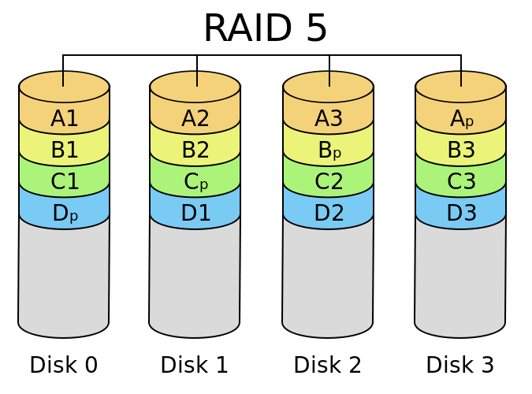
Raid levels – RAID 5
Uses a form of striping with an added (distributed) “parity” block.
  Parity information can be used to re-calculate the data on a failed disk, in combination with the other data.
  The parity value itself must be calculated, making RAID 5 more computationally expensive than the RAID levels we’ve looked at before it.
    Write Performance is slower than RAID 0 and 1
    Highest Read data transaction rate
    Storage is effectively size of disk array -1. So a 4 x 1TB RAID 5 array is of size 3TB.

Slide 24
Raid levels – RAID 5
Can consist of between 3 and ∞ disks. Large numbers of disks are extremely inadvisable for this array type.
Difficult to rebuild in the event of a disk failure (as compared to RAID level 1)
Data can be rebuilt from information found on other drives.
  The restore process is very read-intensive – high chance of failure during.
  The rebuild process has to read EVERY disk in the array – unlike RAID 10 which only has to read one. Increased risk of failure as a result.
Should not use large disks for this array.

Slide 25
Raid levels – RAID 5
Recommended Applications
File and Application servers
Database servers
Web, E-mail, and News servers
Intranet servers

Slide 26
Performance Monitoring
What
  is the purpose of a server?
  are the services provided?
  components needed to be monitored?
  is the metric of component performance?
  tool is required to analysis and collected data?

Slide 27
Performance Monitoring
Document the server's hardware, software, and configuration.
Establish the server's baseline.
  a server baseline represents a snapshot of a server's performance under a normal workload. It enables you to compile a detailed report on the performance of various server components under normal workload conditions.
  How do you know when servers are working under their load?
  Do you have a sample to compare their performance against?
  Collect the following performance information:
    Processor utilization
    RAM utilization
    Disk read-and-write operations
    Network connection utilization

Slide 28
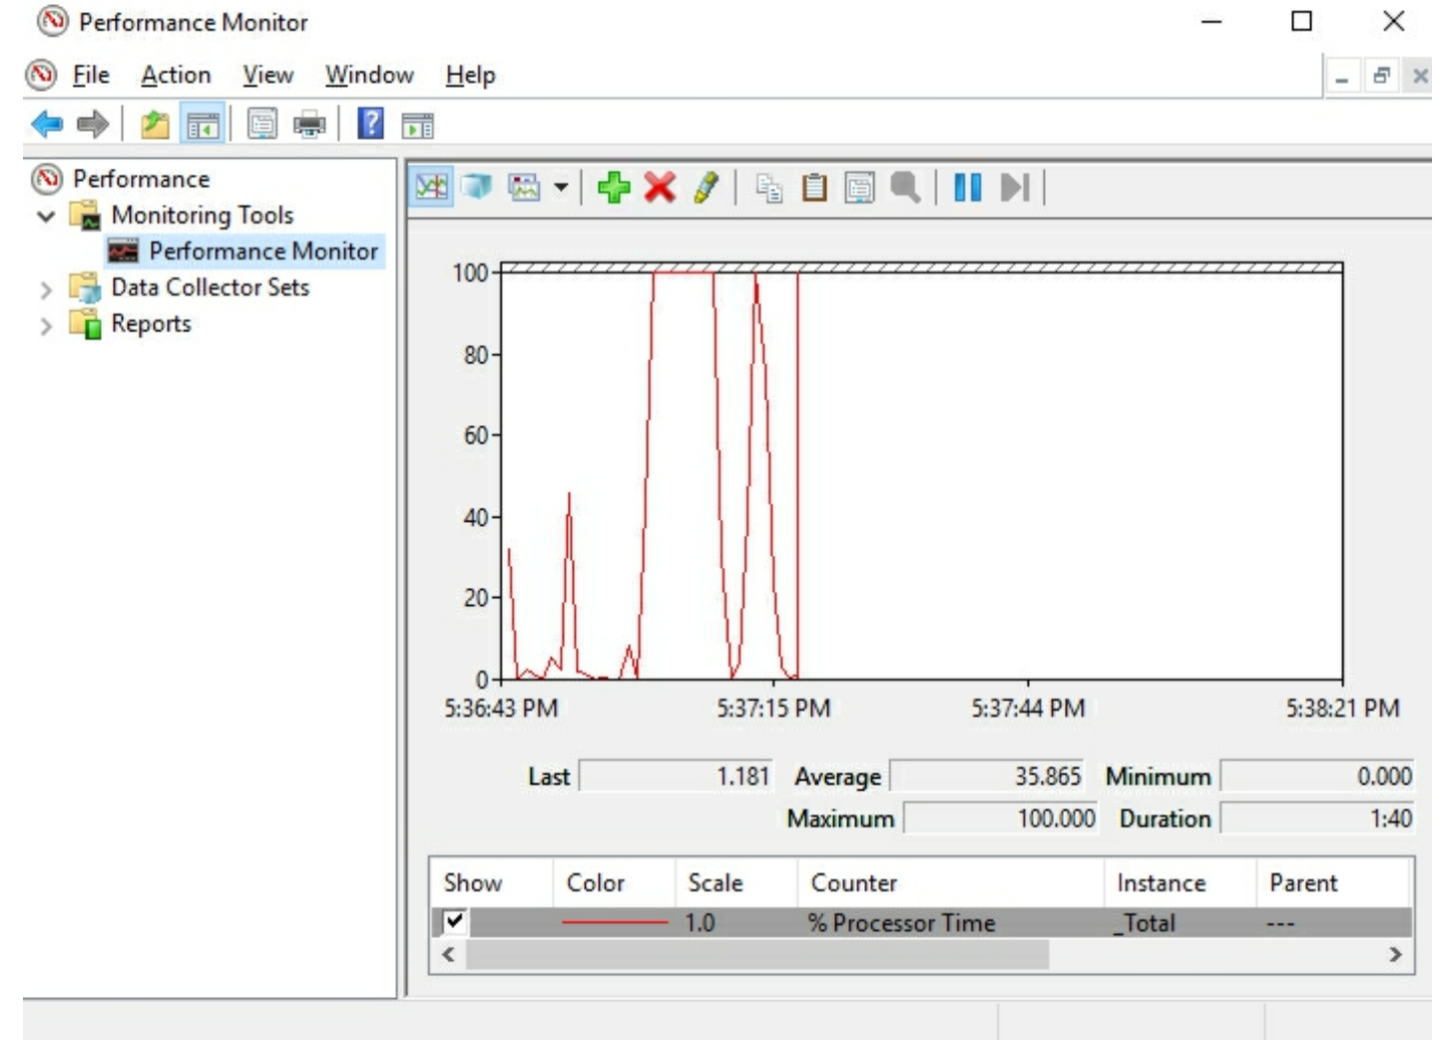
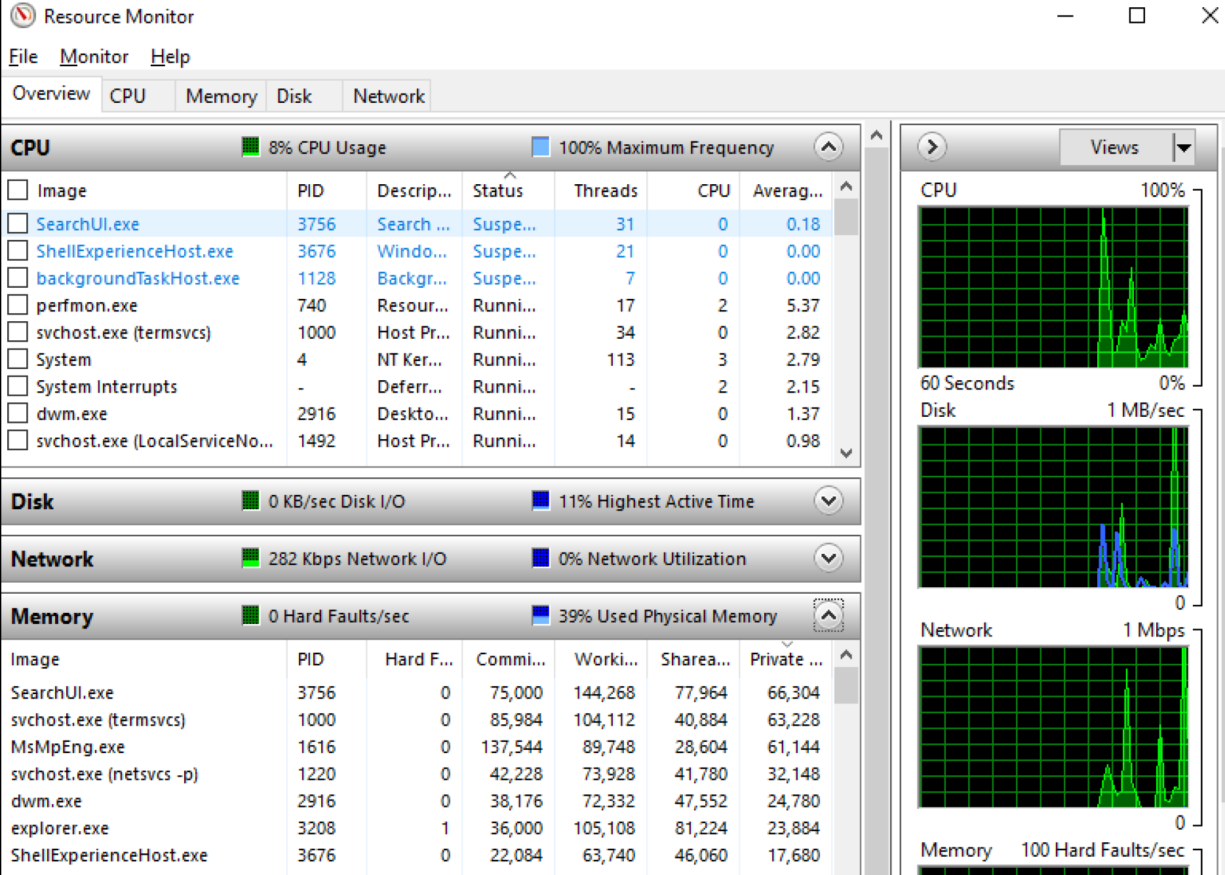
Performance Monitoring
Upgrade the server's hardware and software.
Perform the server's baseline and compare that with previous baselines.
Identify server bottlenecks.
Take concrete steps to fine-tune the server's performance.
Notes:
Performance Monitor is a Windows Microsoft Management Console (MMC) that monitors the server's performance. It enables us to visualize performance information, either in real time or from a log file. The examined performance information is displayed in formats such as a line graph, histogram bar, or report

Slide 29
Troubleshooting
Discover the problem by gathering as much technical information as possible.
Evaluate system configuration by asking questions to determine whether any hardware, software, or network changes have been made recently.
List or track possible solutions by isolating the problem through removing or disabling hardware or software components.
Execute a plan through testing solutions, and, at the same time, ensure that you have a plan B too.
Check the results. If the problem has not been solved, go back. Take a proactive approach by documenting any changes that you have made while troubleshooting the problem.
Notes:
You can learn more about the ISO 9000 standard at http:/ / asq. org/
learn- about- quality/ iso- 9000/ overview/ overview. html and the ISO
14001 standard at http:/ / asq. org/ learn- about- quality/ learn- aboutstandards/
iso- 14001.

Slide 30
Troubleshooting - Disaster Recovery Plan (DRP).
Make an inventory of all hardware and software.
Analyze all potential threats and vulnerabilities.
Establish the organization's priorities.
Define the organization's tolerance in case of a disaster.
Review how the disaster was handled in the past.
Acknowledge that staff matters more than data recovery and services.
Execute DRP DRY tests regularly.
Have management approve the DRP.
Never forget to update the DRP.

Slide 31
Troubleshooting
Think and Plan
  Data Redundancy
    Clustering refers to a group of servers that combine processor power, RAM, storage capacity, and network interfaces to achieve high availability of services.

Slide 32
Troubleshooting
    Failover clustering:
      This requires a minimum of two servers and works on the active-passive principle, where one server is active and the other server is passive.
      Usually, it is applied to databases, mail servers, and, in general, backend processing environments.
    Load-balancing clustering:
      This requires a minimum of two servers as well; however, servers are merged into one virtual server, exchanging heartbeats.
      As far as users are concerned, they access a single server; as far as backend processing is concerned, the loads are distributed between the servers
      Usually, it is applied to web servers, and, in general, frontend processing environments.

Slide 33
Always… there is never an for the process of learning…
Different perspective of Network Operating Systems Services….
  Different Network Operating Systems and different scopes and services
  so far we were focusing on Windows Server 2019 Servers various Services…
  Progressive Path:
    Cloud,
    What if you have network which performs at the speed of software? Yes, it will… In very near future… it might be a decoupled architecture enabling customized services…
  How will you optimize/ customize the services?

Slide 34
Thank you and all the very best…

