Slide 1

Gender Inequality in Modern Society
Jazmin Leonard (1803407)

Slide 2
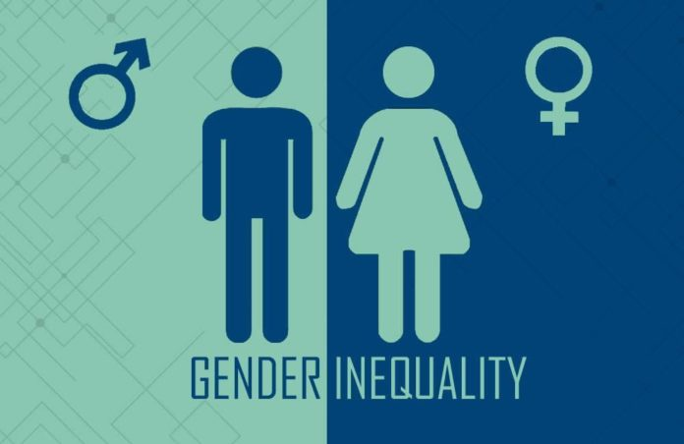
Stage One:
What is gender inequality?
Barlow, N. (2020) Gender Inequality

Slide 3
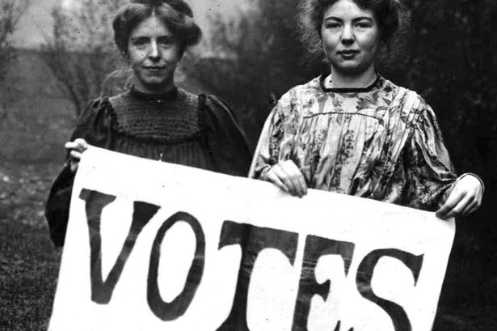
Definition:
The act of not treating a person equally based on their gender identity.
Traditionally, men are superior to women - "Votes For Women" (1928).
Bell, A. (2018). Suffragettes

Slide 4

Stage Two:
What challenges are linked?
Olenski, S. (2014)

Slide 5
Challenges:
Lack of access to menstrual products – Condoms are free, yet menstruation is not optional
Gender-based violence – Save The Children (2023) state, "An estimated 1 in 3 women globally have experienced physical or sexual violence in their lifetime, mostly at the hands of their partners."
Lack of education for girls – 2.5 times more likely to be out of education compared to male peers, Save The Children (2023).

Slide 6

Stage Three:
What can be done to help?
Tenor (no date)

Slide 7
How to help:
Encourage women to have power
Access to menstrual products
Educate all genders

Slide 8
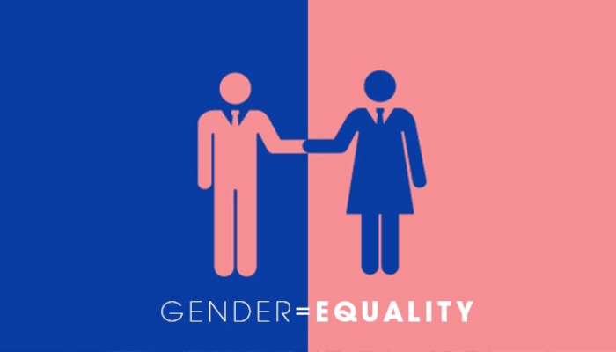
Stage Four:
What solutions do we have?
Bailey, B. (2022)

Slide 9
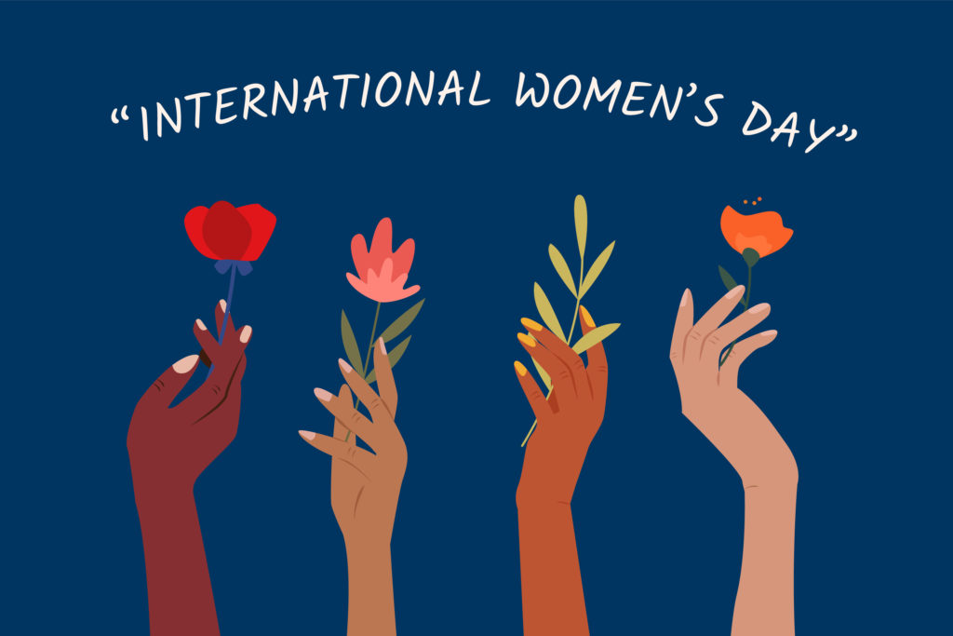
Current Solutions:
International Women's Day – Since 1911 (Tryengineering.org, 2022)
The 'Global Gender Gap' Report for 2022 - World Economic Forum (WEF) - "the UK had closed 78% of its gender gap" (WEF, 2022).
Tryengineering.org. (2022) International Women's Day

Slide 10
More work needed:
132 years to reach gender equality worldwide (WEF, 2022).

Slide 11
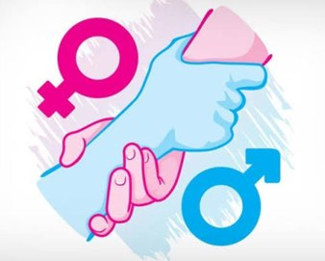
Conclusion:
More education is needed to minimise gender inequality.
Shafaa, R. (2022)

Slide 12
References
Bailey, B. (2022). Gender Equality [image]. Available at: https://businessday.ng/news/article/gender-based-policies-seen-tackling-inequality-diplomats/ (Accessed: 22 April 2023).
Barlow, N. (2020). Gender Inequality [image]. Available at: https://aboutmanchester.co.uk/at-the-turn-of-the-decade-gender-inequality-still-affects-majority-of-uk-girls-reveals-new-report/ (Accessed: 22 April 2023).
Bell, A. (2018). Suffragettes Marched [image]. Available at: https://www.dailypost.co.uk/news/what-is-a-suffragette-14251597 (Accessed: 22 April 2023).
International Women’s day 2023: Have gender gaps narrowed? (2023). Available at: https://lordslibrary.parliament.uk/international-womens-day-2023-have-gender-gaps-narrowed/ (Accessed: April 22, 2023).
Olenski, S. (2014). Challenges [image]. Available at: https://imageio.forbes.com/blogs-images/steveolenski/files/2014/09/bigstock-Challenges-Road-Sign-3530978.jpg?format=jpg&width=960 (Accessed 22 April 2023).

Slide 13
References
Save The Children. Gender discrimination causes inequality between girls and boys around the world (2023) Save the Children. Available at: https://www.savethechildren.org/us/charity-stories/how-gender-discrimination-impacts-boys-and-girls (Accessed: April 22, 2023).
Shafaa, R. (2022). Gender Equality Is A Human Right [image]. Available at: https://www.voicesofyouth.org/blog/gender-equality-human-right (Accessed: 22 April 2023).
Tenor (no date) Help [image]. Available at: https://tenor.com/en-GB/view/help-help-in-white-bubble-letters-inside-red-shouting-speech-bubble-help-me-i-need-help-somebody-help-gif-20015643 (Accessed: 22 April 2023).
Tryengineering.org. (2022). International Women's Day [image]. Available at: https://tryengineering.org/news/its-international-womens-day-march-8/ (Accessed: 22 April 2023).

Slide 14
Teams Link:
https://uowtsd.sharepoint.com/teams/assignment117_GRP/Shared%20Documents/General/Recordings/New%20channel%20meeting-20230422_214557-Meeting%20Recording.mp4?web=1

