Slide 1
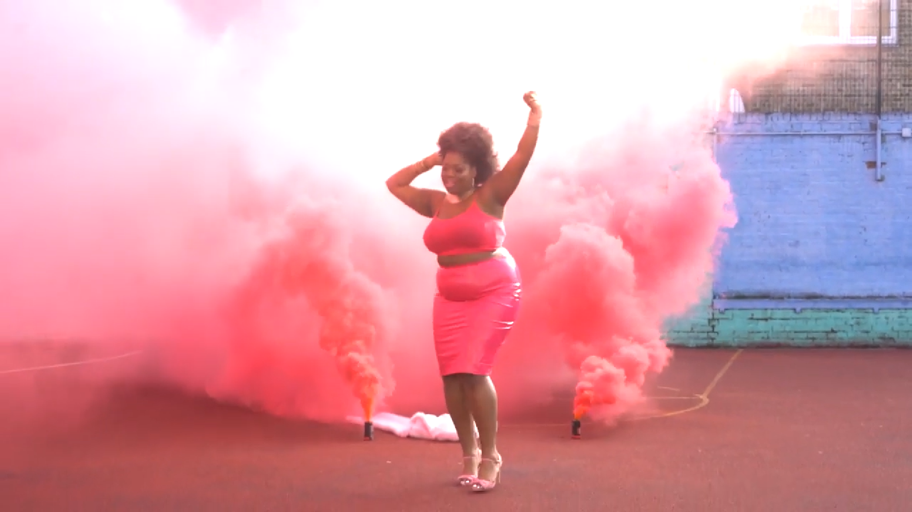
ENTERTAINMENT MARKETING
BMTY7003
Assessment Component 1 - Report
ALBUM RELEASE:
ESTHER COLE – LOVE ME OR HATE ME
Marketing Plan

Slide 2

Artist Overview
R&B/Soul artist with a gospel influence from South East London.
Began singing at church.
Writes about true matters of the heart and is relatable to many young women around the world.
Believes in empowering other artists, women and in community.

Slide 3

Album Details
Artist Name: Esther Cole
Album Title: Love Me or Hate Me
Release Date: Friday 14th February 2020
Label: Independently
Distributor: AWAL
Producers: Patch Boshell and Esther Cole
Studio: Larkhill Studios
Mixed: James Glover
Mastered: James Glover

Slide 4
Track Listing
I Wish I Could – 3mins 48secs. Writer: Esther Cole. Composer: Deborah Abraham. Producer: Patch Boshell
Is It True - 3mins 33secs. Writer: Esther Cole. Composer: Deborah Abraham
Love Me or Hate Me – 3mins 58secs. Writer: Esther Cole. Producers: Esther Cole and Patch Boshell.
My Man - 4mins 8secs. Writer: Esther Cole. Composer: Deborah Abraham. Producer: Patch Boshell
The Inside - 3mins 15secs. Writer: Esther Cole. Composer: Deborah Abraham. Producer: Patch Boshell
Get Yo Man - 3mins 41secs. Writer: Esther Cole. Producers: Esther Cole and Patch Boshell.
Make Me Your One and Only - 3mins 55secs. Writer: Esther Cole. Producers: Esther Cole and Patch Boshell.
You Should Have Loved ME - 3mins. Writer: Esther Cole. Composer: Deborah Abraham

Slide 5
Details on Sound Recording
The Album will have a variety of trusted creatives working on it
Church Choir
Patch Boshell – Producer and Engineer from ACM
Deborah Abraham – Songwriter, Composer and Pianist from ACM
James Grover - Producer from Tileyard
Tonesound – Photgrapher, Videographer and Film Editor Tileyard
They have all successfully worked with me in the past on other projects and are either free or affordable.

Slide 6
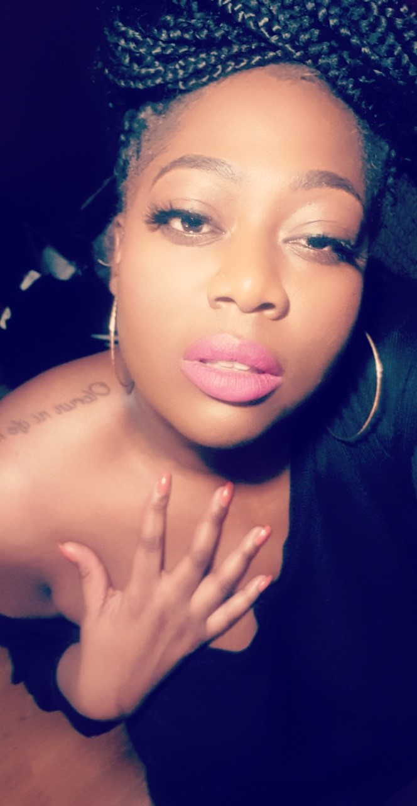
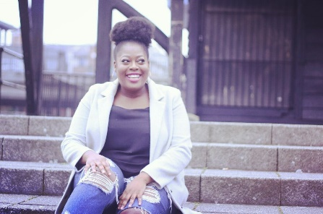
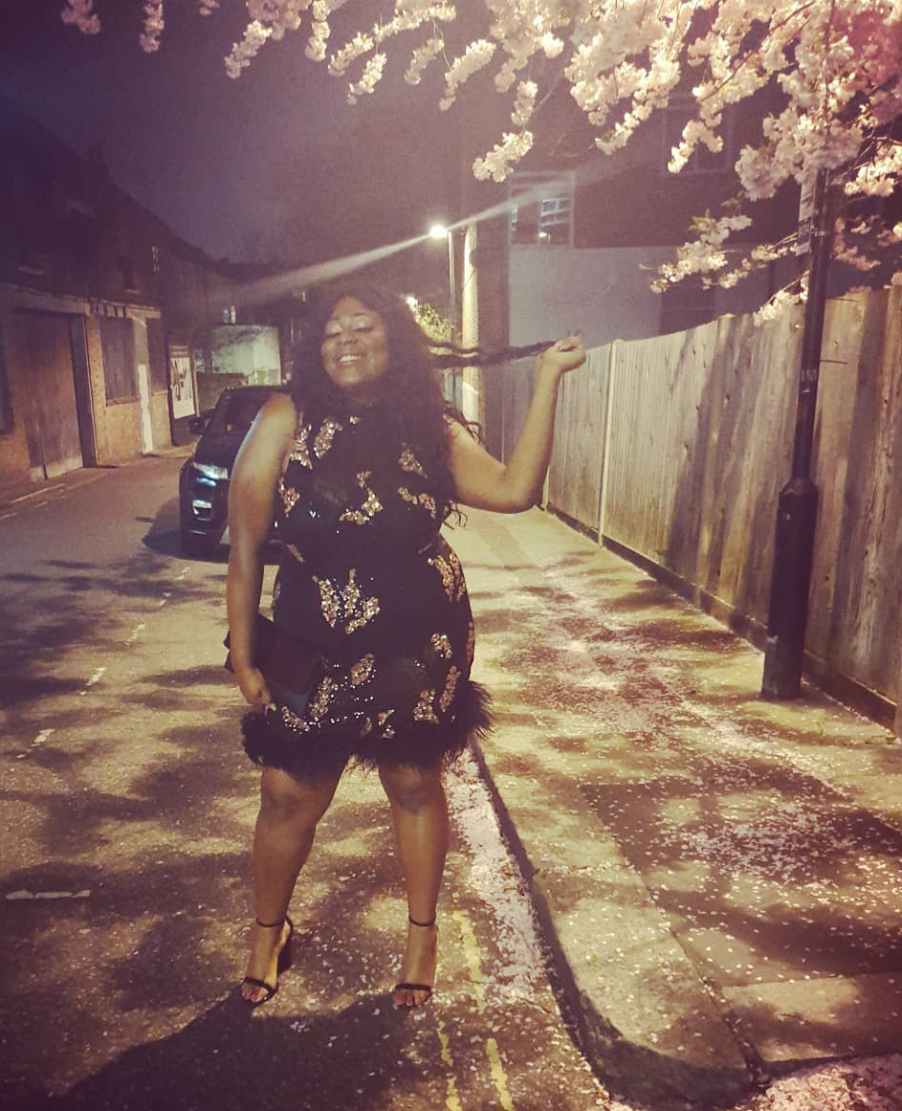
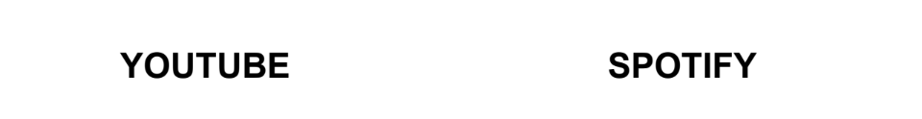
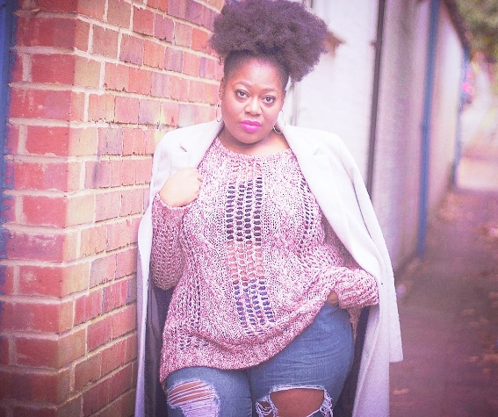
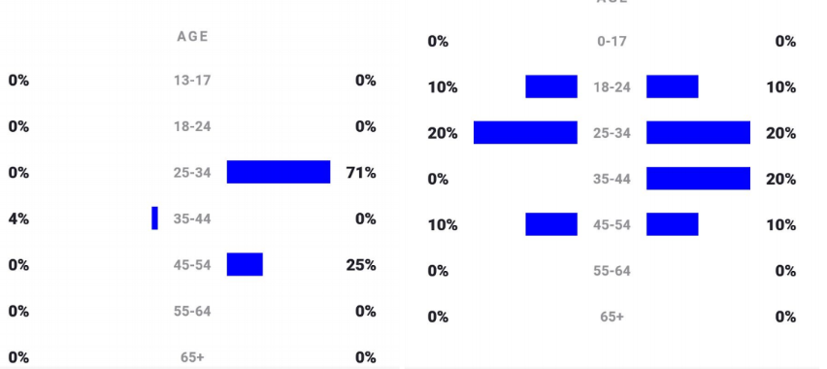
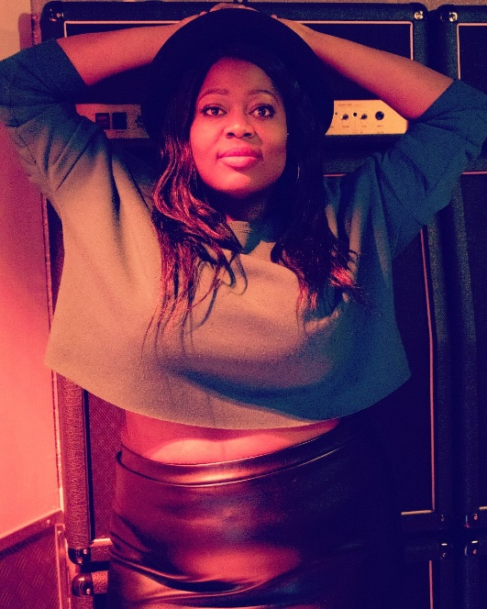
Target Market(s)

Slide 7
Target Market(s)
Incorporating the “communications mix” of: Advertising, PR, Promotion, Personal Selling and Sponsorship we will target a variety of markets with a specific target on girls and women in the UK
Age: 16 - 34
Gender: Female
Location: South East, South, East and North LDN
Culture: Feminism, Women Empowerment, Black Girls Matter, etc.

Slide 8
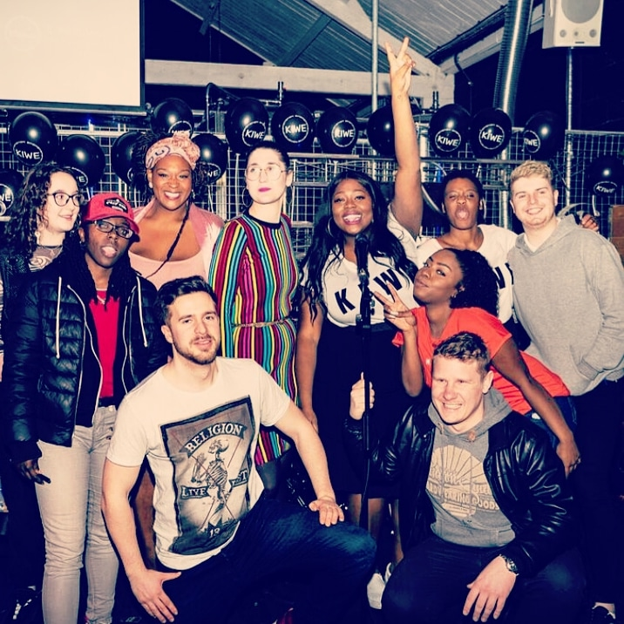
Team
Manager: Michaela Cole (Agents, Publicists, Radio Trackers, Publishers)
Radio Plugger: Yinka Bokkini
Distributor: AWAL
Street Team: Volunteers and Family
Administrator for all things concerning the album release: Esther Cole

Slide 9
Release Plan
Build our media list ceaselessly.
Create awareness during the entire Production Process.
12-6 months ahead of release — Begin the brainstorming and cost sourcing.
4 – 3 months ahead of release — Print Media – submit music and plans to mags.
4 months ahead of album release and 1 month ahead of single release — Create a hype for digital single release and set up single distribution with AWAL.
4 – 3 months ahead — organise CD’s and Vinyl.
4 – 3 months ahead — set up distribution.
3 – 2 months ahead — Online Media and Radio.
3 – 2 months ahead — Digital single release.
2 – 1 month ahead — Create hype for single release and single release party.
3 weeks ahead — Media and radio follow up.
2 weeks ahead — University radios.

Slide 10
Publicity
KIWE events
Street Teams – Campaign stalls, flyers, merchandise, busking support, mini outdoor shows.
Local cafes, bars, live music venues, community centres, youth centres and schools that I have links with.
AWAL Support
Social Media
Press Release – Blogs, magazines, newspapers, brand partnerships.

Slide 11
Print Advertising – Publications to approach
CLASH
CMU (COMPLETE MUSIC UPDATE)
DAZED AND CONFUSED
ECHOES
LIVE UK
SONGLINES
THE WIRE
TIME OUT
ATWOOD MAGAZINE
SOUTH LONDON PRESS
SOUTHWARK NEWS
CROYDON ADVERTISER
WALTHAM FOREST GUARDIAN

Slide 12
Radio & TV
We will approach TV stations and broadcasters but will not rely on it. Capital Xtra.
We will schedule radio interviews with:
Premier Christian Radio
Premier Gospel
Vibe FM
ACM Radio
GNTV
BBC Radio

Slide 13
Online & Social Media
Free social media platforms will be heavily utilised daily
EPK/Website – Competitions, prizes, mailing list intentives.
YouTube
Vlogging
Podcasting
Blogging

Slide 14
Branding Tools
Posters
Promotional Albums (CD, vinyl, USB, Dropcards, etc.)
Flyers/Postcards
Stickers/Buttons/Badges
T-shirts and other clothing merchandise (KIWE branded clothing), Baloons, banners.
Street Team

Slide 15
Distribution
Physical Retail (Indie retailers, Personal Website, Church)
Digital Retail (Spotify, iTunes, Amazon, GooglePlay, Deezer).
Events.
YouTube, Vimeo, Vevo.

Slide 16
Video
With the web becoming the leading platform over TV, platforms such as YouTube make music videos easy to access and share. “For up-and-coming artists, this access gives their fans an outlet to constantly keep up with their progress” and “embeds the look and sound of the artists into the minds of the fans” (Petchers, 2012). Music videos “have also set themselves free from the television set” (Aufderheide, 1986). This empowered the idea of making music a video because they have the power to highlight skills, messages and build a fan base.

Slide 17
Video
“MAKING THE VIDEO” CLIPS
With the web becoming the leading platform over TV, platforms such as YouTube make music videos easy to access and share. “For up-and-coming artists, this access gives their fans an outlet to constantly keep up with their progress” and “embeds the look and sound of the artists into the minds of the fans” (Petchers, 2012). Music videos “have also set themselves free from the television set” (Aufderheide, 1986). This empowered the idea of making music a video because they have the power to highlight skills, messages and build a fan base.
VIDEO TEASERS
IMAGERY FOR SOCIAL MEDIA
CLEAR MESSAGE
WIDER REACH

Slide 18

Touring - KIWE
Esther will tour a range of bars and café’s:
November through to the end of December
Confirmed Tour Dates:
KIWE partners with Vix3ns Events – The Enchanted Forest – South East London: 7th November 2019
KIWE at Metropolis – West London: 8th November 2019
KIWE at The Star – Guildford: 9th November 2019
KIWE at The George IV – West London: 6th December 2019
KIWE at the Venn Street Records – Saturday Live Music Nights: 7th December 2019
Vibe 107.6 – Raw Vibes Show: Live performance 8th December 2019
Interview and performance at Ladies in Waiting event: 25th January 2020
Black Beauty and Fashion Awards – West London: 22nd February 2019
Single release date: 14th February
Video release: 13th March 2020

Slide 19
KIWE CONCEPT

Slide 20
Budget Plan

Slide 21
Budget Plan

Slide 22
References
Aufderheide, P. (1986). Music Videos: The Look of the Sound, Journal Of Communication, 36 (1), pp. 57-78. DOI:10.1111/j.1460-2466.1986.tb03039.x.
Petchers, B. (2012). The Branding Power of Today's Music Videos, Forbes.com. Available from: https://www.forbes.com/sites/brianpetchers/2012/09/25/the-branding-power-of-todaysmusic-videos/#6f3e2a801c1f [Accessed 1 August 2018].

