Slide 1

Student Name: Yovka Nedeva
Student Number: 1908957
Module: Managing Enterprise (BMSW4011 )

Slide 2

Introduction
Welcome to Yovella Hair – Affordable, premium hair extensions with fast Cardiff delivery.

Slide 3

My Business idea
Business: Yovella Hair
Product: Premium hair extensions
USP: Fast, same-day Cardiff delivery
Based in Grangetown, Cardiff

Slide 4

Why I Choose This Idea
Based on personal experience
Customers frustrated with delivery delays
Gap in Cardiff market for fast, friendly service

Slide 5

Business Structure and SMART Objectives
Sole trader
Full control, easy to manage
SMART objectives:
50 customers in 6 months
Profit margin of 20%
Deliver 80% of orders in 24 hours
500 Instagram followers in first year

Slide 6

Location – Grangetown, Cardiff
CF11 postcode area
Close to Cardiff Bay, Canton, and city centre
Fast delivery possible
Target audience: Local women aged 18–34

Slide 7

Market Research
Primary: Google Forms survey (25 responses)
Secondary: Haircare market research
Key findings:
80% prefer human hair
Fast delivery is a top priority
Instagram is the most popular platform

Slide 8





Marketing Materials
Designed Instagram story ads and digital flyers
Created logo and brand visuals using Canva
Focused on Instagram as main platform

Slide 9
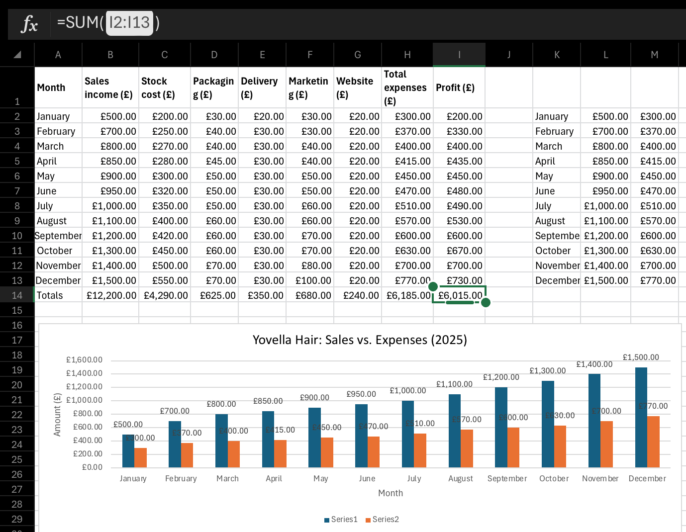
Financial Planning
Start-up cost: £1,450
Running cost: £300 per month
Personal savings + potential Prince’s Trust funding
Cash flow forecast created in Excel

Slide 10

SWOT Analysis
Strengths: Fast delivery, affordable prices
Weaknesses: New brand, small budget
Opportunities: Local partnerships, social media growth
Threats: Bigger online competitors, delivery challenges

Slide 11

Reflection and Conclusion
Improved digital, research, and planning skills
Learned how to manage challenges
Confident in launching Yovella Hair

Slide 12
References
Blythe, J. (2013). Consumer Behaviour. London: SAGE.
Burns, P. (2016). Entrepreneurship and Small Business. 4th edn. London: Palgrave Macmillan.
Burdett, A. (2020). Digital Business Tools for Beginners. London: Skillset Books.
Burgess, J., Marwick, A. and Poell, T. (2018). The SAGE Handbook of Social Media. London: SAGE Publications Ltd.
Prince’s Trust (2024). Start Something: Funding and Support for Young Entrepreneurs. Available at: https://www.princes-trust.org.uk (Accessed: 15 June 2025).
Solomon, M. R., Russell-Bennett, R. and Previte, J. (2021). Consumer Behaviour: Buying, Having, and Being. 5th edn. Harlow: Pearson Education.
Statista (2023). Haircare Market in the UK. Available at: https://www.statista.com/statistics/1221331/haircare-market-value-uk/ (Accessed: 10 June 2025).
Statista (2024). Beauty and Personal Care Market UK. Available at: https://www.statista.com/outlook/cmo/beauty-personal-care/united-kingdom (Accessed: 10 June 2025).

