Slide 1
Barry Island
Assessment Research

Slide 2
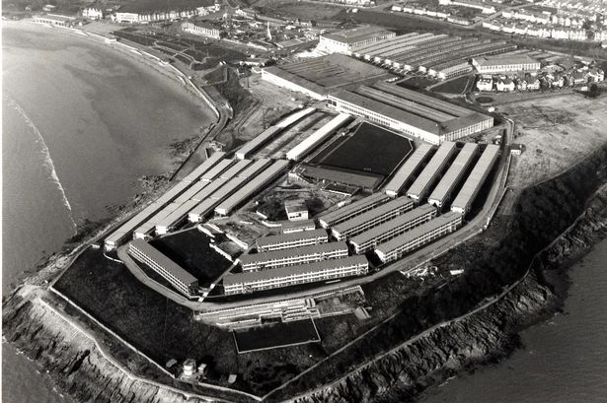
Barry Butlin’s

Slide 3
Site
Prominent headland
Site for potential Leisure and Tourism Attraction
10-acre vacant site for development
Grade II-listed former toilet block on an adjacent 0.4 acre site.
Butlins closed 1997
Recent use – over flow car park for Eastern Promenade
Temporary Events Site

Slide 4
Barry
£3.3 million regeneration project for Barry
The Welsh government has funded £692,000 to start the regeneration of Barry Island
Major regeneration plans for Eastern Prom
“The council has recently submitted planning and listed building applications for the much-awaited regeneration of the Eastern Promenade at Barry Island.” Vale of Glam C

Slide 5
Barry Riviera
Barrybados
Breathe new life into Seas front
Regenerate landmark grade II listed Eastern Shelter and eastern promenade which has been negelected.
West side was central to Gavin and Stacey
Beach Huts, walkways, water feature in the shape of fossil
Studt’s take over Barry Island Pleasure Park

Slide 6
Barry Council
“We believe this is the beginning of a great future for Barry Island and we are looking forward to seeing the work start.
“We are committed to improving the visitor experience at the Island and the work on the eastern promenade is an example of how we’re improving the resort for the benefit of the town and the Vale as a whole.
“We hope that when the works are completed, around next March, they will provide a boost to investment on the Island.

Slide 7
Vale
“Barry Island exhibits significant landscape and townscape features that give it a distinctive sense of place and contribute materially to the broader character and identity of the town.
“This legacy deserves to be preserved and enhanced through conservation and adaptation of period buildings, and improvements to public spaces.”

Slide 8
Nell’s Point
“This is therefore the perfect time to bring forward the development of the Nell’s Point site to create an exciting tourism destination for everyone who visits Barry Island. Attracting private investment in the site is the key to achieving this goal.”

Slide 9
For Sale!
“In marketing this landmark site we are seeking development proposals that are sustainable and in line with its prominent nature, while being commercially viable and, most importantly, realistic and deliverable.”
Knight Frank Sales 2013

Slide 10
Site
Partial housing developed in 1995
Rest of site cleared in 2002
Planning consent for Leisure
Council supportive of development that can positively contribute to local tourism
Used for filming of Dr Who

Slide 11
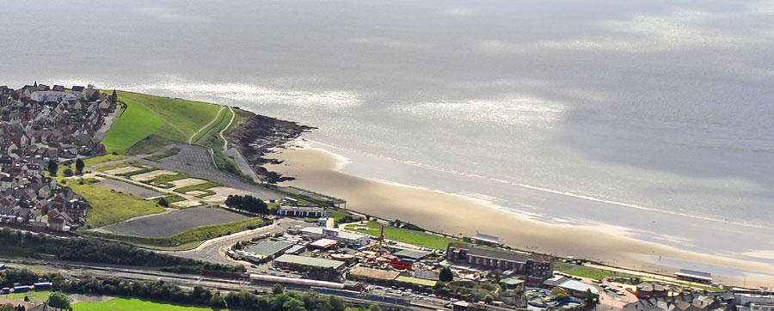
Future

