Slide 1

SPORTS INDUSTRY RESEARCH PROJECT
Jack Rees

Slide 2
TITLE
Golf sponsorship in South East Wales golf clubs

Slide 3
RATIONALE
Played golf for over 10 years (represented county and played in British amateur events all over the country)
Worked in industry for 6 years
Seen first hand the decline in participation in recent years (especially junior golf)
Sponsorship is used worldwide on a professional level in golf, but do not see it as much in local golf clubs.
Extremely interested to see if sponsorship effects participation and revenue
With my research, hopefully aid golf clubs utilise sponsors in order to increase participation and revenue

Slide 4
AIM
Evaluate how effectively South East Wales Golf Clubs attract and use sponsorship in order to increase participation and revenue.

Slide 5
OBJECTIVES
Analyse data from interviewees and questionnaires regarding sponsorship within their respective golf clubs
Evaluate the effectiveness of sponsorship within South East Wales Golf Clubs and if there is a direct link to participation and revenue
Evaluate the effectiveness of sponsorship in sport and recommend how South East Wales golf clubs can capitalise on this in order to increase participation, and as a result – revenue.

Slide 6

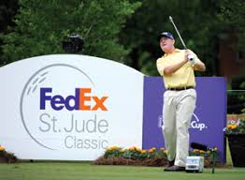
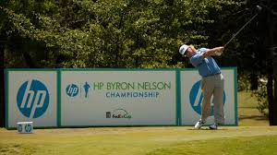
BACKGROUND
In 2002, the global sponsorship market was worth approximately $30 billion (Beech & Chadwick, 2007).
By the end of 2017, the global sponsorship spending is predicted to amount to 62.8 BILLION dollars!! (statista.com, 2017).
That’s a rise of over 50% in the last 15 years!
Golf sponsorship equates to 1.82 billion dollars of those spending's, in comparison Tennis spends 801 million dollars (statista.com, 2017).
However, the research I have found is specifically linked to international, global professional events. There is little research directly linked to local golf clubs and their use of sponsorship.
Resulting in my interest on whether or not LOCAL golf clubs attract and use sponsors in order to increase participation and revenue.

Slide 7
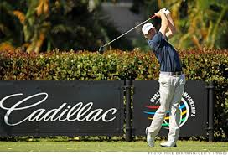
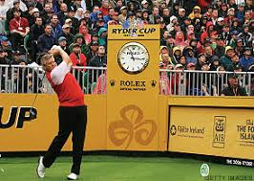
LITERATURE REVIEW
Howard & Crompton (1995) cited in Beech & Chadwick (2007) define sponsorship as ‘a business relationship between a provider of funds, resources or services and a sports event or organisation which offers in return some rights and association that may be used for commercial advantage’.
Sporting Sponsorship is ‘investing in a sports entity (athlete, league, team, or event) to support overall organisational objectives, marketing goals, and promotional strategies’ (Shank, 2009 pg 324).
Conversely, Chadwick (2016) cited by Walker (2016) argued because of the amount of money sponsors spend on sport teams, events, players they are expecting a “tangible return” and are constantly being asked to show numbers that prove the investments sponsors made are giving a good return.
However, recent research (into sponsorship effects on firms) proved sponsorship deals of smaller firms, deals on brand level, and national deals were found to have significantly higher abnormal returns (Reiser, Breuer and Wicker, 2012).

Slide 8

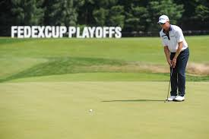
LITERATURE REVIEW
However, the four majors in the golf calendar are rare examples of international major events that do not have a title sponsor.
Golf events can include corporate outings, celebrity and pro-am tournaments, fund raising tournaments and professional tournaments. The corporate golf day is the most popular (in relation to local golf clubs) and can range from a small group of corporate executives getting together on a specific day to play golf, to a major cooperate event which would involve suppliers, clients and corporate executives (Graham, Neirotti & Goldblatt, 2001).
What’s attractive to sponsors about golf is the difference in the level of participation, because of the handicap system you can give sponsors the chance to play against the highest level of competition i.e professional golfer (Cave, 2006).
Research specifically to international, global professional events
Further research is needed specifically to local golf clubs and sponsorship
However, my original research has found a ‘tiered structure’ (Masterman, 2014) approach to sponsorship in golf clubs where each status has more status than the one below e.g gold, silver and bronze packages

Slide 9
ACCESS TO RESOURCES
Personal contacts in Golf Clubs
  John Peters (Southerndown Golf Club, Director of Golf)
  Mike Thomas (Grove Golf Club, Chief Executive)
  Mike Perry (Whitchurch Golf Club, Chief Executive)
Furthermore, through those contacts above, they have referred myself to other Director of Golf/ Chief Executives in order to carry out my research
Secondary Research
  Journals, Textbooks, Online Articles, Newspapers

Slide 10
METHODOLOGY
‘Research is essentially about the production of new knowledge’ (O’Gorman & Macintosh, 2015).
Interviews
  5 or 6 Director of Golf/ Chief Executive
  Sponsorship Manager of Velindre Fundraising
  Interviews are seen by many as straightforward and an effective method of gaining insight into real life situations
  Best suited to studies where opinions, emotions and experiences are relevant (Pasian, 2015)
  However, results may not be repeatable as they reflect reality of the time of the interview and could change in time (Smith et al,. 2012 cited in Pasian, 2015)

Slide 11
METHODOLOGY
Questionnaires
  20 to 25 questionnaires
  Questions focusing on business owners and golf club members
  Closed questions which are ‘easy to code, record and analyse results’ (Gorgens and Kusek, 2009:300)
  Results can be quickly and easily quantified and cost effective
  However, if the questionnaire is long it may provide artificial answers and as a result, question the integrity of questionnaire
Desk Research
  Textbooks
  Journals
  Articles
  Previous studies

Slide 12
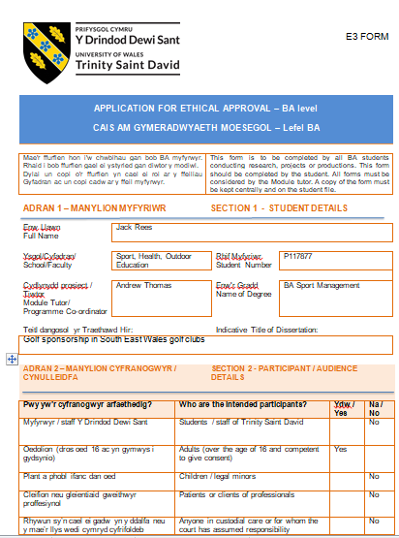
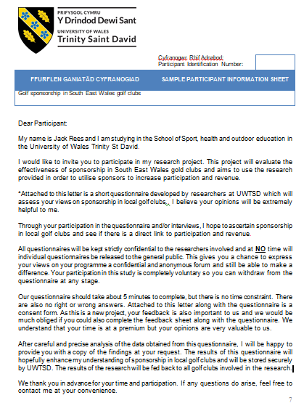
ETHICS FORM

Slide 13
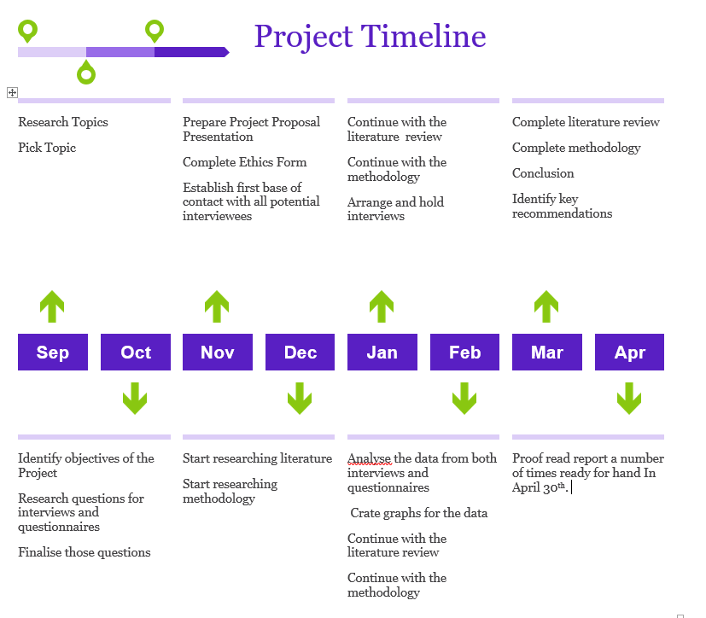
TIMELINE

Slide 14
TIMELINE
Task | Start Date | End Date | Days
Research Topic | 29/09/17 | 05/10/17 | 6
Pick Topic | 05/10/17 | 12/10/17 | 7
Identify objectives of project | 12/10/17 | 19/10/17 | 7
Research questions | 19/10/17 | 26/10/16 | 7
Finalise questions | 26/10/17 | 30/10/17 | 4
Preparation of presentation | 26/10/16 | 09/11/17 | 14
Complete initial ethics form required | 06/11/17 | 09/11/17 | 3
Establish contact with interviewees | 10/11/17 | 24/11/17 | 14
Research literature | 24/11/17 | 28/02/18 | 96
Research methodology | 12/12/17 | 28/02/18 | 78
Arrange and hold interviews | 15/01/18 | 12/02/18 | 28
Complete ethics form | 15/01/18 | 12/02/18 | 28
Analysis of primary data and hand in of primary data | 12/02/18 | 28/02/18 | 16
Create graphs | 28/02/18 | 07/03/18 | 7
Conclusion and key recommendations | 07/03/18 | 31/03/18 | 24
Proof read ready for hand in | 01/04/18 | 30/04/18 | 29

Slide 15
REFERENCES
Beech J and Chadwick S. 2007. The Marketing of Sport. Harlow. Pearson Education Limited.
Cave, A 2006, 'The Daily Telegraph: THE BEST SPORT TO SPONSOR A TOUGH YEAR FOR CLUBS AND SALES The chance of taking to the fairway with a top golfer, or spending a day in the hospitality tent make golf a good bet for businesses to raise their profile.', Daily Telegraph, The (London, England), 6 Nov, p. 003, (online NewsBank).
Görgens, M. and Kusek, J. (2009) Making monitoring and evaluation systems work. 1st ed. Washington, DC: World Bank, p.300.
Masterman, G. (2014). Strategic Sports Event Management, Third Edition.
O’Gorman K & MacIntosh R (2015) Research Methods for Business and Management, 2nd edition. Goodfellow Publishers.
Pasian, B. (2015). Designs, methods and practices for research of project management. Farnham: Gower Applied Research.
Reiser, M, Breuer, C, & Wicker, P 2012, 'The Sponsorship Effect: Do Sport Sponsorship Announcements Impact the Firm Value of Sponsoring Firms?', International Journal Of Sport Finance, 7, 3, pp. 232-248, SPORTDiscus with Full Text, EBSCOhost, viewed 9 November 2017.
Shank, M. 2012. Sports Marketing: A Strategic Perspective. 4th edition. London. Pearson International edition.
Statista. (2017). Golf sponsorship spending worldwide 2010-2016 | Statistic. [online] Available at: https://www.statista.com/statistics/380418/golf-sponsorship-spending-worldwide/ [Accessed 1 Nov. 2017].
Statista. (2017). Tennis sponsorship spending worldwide 2010-2-16 Statistic. [online] Available at: https://www.statista.com/statistics/380296/tennis-sponsorship-spending-worldwide/ [Accessed 1 Nov. 2017].
Walker, T., 2016. The power of brands. Are sponsors who plough huge sums of money into sport becoming too powerful as they seek a return on their investment?, 20 (3/115), pp 40-42.

