Slide 1
“Community Care and Management of Chronic Kidney Disease: for Primary Care Professionals (General practitioners, practice nurses)”
Name: Bilkis begum
ID: 2432744
Lecturer: Dr Brian Mashumba
Module code -LCHS7003
Module name - Community Care and Management of Longer-term Conditions

Slide 2
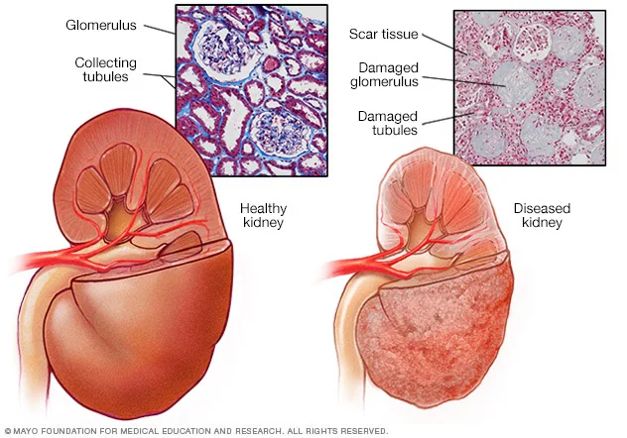
Overview of Chronic Kidney Disease: Definition, Symptoms and Aetiology
Definition: Chronic kidney disease (CKD) is defined as sustained abnormalities of kidney function and/or structure present for at least three months (Addo and Senoo-Dogbey, 2025). Unlike acute kidney injury, which develops rapidly, CKD represents a gradual, long-term decline.
Symptom: As kidney dysfunction progresses, patients may experience characteristic symptoms are leg swelling, fatigue, vomiting, loss of appetite, confusion, nausea, weakness, sleep problems (Mayo Clinic, 2023).
Source: (Mayo Clinic, 2023)

Slide 3
Overview of Chronic Kidney Disease: Definition, Symptoms and Aetiology
Aetiology: Diseases and conditions that cause chronic kidney disease include:
  Type 1 or type 2 diabetes
  High blood pressure
  Glomerulonephritis (gloe-mer-u-low-nuh-FRY-tis), an inflammation of the kidney's filtering units (glomeruli) (Agathangelou et al., 2025).
  Interstitial nephritis (in-tur-STISH-ul nuh-FRY-tis), an inflammation of the kidney's tubules and surrounding structures (Alani, 2014).
  Polycystic kidney disease or other inherited kidney diseases

Slide 4
Prevalence of Chronic Kidney Disease in the UK and Worldwide
Approximately 15% of adults aged 35 years and over in England have CKD, with this prevalence increasing significantly with age (Bhachu et al., 2021).
More specifically, 7.2 million adults in the UK have chronic kidney disease across all stages, representing more than 10% of the entire population (Davison et al., 2024).
Globally, the World Health Organization (WHO) estimates that over 850 million people are affected by various forms of kidney disease (Forbes et al., 2024). CKD is the 11th leading cause of death worldwide.

Slide 5
Economic and Social Burden of CKD
Economic:
CKD care costs the NHS £1.5 billion per year, excluding dialysis and transplantation (NHS England, 2023).
Dialysis for end-stage kidney disease (ESKD) is one of the most expensive long-term treatments, costing £35,000–£45,000 per patient per year (Hawthorne et al., 2023).
Social:
Individuals with CKD often experience reduced quality of life, fatigue, employment difficulties, and complex medication routines (Donald et al., 2021).
Psychological impacts include depression, anxiety, and fear of disease progression.

Slide 6
Diagnosis and Initial Assessment of Chronic Kidney Disease
The clinician asks about past diagnoses such as hypertension, use of medications that may affect renal function (Hirst et al., 2020).
Blood tests measure waste products such as creatinine and urea to evaluate kidney filtration (Kosmala-Anderson, Wallace and Turner, 2010).
Urine tests help detect abnormalities that indicate chronic kidney damage and may suggest underlying causes (Martinez et al., 2021).
Imaging, most commonly an ultrasound scan, is used to assess kidney size, shape, and structural changes (Lightfoot et al., 2025).

Slide 7
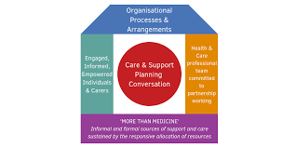
Management of CKD in the UK (Using a Specific Model)
  The House of Care Model for CKD Management: The House of Care model represents an evidence-based framework particularly suited to CKD management in primary care (Mc Laughlin et al., 2021).
    Engaged and informed individuals
    Healthcare professionals committed to partnership working
    Organisational systems supporting coordinated care
    Supportive commissioning of integrated community services (Roberts et al., 2019)
  Applying this model to CKD ensures that patients are involved in care planning, receive personalised education.
Source: (NHS England, 2023)

Slide 8
Management of CKD in the UK (Using a Specific Model)
  As first-line blood pressure-lowering agents, renin-angiotensin system (RAS) blockers like ACE inhibitors or ARBs are essential to modern CKD management (Lightfoot et al., 2022).
  CKD care requires blood pressure management, which varies by disease stage and proteinuria.
  Patients with CKD stages G4 and G5 and ACR ≤3 mg/mmol should start antihypertensive agents when blood pressure exceeds 140/90 mm Hg, aiming for <140/90 (Martinez et al., 2021).

Slide 9
Treatment Options for CKD in the UK
Lifestyle Changes:
  These include stopping smoking, following a balanced diet, limiting salt intake to less than 6g per day, engaging in regular physical activity (at least 150 minutes weekly) (NHS, 2019).
Pharmacological Treatment
  According to NICE (2019) NG203:
  ACE inhibitors or ARBs for hypertension and albuminuria
  SGLT2 inhibitors (e.g., dapagliflozin) recommended for diabetic and non-diabetic CKD to slow progression (NHS, 2019).
  Statins for cardiovascular risk reduction

Slide 10
Treatment Options for CKD in the UK
Dialysis
  Dialysis becomes an option at this stage, removing waste products and excess fluid from the blood (National Health Service, 2019).
Kidney Transplant
  A kidney transplant is an alternative to long-term dialysis for those with advanced kidney failure (NHS Choices, 2020).
  It is often the most effective treatment but requires major surgery and lifelong immunosuppressant therapy to protect the donor kidney (nihr.ac.uk, 2024).

Slide 11
Comorbidities Associated with CKD
Cardiovascular Disease: Cardiovascular disease is the most critical comorbidity in CKD (nihr.ac.uk, 2024).
Anaemia: Anaemia develops early in CKD and worsens as kidney function declines.
Mineral and Bone Disorders: Disturbances in calcium, phosphate and PTH regulation begin early in CKD (Rcp.ac.uk, 2025).
Hypertension: Hypertension is common in CKD and typically worsens as function declines (Roddick et al., 2023).

Slide 12
Prevention of Chronic Kidney Disease
Controlling blood pressure is central to CKD prevention.
As diabetes is a major cause of kidney failure, maintaining good glycaemic control through medication (Roddick et al., 2023).
A balanced diet supports kidney health by helping control blood pressure and cholesterol (Stewart et al., 2024).
Regular exercise lowers blood pressure and reduces CKD risk.
Patients should be warned about medicines that may harm the kidneys, especially NSAIDs (Mayo Clinic, 2023).

Slide 13
Critical Evaluation of Skills, Values and Behaviours Required for Co-productive Care
Essential Skills:
  Professionals managing CKD require strong assessment skills, including the ability to gather detailed health histories, conduct focused physical examinations (Coulter et al., 2016).
  Clear communication is essential, enabling clinicians to explain CKD diagnoses in accessible language (Sullivan et al., 2021).
  Education skills support patients to understand their condition, recognise red-flag symptoms, and adopt effective self-management practices (Coulter et al., 2016).

Slide 14
Critical Evaluation of Skills, Values and Behaviours Required for Co-productive Care
Core Values:
  CKD care must be grounded in patient-centredness, recognising individuals as partners in their care and valuing personal goals as much as clinical measures (Tang et al., 2025).
  Respect and dignity require clinicians to respect patient autonomy, confidentiality, and care choices that differ from professional preference (Tang et al., 2025).
Essential Behaviours:
  Clinicians must communicate clearly and collaborate with patients to create shared care plans to encourage shared decision-making (Walker et al., 2025).
  Cultural responsiveness helps clinicians respect diverse illness beliefs and adapt care.

Slide 15
Comprehensive Model of Personalised Care for CKD Management
Shared Decision-Making: Help patients understand treatment options (e.g., SGLT2 inhibitors, ACE inhibitors, dialysis) and participate in care planning (UK Kidney Association, 2021).
Individualised Care and Support Planning: Structured consultations should address patient goals, symptoms, social circumstances, and future planning using the House of Care model (Walker et al., 2025).
Supported Self-Management: Provide tailored education on diet, fluid balance, monitoring blood pressure, and recognising symptom changes (Addo and Senoo-Dogbey, 2025).

Slide 16
Comprehensive Model of Personalised Care for CKD Management
Social Prescribing and Community-Based Support: Connect CKD and dialysis patients to activity, weight management, mental health, and peer support groups (Davison et al., 2024).
Personal Health Budgets: PHBs can assist complex patients like home dialysis patients with home adaptations, equipment, and care (Donald et al., 2021).
Enabling Choice: Offer clear information about care pathways, such as home vs. in-centre dialysis, conservative management options.

Slide 17
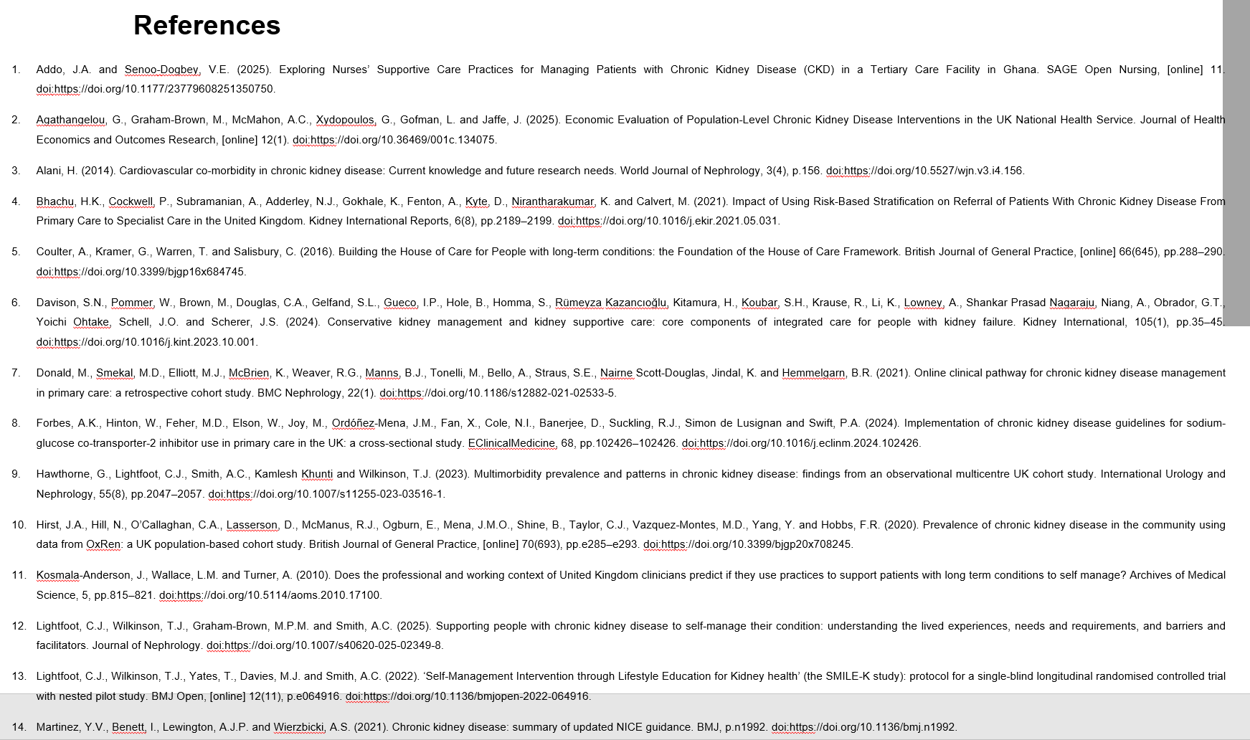

Slide 18
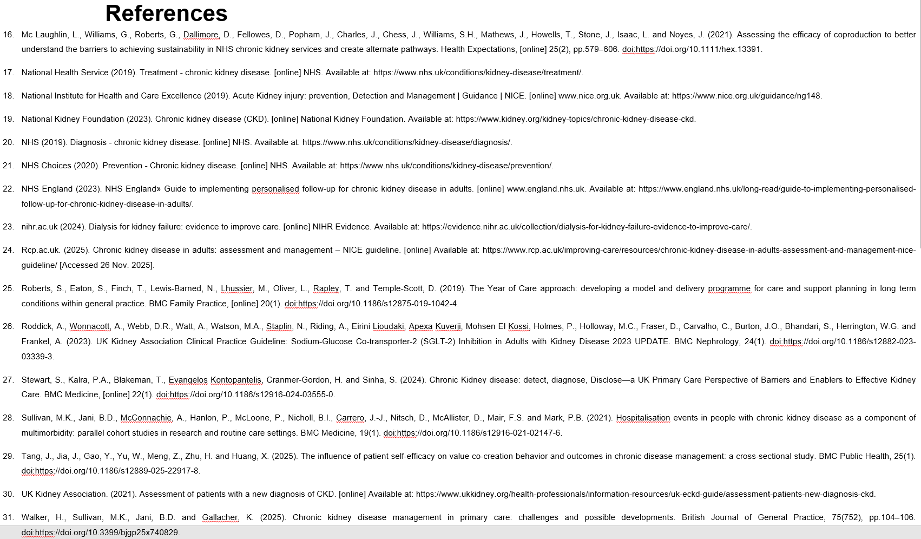

Slide 19


