Slide 1


Program: MSc Public Health and Social Care in Practice
Module: Quality Assurance and Service Improvements
Module code: LCHS7006
Case Study: Shrewsbury and Telford Hospital NHS Trust (UK) — Maternity Scandal
Student ID: 2526924
Student Name: Ami patel

Slide 2

Problem Outline
Telford Hospital and shrewsbury NHS Trust exhibited major failings relating to the management of mothers between the 1970s and 2019 (BBC News, 2022).
The deaths of the mothers and fetuses, including deaths of neonates, and birth injuries would have been avoided because of the poor clinical practice.
Families' worries and safety alerts were not taken into due consideration and actioned upon.
According to the Ockenden review, during a period of time, problems in terms of governance, leadership and patient safety culture resulted in harm and a need for improvement was highlighted (OCKENDEN REPORT, 2026).
Notes:
The Shrewsbury and Telford Hospital NHS Trust Maternity Scandal is one of the largest patient safety scandals in the history of the NHS. Mothers and babies lost their lives, died in infancy, had stillbirths, or were born with brain injury and disability as a consequence of substandard maternity care over the years (BBC News, 2022). Much could have been done at a clinical level at the right time and in line with the national maternity guidelines. Families' complaints were often overlooked, and lessons learned from past experiences were not taken into consideration. The case clearly illustrates the ineffectiveness of governance, as well as the absence of quality assurance procedures and systems to manage unsafe practices and their impact on patient safety and the quality of maternity care (OCKENDEN REPORT, 2026).

Slide 3
Root Causes of the Problem
There was no effective leadership and clinical governance, so that safe maternity services could not be ensured (BBC, 2025).
Non-compliance with evidence-based guidelines for maternity care caused higher levels of clinically avoidable risks.
Defensive organisational culture impeded the learning of incidents and family complaints (The Guardian, 2026).
Poor workforce management, training and multidisciplinary communication led to poor quality of care.
Notes:
The problems faced in relation to maternity services stemmed from several organisational weaknesses, not just from individual mistakes by healthcare providers. There was no effective leadership that would establish good governance mechanisms, which would identify repetitive safety risks and take responsibility (BBC, 2025). Often, staff members violated national guidelines for fetal monitoring, escalation and early delivery procedures, causing unnecessary risk to mothers and their children. Defensive organisational culture impeded the learning process and prevented people from learning lessons from previous incidents or being open towards complaints from families. Poorly trained physician-staffed midwife and neonatal teams had problems communicating with each other, further complicating the clinical decision-making process (The Guardian, 2026). At the same time, there was a lack of external monitoring, which could have helped identify ongoing safety risks even though there were repeated negative outcomes. All these factors led to poor quality assurance and slow organisational learning.

Slide 4
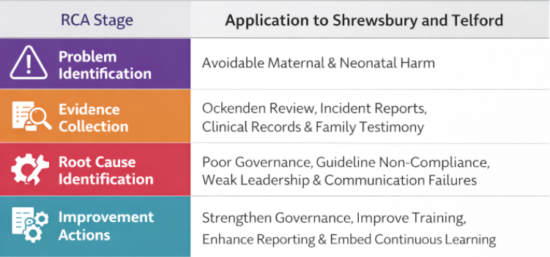
Elaboration of Theories and Models: Root Cause Analysis
Focuses on organisational systems rather than individuals.
Acknowledges common failures in various clinical scenarios (Chen et al. 2024).
Provides strategies for evidence-based improvements in service.
Promotes continuous assessment of patient safety (The Guardian, 2022).
Notes:
Root Cause Analysis (RCA) is a technique of systematic investigation that enables understanding of the root causes within the organisation for an undesirable healthcare event. RCA is employed in the analysis of the Shrewsbury and Telford maternity scandal case to reveal the harm done to patients due to interconnected failures in governance, leadership, communication, and compliance with clinical guidelines, rather than the failure of individual professionals (The Guardian, 2022). The systemic issues are revealed in the maternity services based on the information provided in the Ockenden Review, patients’ medical records, incident investigations and families' experiences. With the help of RCA, organisations can take a step beyond clinical error and identify the causes of recurring clinical errors (Chen et al. 2024). These findings help make practice improvements, including governance, multidisciplinary education, better incident reporting and adherence to the national guidelines in maternity. Nevertheless, ignoring the aspects of systems in combination with other cultural and/or policy influences may restrict the application of RCA to the situation at hand.

Slide 5
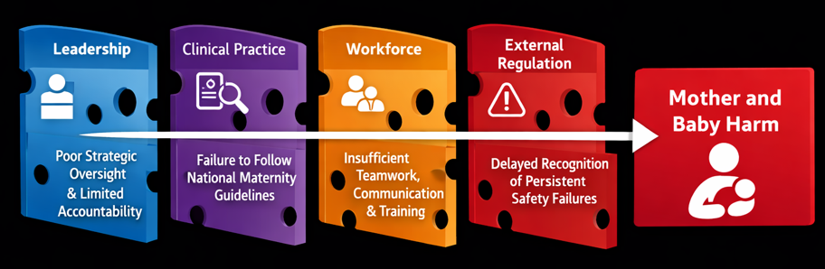
Elaboration of Theories and Models: Swiss Cheese model
Gives an account of the process of failure of multiple safety barriers.
References general deficiencies in the organisation, rather than inconsistency (Lewandowski et al. 2023).
Allows us to understand the significance of resilience in a defence system.
Encourages the adoption of proactive patient safety and risk management.
Notes:
The Swiss Cheese Model is a model that illustrates patient harm due to various deficiencies in the safety barriers of the organisation. All the defensive layers were lost simultaneously over several years in Shrewsbury and Telford maternity services. The monitoring of the performance of maternity services by the leadership of the organisation was insufficient, and governance procedures failed to reveal the recurring safety issues (Lewandowski et al. 2023). There was no fetal monitoring and emergency care in accordance with the national standards, which resulted in an increase in preventable events. Communication between midwives and obstetricians, along with other staff shortages, was one more issue that affected patient safety. Multiple adverse effects and warnings were not dealt with on time by external regulators (Lewandowski et al. 2023). These vulnerabilities occurred together, leading to unnecessary suffering of the mother and her baby. Thus, the Swiss Cheese Model proves that the only way to enhance patient safety is to strengthen all the layers of the defensive system.

Slide 6
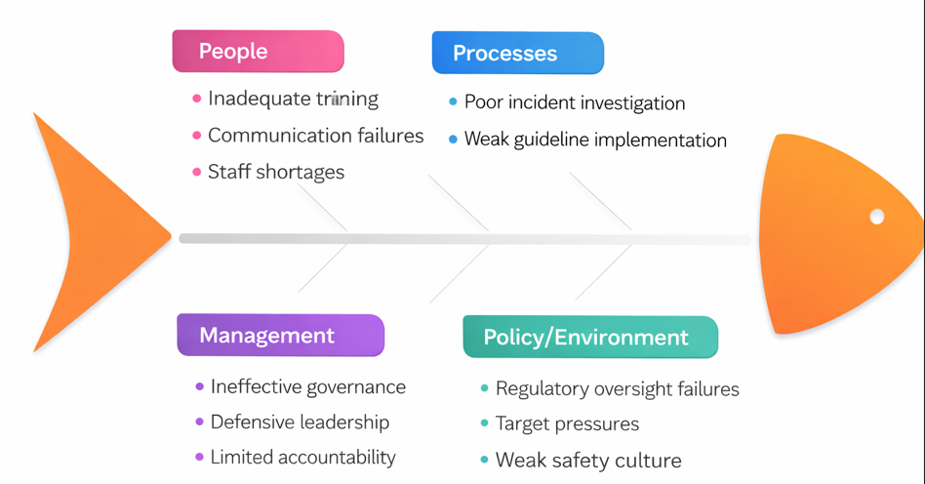
Elaboration of Theories and Models: Fishbone Diagram
Systematically identifies several factors contributing to problems.
Encourages multi-disciplinary analysis of complex problems in healthcare (Nadiyah and Dewi, 2022).
Identifies priorities for quality improvement within an organisation.
Helps develop targeted interventions aimed at improving patient safety.
Notes:
A fishbone diagram is a tool designed to analyse numerous organisational factors which may contribute to complex failures in health care. Using this tool in relation to the Shrewsbury and Telford maternity scandal, it becomes clear that adverse events happened due to the interaction of various issues in areas of people, process, management and environment. People-related factors include inconsistent training, staff pressure and poor communication among multidisciplinary team members (Nadiyah and Dewi, 2022). Process-related issues are related to ineffective investigation of incidents, organisational learning and implementation of the national guidance for maternity. Management issues consist of poor governance, accountability and ineffective decisions about prioritising patient safety. Environmental factors are considered to be ineffective in the regulation of the environment, and the organisational culture is not supportive of learning from mistakes. A fishbone diagram helps to visualise all these interconnected factors and perform Problem Analysis to identify appropriate improvement strategies based on facts for healthcare organisations (Nadiyah and Dewi, 2022). The best option would be to combine this tool with others, such as Root Cause Analysis (RCA).

Slide 7

Contribution of Policy Issues to the Root Causes and Their Impacts on Service Delivery
Lacklustre NHS maternity safety policies and governance implementation.
Poor compliance with NICE fetal monitoring and escalation guidance (The Guardian, 2024).
Failure of whistleblowing and reporting systems to facilitate organisational learning.
Delayed regulation contributed to the lack of accountability and improvements.
Notes:
Although there were policies in place for national maternity care, the Trust repeatedly failed to properly implement them. As per the Ockenden Report (2022), there were frequent breaches of NICE guidelines regarding fetal monitoring and risk/escalation management. As a result of poor clinical governance, the lessons arising from audit results, investigations into incidents and complaints from the families did not have any impact (OCKENDEN REPORT, 2026). Moreover, the failure of whistleblowing mechanisms further discouraged the staff from voicing their safety issues, thus creating a defensive organisation. External regulators also failed to intervene despite several warning signs. Policy failures further contributed to organisational weaknesses, thus reducing accountability and delays in rectifying the situation.

Slide 8
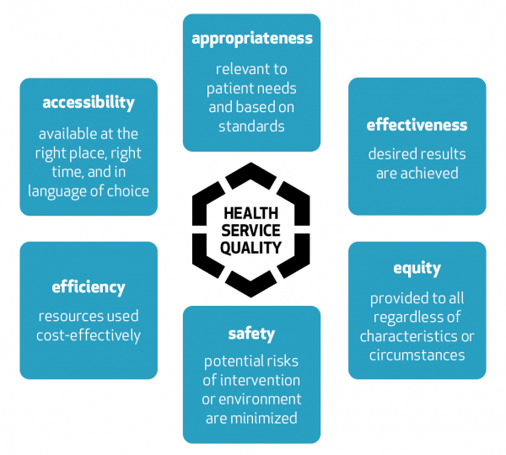
Influence on the effectiveness, equity, and quality of Health and Care Services
Quality suffered from preventable mistakes in the clinical field and harm to patients.
Efficiency suffered due to a failure, which made further investigation costly.
Equity was compromised as maternity care standards were inconsistent (Osborneslaw, 2026).
Public trust in NHS maternity services was greatly diminished.
Notes:
The maternity scandal impacted healthcare quality in that the standards of practice were not adhered to, and hence there were preventable deaths of mothers, still births and even injuries to neonates for life (OCKENDEN REPORT, 2026). Efficiency was also undermined as there were recurring cases requiring costly investigations, lawsuits and other interventions, which diverted attention from front-line services. Equity was undermined since women did not receive a uniform standard of maternity care despite the expectations of the NHS about their safety. When families raised issues of concern, they were met with poor communication and a lack of involvement in decisions.

Slide 9
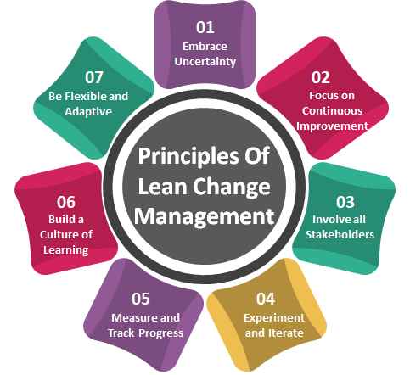
Application of Lean Framework for Change
Standardise maternity process pathways.
Eliminate delays in clinical escalation (Osborneslaw, 2026).
Enhance continuous quality monitoring.
Enhance multidisciplinary collaboration.
Notes:
Lean is a suitable model since it ensures efficiency by eliminating inefficient practices and adding value to patients (Chandraharan, 2023). Under the Trust, Lean will ensure that the maternity service has standardised pathways, eliminates delays in diagnosis and escalation and improves communication between midwifery, obstetrics, and neonatology teams. The continuous monitoring of performance indicators and the participation of staff will enhance clinical practice, patient safety, and quality improvement.

Slide 10
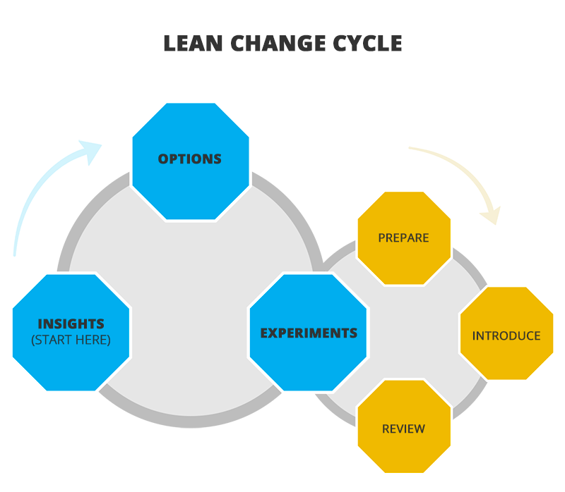
Explanation of the Application
Map maternity pathways for identifying delays and risks.
Standardise fetal monitoring and escalation protocols (Alsubaie et al., 2024).
Training of multidisciplinary teams on Lean methodology.
Audit of results and patient feedback.
Notes:
The Lean programme implementation will involve the mapping of the full maternity care pathway in order to identify any delays and risks. The standardised operations procedures will ensure that there is compliance with the NICE guidelines regarding fetal monitoring, documentation, and escalation of care (Alsubaie et al., 2024). Training will lead to better teamwork between the obstetricians, midwives, and neonatal specialists in addition to developing problem-solving skills. Audits, incident reports, and patient feedback will be used for measuring improvements and new risk identification. Monitoring of key performance indicators will be conducted by the senior management.

Slide 11
Recommendations
Strengthen governance and clinical leadership accountability.
Improve training and multidisciplinary communication among staff.
Enhance reporting and whistleblowing systems (Fukami and FUKAMI, 2024).
Undertake regular auditing against national standards.
Notes:
Governance must be strengthened within the trust through the assignment of responsibility for maternity safety and quality improvement. Compulsory education based on staff competency should enhance staff skills in terms of fetal monitoring, emergency obstetric care, and multidisciplinary communication (Khattak et al., 2023). Reporting of incidents should facilitate learning within an open and just culture where staff and family members are able to voice their concerns without fear of repercussions. Continuous auditing from both internal and external sources should assess the trust’s compliance with NICE guidelines, the Ockenden report, and CQC guidelines through measurable performance indicators.

Slide 12
Outline of the Report Structure
Analyse root cause using quality improvement models.
01
Examine policy issues impacting service delivery.
02
Implement Lean for sustainable service improvement.
03
Propose evidence-based recommendations.
04
Notes:
The report will critically analyse the Shrewsbury and Telford maternity scandal by analysing the root causes using Root Cause Analysis, the Swiss Cheese Model, and the Fishbone Diagram. The report will examine the policy issues impacting the quality of healthcare services before using the Lean approach to facilitate sustainable service improvement. Finally, the report will offer evidence-based recommendations.

Slide 13
References
Alsubaie, S.S., Bukhamseen, Z.F.A., Alyami, F.S.A., Alotaibi, M.F., Alkahtani, F.A., Alkhamsan, M.S., Alaseel, A.J., Albahri, M.A.S., Bahrani, J.I.A.A. and Khamees, Z.H.A., (2024). Multidisciplinary approaches in general medical practice: enhancing collaboration for better patient care. J Ecohumanism, 3(7), pp.2659-2669. https://pdfs.semanticscholar.org/3bd8/2c927dcacde489d119ec5d87377e44b06b4c.pdf
BBC News, (2022). Shrewsbury maternity scandal: Repeated failures led to deaths. Available at: https://www.bbc.com/news/uk-england-shropshire-60925959 [Accessed on 15.06.2026].
BBC, (2025). NHS maternity care: What are the problems at the heart of its failures? Available at: https://www.bbc.com/news/articles/clyn8n3nyrlo [Accessed on 15.06.2026].
Chandraharan, E., (2023). Updated NICE Cardiotocograph (CTG) guideline: Is it suspicious or pathological. J Clin Med Surgery, 3(2), p.1129. https://www.jclinmedsurgery.meddocsonline.org/articles/jcms-v3-1129.pdf
Chen, Y., Xie, H., Ma, M., Kang, Y., Gao, X., Shi, L., Cao, Y., Gao, X., Fan, H., Wen, M. and Zeng, J., (2024). Automatic root cause analysis via large language models for cloud incidents. In Proceedings of the Nineteenth European Conference on Computer Systems (pp. 674-688). ‌Available at: https://dl.acm.org/doi/pdf/10.1145/3627703.3629553
Fukami, T. and FUKAMI, T., (2024). Enhancing healthcare accountability for administrators: fostering transparency for patient safety and quality enhancement. Cureus, 16(8). https://www.cureus.com/articles/268126-enhancing-healthcare-accountability-for-administrators-fostering-transparency-for-patient-safety-and-quality-enhancement.pdf
Khattak, A.F., Rahman, A.U., Khattak, M., Qazi, M., Gilani, H., Khan, A. and Rahman, A., (2023). Toward sustainable healthcare systems: a low and middle-income Country’s case for investing in healthcare reforms. Cureus, 15(5). https://www.cureus.com/articles/155545-toward-sustainable-healthcare-systems-a-low-and-middle-income-countrys-case-for-investing-in-healthcare-reforms.pdf
Lewandowski, J., Ma, Y., Yang, J. and Zhang, C., (2023). Quantum oppenheimer-snyder and swiss cheese models. Physical Review Letters, 130(10), p.101501. Available at: https://arxiv.org/pdf/2210.02253
Nadiyah, K. and Dewi, G.S., (2022). Quality control analysis using flowchart, check sheet, p-chart, Pareto diagram and fishbone diagram. OPSI, 15(2), pp.183-188. Available at: https://www.researchgate.net/profile/Khairun-Nadiyah-2/publication/367438216_Quality_Control_Analysis_Using_Flowchart_Check_Sheet_P-Chart_Pareto_Diagram_and_Fishbone_Diagram/links/658ba57b6f6e450f19a61ebc/Quality-Control-Analysis-Using-Flowchart-Check-Sheet-P-Chart-Pareto-Diagram-and-Fishbone-Diagram.pdf
OCKENDEN REPORT, (2026). FINDINGS, CONCLUSIONS AND ESSENTIAL ACTIONS from the Independent Review of Maternity Services at Nottingham University Hospitals NHS Trust. Available at: https://www.ockendenmaternityreview.org.uk/wp-content/uploads/2026/06/ockenden-report-review-of-maternity-services-nottingham-university-hospitals-nhs-trust-web-accessible.pdf‌ [Accessed on 15.06.2026].
Osborneslaw, (2026). Maternity and Neonatal Scandals: Lessons Learned. Available at: https://osborneslaw.com/blog/maternity-neonatal-scandals/ [Accessed on 15.6.26]
The Guardian, (2022). Shropshire maternity scandal: 300 babies died or left brain-damaged, says report. Available at: https://www.theguardian.com/society/2022/mar/26/shropshire-maternity-scandal-300-babies-died-or-left-brain-damaged-says-report [Accessed on 15.06.2026].
The Guardian, (2024). Pregnant women suffer racist and discriminatory abuse at NHS trust, says inquiry head. Avaialble at :https://www.theguardian.com/society/article/2024/jul/24/pregnant-women-suffer-racist-and-discriminatory-abuse-at-nhs-trust-says-inquiry-head?utm_source [Accessed on 15.6.26]
The Guardian, (2026). Factors leading to failures in NHS maternity care. Available at: https://www.theguardian.com/society/2026/jun/07/factors-leading-to-failures-in-nhs-maternity-care [Accessed on 15.06.2026].

Slide 14


