Slide 1



Culture and Organisational Performance
10 October 2023

Slide 2
Learning Outcomes
Be able to define culture in the context of organisations
1
Understand the importance of culture on organisational performance
2
Identify the key factors that shape and influence culture
3

Slide 3


What do we mean by culture?
Pick a team you know well. It could be a football team, or a fictional team, maybe even AFC Richmond (Ted Lasso, anyone?). Perhaps it is a company you have worked for.
How would you describe the culture?
What informed your opinion?

Slide 4
Edgar Schein
Artefacts: things that can be seen, felt & unheard by observers such as décor, facilities, offices, dress, and how people speak to each other.
Espoused Values: the professed culture, as seen in company slogans, mission statements and websites
Basic underlying assumptions: unwritten rules "the ways things are done around here"
"a pattern of shared basic assumptions...taught to new members as the correct way to perceive, think and feel" (Shein, 1992)

Slide 5
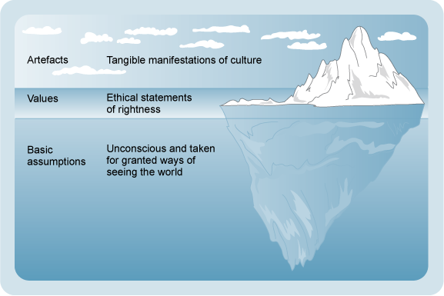
Schein's Iceberg

Slide 6

Geert Hofstede
Created an Organisational Culture Model, featuring 6 dimensions
"the programming of the human mind by which one group of people distinguishes itself from another"
Many layered...like an onion
One of THE most important factors determining business success

Slide 7

More Hofstede
Optimal Culture (the one we need for business success)
Actual Culture (the one we have)
Perceived Culture (what we think we have)
Ideal Work Environment (what we all want)

Slide 8
Even More Hofstede
Researched organisational culture
Also researched national culture
  Why might this be important?

Slide 9
Charles Handy
Bases organisational culture to organisational structure
Power Culture
Role Culture
Task Culture
Person Culture

Slide 10

Johnson & Scholes
1992 – developed The Cultural Web – 6 inter-related elements
Stories
Rituals & Routines
Symbols
Organisational structure
Control Systems
Power Structures

Slide 11
Why culture matters
Culture correlates with performance
Culture is difficult to copy
Healthy cultures allow organisations to adapt
Unhealthy cultures lead to underperformance

Slide 12
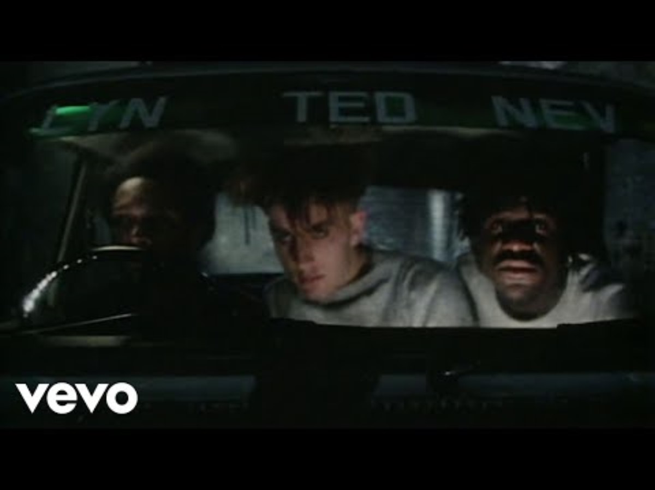
1980s music business school playlist #1
Bananarama and Fun Boy Three
It ain't what you do, it's the way that you do it
It ain't what you do, it's the way that you do it
It ain't what you do, it's the way that you do it
And that's what gets results
It ain't what you do, it's the time that you do it
It ain't what you do, it's the time that you do it
It ain't what you do, it's the time that you do it
And that's what gets results
You can try hard (aah-ahh-ah)
Don't mean a thing (aah-ahh-ah)
Take it easy (aah-ahh-ah)
Then your jive will swing (aah-ahh-ah)

Slide 13

Culture Definitions
What people do and how they do it
Why
Culture: a common set of behaviours and underlying mindsets that shape how people work and interact day to day
This separates the highest performing organisations from the rest

Slide 14

Assessing Culture
Think of a busy McDonalds, Five Guys, or Nandos (or anywhere really!)
You've been given the job of Area Manager – no one knows you yet so you can visit undercover before starting officially on Monday.
What observations could you make to help you assess the culture? Think about everything that you can see front of house.
What about after you start?
In your group – come up with list of observations and questions you might ask to assess the culture
AND – what are the things that have an impact on culture?

Slide 15
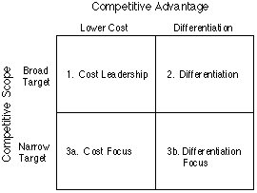
Porter's Competitive Advantage Theory

Slide 16

The correlation between culture and performance
Group task – present to the class AND upload your findings to Moodle. Don't forget references (what do I mean by that?)
What EVIDENCE can you find to support the link between culture and performance
  Case studies
  Statistical data
  Theorie

