Slide 1

Title Page:
Programme: BSc Health and Social Care
Module name: Introduction to Physiology
Student name: Kwabena Amponsah Mensah
Student ID no. 2027768
Assignment title: Individual Academic Poster Presentation
Module code: BMHP5003_BIRM
Lecturer's name: Gillian Weaver

Slide 2
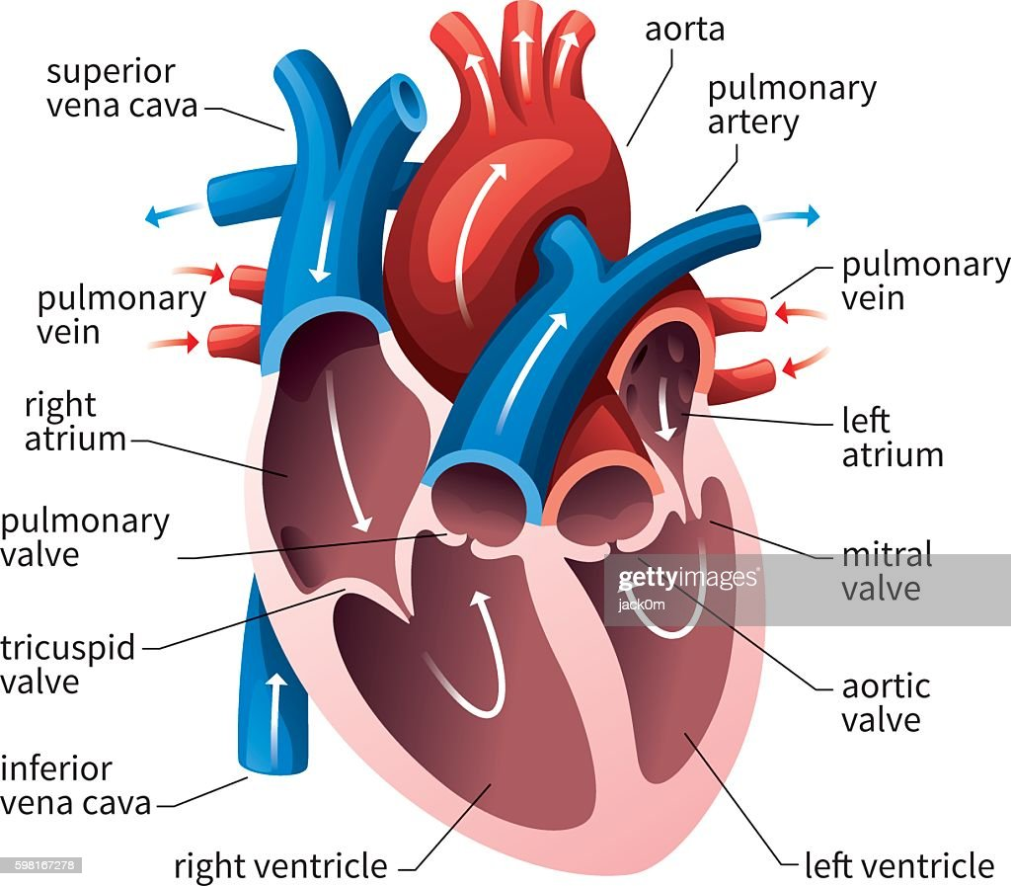
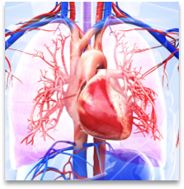
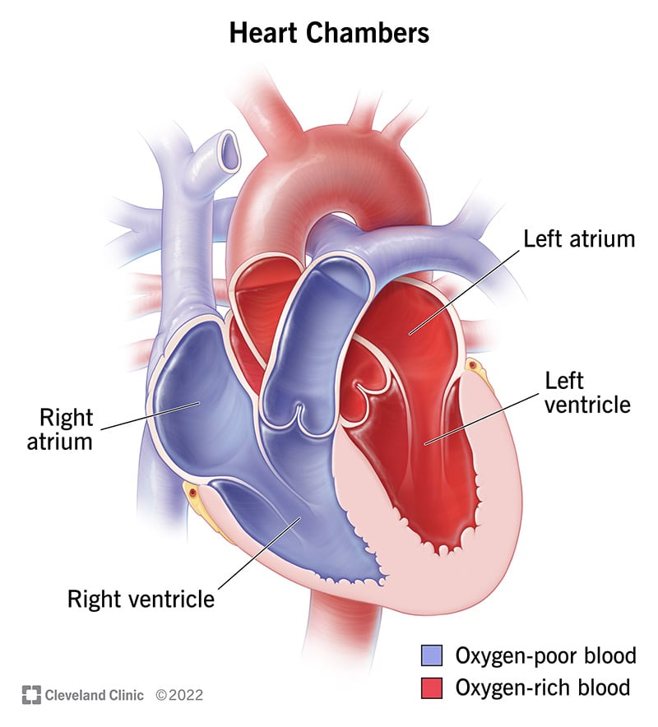
Kwabena Amponsah Mensah
Student ID: 2027768

Slide 3
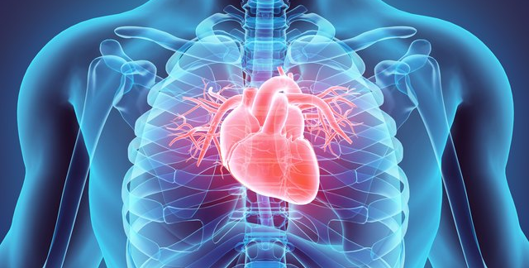

Citation
(Artaza, Mehrotra and Norris, 2009)
(Foster and Coetzee, 2016)
(Kang et al., 2012)
(Leinwand, 2003)
(MacLeod et al., 2000)
(Palmeiro et al., 2012)
(Peng et al., 2016)
(Romero, Minson and Halliwill, 2017)
(Santoro et at., 2009)
(Schiffrin, Lipman and Mann, 2007)

Slide 4
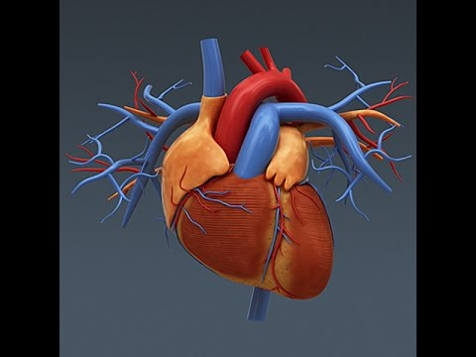
Reference list
Artaza, J.N., Mehrotra, R. and Norris, K.C., (2009). Vitamin D and the cardiovascular system. Clinical Journal of the American Society of Nephrology, 4(9), pp.1515-1522. Available at: https://journals.lww.com/cjasn/Fulltext/2009/09000/Vitamin_D_and_the_Cardiovascular_System.18.aspx. (Assessed: September 2009).
Foster, M.N. and Coetzee, W.A., (2016). KATP channels in the cardiovascular system. Physiological reviews, 96(1), pp.177-252. Available at: https://pubmed.ncbi.nlm.nih.gov/26660852/. (Assessed: January 2016).
Kang, D., Woo, J., Slomka, P.J., Dey, D., Germano, G. and Jay Kuo, C.C., (2012). Heart chambers and whole heart segmentation techniques. Journal of Electronic Imaging, 21(1), pp.010901-010901. (Assessed: January – March 2012).
Leinwand, L.A., (2003). Sex is a potent modifier of the cardiovascular system. The Journal of clinical investigation, 112(3), pp.302-307. Available at: https://www.ncbi.nlm.nih.gov/pmc/articles/PMC166308/.(Assessed:01 August 2003).
MacLeod, R.S., Ni, Q., Punske, B., Ershler, P.R., Yilmaz, B. and Taccardi, B., (2000). Effects of heart position on the body-surface electrocardiogram. Journal of Electrocardiology, 33, pp.229-237. Available at: https://pubmed.ncbi.nlm.nih.gov/11232624/. (Assessed:12 February 2001).

Slide 5

Reference list
Palmeiro, C.R., Anand, R., Dardi, I.K., Balasubramaniyam, N., Schwarcz, M.D. and Weiss, I.A., (2012). Growth hormone and the cardiovascular system. Cardiology in review, 20(4), pp.197-207. Available at: https://pubmed.ncbi.nlm.nih.gov/22314142/. (Assessed: July- August 2012).
Peng, P., Lekadir, K., Gooya, A., Shao, L., Petersen, S.E. and Frangi, A.F., (2016). A review of heart chamber segmentation for structural and functional analysis using cardiac magnetic resonance imaging. Magnetic Resonance Materials in Physics, Biology and Medicine, 29, pp.155-195. (Assessed: 25 January 2016.
Romero, S.A., Minson, C.T. and Halliwill, J.R., (2017). The cardiovascular system after exercise. Journal of Applied Physiology, 122(4), pp.925-932.Available at: https://pubmed.ncbi.nlm.nih.gov/28153943/. (Assessed:02 February 2017).
Santoro, G., Wood, M.D., Merlo, L., Anastasi, G.P., Tomasello, F. and Germanò, A., (2009). The anatomic location of the soul from the heart, through the brain, to the whole body, and beyond: a journey through Western history, science, and philosophy. Neurosurgery, 65(4), pp.633-643. Available at: https://www.researchgate.net/publication/38015619_The_Anatomic_Location_of_the_Soul_From_the_Heart_Through_the_Brain_To_the_Whole_Body_and_Beyond_A_Journey_Through_Western_History_Science_and_Philosophy. (Assessed: October 2009).
Schiffrin, E.L., Lipman, M.L. and Mann, J.F., (2007). Chronic kidney disease: effects on the cardiovascular system. Circulation, 116(1), pp.85-97. Available at: https://www.frontiersin.org/articles/10.3389/fcell.2020.00185/full. (Assessed: 20 March 2020).

