Slide 1

Health, Wellbeing & sustainable Development
Name: Naima Amin
Module Code: BMHP6030
Assignment Title: Presentation/HEALTH, WELL BEING & SUSTAINABLE DEVELOPMENT
Lecturer: Parease Ahmed

Slide 2
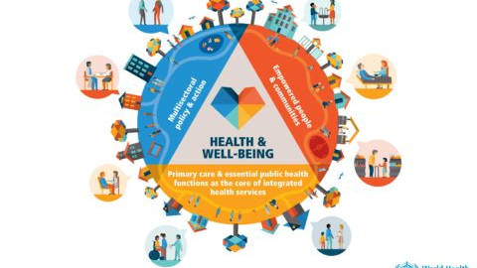
Introduction
Integrating health, well-being, and sustainable development (SD) in health and social care is vital for tackling health inequalities, environmental degradation, and social exclusion.
Health and well-being are central to human development, while sustainable development offers a balanced framework across social, economic, and environmental dimensions to improve quality of life.
Embedding SD principles ensures services are patient-centred, resource-efficient, socially inclusive, and resilient to challenges like climate change, ageing populations, and rising healthcare costs.
This integrated approach supports UN Sustainable Development Goal 3: Good Health & Well-being (United Nations, 2015).
It is reinforced by both UK and international strategies, including the NHS Long Term Plan and the UN SDGs, which emphasise equity of access, sustainability, and effective resource management.

Slide 3
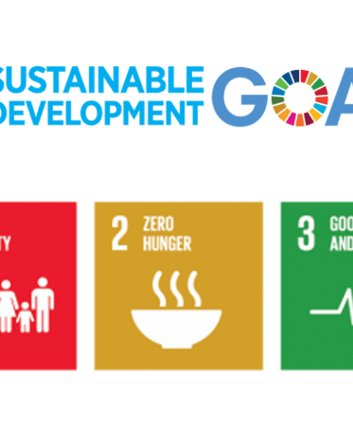
Definitions & Key Concepts
Health: According to the World Health Organization (1948), is not just the absence of illness but a state of complete physical, mental, and social well-being.
What is Well-being?
Well-being refers to the overall quality of a person’s life, including how they feel, function, and flourish. It goes beyond physical health to include mental, emotional, social, and economic aspects of life. It can be understood in two ways:
Subjective well-being : how people experience their lives (e.g. happiness, life satisfaction, sense of purpose).
Objective well-being: measurable conditions like income, housing, health status, education, and safety.
Because well-being is multi-dimensional, many organisations and researchers define it slightly differently.
Well-being is broadly understood as feeling good, functioning well, and living with purpose and security, alongside practical factors such as health, relationships, housing, and resilience. Across definitions from WHO to UK ONS, it is seen as both how people feel and how they live within society.

Slide 4
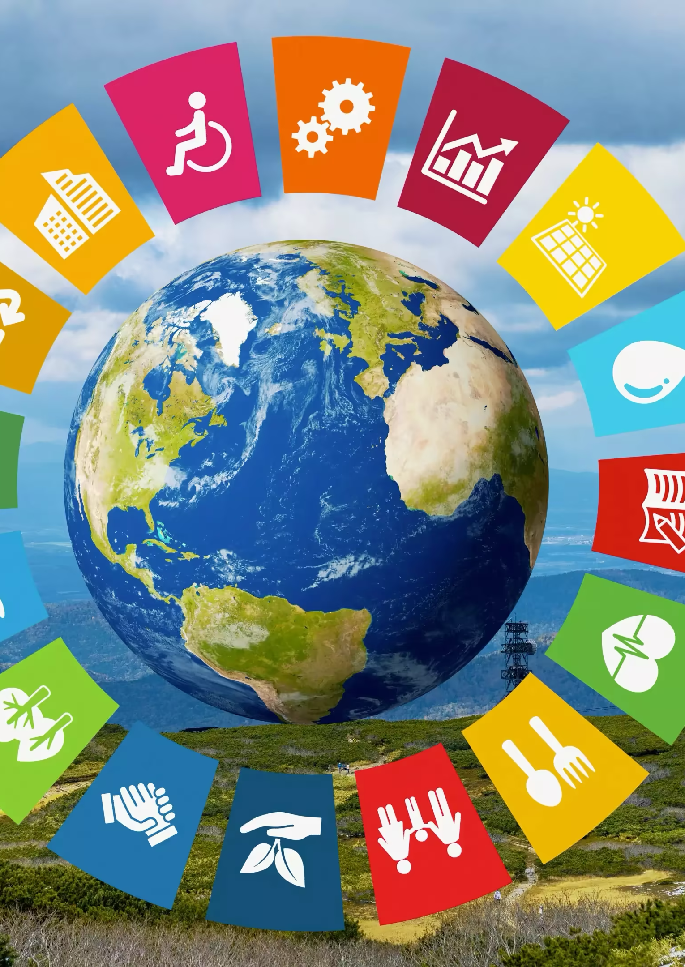
Sustainable Development
The UN Sustainable Development Goals (SDGs) are a global framework of 17 goals designed to tackle poverty, inequality, climate change, and promote peace and prosperity by 2030. They encourage countries to develop in ways that are socially fair, economically sustainable, and environmentally responsible.
Within this framework, SDG 3: Good Health and Well-being focuses specifically on ensuring healthy lives for all by reducing mortality, preventing disease, promoting mental health, and achieving universal health coverage (WHO, 1948, United Nations, 2015).

Slide 5
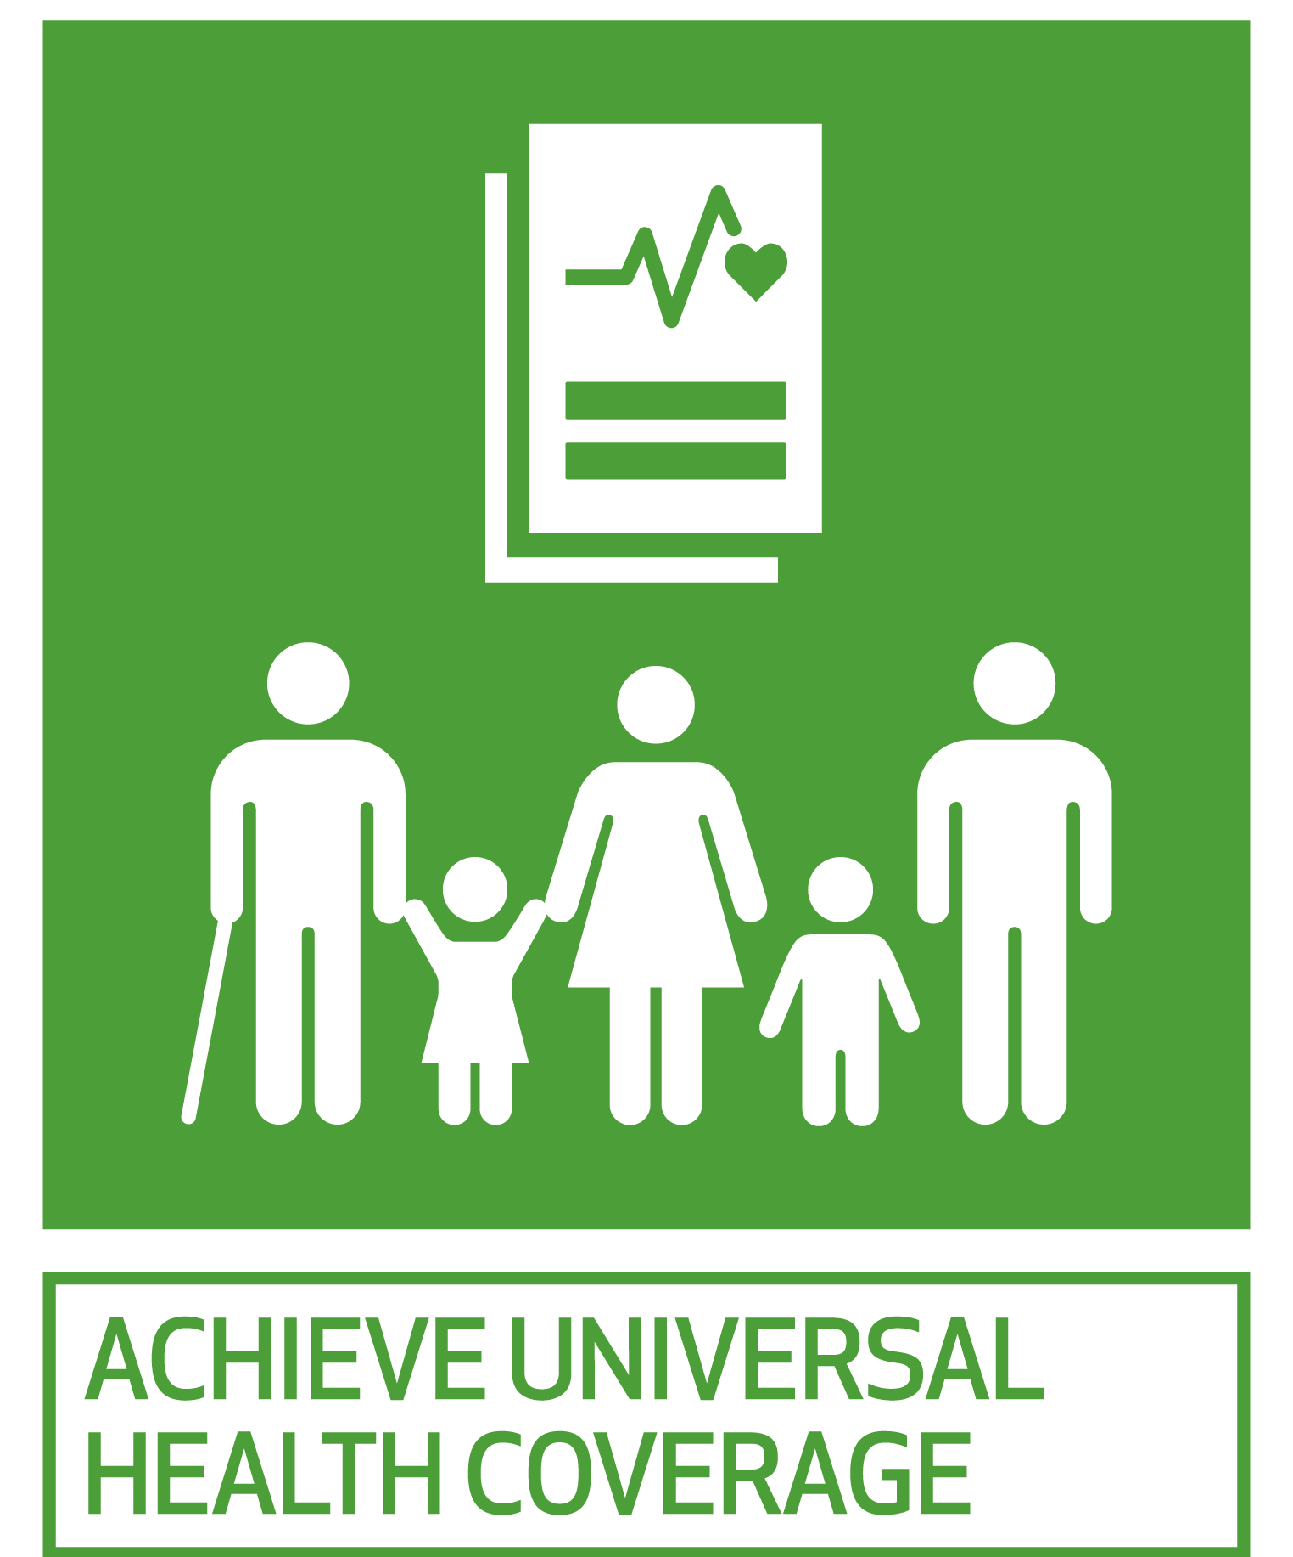
Intergration into Health & Social Care
International Frameworks:
The WHO’s Health in All Policies (HiAP) approach encourages governments to consider health impacts across areas like housing, transport, and education (WHO, 2014).
This framework guides UK public health strategy by promoting cross-sector collaboration.
Social Processes and Ideologies:
Neoliberalism influences UK services by emphasising personal responsibility and cost efficiency.
There is a growing shift towards holistic and biopsychosocial models, reflecting person-centred care and wellbeing.
Social justice awareness drives policies focused on reducing deprivation, improving access, and prioritising prevention and sustainability (Bambra, 2022)

Slide 6
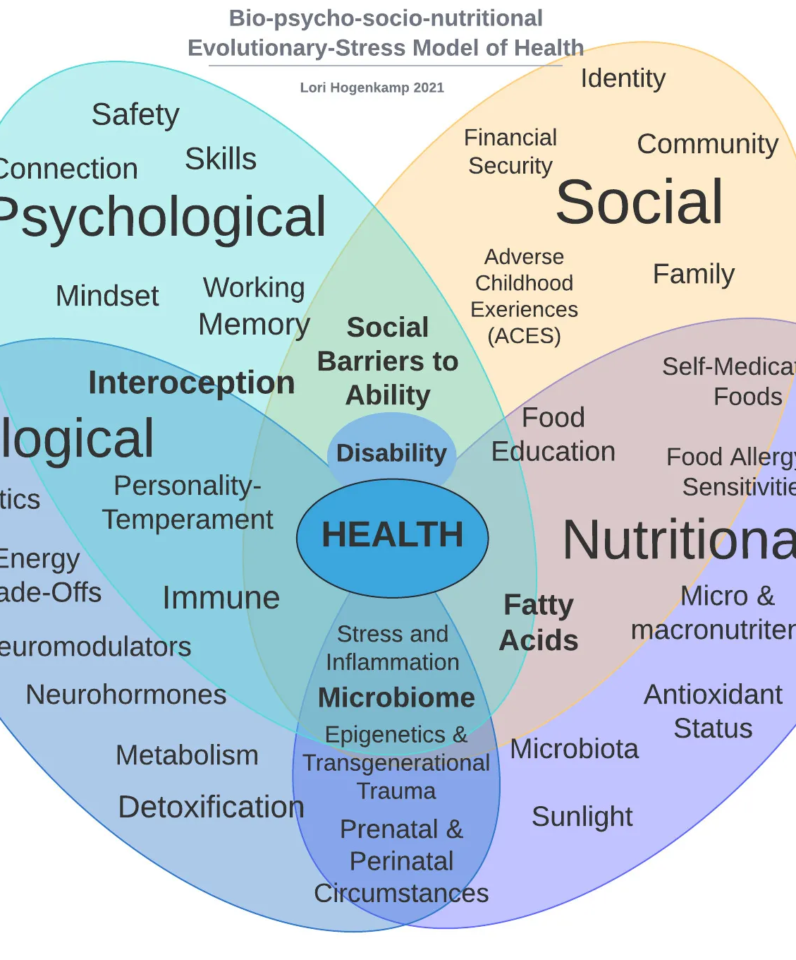
Theories & Models
Biopsychosocial Model: Because biological, psychological, and social variables influence health, preventive and holistic service design is supported (Engel, 1977).
Ecological Model: Individual, community, organisational, and policy levels all have an impact on health outcomes, which informs UK initiatives such as the NDPP(National Diabetes Prevention Program) (Bronfenbrenner, 1979).
Holistic Model:
Wellbeing involves the whole person physical, mental, social and environmental needs promoting person-centred and sustainable care (Dossey and Keegan, 2016).

Slide 7

Biopsychosocial Model
The biopsychosocial model views health as the result of a combination of biological, psychological and social factors. It supports personalised and preventative care by recognising that conditions like diabetes are influenced not only by physical health but also by lifestyle, mental wellbeing and social circumstances. This approach encourages holistic service design in the NHS, promoting sustainability through early intervention and long-term behaviour change rather than relying solely on medical treatment (Engel,1977) .

Slide 8
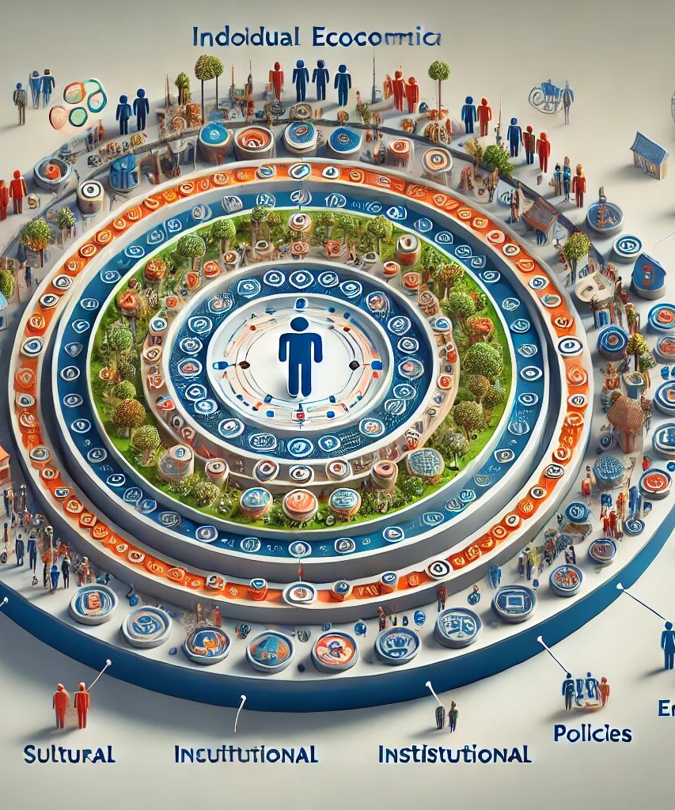
Ecological Model
Ecological Model in UK Health Practice
The ecological model suggests that health is influenced by multiple interacting levels from individual behaviours to family, community, organisational systems, and national policies (Bronfenbrenner, 1979).
In the UK, this approach guides initiatives like Making Every Contact Count (MECC) and Healthy Schools Programmes, which address lifestyle, social support, education, and wider environmental factors.
It reflects the aims of SDG 3 by promoting multi-level interventions that improve both personal and collective wellbeing.
Challenges and Critical Perspective:
Cross-sector coordination is difficult, as services often work in silos, limiting holistic implementation.
There is a risk of shifting responsibility onto individuals, while deeper structural issues like poverty, racism, or poor housing remain under-addressed.
Resource inequalities between communities can mean some areas benefit more than others, potentially reinforcing existing health gaps.

Slide 9
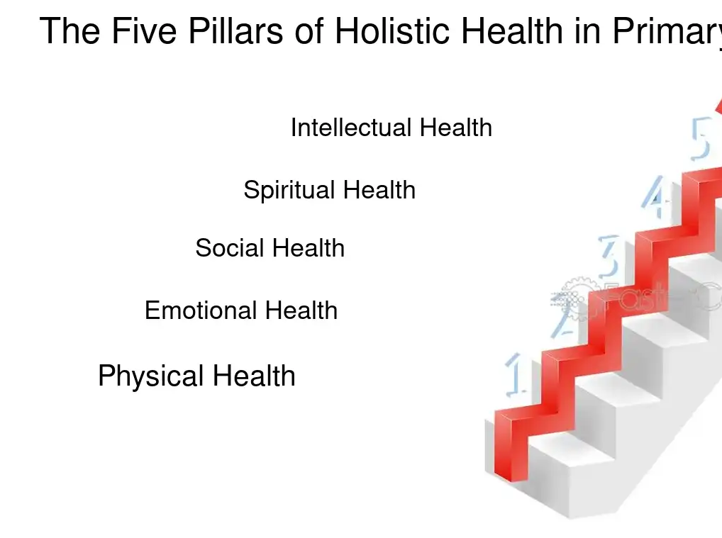
Holistic Model in Health & Social Care
The holistic model views health as a combination of physical, mental, emotional, social, and environmental wellbeing.
It underpins person-centred care, prevention strategies, and self-management approaches, commonly used for long-term conditions in UK services.
By treating the whole person rather than just the illness, it supports wellbeing, sustainability, and service adaptability, aligning with SDG priorites on health equity and resilience.
Critical Perspective:
While widely promoted, true holistic care can be difficult to implement in systems constrained by time pressures, staff shortages, and medicalised cultures.
There is a risk of overemphasising individual responsibility, potentially overlooking structural barriers such as poverty, discrimination, or limited access to services.
Measuring “holistic outcomes” is challenging, making it harder to justify investment compared to more clinical, disease-focused interventions (Dossey and Keegan, 2016).

Slide 10

Policy and Legislation
WHO’s Health in All Policies (HiAP) encourages UK policymakers to consider health impacts across sectors like housing, transport, and education (WHO, 2014).
The NHS Long Term Plan (2019) prioritises prevention, mental health support, digital access, and health inequality reduction, promoting Integrated Care Systems (ICSs).
The Health and Care Act 2022 formalises ICSs to strengthen collaboration between health and social care services(UK Government, 2022).
The Care Act 2014 and Equality Act 2010 ensure inclusion, personalisation, and protection from discrimination in service delivery (HM Government, 2010, Department of Health, 2014).
UK health practice is shaped by neoliberal ideologies of personal responsibility, balanced by growing emphasis on holistic and biopsychosocial care, with social justice and sustainability driving policy focus (Bambra, 2022).

Slide 11
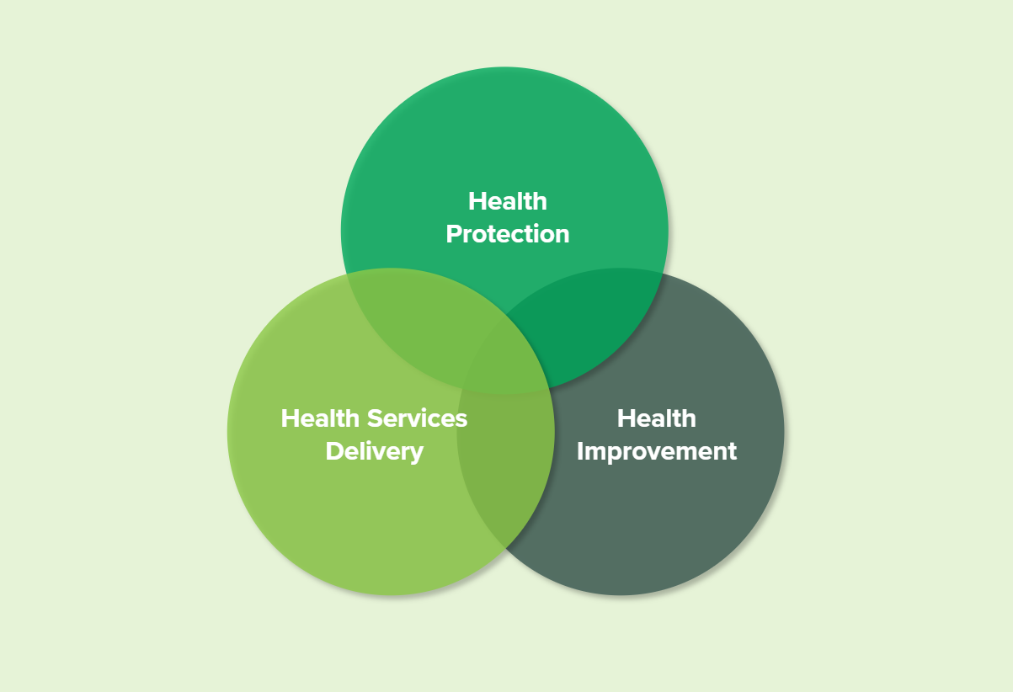
Examples and Case Studies
NHS Diabetes Prevention Programme (NDPP) – Explained with Health Belief Model:
The NHS Diabetes Prevention Programme reduces the risk of Type 2 diabetes through education, lifestyle coaching, and physical activity support, aligning with SDG 3 by improving long-term health and reducing inequalities (Public Health England, 2020).
Using the Health Belief Model, participants are more likely to engage when they:
Perceive high personal risk (susceptibility) and understand serious consequences (severity).
Believe the benefits outweigh the effort,
Experience fewer barriers through accessible sessions and digital options.
Cues to action like GP referrals and community messaging, along with goal-setting support, build self-efficacy.
Evaluation shows behaviour change is working over 50% of participants achieve 3–5kg weight loss, significantly reducing diabetes risk (NHS England, 2023).

Slide 12
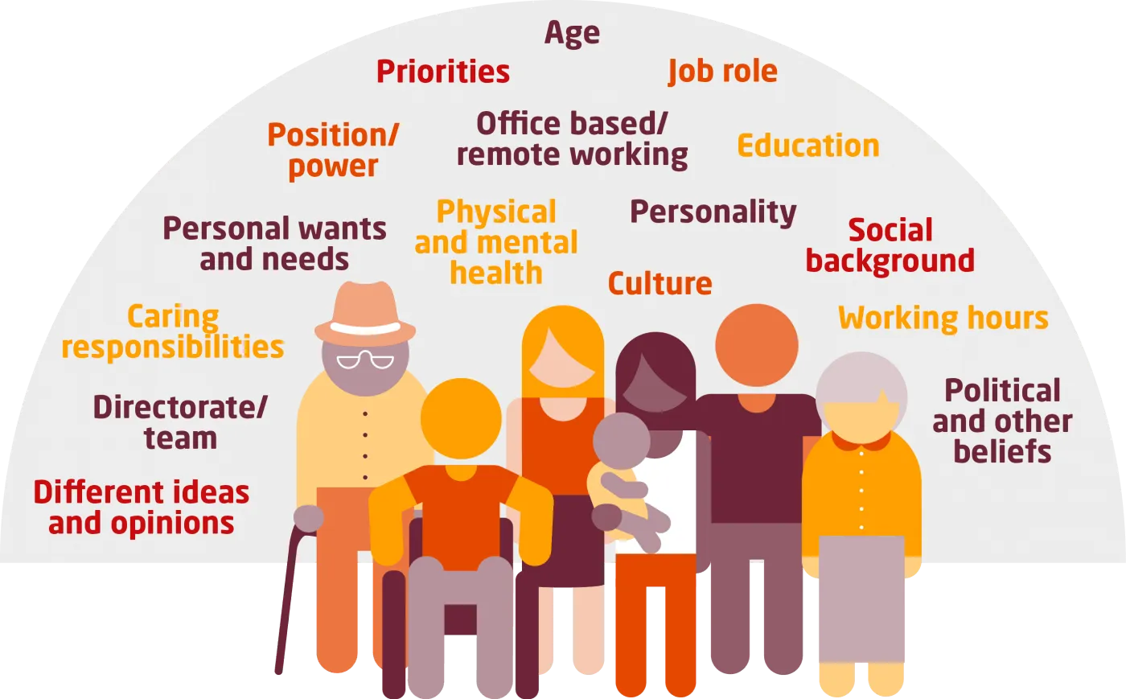
Equality and Access
Barriers to quality access include cultural and language differences, digital exclusion, and mistrust of services leading to late diagnosis and lower engagement in prevention programmes (Nazroo et al., 2020).
Equality in health involves ensuring fair access, treatment, and outcomes regardless of race, gender, disability, age, or socioeconomic status.
Culturally tailored programmes like HEAL-D improve engagement among African-Caribbean communities by providing relevant lifestyle education and diabetes prevention support.
Policies such as Public Health England guidance and the NHS Workforce Race Equality Standard (WRES)promote service fairness, representation, and accountability across healthcare (Public Health England, 2020; NHS England, 2023).

Slide 13
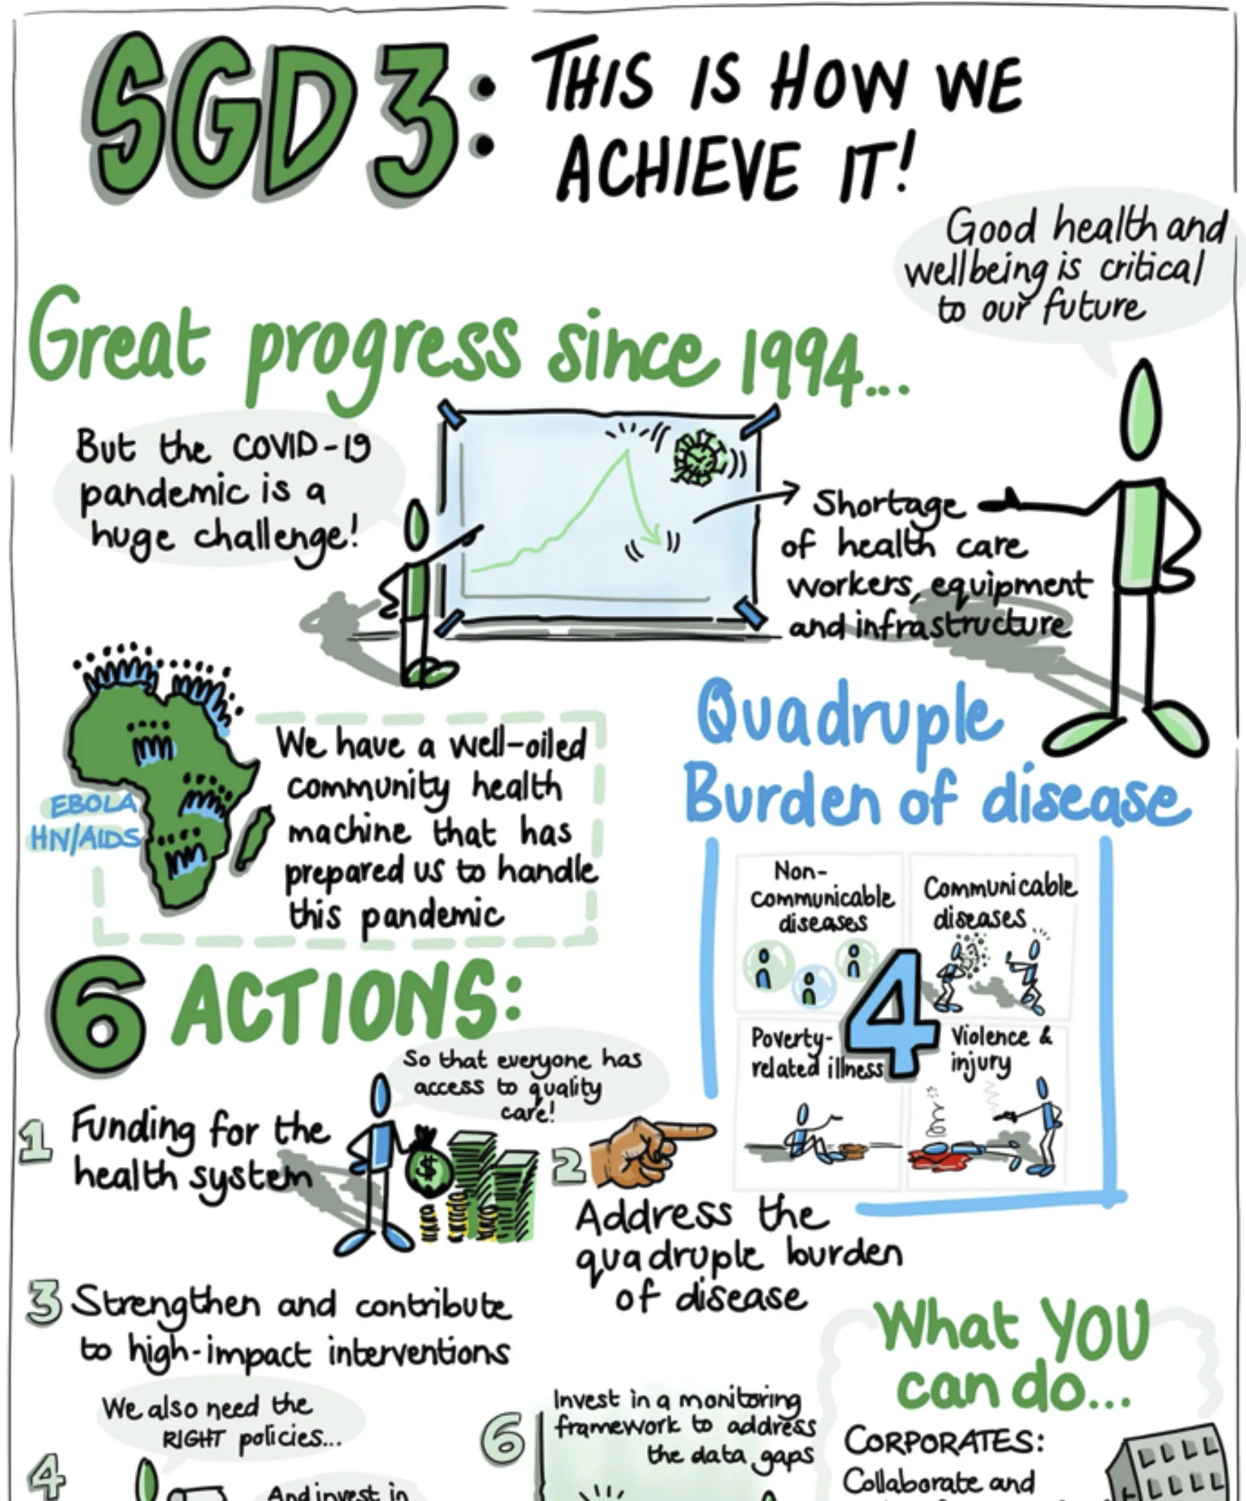
Future Recommendations
Scale up culturally tailored and community-led interventions by co-designing programmes with local leaders, faith groups, and grassroots organisations to build trust and relevance across diverse populations.
Tackle digital exclusion by offering non-digital service options, providing digital literacy training, and ensuring access to affordable devices and internet for marginalised groups.
Improve ethnic and socioeconomic data collection across health services to track inequalities, identify gaps in access, and inform targeted prevention strategies.
Embed equity-driven design into policies and commissioning so that all new services are assessed for their impact on disadvantaged groups and include clear accountability measures (Bambra et al., 2021).

Slide 14

Conclusion
The Sustainable Development Goals (SDGs), particularly Goal 3, provide a global framework that underpins integrated, equitable, and sustainable health and social care in the UK. By promoting prevention, reducing inequalities, and addressing social determinants of health, the SDGs guide policies, programmes, and service design from culturally tailored interventions to system-level strategies like Integrated Care Systems. Aligning UK practice with the SDGs ensures that health and wellbeing are prioritised for all populations, supports long-term sustainability, and fosters a more inclusive, person-centred approach to care (United Nations, 2015, Public Health England, 2020).

Slide 15
REFRENCES
Bambra, C., Smith, K.E., & Garthwaite, K. (2021) ‘Health inequalities and COVID-19: A review of the evidence’, Public Health Reviews, 42(1), pp. 1–20
Bronfenbrenner, U. (1979) The ecology of human development. Cambridge, MA: Harvard University Press
Bambra, C. (2022) Health Divides: Where You Live Can Kill You. Bristol: Policy Press.
Dahlgren, G. and Whitehead, M. (1991) Policies and strategies to promote social equity in health. Stockholm: Institute for Futures Studies.
Department of Health (2014) Care Act 2014. London: DHSC.
HM Government (2010) Equality Act 2010. London: The Stationery Office.
Engel, G.L. (1977) ‘The need for a new medical model: a challenge for biomedicine’, Science, 196(4286), pp. 129–136.
Jones, A. et al. (2021) ‘Behavioural models in preventative health interventions’, Journal of Public Health, 43(4), pp. 850–857
Nazroo, J., Bhui, K., & Rhodes, J. (2020) ‘Where next for understanding race/ethnic inequalities in severe mental illness? Structural, interpersonal and institutional racism’, Sociology of Health & Illness, 42(2), pp. 262–276.
NHS England (2019) The NHS Long Term Plan. London: NHS.

Slide 16
REFRENCES
NHS England (2023) HEAL-D: Healthy Eating and Active Lifestyles for Diabetes Programme. Available at: https://www.england.nhs.uk/long-read/addressing-health-inequalities-through-co-developing-the-healthy-eating-active-lifestyles-for-diabetes-heal-d-programme (Accessed: 30 September 2025).
NHS England (2023) Five areas NHS integrated care boards can improve diabetes care for people. Available at: https://www.england.nhs.uk/blog/five-areas-nhs-integrated-care-boards-can-improve-diabetes-care-for-people/(Accessed: 23 September 2025)
Public Health England (2020) Health Profile for England 2020. London: PHE. (Accessed 30th September 2025).
Public Health England (2020) NHS Diabetes Prevention Programme: evaluation report. London: PHE (Accessed 1st October 2025).
United Nations (2015) Transforming our world: the 2030 Agenda for Sustainable Development. New York: UN (Accessed 30th September 2025)
United Nations (2015) Transforming our world: the 2030 Agenda for Sustainable Development. New York: United Nations.
United Nations (2015) Transforming our world: the 2030 Agenda for Sustainable Development. New York: United Nations. Available at: https://sdgs.un.org/2030agenda (Accessed: 23 September 2025).
United Nations (2015) Transforming our world: the 2030 Agenda for Sustainable Development. New York: UN. Available at: https://sdgs.un.org/2030agenda (Accessed: 23 September 2025).
WHO (2014) Health in All Policies: Framework for Country Action. Geneva: World Health Organization.
World Health Organization (2020) Promoting well-being. Available at: https://www.who.int/activities/promoting-well-being (Accessed: 23 September 2025).

