Slide 1
Leadership and Change Week 8
Julie Thomas

Slide 2
What we’ll cover today
Presentation mop up
Learning from Presentations
Task 2 of Assignment
Continue with Resistance to Change and Reactions to Change

Slide 3

Learning Points from Presentations
Overall, the standard of presentations was high
Eye contact was good, content was relevant and logical, points were underpinned with appropriate evidence, slides were clear and visually appealing, questions were answered well.
Learning points:
Need to use Harvard Referencing correctly (easy marks!)
Structure your work well – clear beginning, middle and end
Proof-read for spelling errors
Practice is key – some presentations were rushed in parts/too long

Slide 4

Resistance to Change

Slide 5
Change is met with enthusiasm when . . .
employees propose the change
they are involved in the design of the change
they feel that their opinion/views are heard, and contribute to the new reality
they or the organisation/wider community benefits from the change
they dislike the present status quo
they are confident about their competence in the new context
they trust/respect/like the person/group, proposing the change

Slide 6
Change is met with enthusiasm when . . .
they can see the big picture and how the change contributes to it
they are given support and time to adjust to the changes
they are not expected to change too many things at the same time
change is spaced
they understand the reasons for the change
they believe the change is important
they believe the change is necessary (adapted from JISC Infokit on Change Management, Northumbria University).

Slide 7
People’s Initial Reactions to Change
Flight
Fight
Freeze
Fold
Flock

Slide 8
SCARF Theory – David Rock (2006)
Management behaviour can result in threat responses or reward responses from employees and harnessing those reward responses is key to productive workplaces.
Rock identified five social qualities which managers could focus on to minimise the threat responses and maximise the reward responses. These are:
Status
Certainty
Autonomy
Relatedness
Fairness (making the acronym SCARF).
Notes:
Status – in relation to change this could mean a threat of redundancy
Certainty – threat to job security
Autonomy – no part in decision making, nature of change
Relatedness – worry that structure will change and social connections lost
Fairness – why is it happening to me? No longer feel part of the group.

Slide 9
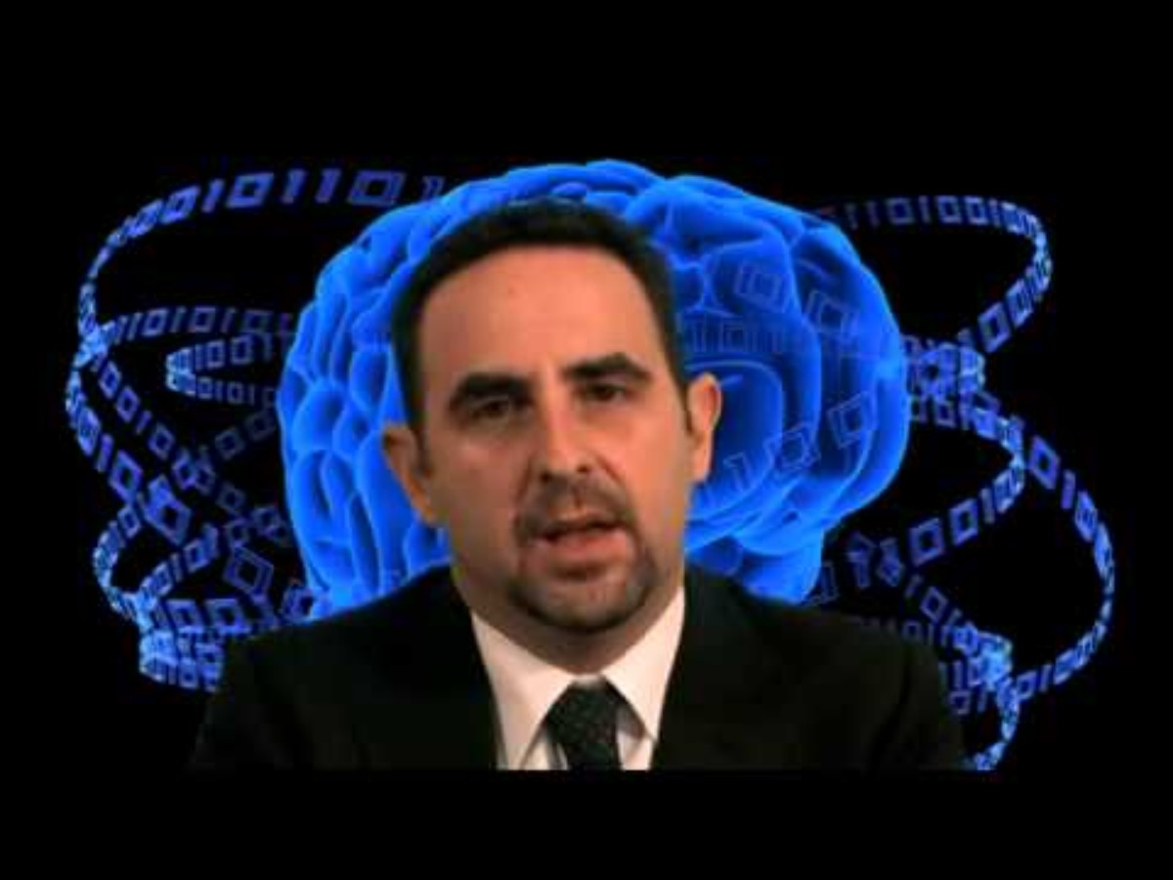

Slide 10
People’s Reactions throughout a Change
Kubler-Ross Change Curve
DREC model

Slide 11
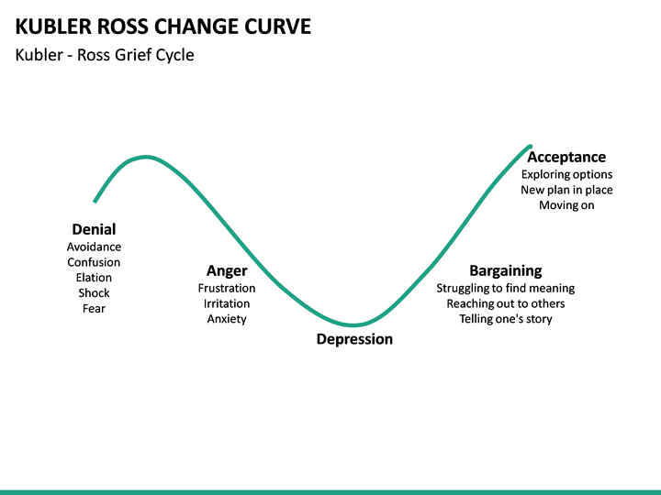

Slide 12
The DREC Model
Denial
Resistance
Exploration
Commitment
Notes:
How individuals cope with change.
Derived from the Kübler-Ross Model – denial, anger, bargaining, depression, acceptance. Known as the coping/change cycle.
DREC – denial, resistance, exploration, commitment
It takes time for individuals to work through the cycle
Kew and Stredwick (2016).

Slide 13
Activity
If we think about the change scenario we discussed 2 weeks ago (local authority introducing IPads for its social workers) how might managers trigger a threat response and how instead could they trigger a reward response, before, during and after the change?
Consider how Status, Certainty, Autonomy, Relatedness and Fairness could be affected before, during and after the change.

Slide 14
Use a Table:
 | Threat Response | Reward Response
Status
Certainty
Autonomy
Relatedness
Fairness

Slide 15
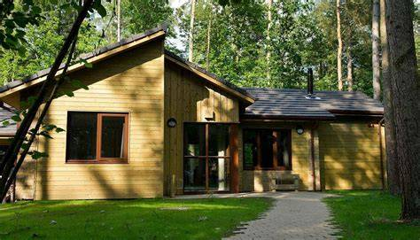

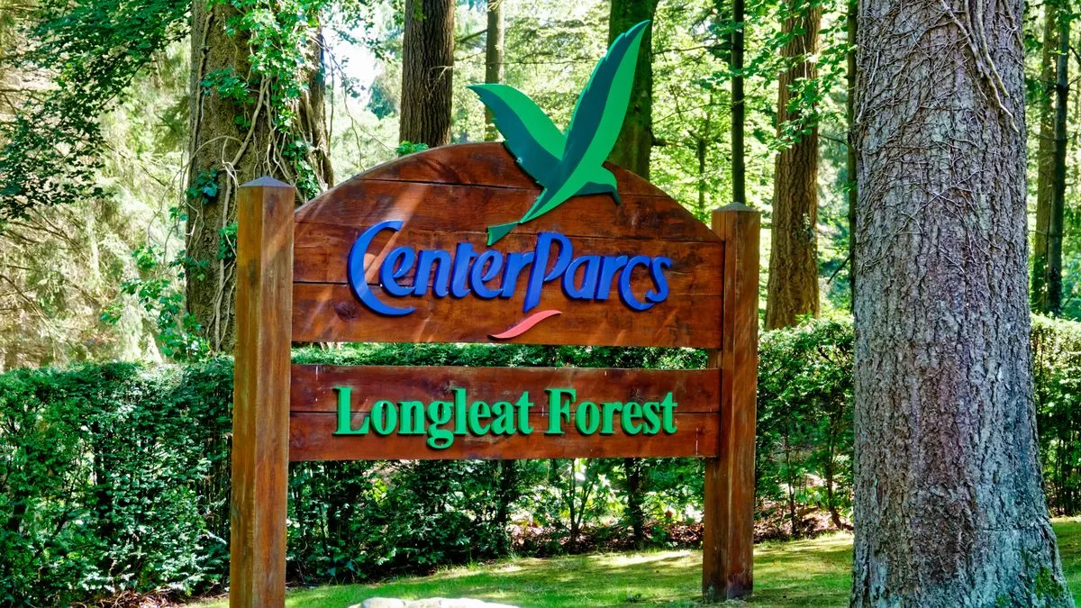
Technology Adoption in Center Parcs

Slide 16
Technology Adoption - Learning from Center Parcs
Introduced new app for employees to clock in and clock out, manage shifts
10,000 employees, 90% adoption, demographic 18-80 years
Enhanced employee experience (e.g. published schedules 8 weeks in advance, could swap shifts easily) as well as have efficiencies for payroll processing
Used to have 9 systems – now one app
Built on its success and employee trust in technology – added to app, sent out surveys
People-centred approach to introducing it – practical support for managers and employees, bi-weekly calls
Healthy competition between teams
Myth busting – older employees were fine!
Safeguards in system – people can’t clock in/out beyond site boundaries
Now have a holistic overview of workforce – data to enable planning
Managers still have responsibility for lateness, absence

Slide 17
Need for Agility
Change is constant
Need for agile business processes and agile workforce, for long-term sustainability
Need to promote a change-ready culture
Build resilience and change capabilities
Promote a change mindset to encourage innovation

Slide 18
Encouraging a Change Ready Culture
Thoroughly plan for change
Involve people in planning and implementation
Clearly communicate goals, purposes and potential benefits
Open dialogue to discuss potential issues and actual issues
Quick response to issues raised
Learn from previous change initiatives
Celebrate successful change efforts
Build capabilities – coping with change, transferable skills
Introduce flexible structures and job descriptions

Slide 19
What we have learnt
Change can evoke a range of reactions
Need to manage change well to minimise resistance
Rock’s SCARF model can be used to help plan for change in a people centric way
Organisations need to be agile, with change ready cultures

