Slide 1
Instructor Materials lecture 2: The Cybersecurity Sorcery Cube
Advanced Cyber Security
Lecture 5
Compromising Web Server and Applications
Dr. Carlene Campbell

Slide 2
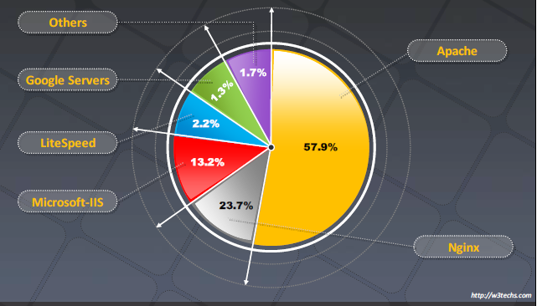
Webserver Market Shares
Notes:
Research the Open Web Application Security Protection (OWASP) on the top 10 vulnerabilities

Slide 3
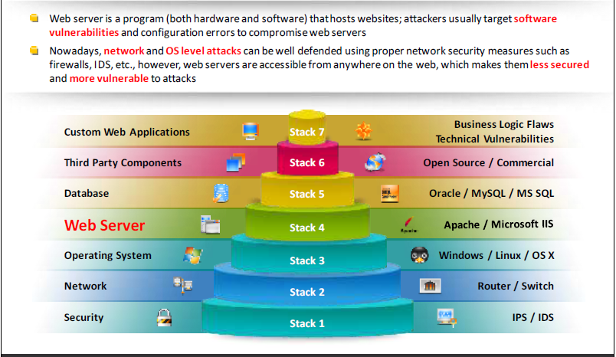
Web Server Security Issue
Notes:
Web servers run on general-purpose or embedded OS. Each component (application, server and OS) has its own set of vulnerabilities, but when these components are combined, there’s an increased risk of Web applications being compromised.
HTML is still the foundation of most Web applications and commonly used for creating static Web pages. Static web pages display the same information regardless of the time of day or the user who access the page. Dynamic web pages can vary the information that’s displayed, depending on variables such as current time and day, username, and purchasing history (information collected with cookies or web bugs.

Slide 4
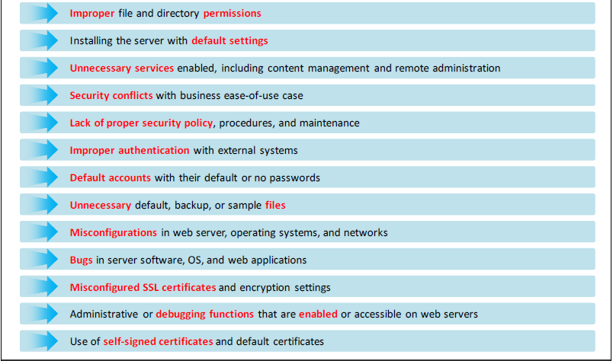
Why Web Servers are Compromised
Notes:
Many security professionals have experience in networking but little or no experience in programming.
No matter how efficient a company’s firewalls or IDS/IPS are, most systems ignore the content of HTTP traffic.
Network layer protection does not prevent application layer attacks from occurring.

Slide 5
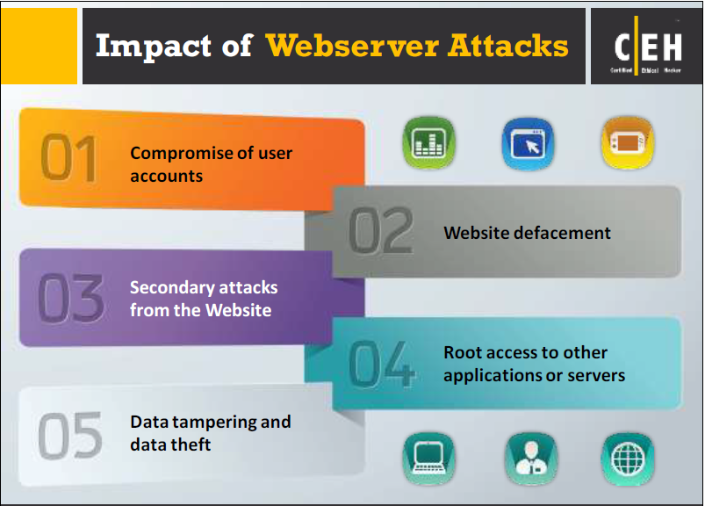
Impact of Webserver Attacks
Notes:
Apache web server runs on more than twice as many web servers.
Internet Information Services (IIS) is an extensible web server created by Microsoft

Slide 6
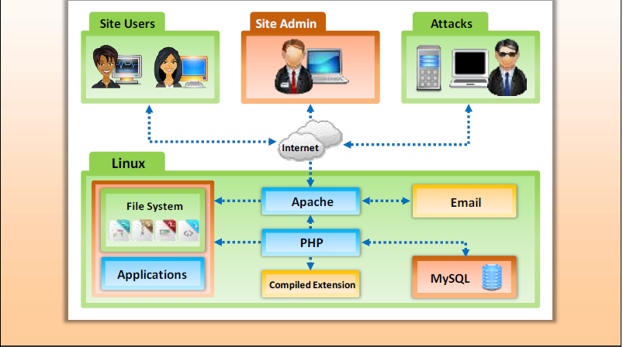
Open Source Webserver Architecture
Notes:
Scripting languages used to develop web pages:
VBScript
JavaScript
PHP Hypertext Processor:
ASP
PHP
Database (backend); Open Database connectivity (ODBC) is a standard database access method developed by SQL Access group.:
Microsoft SQL
Oracle

Slide 7
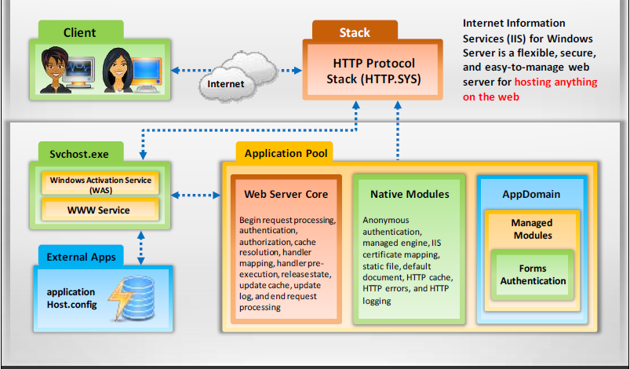
Internet Information Services (IIS) Web Server Architecture

Slide 8
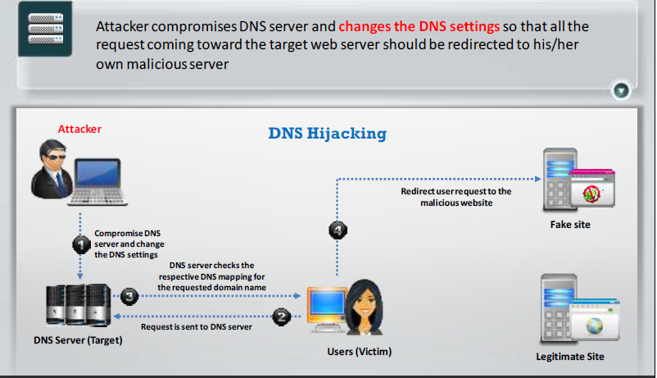
DNS Server Hijacking

Slide 9
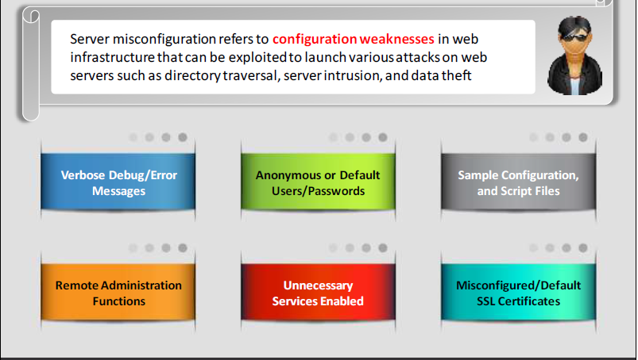
Web Server Misconfiguration

Slide 10
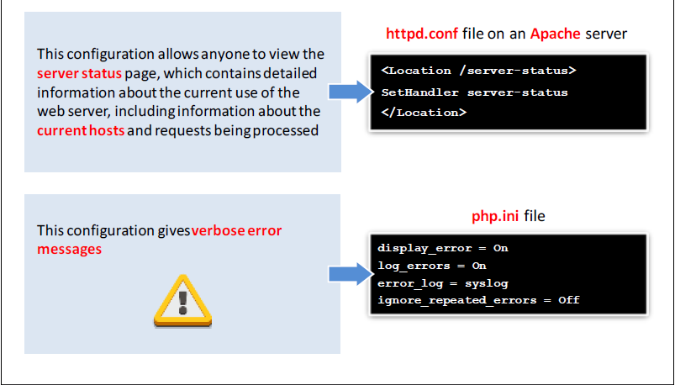
Web Server Misconfiguration Example

Slide 11
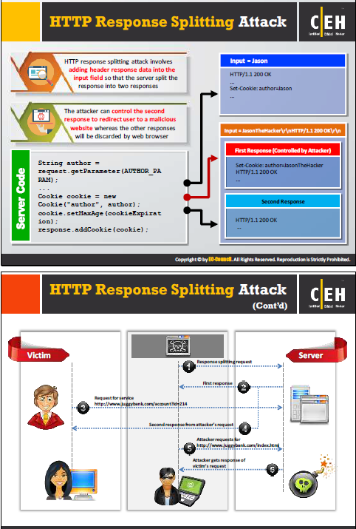
HTTP Response Splitting Attack

Slide 12
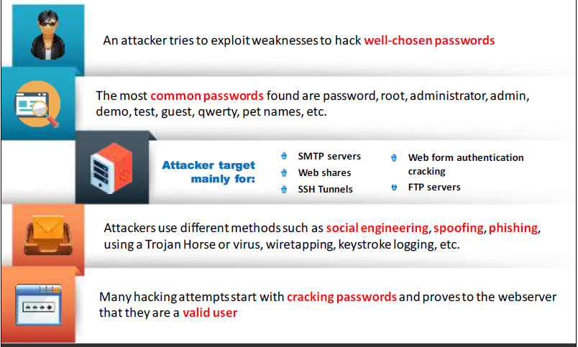
Webserver Password Cracking

Slide 13
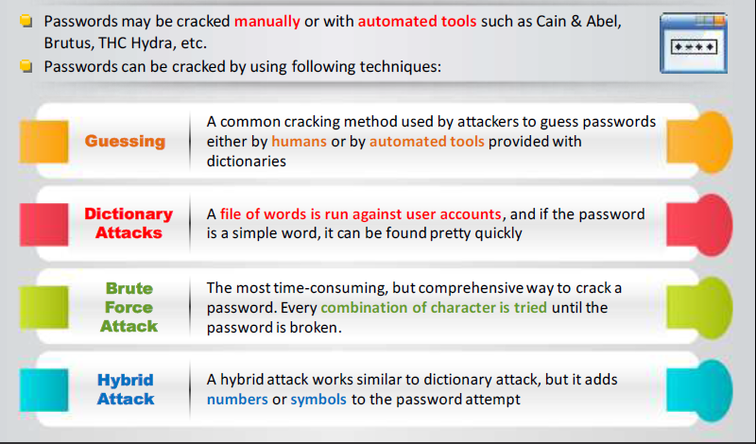
Webserver Password Cracking Techniques

Slide 14
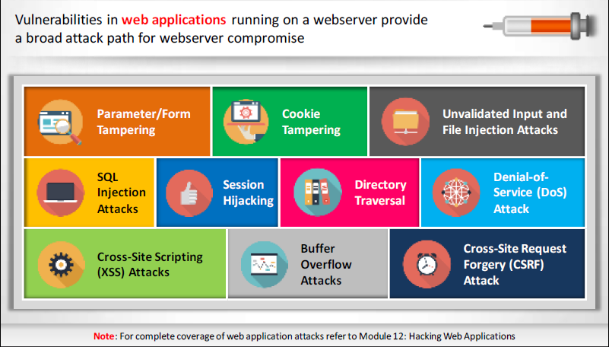
Web Application Attacks

Slide 15
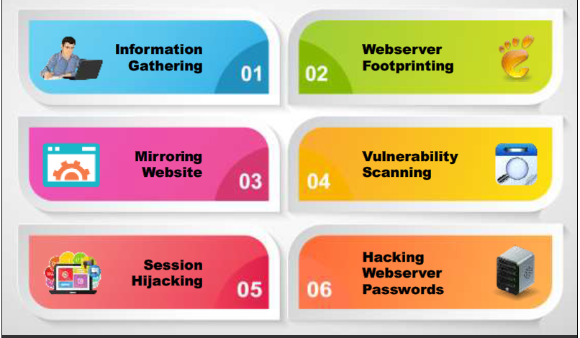
Webserver Attack Methodology

Slide 16
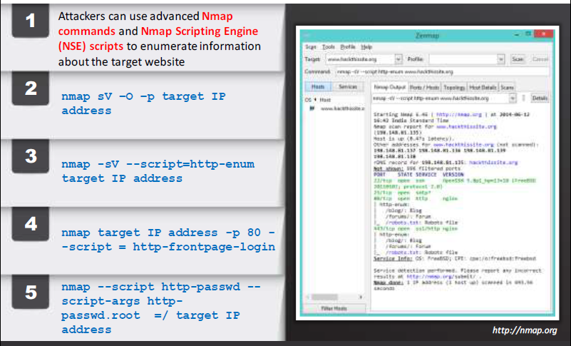
Enumerating Webserver Information Using Nmap

Slide 17
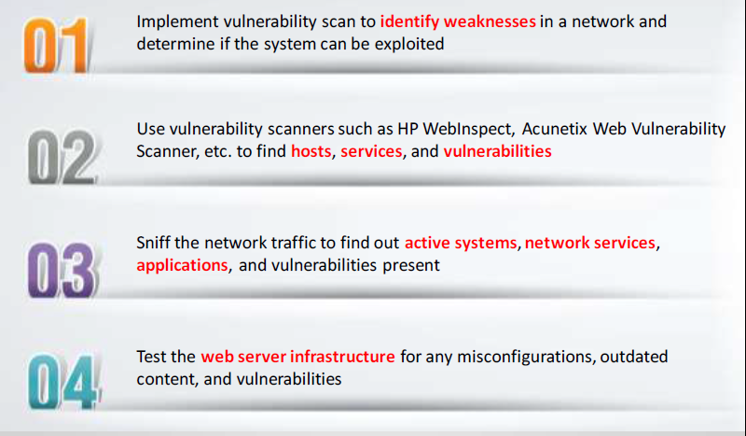
Webserver Attack Methodology Vulnerability Scanning

Slide 18
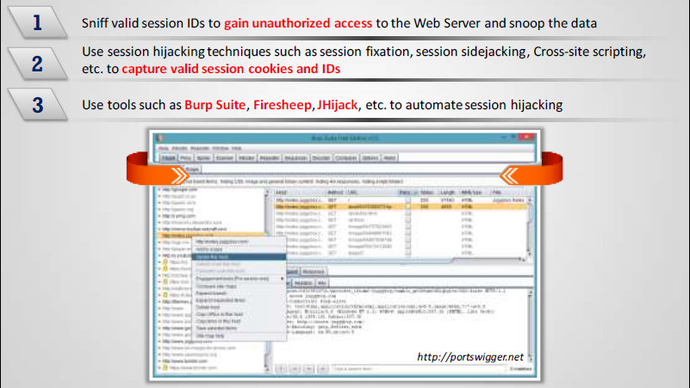
Webserver Attack Methodology
Session Hijacking

Slide 19
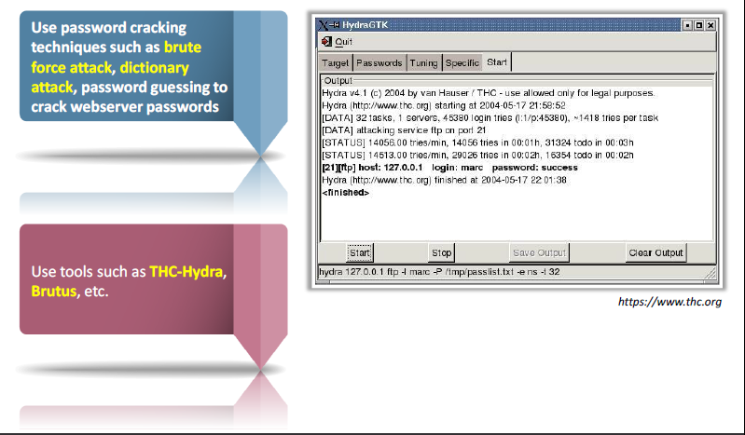
Webserver Attack Methodology:
Hacking Web Password

Slide 20

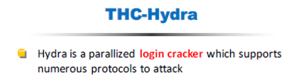
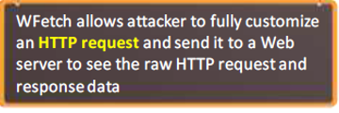
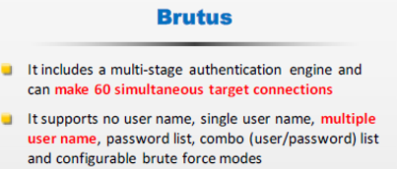
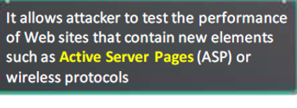
Tools
Metasploit
Wfetch
THC-Hydra and Brutus

Slide 21
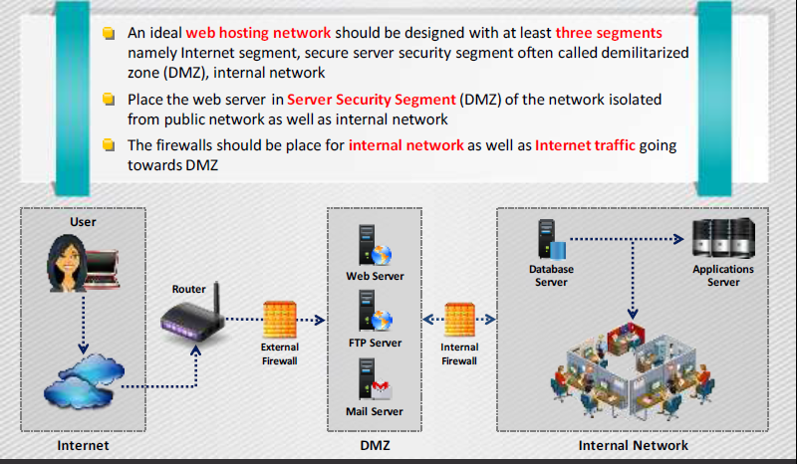
Place Web Servers in Separate Secure
Server Security Segment on Network

Slide 22
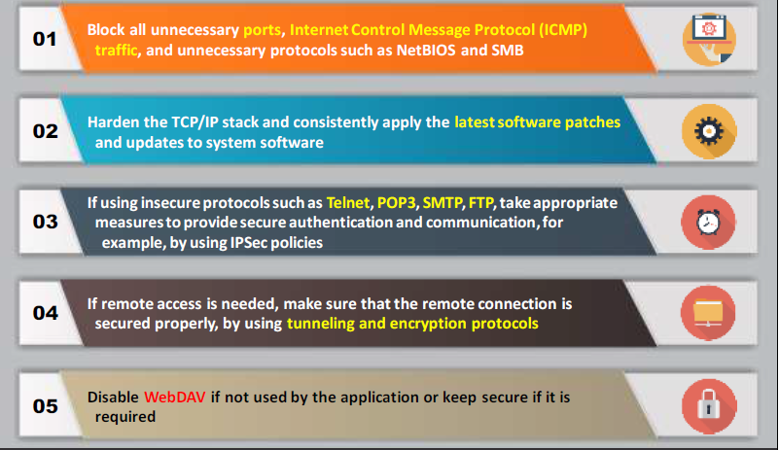
Countermeasures: Protocols

Slide 23
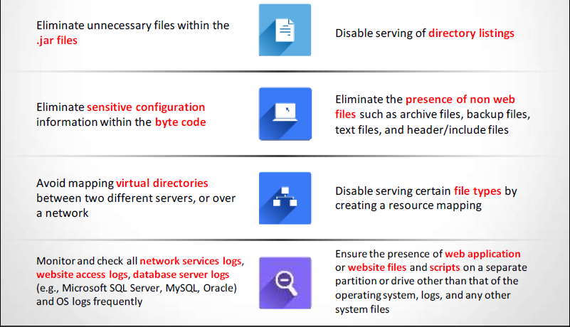
Countermeasures: Files and Directories

Slide 24
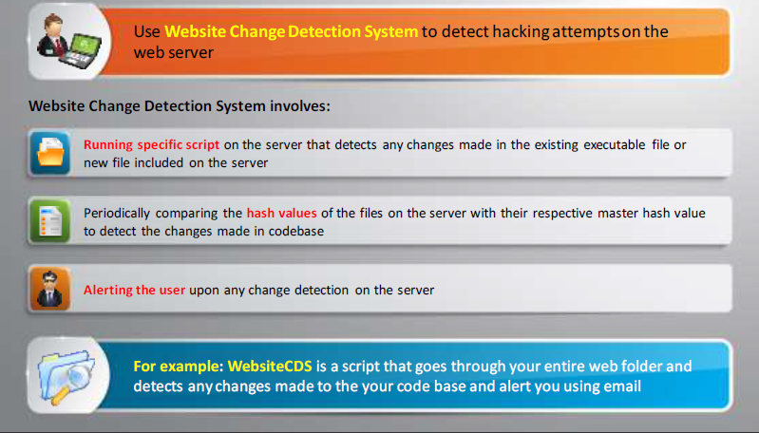
Detecting Web Server Hacking Attempts

Slide 25
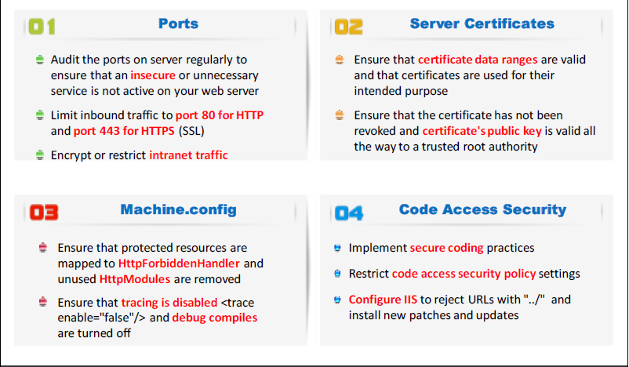
How to Defend Against Web Server Attacks

Slide 26
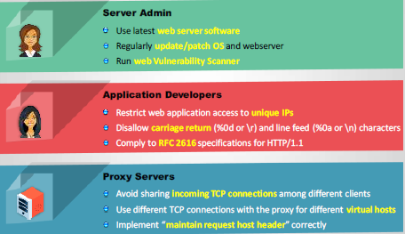
How to Defend against HTTP Response Splitting and Web Cache Poisoning

Slide 27
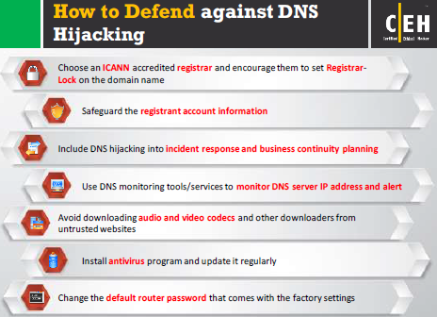
How to Defend against DNS Hijacking

Slide 28
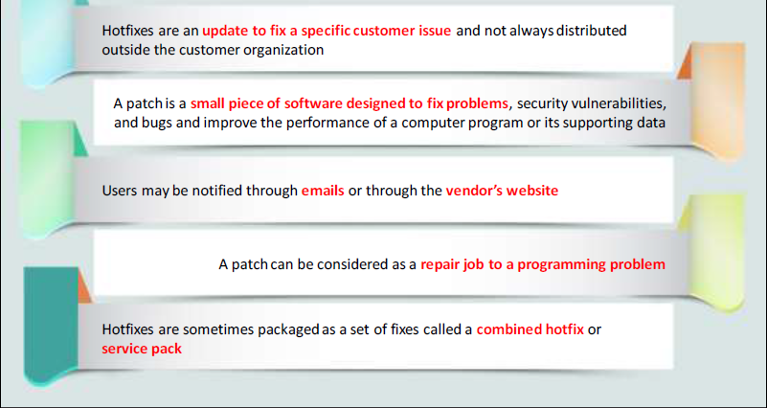
Patches and Hotfixes

Slide 29
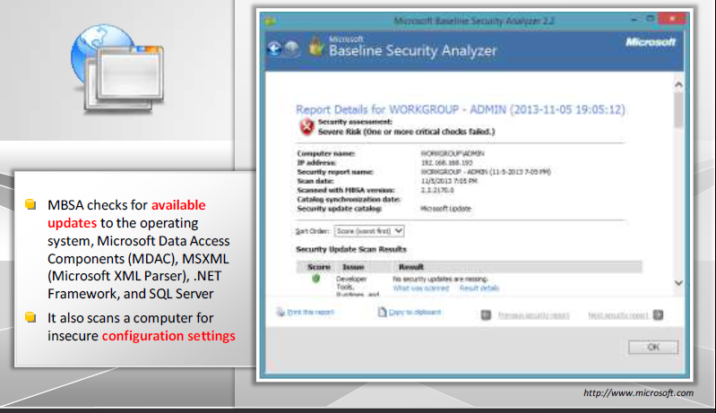
Patch Management Tool: Microsoft
Baseline Security Analyzer (MBSA)

Slide 30
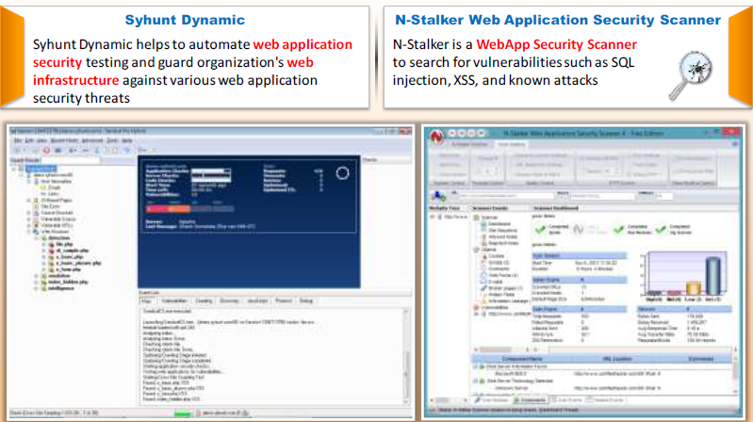
Web Application Security Scanners: Syhunt Dynamic and N-Stalker Web Application Security Scanner

Slide 31
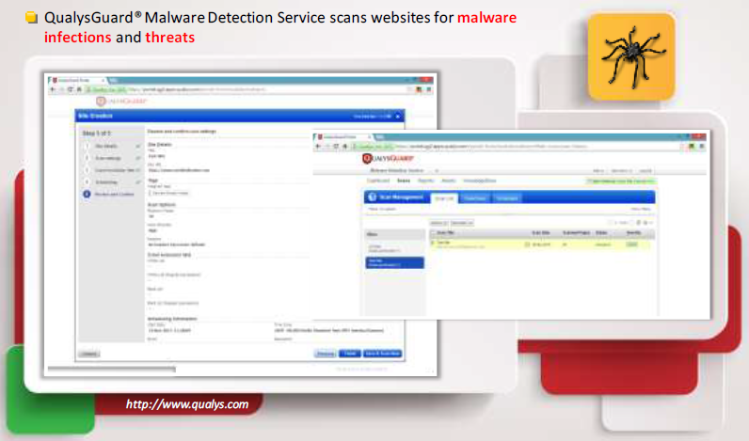
Web Server Malware Infection Monitoring Tool: QualysGuard Malware Detection

Slide 32
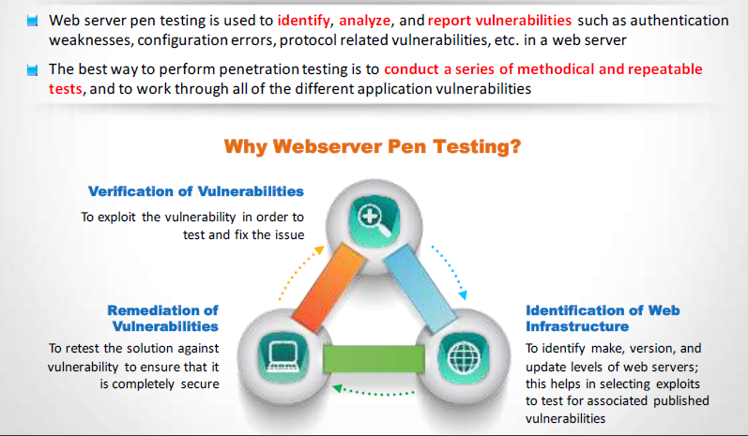
Web Server Penetration Testing

Slide 33
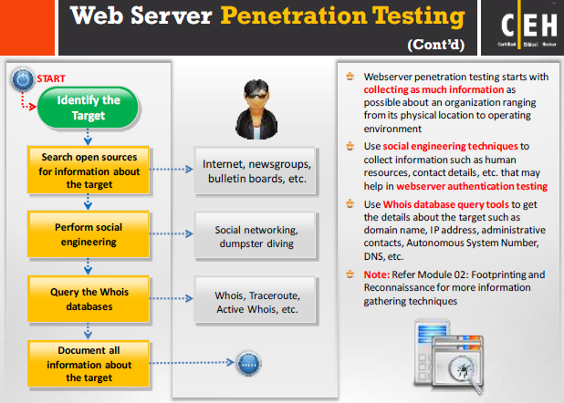
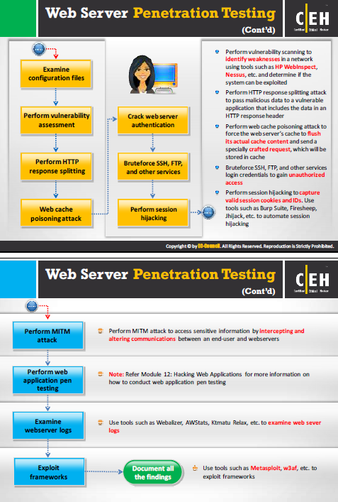
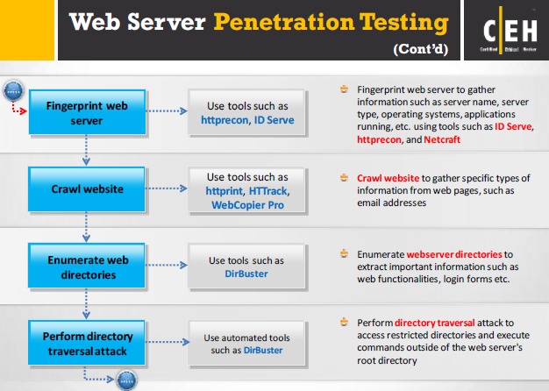

Slide 34
Questions?

Slide 35
Sources References
Fundamentals of Information Security Systems, David Kim, Michael G Solomon, 2nd ed.
CCNA security v2
CCNA Cybersecurity Operations v1.0
Certified Ethical Hacker (CEH) v9, EC-Council certified
Technology, Entertainment and Design (TEDx) Talks, www.ted.com
Copyright 2017 CloudNexus and First Resource Insurance Group
Source: Hackmageddon, http://www.hackmageddon.com/category/security/cyber-attack-statistics
Source: http://www.idtheftcenter.org/2016databreaches.html

