Slide 1


Slide 2


Slide 3


Slide 4
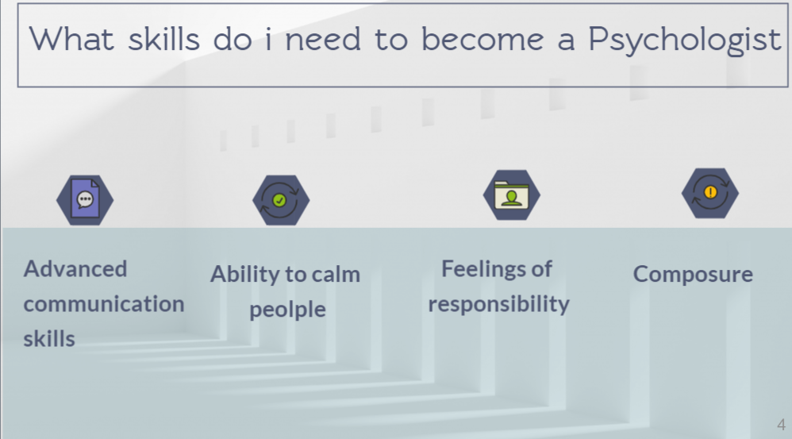

Slide 5
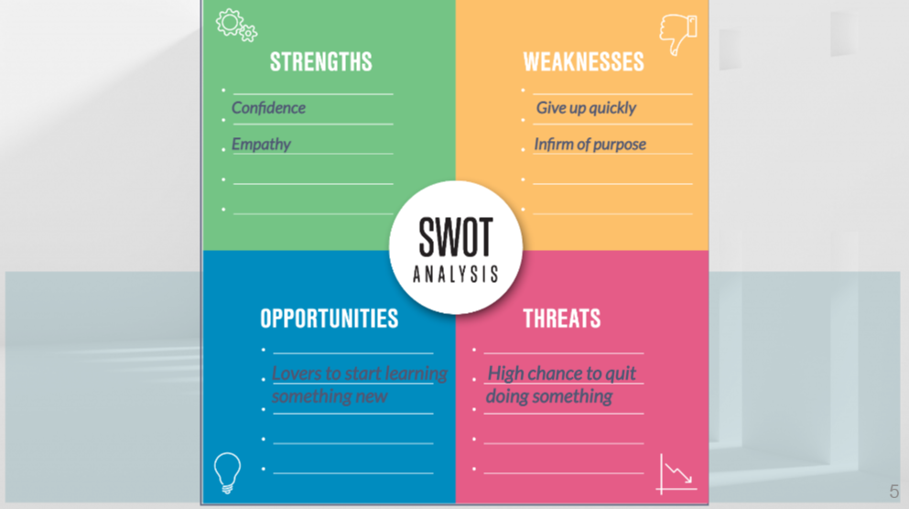

Slide 6


Slide 7


Slide 8
If you have any questions, please feel free to now ask ?
Thank you for your time!
And feedback!
Have a good day.

