Slide 1
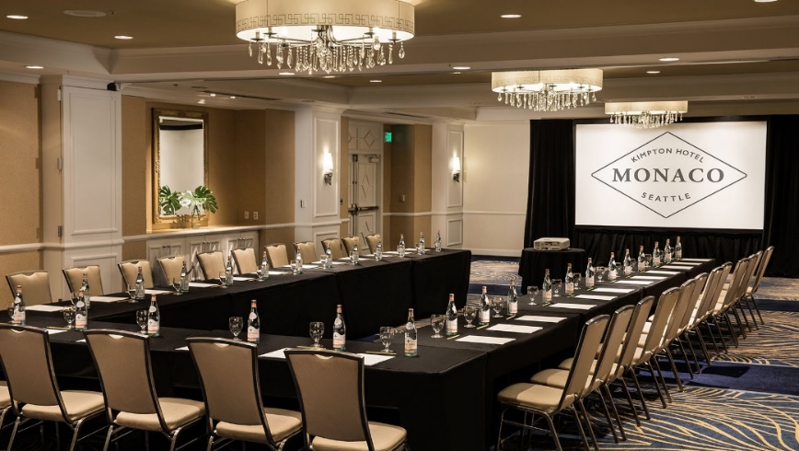
Operating
Hotel Facilities
BMIH4006
Week 8
Meetings & Events
Ryan Anthony Peters
BA(Hons) PGDip MIH

Slide 2

Week 8 – AGENDA:
Learning Outcomes
MICE
Event process
Layouts
A day in the life of events at hotels…
Assignment 3
AOB

Slide 3
Learning Outcomes
Upon the successful completion of this module, the student should be able to demonstrate the ability to:
Understand the variety of different positions within facilities management and appreciate the importance of the work based key skills within this area of hotel operation.
Develop knowledge of guest service skills and competencies appropriate to each departmental area of operation – and which meet organisation standards and requirements.
Understand issues relating to Facilities service delivery such as resource allocation, need for technical knowledge, industry standards, programme management, planning and organisation, management styles, health and safety.

Slide 4
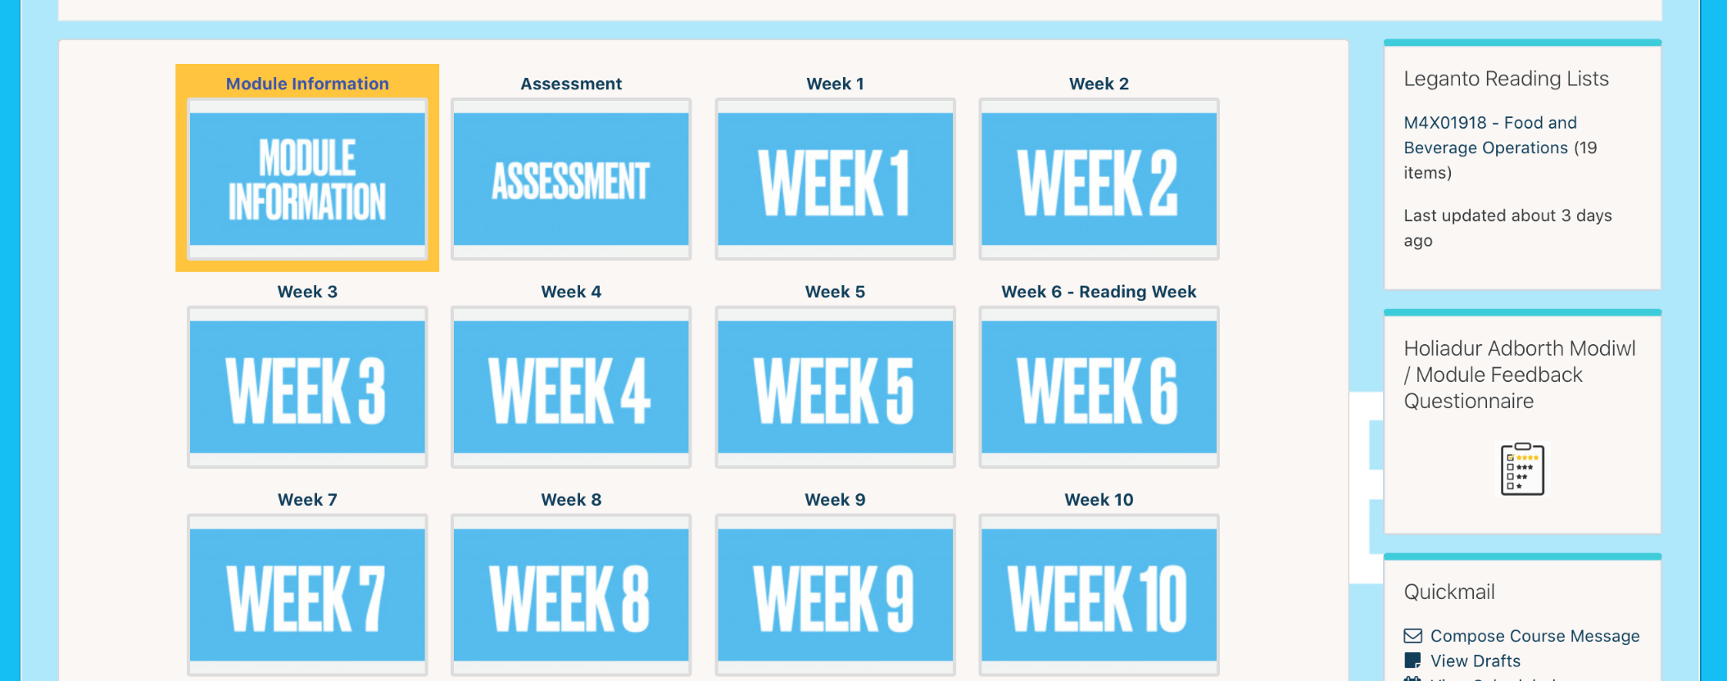
Module feedback
BMIH4006
Operating Hotel Facilities
Institute of Management & Health
Take 10 minutes to complete the module feedback questionnaire on Moodle.

Slide 5
NEXT WEEK
10 Minute Presentation…
BMIH4006
Book your individual appointment slot on Moodle (under Week 9).
THIS IS YOUR RESPONSIBILITY.
Ensure that your slot has been booked by the end of this week.
Please ensure that you are ready to share your screen, with your camera and sound on. Be on time. We have a very tight schedule .
PRACTICE, PRACTICE, PRACTICE!

Slide 6

What type of events / meetings would take place in a hotel?

Slide 7

Conferencing & Banqueting at De Vere
Let’s see how many of the events that you have mentioned feature in this DeVere promo video…

Slide 8

MEETINGS
INCENTIVES,
CONFERENCES & EXHIBITIONS
MICE

Slide 9
Meetings
Meetings are usually a single-day event held in hotel conference rooms or at convention centres. They can vary in size from only a small group of senior executives to larger gatherings like annual shareholder meetings.
The purpose is to bring together people from one company, industry, or project to address challenges, discuss plans, and set goals. Catering is often kept simple and there’s rarely an entertainment program.
MICE
(Hahn, 2021).

Slide 10
Incentives
Incentives are probably the most fun part of the MICE segment. They include all types of travel rewards a company offers to individual staff, teams, or partners (e.g. affiliates). In this context, the goal of an incentive is to thank people for their great performance, boost morale, or increase employee loyalty.
Incentives can take different forms depending on the company organising them. Some may send their team for an all-inclusive weekend trip to an out-of-town resort. Others might plan a variety of activities closer to home to encourage staff to bond in an informal setting.
MICE
(Hahn, 2021).

Slide 11
Conferences
Think of conferences as supersized meetings. They often last more than one day and can vary in size, but usually they have more attendees than meetings. As with incentives, conferences can look very different depending on the organisers and the industry behind them.
Common activities at conferences include one, a mix, or all of the below:
Panels: A group of experts discusses a topic and presents new findings. A moderator asks questions, ensures good flow, and may take questions from the audience.
Presentations: At a company conference, senior leaders may present the latest successes or results of the business. At public industry conferences, thought leaders may be invited as guest speakers to share the newest trends and insights. Presentations often rely on props, slides, or other visual elements.
MICE
(Hahn, 2021).

Slide 12
Conferences
Speeches: Also known as keynotes, speeches often mark the beginning or end of a conference. Sometimes it’s the host or organiser welcoming or thanking attendees for joining. Other times an industry leader may address an important issue and share ideas for solutions.
Discussions: They can be part of a panel. In this case, a select group talks about a topic while the audience listens. Some organisers use breakout rooms to encourage active debate among small groups of attendees.
Workshops: A small group of participants works on a specific problem case or researches a certain topic. This approach is a great way to offer attendees an interactive learning experience.
The purpose of conferences varies, but usually, they’re meant to address and find solutions to challenges in a business or industry. Sharing new insights and research is a big part of that. So are networking and team-building activities.
MICE
(Hahn, 2021).

Slide 13
Exhibitions
Also referred to as trade shows, exhibitions are usually massive events that draw thousands of visitors and exhibitors from around the world. They can last anywhere from several days to a week. Exhibitions are usually very industry-specific and have a well-defined target market.
Exhibitors go to trade shows to present and promote their product or service, drive business, and liaise with existing and potential partners. Industry professionals go to network, find clients or jobs, and discover new ways to solve problems.
MICE
(Hahn, 2021).

Slide 14
Exhibitions
Common activities at exhibitions can include one, a mix of, or all of the activities present at conferences, as well as:
Networking events: Trade shows often have networking parties for subgroups among their attendees. This is a great place to meet potential partners, discuss collaborations, and exchange thoughts on current trends.
Awards: An award show is part of many exhibitions and honours industry leaders for their achievements. It also gives winners quite a PR and marketing push. Even if you’re not up for an award, it’s worth checking out the nominees for inspiration.
New business pitches: Since trade shows want to promote growth and innovation in their industry, there’s often a dedicated event for new business pitches. It’s great for start-ups to gain visibility, funding, clients, and job applicants.
(Hahn, 2021).
MICE

Slide 15
Why is MICE business important for hotels?
Additional occupancy
Increase in expenditure
Reliable source of recurring revenue
(Hahn, 2021).
MICE

Slide 16
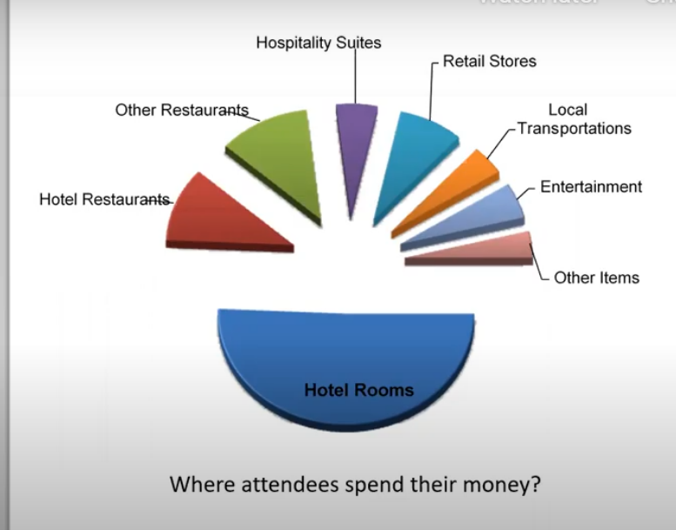

Why is MICE business important for hotels?
Hotels are the main suppliers of MICE and are the main beneficiaries as well. Business travellers who attend MICE events spend over 65% of their money on hotels for rooms and hotel dining while 15% is spent on other restaurants outside the hotel. Around 10% is spent on shopping and another 10% on local transportation.
(Lau, 2016).
MICE

Slide 17
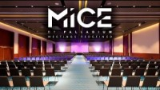
MICE

Slide 18
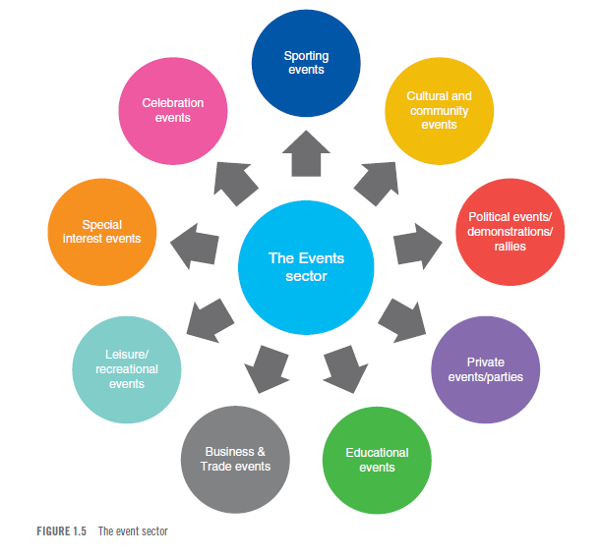
The
Event
Sector

Slide 19
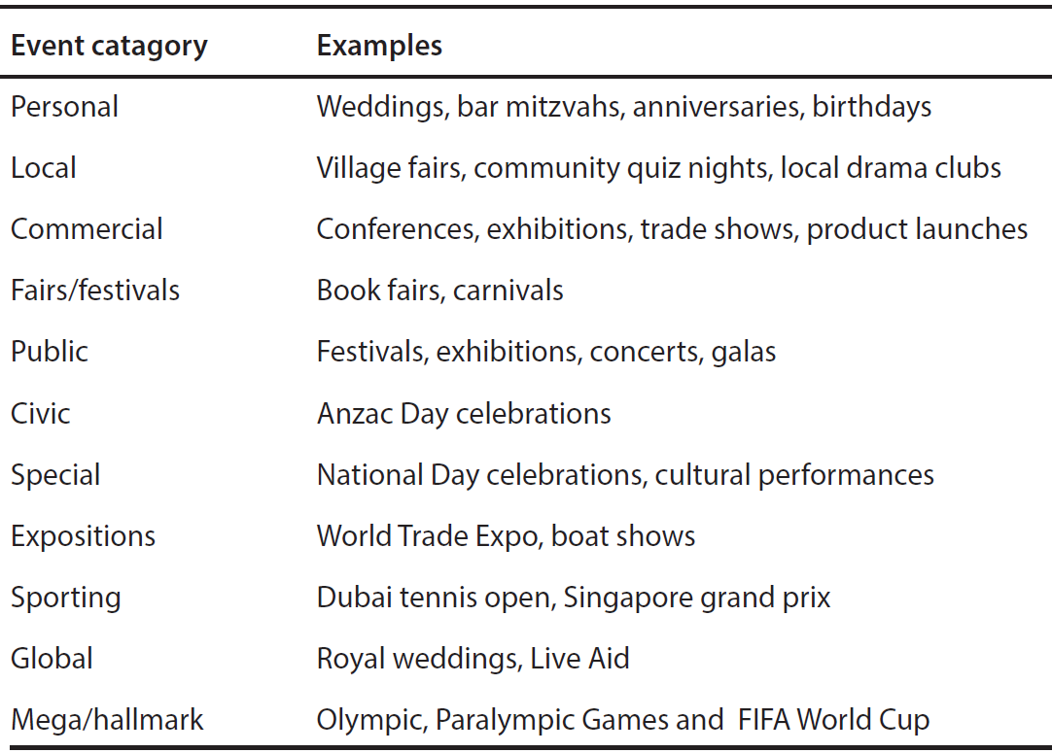
Events, conferencing and banqueting
An event is the planned management of an occasion that takes place between a space provider and a customer. The sector is commonly referred to as MICE (Meetings, Incentives, Conferences and Exhibitions) but other names used can include catering, events, conferences and banqueting.

Slide 20
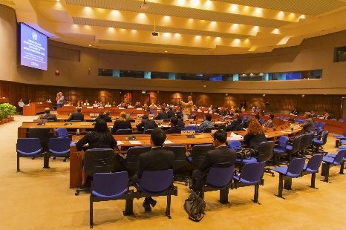
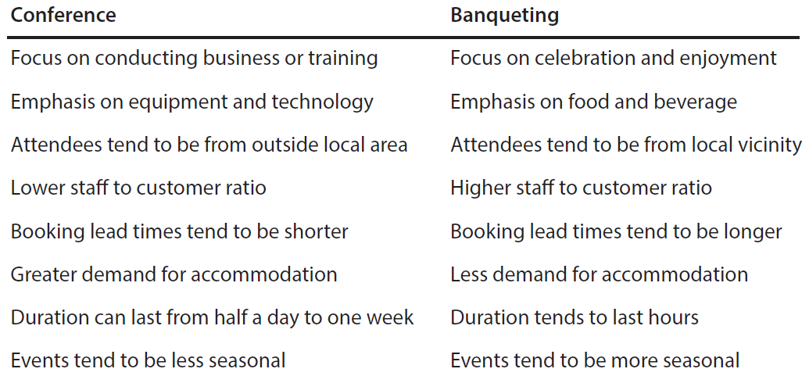
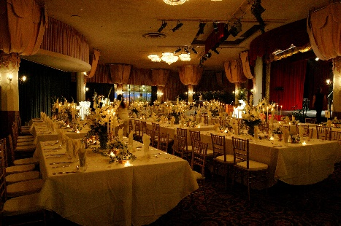
Comparison of characteristics

Slide 21
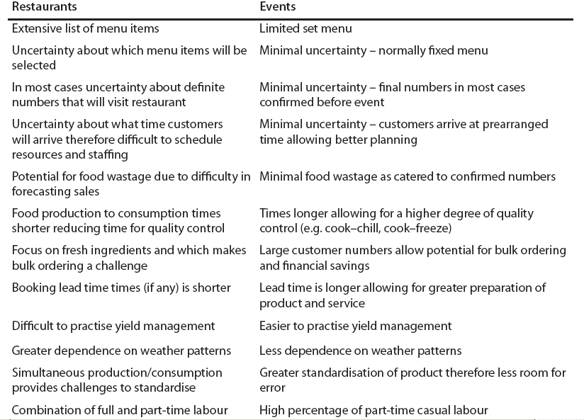
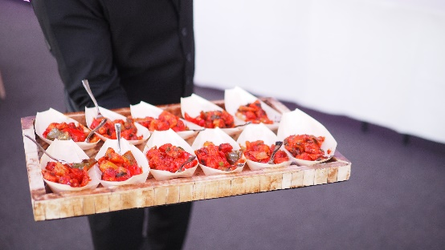
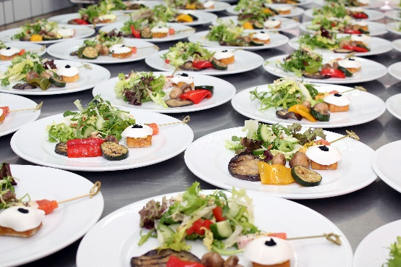
Restaurant and event operations

Slide 22
The 3 phases of the event cycle
The planning phase
The delivery phase
The evaluation phase
The Event Cycle
The Planning Phase
The Delivery Phase
The Post Event & Evaluation phase

Slide 23
The planning phase
Detailed planning is the basic prerequisite of the process
The first task is to establish a formal strategic plan
This should identify the vision and detail the actions that will fulfil and achieve this vision.
Establish the vision
Develop the event objectives
Implement operational plans
Devise control systems
Plan for shutdown and evaluation

Slide 24
The lead-in period
What happens during the lead-in period | The impact of a short lead-in period
Planning Booking entertainment Venue sourcing Sourcing suppliers Client liaison Liaison with suppliers, such as caterers Research schedule Producing documents, i.e. production schedule Fact-finding | Limits creativity- as no time Unavailability of suppliers and venues Limits choice Compromises decisions Costs more Reactive, rather than proactive management

Slide 25
Factors to consider in the planning process
Define the objectives
Set the budget
Choose the venue
Invite the audience
Design the programme content
Select catering, entertainment and audio-visual provision
Choose the team
Liaise with stakeholders and suppliers
Determine how to evaluate

Slide 26

Events at The Four Seasons

Slide 27
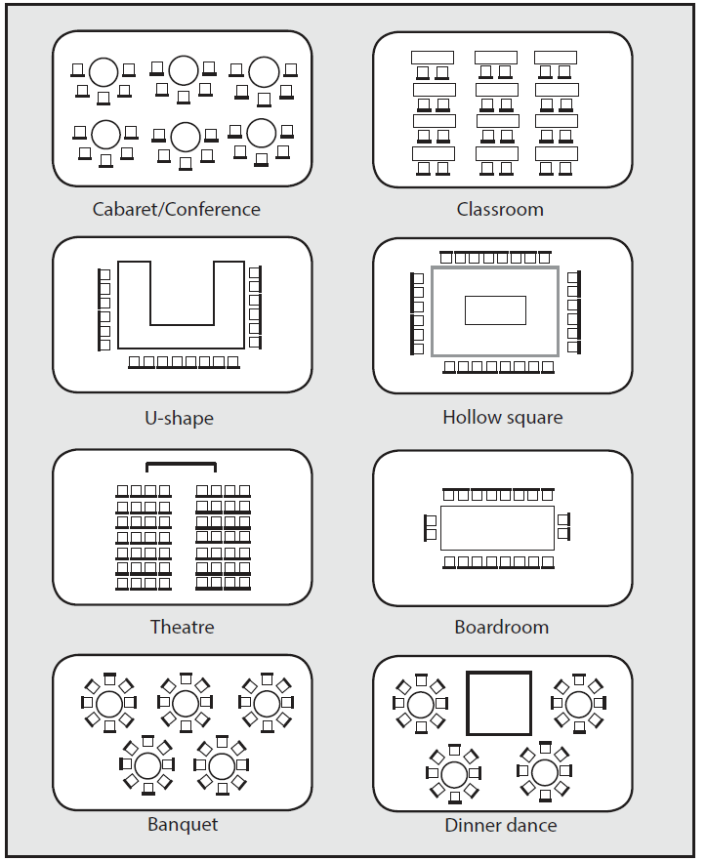
Example room layouts
(Cousins, Foskett, Graham and Hollier, 2019).

Slide 28
What types of events / activities would require this type of setup?

Slide 29
What types of events / activities would require this type of setup?

Slide 30
What types of events / activities would require this type of setup?

Slide 31
What types of events / activities would require this type of setup?

Slide 33

A Typical Business Meeting:
What Is Needed?
Using the Chat function on Teams, write down the essential items that are needed in a conference room, for a standard business meeting. What would you expect to see?

Slide 34
What is needed?
When preparing a room for a conference or meeting there should be items that will be needed.
A meeting should always contain :
Pens and paper
Water and glasses
Audio equipment
Screen / Projector
Flipcharts and pens
Chairs and tables
Strong Wifi Connection
An organiser may also have to make sure of other items at a customer's request: flowers, decorations, food, beverages, marketing materials.

Slide 35

Effective sales teams
Sales personnel should be allocated specific targets
Monitoring may include:
  Number of telephone calls made
  Number of sales calls or presentations made
  Revenue achieved by sales person
Event sales strategies include:
Utilising efficient event-booking software
Applying effective sales techniques
Creating venue generated events
Developing high quality event collateral

Slide 36
Sales activities include:
Forecasting high and low demand periods
Maintaining reservation records and customer history
Forecasting net yield for event bookings
Awareness of segment booking patterns
Avoiding very advanced bookings
Enforcing clear cancellation procedures
Considering commissions for intermediaries

Slide 37


When demand is high:
Accept only full priced bookings
Don’t
  Let out part space bookings too far in advance
  Offering discounts or promotions
  Provide complimentary products or services
  Have out of order rooms or refurbishments
When demand is low:
Maximise spending of existing customers
Offer promotions and be prepared to negotiate
Creating venue generated events
Provide familiarisation for potential clients
Offer free space to local communities
Carry out internal quality audits and deep cleaning and routine maintenance

Slide 38
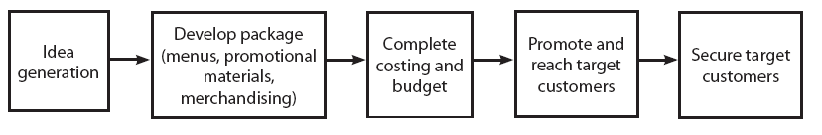
Creating venue generated events: the process
(Davidson and Hyde, 2014).

Slide 39
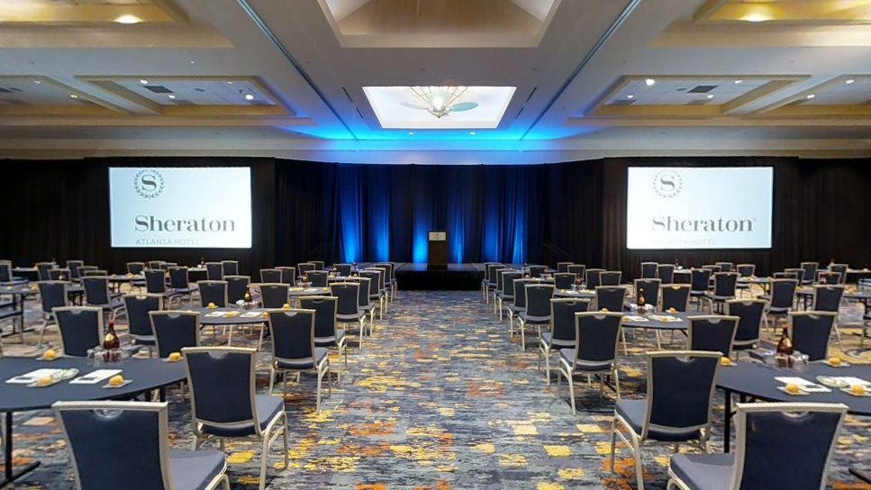
Event collateral
Includes:
  Logo of venue or establishment
  Contact information and location
  Information about the venue
  Floor plans, room setups and example menus
  Professional photographs
  List of products and services offered
  Pricing, including packages
  Reviews, classifications and awards

Slide 40
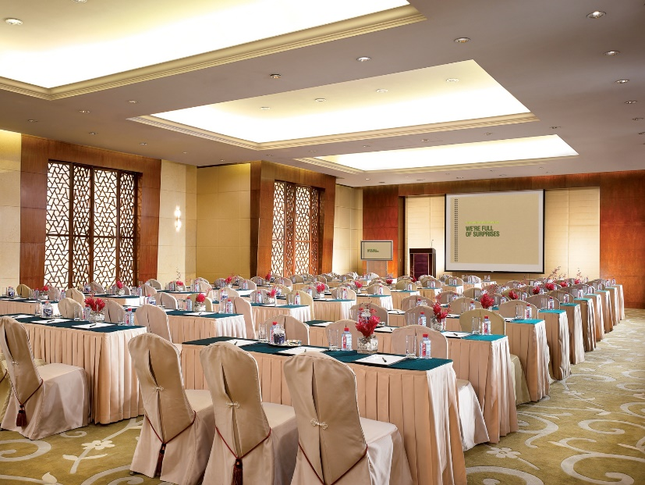
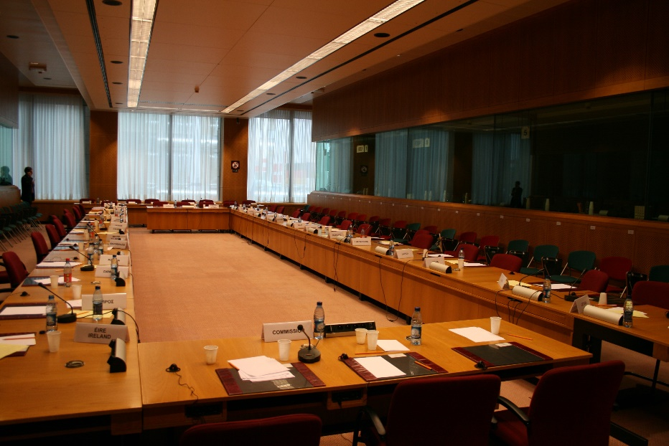
Virtual Tours
Using the Chat function on Teams, write down the benefits of hotels using virtual tours to advertise their event spaces, instead of the traditional sales pack and showround approach.
https://my.matterport.com/show/?m=44NzWtgL1C3&brand=0
https://my.matterport.com/show/?m=zm2ZF1rWadg

Slide 41
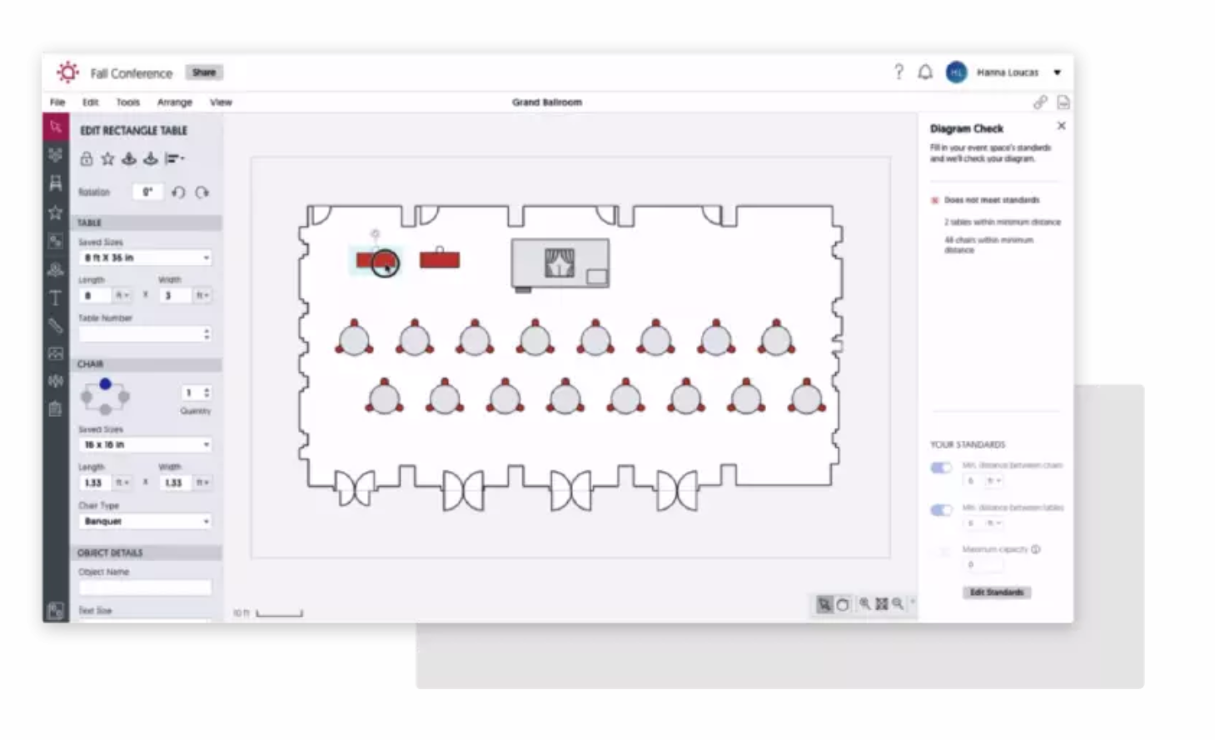
Technology
Sales packs are slowly becoming a thing of the past, as technology helps to drive new ways of working.
Cvent Event Diagramming: Better Events By Design | Cvent | Cvent UK

Slide 42
MICE technology at events
Facial recognition: This technology can be used to grant admission to registered attendees on Day 1 of the event. It also does away with the need for IDs or tickets since people entering can simply have their faces scanned.
Augmented, mixed, and virtual reality: As these technologies evolve, they create new chances for more immersive and engaging events. Especially for product demonstrations, presentations, or entertainment, AR and VR are opening endless new doors in the MICE industry.
Internet of Things: Web-based access control (think digital keys), thermostats, speakers, and lighting controlled via the internet: The Internet of Things makes it all possible and creates new ways for venues to tailor their service to the client’s needs.
Virtual event platforms: The increased demand for hybrid and virtual events created the need for sophisticated virtual platforms. Cvent’s Virtual Attendee Hub® addresses that by offering an online space where organisers and attendees can network, engage, and interact.

Slide 43
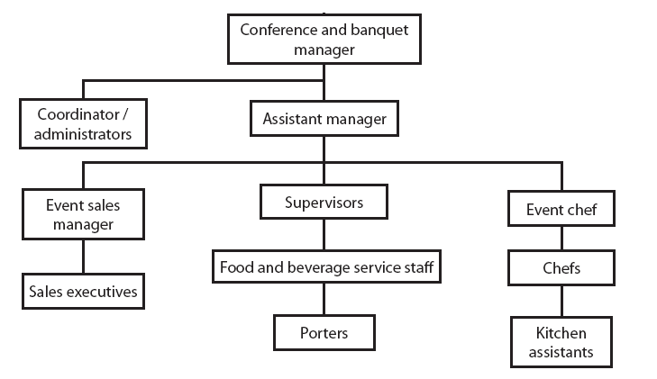
MICE jobs at a hotel level
  Some of the main skills and qualities required for any operator are:
  Welcoming and friendly approach
  Good personal presentation
  Flexibility in meeting customers’ needs
  Ability to sell products and services
  Planning and co-ordination skills
  Visible to staff and clients
  Hard working and creative

Slide 44
Events Assistant – What The Role Entails

Slide 45
Event evaluation is essential
Feedback from the customer
Feedback from team
Measure how the event performed against:
planned budget
event order
departmental service standards
Keep records
Ensure remedial action is taken as necessary

Slide 46
References
Cousins, Foskett, Graham and Hollier (2016). Food and Beverage Management. Wolvercote [Oxfordshire]: Goodfellow Publishers.
Getz, D. (2013) Event Studies. Hoboken: Taylor and Francis.
Hahn, J. (2021) What Is MICE? Guide to Meetings, Incentives, Conferences, and Exhibitions | Cvent Blog. [online] Cvent.com. Available at: <https://www.cvent.com/uk/blog/hospitality/what-is-mice> [Accessed: 24 October 2021].
Lau, C. (2016) Meetings, Incentives, Conventions & Exhibitions. [online] Edb.gov.hk. Available at: <https://www.edb.gov.hk/attachment/en/curriculum-development/kla/pshe/references-and-resources/tourism/MICE_English_2016.pdf> [Accessed: 24 October 2021].

Slide 47
Operating
Hotel Facilities
BMIH4006
Week 8
Meetings & Events
Ryan Anthony Peters
BA(Hons) PGDip MIH

