Slide 1
Presentation
Student Name: STELIAN MOCANU
Student ID number: 2215562
Hospitality and Guest Services(BMIH4003)
Module Tutor: MUHAMMAD CASSAMO

Slide 2

Westin Hotels & Resorts

Slide 3
Table of Contents
Introduction
Westin Hotels & Resorts
Westin’s Main Consumer
Nature, Scope and Role of the Guest Services and Facilities
Role and Function of Guest Services
Importance of Hospitality
Meet/Exceed Guest Expectations
Conclusion
References

Slide 4
Introduction
In the hospitality industry, quality service is fundamental as it boosts sales (Al-Refaie, 2015).
Good quality service aids in improving the satisfaction of the consumer.
The hospitality industry's goal is to make the guest feel at home while they are away from home.
This presentation will highlight Westin Hotels & Resorts, which is a brand of Marriott International.
The presentation will further highlight the guest services and facilities that are provided by the hotel.
Notes:
Quality service is essential in the hospitality industry as it boosts sales and improves consumer satisfaction which translates to less financial loss and a better revenue stream (Al-Refaie, 2015). This presentation will describe Westin Hotels & Resorts and the services and facilities that they provide to the guest.

Slide 5

Westin Hotels & Resorts
Westin Hotels & Resorts is a hospitality leader in wellness.
The hotel empowers guests by providing them with good facilities and services.
The brand has almost 225 resorts and hotels in 40 countries.
This hotel is owned by Marriott International and was founded in 1930 (Westin, 2023).
Notes:
Westin is a subsidiary of Marriott International. The hotel is a known leader for providing good guest services in the hospitality sector. The hotel operates in almost 40 countries and empowers guests to transcend the travel rigours while on the road through six pillars of health and well-being: Sleep Well, Eat Well, Move Well, Feel Well, Work Well, and Play Well (Westin, 2023).

Slide 6
Westin’s Main Consumer
Westin primarily targets sophisticated consumer who seeks hotel experience without pretence.
The consumer of Westin value authenticity, which the hotel delivers.
The consumer of the hotel are individuals who are used to nobility and luxury.
Westin focuses on the market of high-end customers.
The hotels are recognised by local authorities as five start hotels (Segran, 2018).
Notes:
Westin's primary consumers are individuals from the upper and upper-middle class who are used to nobility and luxury. The hotel attracts consumers by providing and showing effective and good quality experiences and services. The hotel is located in convenient places, and consumers can easily go shopping and sightseeing. The hotel is known for its exceptional consumer service, relaxing environment and modern design. The hotel provides the consumer with a relaxing environment and accommodations. The hotel provides unique experiences to consumers as its focuses on wellness and continues with its commitment to its consumer health and well-being lifestyle. The hotel provides its upper-class guest with reinvigorating rooms. To attract consumers, the business provides a huge focus on sustainability. The business has recently introduced a sustainability program that processes, reweaves and collects bed linens into children's pajamas and provides them to families in need (Segran, 2018).

Slide 7

Nature, Scope and Role of the Guest Services and Facilities
Westin applies an industry-leading approach to public space design.
This allows travellers to stay refreshed, connected and balanced on the road.
The design of Westin hotels and resorts is done by keeping the well-being of guests in mind (Smith, 2021).
The concept of a hotel serves as a modern-day oasis for demanding travellers.
Notes:
Westin offers experiences that aids consumers in feeling better and at home (Smith, 2021). The business provides enhanced focus on employee training for that they can attain high consumer satisfaction. The style and décor of the hotel are done by keeping guest expectations in mind.

Slide 8
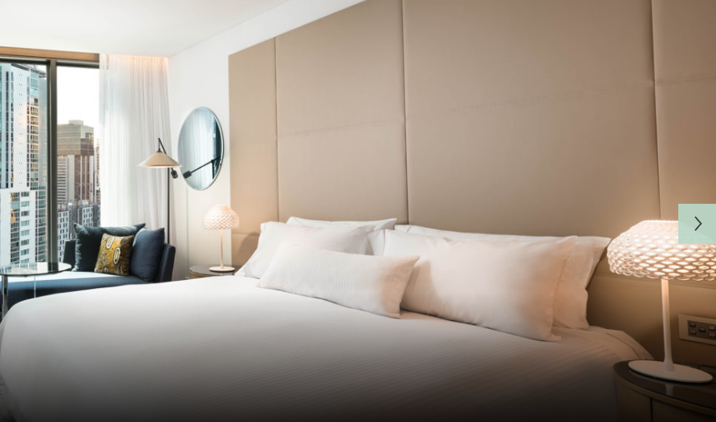
Nature, Scope and Role of the Guest Services and Facilities
The hotel incorporates flexibility, functional zoning and natural design elements and grab-and-go places.
The hotel charges £292 for a standard room that is booked for a night (TripAdvisor, 2023).
Westin is a premium brand in the hospitality sector which is known for its wellness program and high-quality services.
Notes:
The hotel follows a modern-day oasis design to ensure that they provide better flexibility and functioning zone to consumers, which would provide more convenience. The business charge high for a single room as it is a premium brand (TripAdvisor, 2023). The hotel further offers vacation packages, special offers and hotel discounts. Westin further offers healthy menu options and a workout Gear lending program so that they can ensure the wellness of guests.

Slide 9
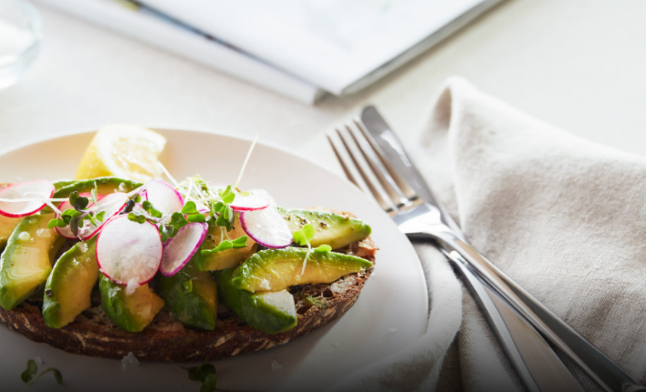
Role and Function of Guest Services
Guest services basically offer the foundation for services in the hospitality sector (Adam et al., 2021).
In Westin, hotel managers ensure that their guest services meet the standards and quality of consumer expectations.
The hotel develops a wellness program by focusing the trends of guests on keeping more focus on well-being.
Notes:
Westin hotel focuses on providing improved guest services so that they can attain guest satisfaction as well as loyalty. The business also develops its campaigns by focusing on trends and expectations of guests so that consumer loyalty can be inspired. Through providing good guest services, Westin was able to retain talent, foster loyalty to the brand and recover consumer acquisition costs.

Slide 10

Role and Function of Guest Services
By focusing on guest services, the hotel was able to improve its image and attain consumer satisfaction.
The function of guest service is that it offers assistance to the guest's request and needs.
Guest service ensures that individuals are responded to in an efficient and timely manner (Lee and Lee, 2020).
Notes:
According to Adam et al. (2021), guest services are considered the consistent delivery of services and products which are not only meeting guest expectations but exceed them. Its focus is on offering a delightful hotel experience that lasts a lifetime (Lee and Lee, 2020).

Slide 11
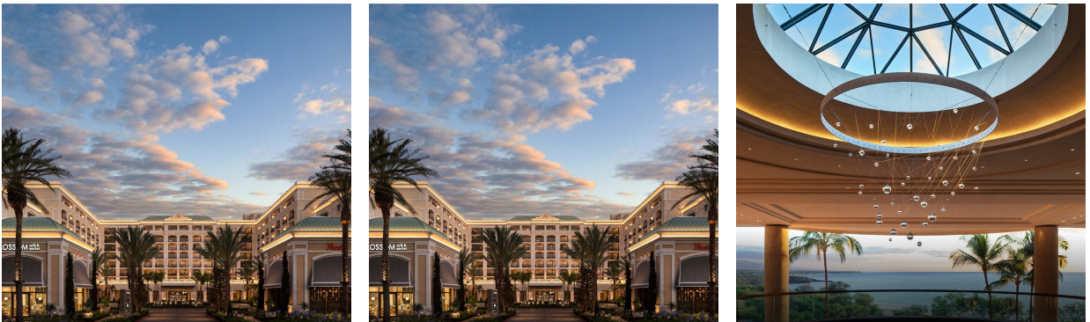
Importance of Hospitality
Hospitality aids in developing better and strong relationships with guest
The hotels can see from a different perspective (Ionel, 2016).
Hospitality is important as it reminds the individual what the brand is offering.
Hospitality also supports economies and jobs (Wilson, 2020).
Notes:
In the view of Wilson (2020), hospitality implies respect, protection and warmth. Hospitality builds appreciation and understanding among cultures. Hospitality is a consumer of the exciting, fast-growing and dynamic industry to work in. hospitality includes friendly treatment of tourists or guests. The hospitality industry deals with accommodation, recreational, food and drink facilities (Ionel, 2016).

Slide 12
Meet/Exceed Guest Expectations
The primary expectation of guests from a hotel is communication, comfort and cleanliness (Kim and Kim, 2017).
Westin hotel and resorts always try to meet the requirements and needs of the guest.
The brand puts a high focus on the well-being of the guest.
Westin meets the expectation of guests by following the trends of wellness as well as the hospitality sector.
By meeting and exceeding guest expectations, the brand is trying to attain consumer satisfaction.
Notes:
In the hospitality sector, earning consumer trust is considered fundamental. To do that, it is required by the hotel brand to meet and exceed the expectations of guests (Kim and Kim, 2017). Westin is known for working on the wellness of guests, due to which they have attained loyalty and high consumer satisfaction. Westin, by exceeding guest expectations, generated profitable sales and was able to become a premium brand. The hotel further offers personalised services to consumers, like healthy food options and workout programs, so that they can feel special. Meeting guest expectations allow Westin to attain further opportunities for experimentation. Recently, the brand has been focusing on reducing its environmental impact by recycling bed linens into children's pajamas. The business is also focusing on promoting wellness in a guestroom.

Slide 13
Conclusion
Westin hotels and resorts were founded in 1930
Operates in almost 40 countries
The primary consumers are the upper and upper-middle classes, who are used to nobility and luxury.
The business provides its rooms at a high cost due to being a premium brand.
The business focuses on guest wellness due to which it was able to attain high consumer satisfaction.
Notes:
In a nutshell, it can be summarised that Westin is a premium brand under Marriott International. Consumer satisfaction is an essential factor for hotel brands to attain high sales and gain a competitive advantage. The brand works with the newest wellness and sustainability trend to attain consumer trust. The hotel follows a modern-day oasis design to attract guests and meet their needs and expectations of wellness.

Slide 14
Thank you
Thank you

Slide 15
References
Adam, M., Wessel, M. and Benlian, A., 2021. AI-based chatbots in customer service and their effects on user compliance. Electronic Markets, 31(2), pp.427-445.
Al-Refaie, A., 2015. Effects of human resource management on hotel performance using structural equation modeling. Computers in Human Behavior, 43, pp.293-303.
Ionel, M., 2016. Hospitality industry. Ovidius University Annals: Economic Sciences Series, 1(1), pp.187-191.
Kim, S.B. and Kim, D.Y., 2017. Antecedents of corporate reputation in the hotel industry: The moderating role of transparency. Sustainability, 9(6), p.951.
Lee, S.M. and Lee, D., 2020. “Untact”: a new customer service strategy in the digital age. Service Business, 14(1), pp.1-22.
Segran, E. 2018. Westin Is Turning Discarded Bedsheets Into Pajamas For Kids In Need. [Online] Available at https://www.fastcompany.com/40539139/westin-hotels-is-turning-bedsheets-into-pajamas-for-kids-in-need [Accessed on 2 Feb 2023]
Smith, M.K., 2021. Creating wellness tourism experiences. In Routledge handbook of the tourist experience (pp. 364-377). Routledge.
TripAdvisor 2023. The Westin London City. [Online] Available at https://www.tripadvisor.com/Hotel_Review-g186338-d23610786-Reviews-The_Westin_London_City-London_England.html [Accessed on 2 Feb 2023]
Westin 2023. Westin Hotels and Resorts. [Online] Available at https://westin.marriott.com/ [Accessed on 2 Feb 2023]
Wilson, B., 2020. Urban heat management and the legacy of redlining. Journal of the American Planning Association, 86(4), pp.443-457.

