Slide 1
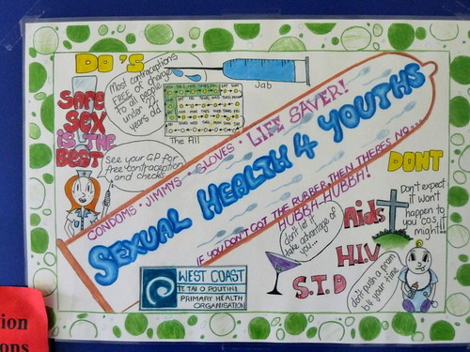
Sexual Health
ThePhoto by PhotoAuthor is licensed under CCYYSA.

Slide 2
Overview
Recent statistics on adolescent pregnancies and STIs in Wales.
Fun Ice breaker activity.
Understanding sexual activities.
Contraception and prevention methods.
Information on STIs and infections.
Sexual health services available.
Quick multiple-choice quiz to round up.

Slide 3
Safe Contract
You don't have to participate in anything.
Respect each other’s boundaries and choices.
This is a safe space for learning, we want everyone to feel respected.
There is no judgement.
Everything shared in the room stays in the room.
If you feel uncomfortable at any point, please let me know.
You are welcome to leave or take a break at any time if you feel uncomfortable.
There is no pressure to share personal information or experiences.

Slide 4
Statistics

Slide 5
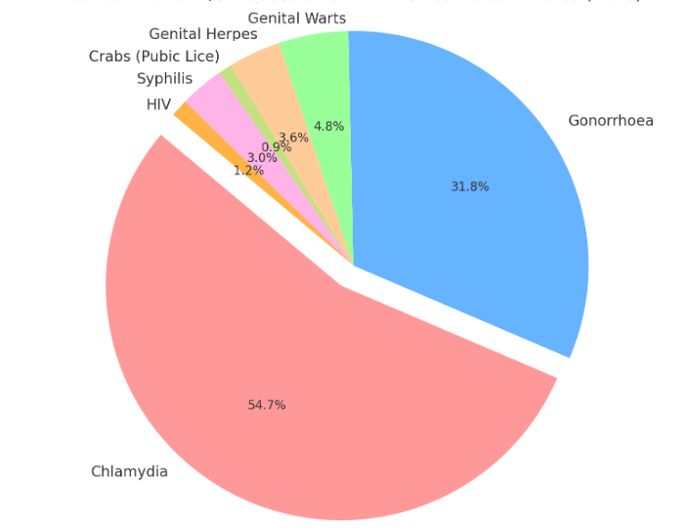
Sexually Transmitted Infections of Young People in Wales
Notes:
These statistics highlights why sexual health education is important to making the correct choices

Slide 6

Ice Breaker Activity
Agree
Disagree
Unsure

Slide 7
Rates of STIs in young people in Wales have dropped in the last 5 years.

Slide 8
You can always tell if someone has an STI just by looking at them.

Slide 9
Consent is an important part of any sexually active relationship.

Slide 10
You can't get a sexually transmitted infection (STI) from oral sex.

Slide 11
STIs only affect certain groups of people.

Slide 12
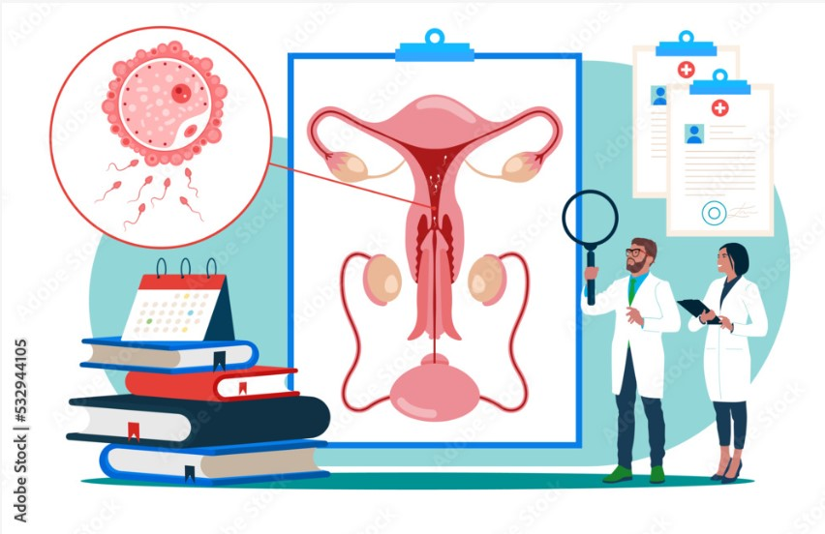
Intercourse
Physical contact with genitals.
Includes vaginal, anal or oral sex.
Can happen between people of any gender.
Vaginal intercourse is when sperm from a penis meets an egg in the vagina, which can lead to pregnancy.
(Stock.Adobe.com, n.d.)

Slide 13

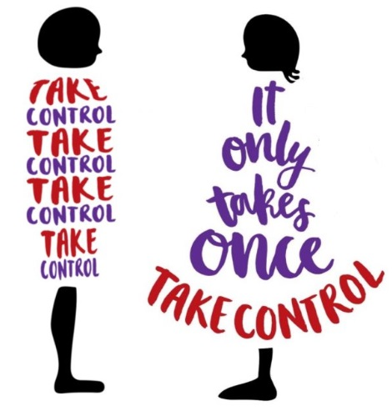

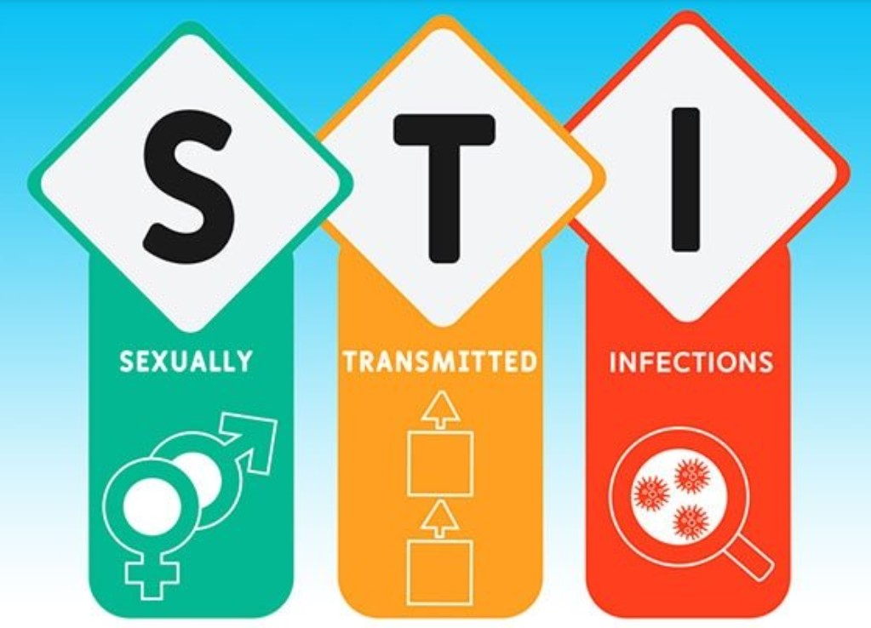
It only takes ONCE when not practiced safely!
Unprotected vaginal intercourse can lead to pregnancy.
All types of intercourse can spread sexually transmitted infections (STIs) and HIV if protection isn't used.
Talk openly with your partner, respect each other's boundaries.
It's important to talk about consent.
(Amani UK, n.d.)
(Stock images Word, n.d)
Notes:
We will explore teenage pregnancy in more detail in the next session as part of this six-week program.

Slide 14
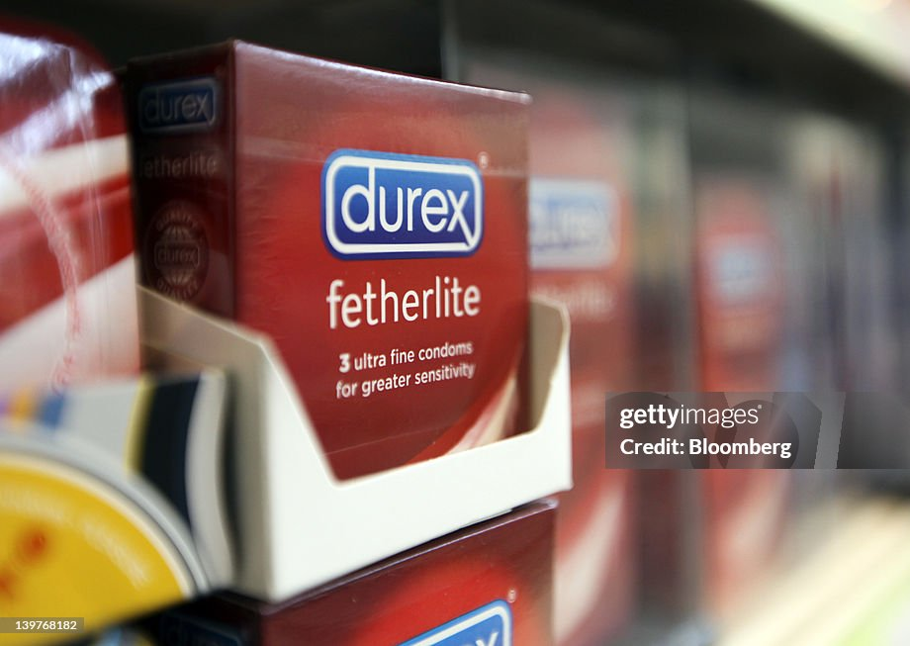

Prevention and Protection
There are different methods to help prevent unplanned pregnancies and reduce STIs.
Condoms protect against both pregnancies and STIs.
It's everyone's responsibility to use condoms not just one person.

Slide 15
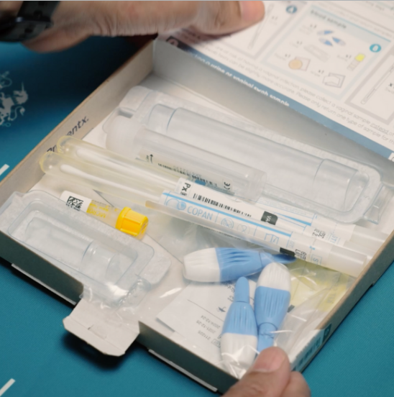
Reduce the risk of catching and passing STIs during sexual activities.
STI checks are important if you have unprotected sex or have more than one partner.
Talk with partners openly about boundaries, consent, sexual health and STIs to build trust and safety.

Slide 16

Condom Banana Activity
Important to use condoms correctly to reduce the risks of STIs and HIV.
Consent needs to come from both individuals.
Check expiry date.
Check package next for air bubbles, don't use if you can't feel any as the packaging could be punctured and not safe to use.

Slide 17


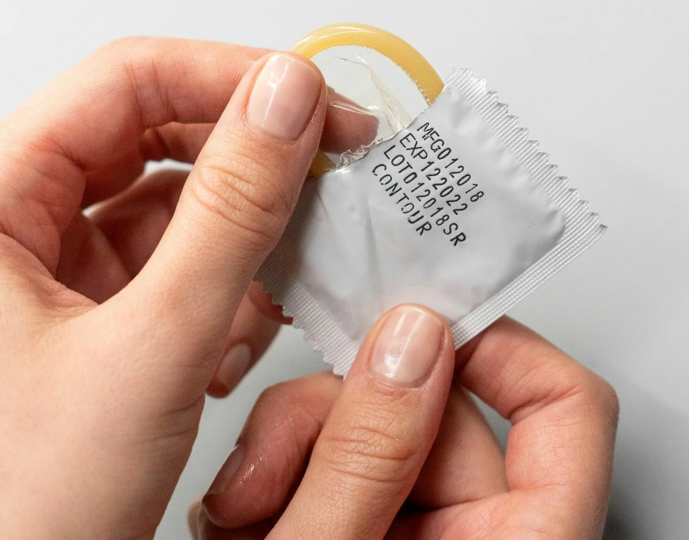
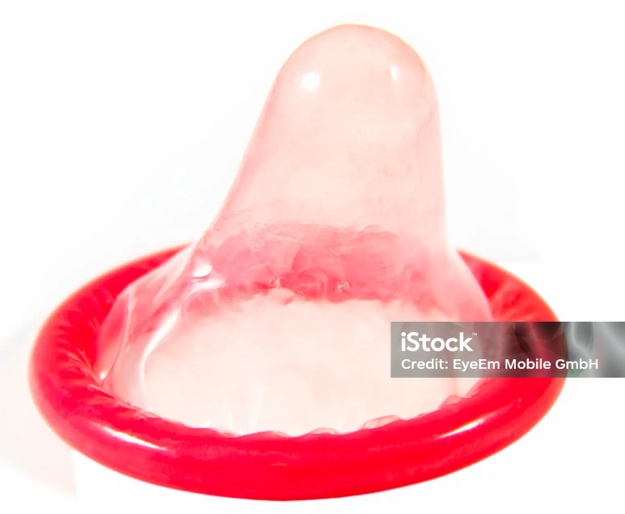
(Dreamstime, n.d.)
Open – DON’T use your teeth in case of puncturing.
Push to one side and peel down on tethered edge.
Push out to the open side.
To make sure it’s the right way up, blow into it gently. The rim should roll outward to look like a little hat.
Use a new one If you accidentally touch it more than you need to or roll it the wrong way.
(GMG Pharmacies, n.d.)
(Adobe Stock, n.d.)

Slide 18


Pinch the tip and roll the condom all the way down to the base of the Penis.
Pinching will leave room for the semen and will help to stop the condom breaking when being used.​
Now you're ready for action.​
(Shutterstock, 2023)
(Shutterstock, 2023)

Slide 19
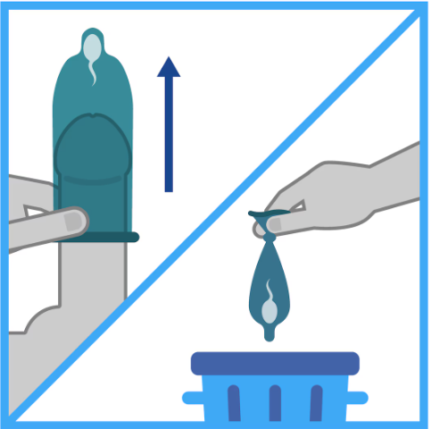
When you're ready to remove the condom, hold onto the condom when pulling out.
Move away from your partners body and carefully remove it.
Tie a knot in it and throw it in the bin, not down the toilet or in the hedge.
Read the instructions on the leaflet inside a condom packet if you're ever unsure.
(Shutterstock, 2023)

Slide 20


STI Symptoms
(Stock images Word, n.d)​

Slide 21
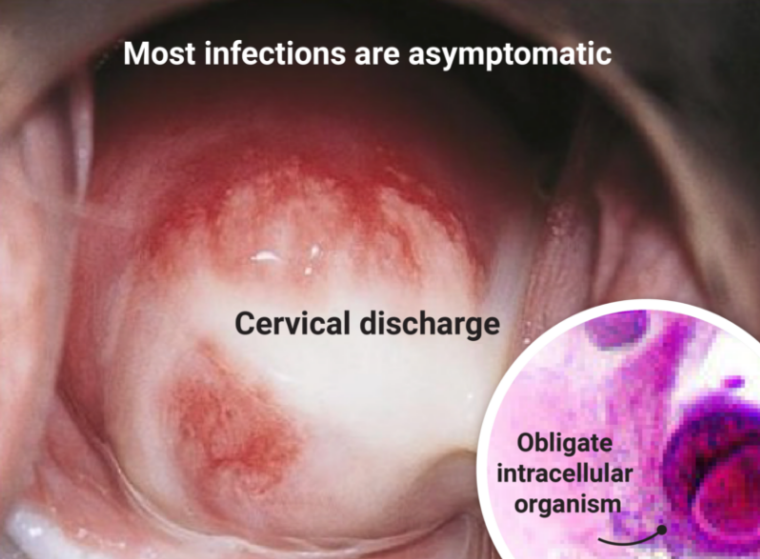
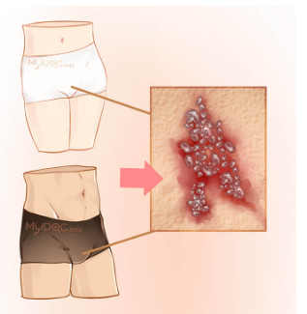
Chlamydia - is the most common. Often no symptoms but may cause pain when urinating , unusual discharge or pain in lower belly. Treatable with medication.
Gonorrhea - painful when urinating, unusual discharge or soreness in the genital or anal area. Sometimes no symptoms. Treatable with medication.

Slide 22
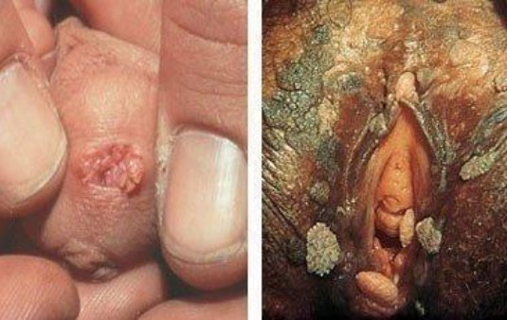
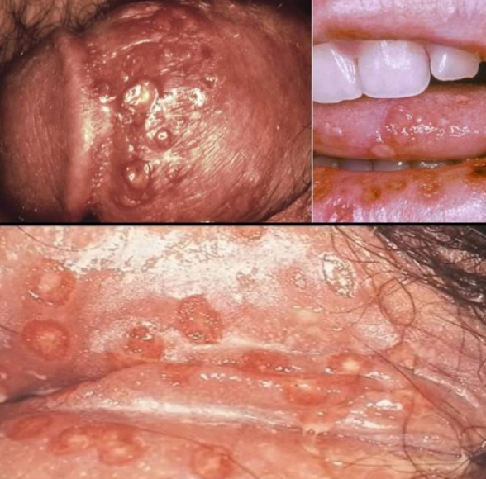
Genital warts – Small growths or bumps in the genital areas. Treatable (With injections)
Genital herpes – Painful blisters or sores around the genitals, mouth or anus. Symptoms come and go but the virus in your body for life. It can be managed with medication.

Slide 23
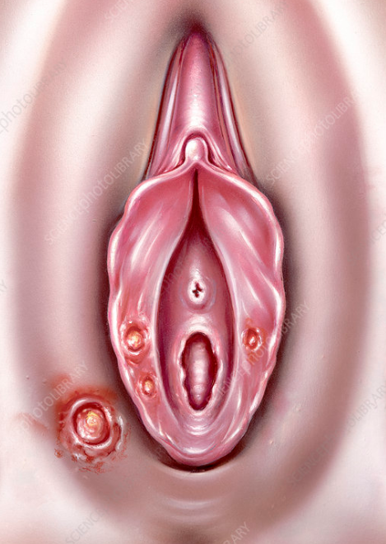
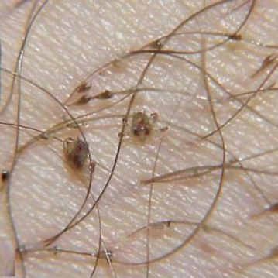
Syphilis – Starts painless sores or ulcers followed by a rash. Can cause serious health problems later in life if untreated. Treatable with right medical care.
Pubic Lice (crabs) - Persistent itching in the genital area and visible lice or eggs in the pubic hair. Treatable with special creams or shampoos.

Slide 24
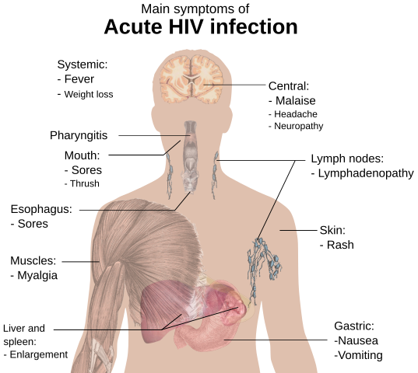
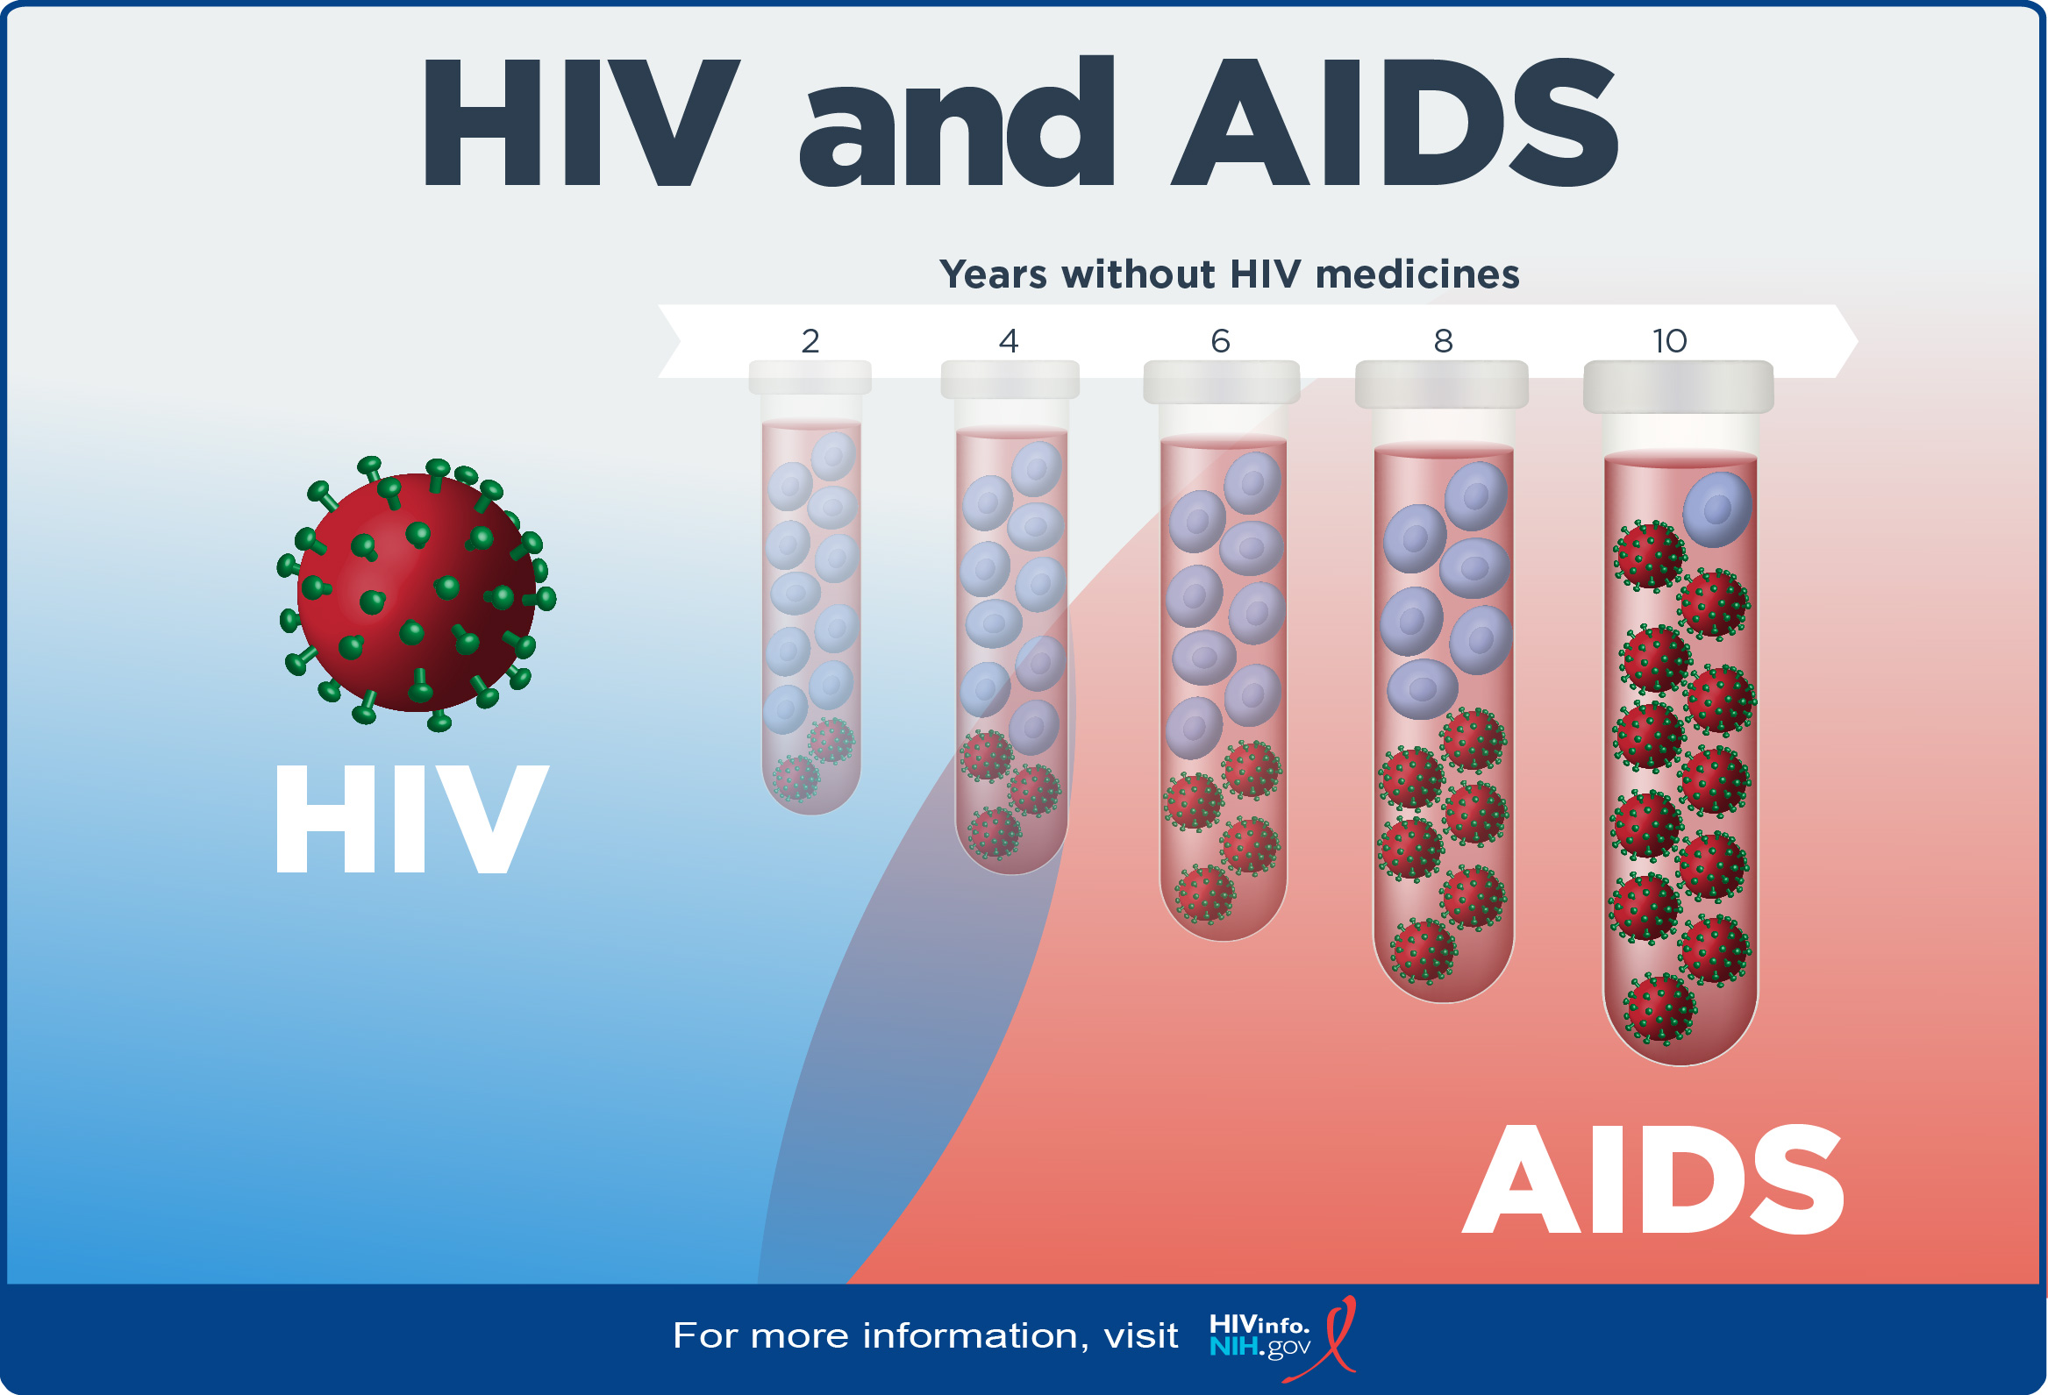
HIV – Fluey symptoms to start like a fever. It Is life changing but people can live longer, healthy lives with right treatment.
Treatment also helps prevent the virus developing into AIDS. (Acquired Immune Deficiency Syndrome) Uncurable but can be kept under control .
(Wikipedia, 2023)
(Ribdo, n.d.)

Slide 25





Services Available
Sexual Health Clinics
Youth Workers
School Nurses
Doctors
Pharmacies
(Bristol University, 2020)
(Stock images Word, n.d)​
(LA Public Health, n.d)
(Education HQ, n.d)
(Alamy, 2013)
Notes:
Hand outs for links
Sexual Health Clinics: Free and confidential STI testing, contraception, advice. Youth Workers: Support and guidance on sexual health and relationships. School Nurse: Accessible for confidential advice and resources Doctors: Regular health check-ups, STI testing, and advice. Pharmacies: Access to contraception and emergency contraception.

Slide 26

Multiple Choice Questionnaire

Slide 27


Decrease in adolescent pregnancy in the last 10 years.
STIs in Wales and how to protect yourself safely.
Contraception like condoms.
Services available for support.
Next session will be adolescent pregnancy and more contraception methods.
Thank you
(Stock images Word, n.d)​

Slide 28
Reference List
8 types of icebreakers that work best [with templates] (2025) Reply. Available at: https://reply.io/blog/icebreakers/ (Accessed: 13 January 2025).
12 common mistakes when using condoms (2024) Brook. Available at: https://www.brook.org.uk/your-life/condoms-common-mistakes/ (Accessed: 13 January 2025).
Admin (2023) About genital herpes, Fekomi Herbals. Available at: https://fekomiherbals.com/2023/07/11/about-genital-herpes/ (Accessed: 12 January 2025).
Best gonorrhea treatment in Butterworth - price guide & reviews (no date) Erufu Care. Available at: https://www.erufucare.com/clinics/gonorrhea-treatment/butterworth (Accessed: 12 January 2025).
By et al. (2024) Piaget’s formal operational stage: Definition & examples, Simply Psychology. Available at: https://www.simplypsychology.org/formal-operational.html (Accessed: 11 January 2025).
Condom on banana copy space stock footage video (100% royalty-free) 511597 (no date) Shutterstock. Available at: https://www.shutterstock.com/video/clip-511597-condom-on-banana-copy-space (Accessed: 12 January 2025).
Durex (no date) A beginner’s guide on how to use a condom, Durex. Available at: https://www.durex.com.my/blogs/explore-sex/how-to-put-on-a-condom/ (Accessed: 11 January 2025).
Editor, B. (2022) Getting tested for an STI: Your guide to how it works, UK Health Security Agency. Available at: https://ukhsa.blog.gov.uk/2022/10/05/getting-tested-for-an-sti-your-guide-to-how-it-works/ (Accessed: 13 January 2025).
Feldstein Ewing, S.W., Ryman, S.G., Gillman, A.S. et al. (2016) Developmental Cognitive Neuroscience of Adolescent Sexual Risk and Alcohol Use. AIDS Behav, 20(Suppl 1), 97–108. Available at: https://doi.org/10.1007/s10461-015-1155-2.
FREE, C., MCCARTHY, O.L., PALMER, M.J., KNIGHT, R., EDWARDS, P., FRENCH, R., BARAITSER, P., FORD COLIN, I.H., WELLINGS, K., ROBERTS, I., BAILEY, J.V., HART, G., MICHIE, S., CLAYTON, T., PLOUBIDIS, G.B., CARPENTER, J.R., TURNER, K.M.E., DEVRIES, K. and POTTER, K. (2020) Safetxt: a safer sex intervention delivered by mobile phone messaging on sexually transmitted infections (STI) among young people in the UK - protocol for a randomised controlled trial, BMJ Open, 10(3).
Gadotti, M. and Torres, C.A., 2009. Paulo Freire: education for development. Development and change, 40(6), pp.1255-1267.
Genital warts (no date) Foothill Dermatology Medical Center. Available at: https://www.foothillderm.com/blog/genital-warts-1 (Accessed: 12 January 2025).
How to use a condom (and why) (no date) YouTube. Available at: https://www.youtube.com/watch?v=fwc9vb3ZPac (Accessed: 08 January 2025).
How to use a condom (no date) Centers for Disease Control and Prevention. Available at: https://www.cdc.gov/condom-use/resources/external.html (Accessed: 12 January 2025).
Human immunodeficiency virus infection (no date) ScienceDirect Topics. Available at: https://www.sciencedirect.com/topics/medicine-and-dentistry/human-immunodeficiency-virus-infection (Accessed: 04 January 2025).

Slide 29
Hrytsenko, A. (2016) Woman opens condom stock photo, image of opening, safe - 81232944, Dreamstime. Available at: https://www.dreamstime.com/stock-photo-woman-opens-condom-young-opening-teeth-package-closeup-image81232944 (Accessed: 13 January 2025).
HIV/AIDS (2025) Wikipedia. Available at: https://en.wikipedia.org/wiki/HIV/AIDS#/media/File:Symptoms_of_acute_HIV_infection.svg (Accessed: 12 January 2025).
https://www.shutterstock.com/image-vector/conclusion-text-on-white-background-2511645971 (no date) NHS choices. Available at: https://www.nhs.uk/conditions/genital-warts/ (Accessed: 13 January 2025).
James Myhre & Dennis Sifris, M. (no date) HIV: Signs and symptoms to look out for, Verywell Health. Available at: https://www.verywellhealth.com/hiv-aids-symptoms-4014373 (Accessed: 12 January 2025).
Keep a girl in school (2022) AmaniUK. Available at: https://www.amaniuk.org.uk/keep-a-girl-in-school/ (Accessed: 02 January 2025).
Library, J.B.P. (no date) Syphilis chancres on vulva, illustration - stock image - C050/7061, Science Photo Library. Available at: https://www.sciencephoto.com/media/1156255/view/syphilis-chancres-on-vulva-illustration (Accessed: 12 January 2025).
McLeod, S., 2011. Albert Bandura's social learning theory. Simply Psychology. London.
Only one banana was harmed during the filming of this tik tok. [#videodescription: Demonstration of how to use an external condom. end video description.] (no date) Facebook. Available at: https://www.facebook.com/watch/?v=3093466224262445 (Accessed: 08 January 2025).
Penetration and sexual intercourse of penis and vagina, male and female sex organ have sex, semen and sperm are ejaculated into uterus, seminar, lecture, Healthcare Meeting, vector illustration (no date) Adobe Stock. Available at: https://stock.adobe.com/vn/images/penetration-and-sexual-intercourse-of-penis-and-vagina-male-and-female-sex-organ-have-sex-semen-and-sperm-are-ejaculated-into-uterus-seminar-lecture-healthcare-meeting-vector-illustration/532944105 (Accessed: 05 January 2025).
Primary Care Dermatology Society (no date) Pubic lice (syn. pediculosis pubis), Primary Care Dermatology Society. Available at: https://www.pcds.org.uk/clinical-guidance/pubic-lice (Accessed: 12 January 2025).
Ramiro, L., Reis, M., de Matos, M.G. et al. (2012) Knowledge, Attitude and Behaviour Related to Sexually Transmitted Infections in Portuguese School (Adolescent) and College Students, Sexually Transmitted Infections, InTech. Available at: http://dx.doi.org/10.5772/33185.
Sexual health (no date) Public Health Wales. Available at: https://phw.nhs.wales/topics/sexual-health/ (Accessed: 09 January 2025).
Sexual health clinics - LA county department of public health (no date) Available at: http://publichealth.lacounty.gov/chs/sexualhealthclinics/ (Accessed: 09 January 2025).
Sexually transmitted infections (STIs) (no date a) Centers for Disease Control and Prevention. Available at: https://www.cdc.gov/sti/ (Accessed: 09 January 2025).
Sexually transmitted infections (STIs) (no date b) World Health Organization. Available at: https://www.who.int/health-topics/sexually-transmitted-infections/#tab=tab_1 (Accessed: 07 January 2025).

Slide 30
Stock photos, royalty-free images, graphics, vectors & videos (no date) Adobe Stock. Available at: https://stock.adobe.com/ (Accessed: 12 January 2025).
Tell us whether you accept cookies (no date) Home - Office for National Statistics. Available at: https://www.ons.gov.uk/ (Accessed: 04 January 2025).
The Humanistic Theory by CARL ROGERS - Simplest Explanation Ever (no date) YouTube. Available at: https://www.youtube.com/watch?v=sL44CV2i6NQ (Accessed: 13 January 2025).
Trimmer-Platman, T. (no date) Youth work, Policy Press. Available at: https://policy.bristoluniversitypress.co.uk/youth-work (Accessed: 09 January 2025).
What are sexually transmitted diseases? How to use STDs Rapid Test Kit? (2023) Vitrosens Biotechnology. Available at: https://vitrosens.com/what-are-sexually-transmitted-diseases-how-to-use-stds-rapid-test-kit/ (Accessed: 02 January 2025).
Yehuda Wolf, M. (2024) Rapid review: Chlamydia cervicitis, RoshReview.com. Available at: https://www.roshreview.com/blog/rapid-review-chlamydia-cervicitis/ (Accessed: 13 January 2025).
Young people and sexual health in Wales (2022) Public Health Wales. Available at: https://phw.nhs.wales/topics/young-people-and-sexual-health/ (Accessed: 12 January 2025).
YouTube video demonstrating correct condom usage (no date) YouTube. Available at: https://www.youtube.com/watch?v=dGnsU8kzty4 (Accessed: 13 January 2025).
Zimlich, R. (2025) CDC recommends comprehensive approach to tackling syphilis epidemic, Medical Economics. Available at: https://www.medicaleconomics.com/view/cdc-recommends-comprehensive-approach-to-tackling-syphilis-epidemic (Accessed: 14 January 2025).

