Slide 1
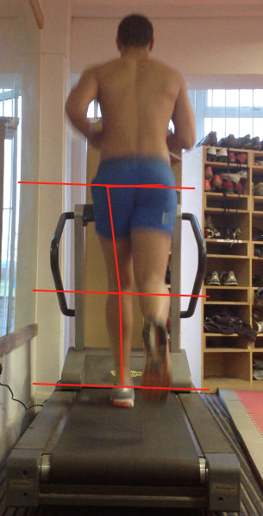
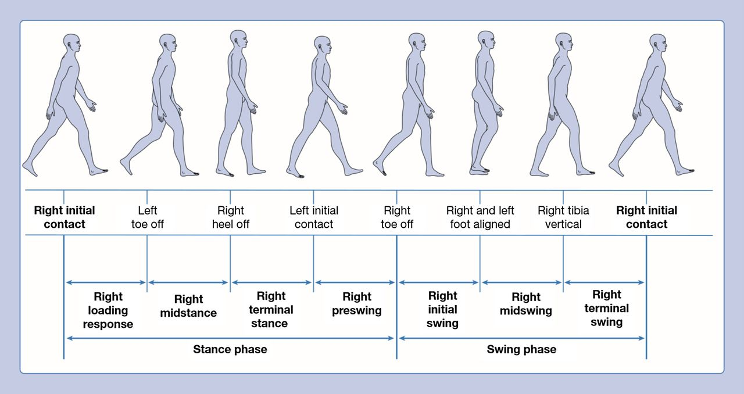
Gait Analysis
The study of human motion and posture to enhance walking or running performance and to reduce the occurrence of injury

Slide 2
Factors Influencing Gait
Terrain
Equipment
Anthropometrics characteristics
Psychological influence
Pathological factors

Slide 3
Use of Gait Analysis
Improve posture, walking and running technique / performance.
Reduce hypokinetic health conditions.
Reduce likelihood of developing musculoskeletal strategies compensatory.
Improve pain free movement.

Slide 4
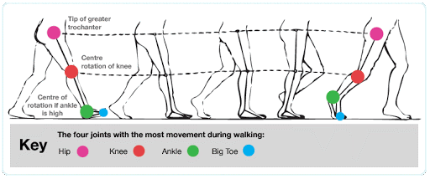
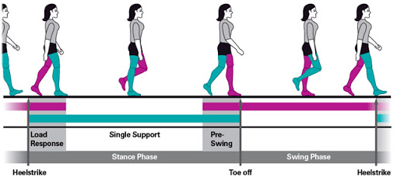
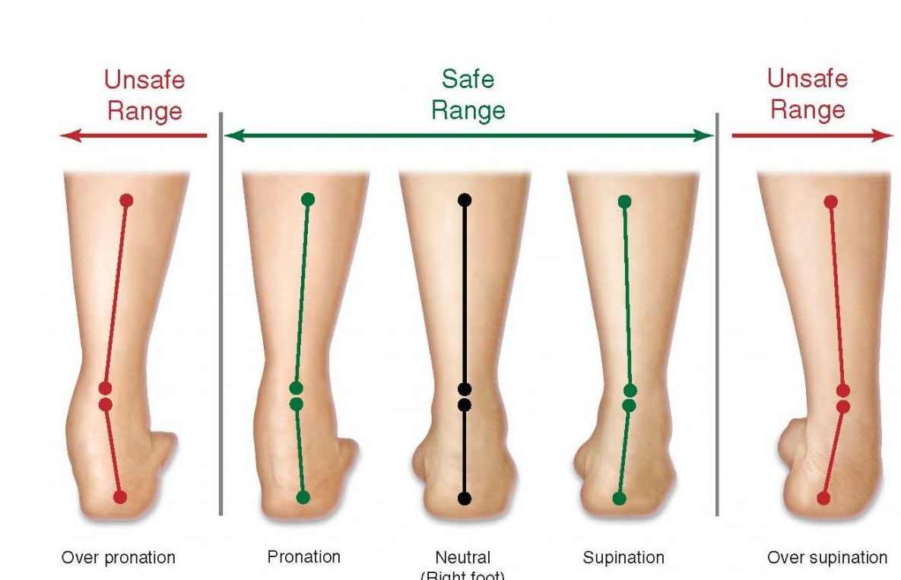
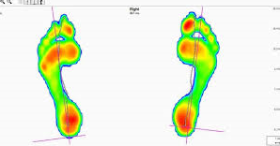
Measurements

Slide 5
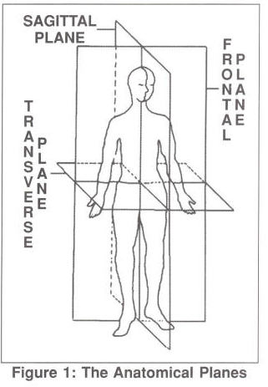
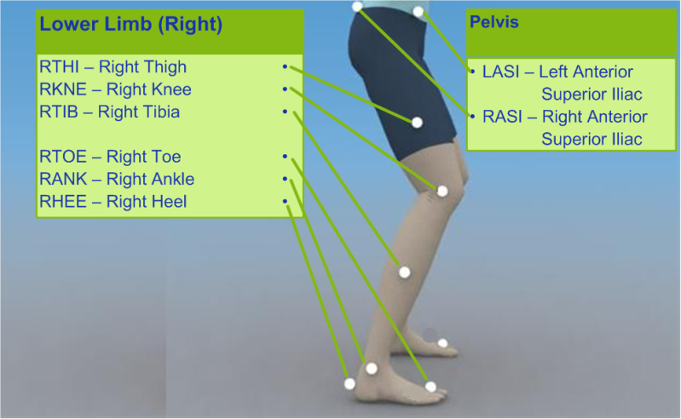
Video Analysis
Record gait in the sagittal plane in the frontal plane

Slide 6
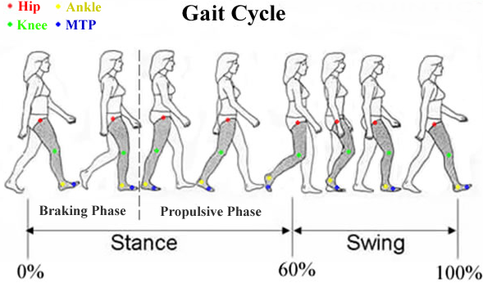
Phases of the Gait Cycle
Stance Phase Swing Phase
initial contact Initial swing (Accel^{n})
loading (flat foot) Mid-swing (Toe Off)
Mid Stance Terminal Swing (Deccel^{n})
Terminal Stance (heel off)
Pre-swing (Toe off)

Slide 7
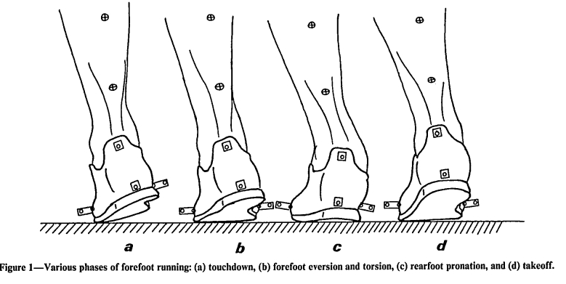
Rear View Analysis
Inversion v Eversion
Risk of injury
Overuse
Efficiency of impact forces
Changes due to wearing trainers

Slide 8
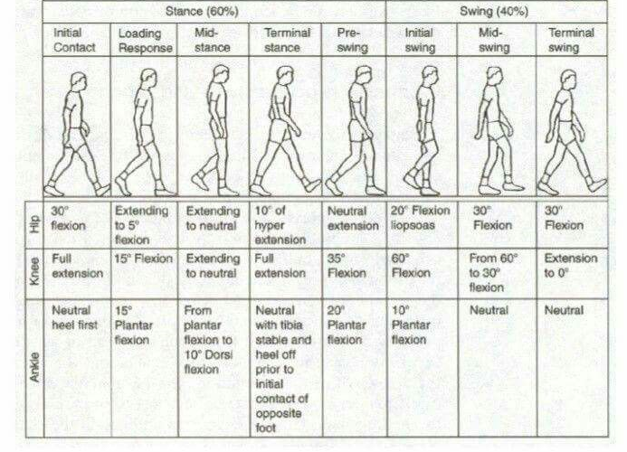
Measures used to Evaluate Gait
Stride length
Stride time
Cadence
Speed
Foot / ankle impact angle
Hip impact angle
Leg strength
Joint ROM
Pelvis angle
Stride base

Slide 9
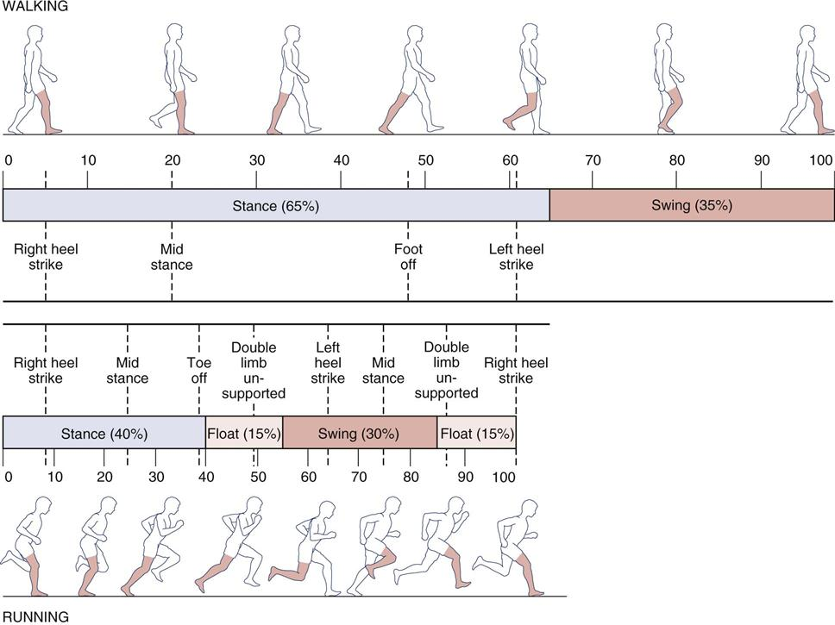
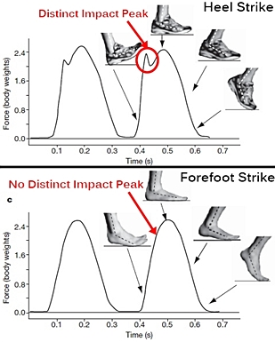
Walking v Running

Slide 10
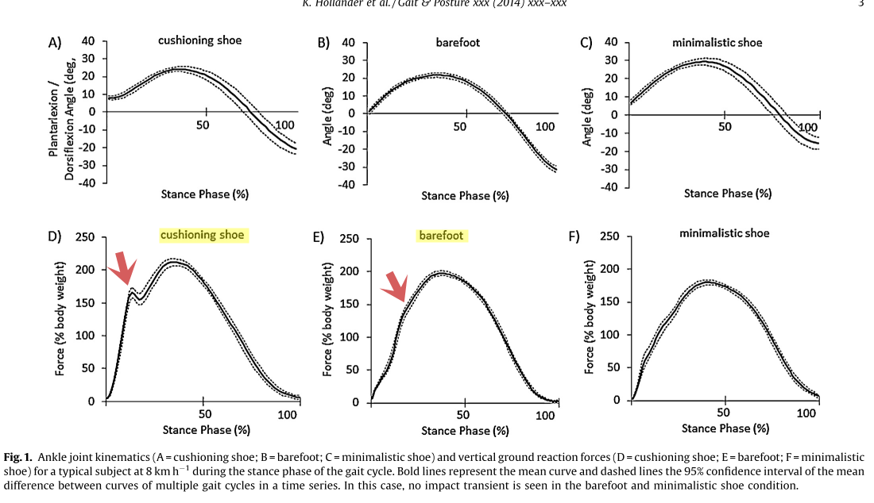
Barefoot v Trainers

