Slide 1

Computer Forensics
Charbel Baaklini

Slide 2

Summary
Introduction
Features and capabilities
Categorization
Distinguishing Capabilities
Real World Use Cases
Advancements and Innovations
Adaptation to Evolving Technologies

Slide 3
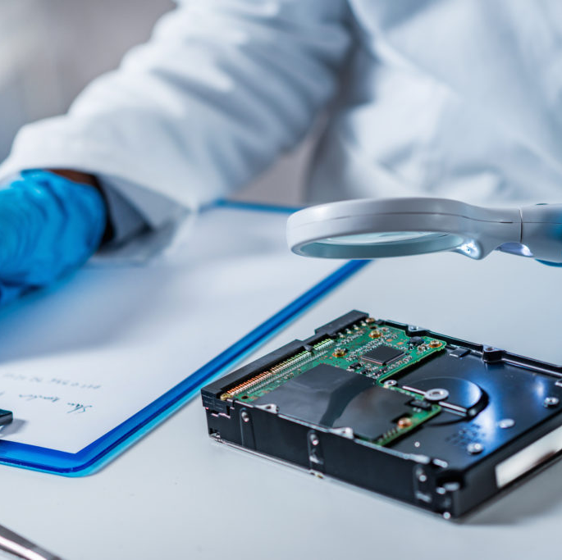
Introduction
Investigate devices / system
Collecting → Preserving → Analyzing
Computers, smartphones…
Special tools
Uncover the crime and who was involved
Prevent similar incidents

Slide 4

Features / Capabilities
Disk Imaging
File Carving
Keyword Searching
Metadata Analysis
Hashing
Reporting

Slide 5

Categorization
Disk Forensics
Memory Forensics
Network Forensics
Mobile Forensics
Multimedia Forensics

Slide 6

Distinguishing Capabilities
Disk Forensics
Memory Forensics
Network Forensics
Mobile Forensics
Multimedia Forensics

Slide 7

Disk Forensics
Memory Forensics
Network Forensics
Mobile Forensics
Multimedia Forensics
Real World

Slide 8
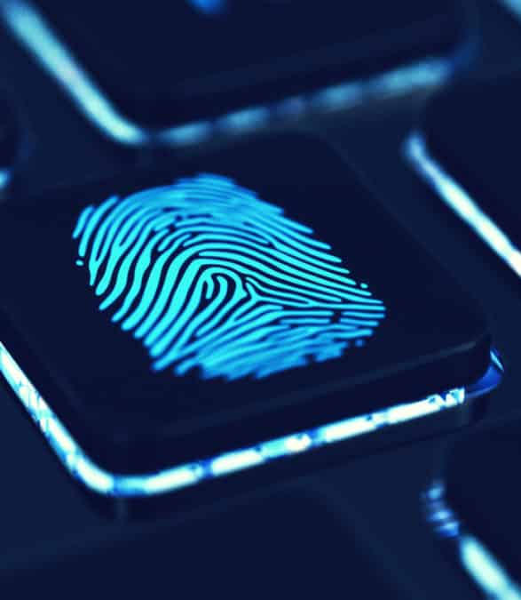
Advancements and Innovations
Integration of Artificial Intelligence and Machine Learning
Cloud-Based Forensic Solutions
Support for Emerging Technologies
Enhanced Scalability and Performance
Data Visualization and Interactive Analysis
Mobile and Remote Forensics
Open-Source and Community Collaboration

Slide 9

Adaptation to Evolving Technologies
Cloud Computing: Tools now support the acquisition and analysis of data stored in cloud services like AWS, Azure, and Google Cloud.
IoT Devices: Forensic tools have been developed to extract and analyse data from IoT devices such as smart home appliances, wearables, and connected vehicles.
Encrypted Communications: Tools are incorporating techniques to decrypt and analyse encrypted communications, such as messaging apps and email services, to uncover evidence in criminal investigations.

Slide 10


Slide 11
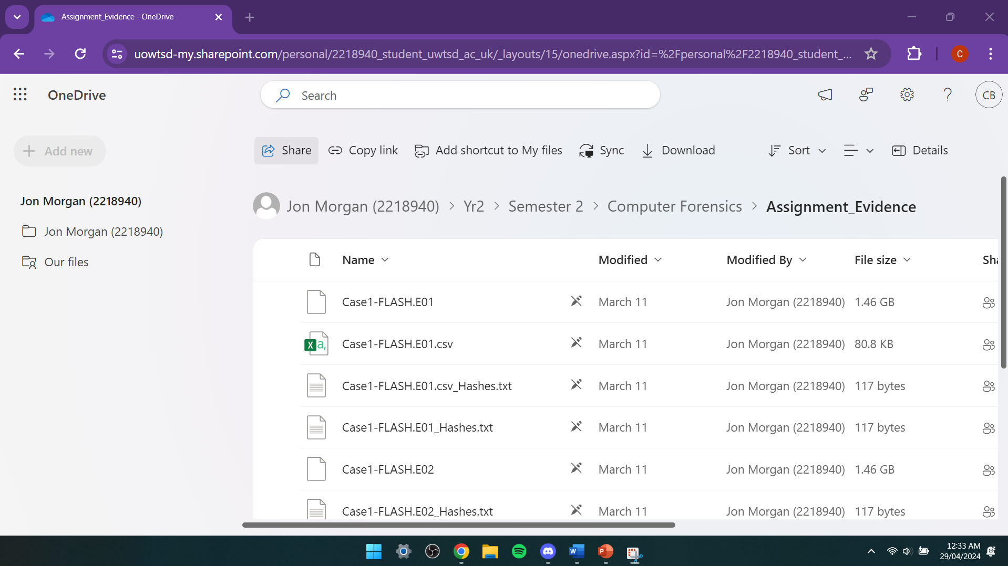

Slide 12
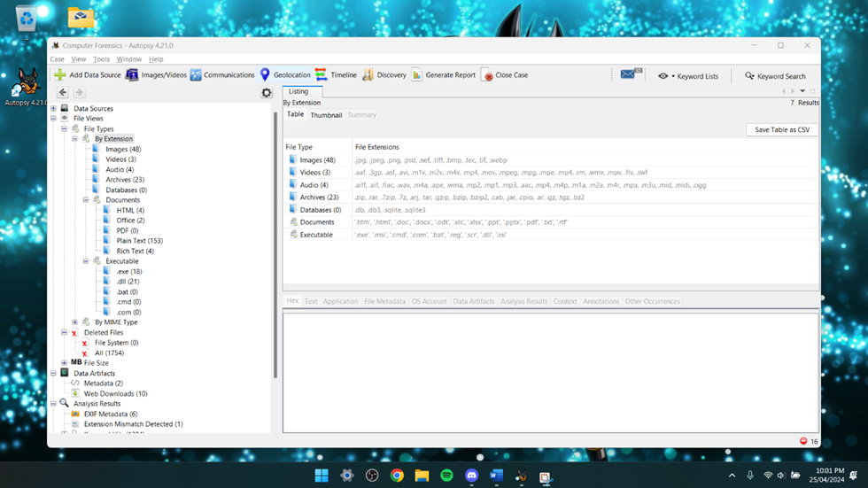

Slide 13
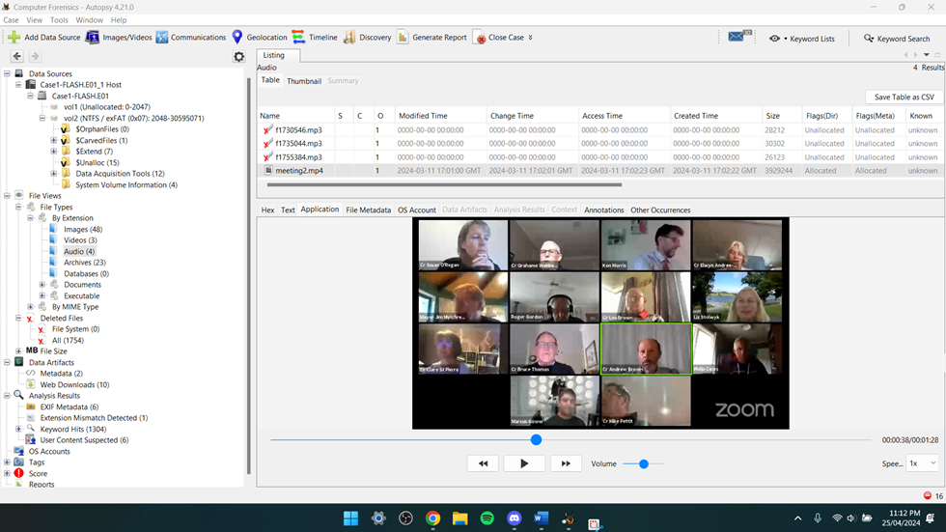

Slide 14
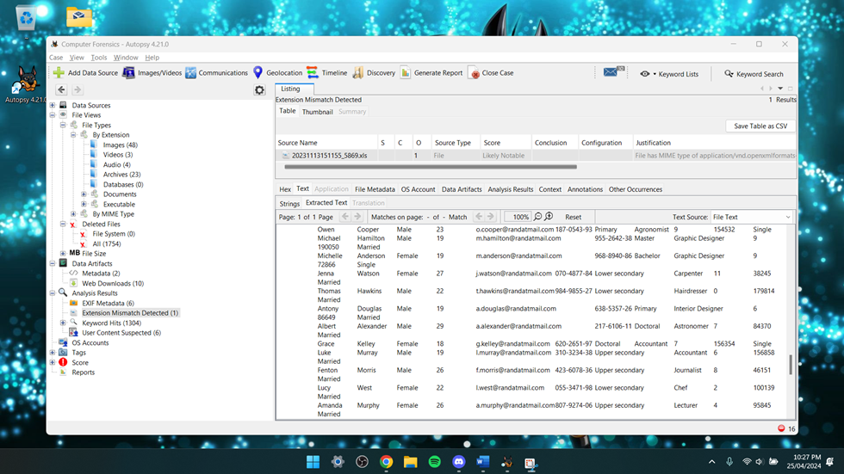

Slide 15
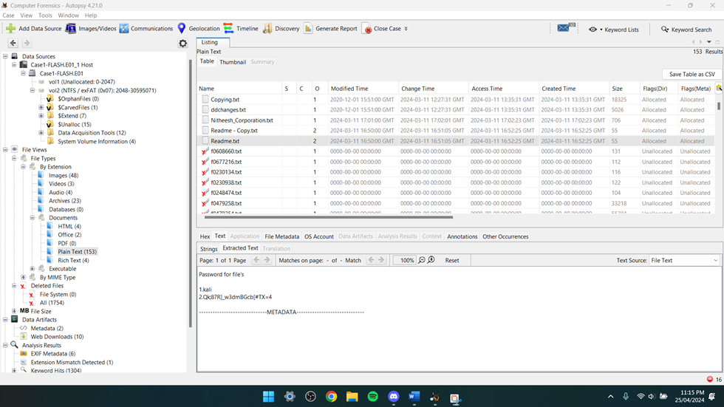

Slide 16
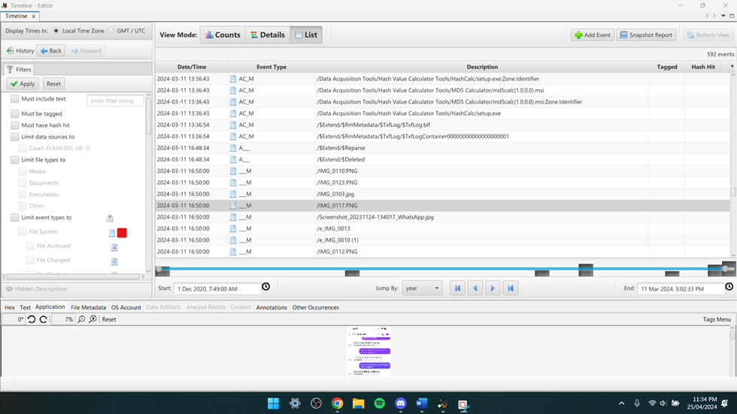

Slide 17


