Slide 1
Developing Relationships and Workplace Achievements
BMSW-5102
TRAINING AND DEVELOPMENT NEEDS FOR A HR OFFICER
Shamima Akther Supa
1916787

Slide 2
Introduction
Training and development are the two different elements in human resource management which work simultaneously in the betterment of an employee and the organisations. Based on the study of Younas et al. (2018), Human resource officers require proper training for developing their organisational behaviour, knowledge and skills to become an effective HR professional. Analysis of the key knowledge, skills and behavioural needs for a HR to understand their roles and responsibilities are presented in the study. Personal skill audit analysis and the appropriate training and developmental needs are justified along with the potential benefits of it to the organisation Sainsbury is given.

Slide 3
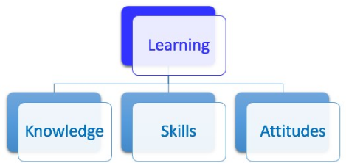
Determining appropriate Knowledge, skills and behaviours (KBS)
Human resource managers require several skills, knowledge and certain behavioural activities which will help them in cooperating with the roles and responsibilities.
According to the study of Kryscynski et al. (2018), HR professionals require many skills including active listening, social awareness, accountability, verbal-nonverbal communication skills, problems solving skills, great decision making skills and self management skills.
Hence, these skills will help the professionals to become an effective HR manager in order to comply with their roles of understanding the health and safety needs of their employees.
Notes:
Furthermore, great decision making skills will also help them to make certain effective decisions about hiring employees and promoting quality and a diverse culture in the organisation. According to the study of De et al. (2018), effective HR managers require data driven analytical knowledge and staff rules and regulation policies. Thus, it will help them to determine the policies for their staff and knowledge on advanced excel also helps them to simplify their work in an effective way. HR professionals with high interpersonal skills and intuitively good communicators are also considered to be the ones who can thrive in this field.

Slide 4
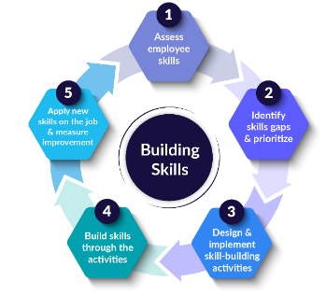
Determining appropriate Knowledge, skills and behaviours (KBS)
The current global environment is rapidly changing and evolving which needs continuous innovation to support the changes and the requirements of the new normal world.
Hence, to comply with the developed roles and responsibilities of the organisation Sainsbury’s, a HR professional needs greater knowledge on digital transformational technologies like; big data analytics, cloud computing, AI and many more.
Furthermore, it will help them in evaluating information about the individuals while recruiting staff and will help them in measuring the quality of the performances.
Notes:
As per the view of Meyers et al. (2020), HR professionals require strong traits which will help them be future oriented, solutions driven and courageous. Thus, it will help them become an enquiring thinker, being more collaborative. Hence, these abilities are a must for a HR professional to become an effective manager who will be able to negotiate with great integrity and implement disciplinary procedures and understand the needs of the employees.

Slide 5
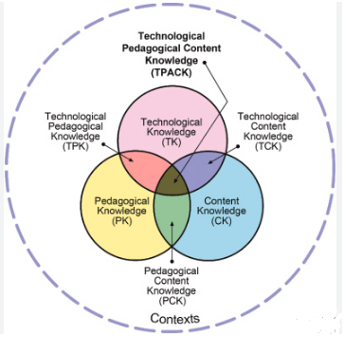
Determining appropriate Knowledge, skills and behaviours (KBS)
Additionally, understanding the required training and developmental activities for the employees is also another responsibility of a HR which can be achieved by having great generic and influential knowledge.
Application of Human relations theory will also help in determining the means of influencing greater employee productivity and employee satisfaction needs (Paais and Pattiruhu, 2020).
Thus, it tends to contribute majorly in the great understanding of the employee's health and safety needs.
Notes:
The theory further justifies that creating strong relationships with the employee are an important factor which helps in formulating a better communication process. Furthermore, as per the theory HR professionals can increase their personal skills of being an active listener and more aware of the surroundings by concentrating in each and every employee will help understanding the needs of them. Thus, it will help them be satisfied with their work.

Slide 6
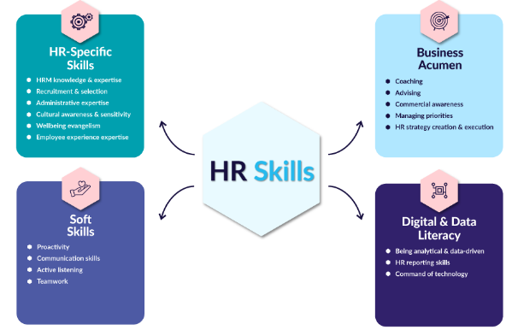
Personal skills audit analysis
Personal skills and audit analysis (referred to Appendix C) helps to evaluate core abilities and weak points.
Thus, it can be identified that great Microsoft skills help in managing documents and making creative PowerPoint Presentations that will help in presentations and will attract the attention of the employees.
Furthermore, great problem solving skills and use of emails efficiently help with making effective communication with the employees and the associates in the organisation.
Notes:
Based on the study of Lemon (2019), being an active listener also helps employees to feel heard and will enhance their productivity by motivating them more towards accomplishing their tasks. Hence, being an active listener for the employees helps to maintain the health and safety needs of them. Additionally, greater accountability skills also help in making the contract drafting process easier.

Slide 7
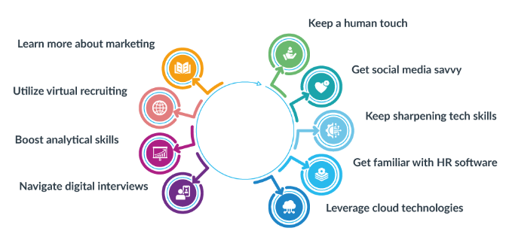
SWOT analysis
Strengths in being great at conflict resolution, verbal and non-verbal communication, discretion, goal setting, excellent use of Microsoft office and complex data managing skills helps me to become great at managing staff and understanding their needs.
Based on the study of Claus (2019), time management skill is considered to be an important skill which helps in multitasking and helps with resolving multiple issues at the same time.
Therefore, in this case it has been identified that poor brainstorming skills and time management skill impose greater threat in accomplishing tasks at times.
Notes:
However, great managerial skills help in providing opportunities of greater productivity.

Slide 8
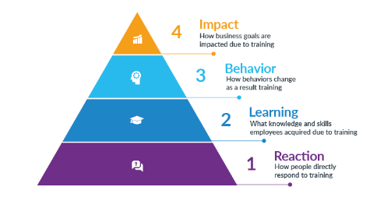
Identified training and developmental needs regarding KBS
Training and development is the core concept of the betterment of an organisation or an individual's abilities.
Based on the study of Lacerenza et al. (2018), exclusive training and developmental programs play a major role in enhancing personal effectiveness.
Thus, it can be determined that personal effectiveness further helps in becoming more motivated and engaged with work which helps in producing greater productivity and better performance.
Notes:
However, in order to gain the required knowledge, skills and behaviour that is appropriate for accomplishing the role and responsibilities of a HR are; exclusive training on personal skill development, time management skills and seminars which will help increase technological skills.

Slide 9
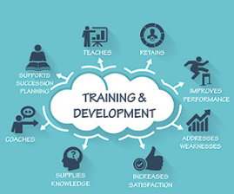
The potential benefits to the organisation and individual development as an HR
The identified skills, knowledge and behavioural factors have significant positive impact in developing personal effectiveness of a HR.
Based on the study of Saks (2022), effective HR helps in developing the productivity of the employee and increases the engagement of the employees.
Therefore, in this case the abilities and the identified skills will not only help in benefiting the HR professional develop efficiency level but will also significantly positively impact in the organisation Sainsbury’s profitability.
Notes:
As per the view of Antony (2018), efficient employees tend to perform better which helps companies to achieve greater goals. It can be determined that cognitive skills of an individual help in becoming emotionally intelligent. Additionally, an emotionally intelligent employee can perform better and will be effective in leading the organisation towards success. Therefore, the role of an effective HR is a crucial factor in the development of an organisation.
Moreover, it can also be analysed that intuitive skills and cognitive skills, greater knowledge of technological skills helps in enhancing the abilities of an individual and helps with making greater problem solving solutions. Therefore, it benefits the organisation in time management and in preventing risks effectively.

Slide 10
Conclusion
The study concludes that training and developer is the core element for a HR professional. It has been identified that cognitive skills and emotionally intelligent HR executives are very much capable of driving innovation and development of an organisation. Moreover, as of the personal audit analysis and SWOT analysis it can be determined that developing time management abilities will help further in increasing the efficiency level. The HR department is also considered to be an important factor to keep the employees healthy, safe and satisfied.

Slide 11
References
Antony, M.R., (2018). Paradigm shift in employee engagement–A critical analysis on the drivers of employee engagement. International Journal of Information, Business and Management, 10(2), pp.32-46.
Claus, L., (2019). HR disruption—Time already to reinvent talent management. BRQ Business Research Quarterly, 22(3), pp.207-215.
De Mauro, A., Greco, M., Grimaldi, M. and Ritala, P., (2018). Human resources for Big Data professions: A systematic classification of job roles and required skill sets. Information Processing & Management, 54(5), pp.807-817.
Kryscynski, D., Reeves, C., Stice‐Lusvardi, R., Ulrich, M. and Russell, G., (2018). Analytical abilities and the performance of HR professionals. Human Resource Management, 57(3), pp.715-738.
Lacerenza, C.N., Marlow, S.L., Tannenbaum, S.I. and Salas, E., (2018). Team development interventions: Evidence-based approaches for improving teamwork. American psychologist, 73(4), p.517.
Lemon, L.L., (2019). The employee experience: How employees make meaning of employee engagement. Journal of Public Relations Research, 31(5-6), pp.176-199.
Meyers, M.C., van Woerkom, M., Paauwe, J. and Dries, N., (2020). HR managers’ talent philosophies: prevalence and relationships with perceived talent management practices. The International Journal of Human Resource Management, 31(4), pp.562-588.
Paais, M. and Pattiruhu, J.R., (2020). Effect of motivation, leadership, and organizational culture on satisfaction and employee performance. The Journal of Asian Finance, Economics and Business, 7(8), pp.577-588.
Saks, A.M., (2022). Caring human resources management and employee engagement. Human Resource Management Review, 32(3), p.100835.
Younas, W., Farooq, M., Khalil-Ur-Rehman, F. and Zreen, A., (2018). The impact of training and development on employee performance. IOSR Journal of Business and Management (IOSR-JBM), 20(7), pp.20-23.

Slide 12
Appendix (SWOT)
Strengths My great qualities are in resolving conflicts, understanding the employee’s needs and implementing disciplinary activities which will help make a better, healthier and diversified environment for the betterment of the organisation. The unique resources that can be drawn from the influential courses and training helps in increasing personal effectiveness and as well as it helps me to become a better HR professional. Other peers see me as a great mentor and manager to resolve conflicts and implement appropriate policies that help keep the employees healthy and safe. | Weaknesses I might focus on improving my time management skills and multitasking skills. I have fewer resources in having adequate technological tools and manpower which creates a difficulty in managing workload for the employees. Others likely see my weaknesses to be not being able to brainstorm effective ideas to mitigate issues.
Opportunities Great staff recruiting and mentoring opportunities are open to me. Exclusive training and developmental courses are great trends that I can take advantage of. I can turn my strengths into opportunities by presenting great management and making ethical decisions during a crisis. | Threats Delay in completing tasks and poor infrastructure, resources is the potential threats that can harm my job role. My greater competition in doing is the rapid change in environment and the increased expectations puts a great pressure on my job role. My weakness in time managing skills imposes a greater threat for me to not being able to multitask and meet deadlines.

Slide 13
Appendix
Name
Job role: Human Resource Officer
 | Very good | Good | Adequate | Little or no experience
Information Technology
Use Microsoft Office Word | ✔
Use Excel spreadsheet | ✔
Use a Database |  | ✔
Use specialist HR software | ✔
Use the internet | ✔
Use e-mail | ✔
Use PowerPoint | ✔
 | Very good | Good | Adequate | Little or no experience
Communication Skills
Drafting contracts of employment | ✔
Taking notes of disciplinary hearings | ✔
Write reports | ✔
Produce material to support presentations | ✔
Delivering a training session |  |  | ✔
Resolving disputes/complaints |  | ✔
Interviewing |  | ✔
Advising on HR issues | ✔

Slide 14
Appendix
 | Very good | Good | Adequate | Little or no experience
Problem solving skills
Make good use of verbal reasoning skills, able to handle complex data and make selective use of information | ✔
Explore more than one solution in order to solve a problem |  | ✔
Consider the ideas of others to help solve problems
Supervisory Management
How much experience have you had in your role? |  |  | < 1 month | 1-3 months | > 3 months ✔
How many people have you managed at any one time? | None |  |  | 1-5 | Above 5✔
I declare that the information given in this form is true
Signed
Date

