Slide 1

The Silver Lily is a family ran business situated in Haverfordwest and Saundersfoot. The workers have over 50 years' experience in retail, they sell high brands such as Clogau Welsh Gold Jewellery along with a range of accessories.

Slide 2
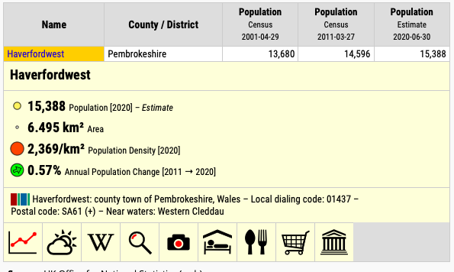
Haverfordwest statistics
2.

Slide 3
Goals & Objectives for my marketing plan
Goals
Improve customer service
Increase profit by 10% in 1 years' time
Increase overall brand awareness
Objectives
Reach out to more community members
Maintain or increase business profit
Improve marketing skills

Slide 4
Segmentation, targeting and Position
Georgaphic
Customers within the community and surrounding area
Demographic
Older generation possibly 30 years' +
No specific occupation
adults
Behavourial
Customers looking for quality gifts for life milestones
Psychographic
Customers who want to purchase for someone imporatant to them or for life events

Slide 5
WHAT ARE THEY CURRENTLY DOING TO ATTRACT THESE CUSTOMERS?
The Silver Lily are currently attracting their target audience by marketing their business on Facebook and Instagram which are well used by individuals who are 30+ years' old.
Additionally, they offer products that are fashionable for the elder crowd but less so for the younger crowd. For instance, it is quite unlikely that younger adults will buy the handbags and scarves they sell.
WHAT NEW MARKETS COULD THEY APPROACH?
By coming up with new designs for their own branded accessories like handbags and scarves, they could advertise their goods to people of different ages. I think that by drawing people of all ages, this would open up a lot of doors for them.
ATTRACTING NEW CUSTOMERS?
Increasing the number of existing customers can boost sales, which results in higher profitability. Individuals who are younger and have a love for jewllery as many younger adults like myself loves jewellery as gifts.
WHAT ARE THE BENEFITS OF ATTRACTING NEW CUSTOMERS?
For The Silver Lily this will allow them to make improvements to their marketing and potential grow their business or open another shop in the area.
They could also build their brand awareness to help them increase their number of customers and sales.

Slide 6
Social media marketing
Using social media sites like Facebook, Instagram, Twitter, LinkedIn, and TikTok allows businesses to successfully reach a larger audience and interact with clients (1).
Benefits of social media marketing for The Silver Lily
Builds brand awareness quickly
Helps to understand your target audience
Helps to see what your target audience has an interest in
Provides responsive customer service

Slide 7
How can The Silver Lily use social media marketing?
The Silver Lily Jewellery shop already have a Facebook page and an Instagram page however, they need to produce ways to grow their followers.
They can accomplish this by encouraging people to join a Facebook group, which will help them improve brand recognition and the number of customers for their business.
Since they are located in a small rural community and can model their own products for free and post them on social media, I don't think they would gain from working with influencers therefore, this isn't something I recommend they use as a business.

Slide 8
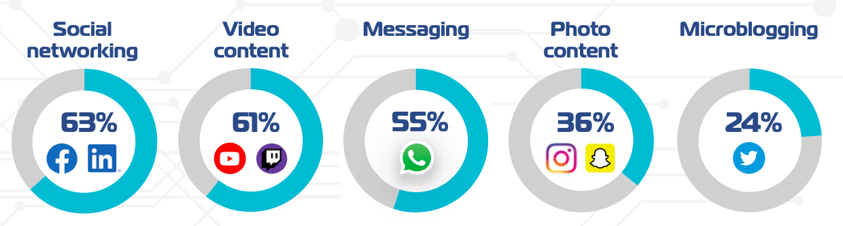
Why a closed Facebook group will help add value to The Silver Lily?
7.
8 in 10 people in Wales use social media
The data below indicates that 63% of people in Wales use social networking sites like Facebook. Because the majority of people use Facebook daily, I think The Silver Lily may significantly raise their profit and sales by using this social media site more strategically.

Slide 9

Flyers posted through doors
Creating flyers advertising their jewellery and range of accessories they sell in store can be a cheap and effective way of marketing their business
Since they are struggling to get people through the door then this will allow them to reach out to new customers who don't go into the main town of Haverfordwest.
Flyers are inexpensive and useful for small businesses looking to increase their customers and brand recognition in the area. I believe that The Silver Lily's sales would significantly rise if they delivered flyers through front doors.
As many as 78% of consumers glance at the messages included in the flyers that are posted through their door, and a total of 23% read them thoroughly. (8)

Slide 10
Product
Although The Silver Lily's product isn't very unique compared to others on the market, jewellery stores frequently draw customers because almost everyone wears some sort of jewellery.
The Silver Lily's target audience are 'According to GWI's jewellery market study, married women with average incomes between the ages of 25 and 34 purchase the most jewellery, while people between the ages of 45 and 54 who earn $200,000 a year spend the most money on jewellery.' (6)

Slide 11
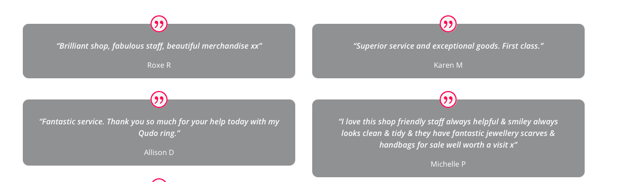
Online Reviews
These are a few reviews offline on their main website. This shows that they are doing a lot correctly yet, they are struggling to keep their sales steady to ensure they can afford to run the business throughout the year.

Slide 12
Price
The Silver Lily sets the prices for the vast majority of their goods, but some of their jewellery is marketed for well-known names like Clogau.
Due to their popularity and the fact that they are made of Welsh gold, Clogau goods are priced the same throughout all of their websites.
Each item of Clogau jewellery comprises rare Welsh gold that was extracted from a mine not far from Dolgellau. The British Royal Family has been using Welsh Gold, the rarest gold in the world, for more than a century. (3) This is one of The Silver Lily's main sales as it is a popular jewellery brand across Wales.
Non-branded items which the Silver Lily sell such as handbags scarfs, their own silver jewellery are sold at reasonable prices which suit their target market because they're affordable and not overpriced.

Slide 13
The best Distribution Channel for The Silver Lily
For a jeweller, there are often two distribution channels: When you buy from wholesalers and sell directly to other jewellery shops, this is referred to as B2B. The benefit of this business strategy is that it allows you to sign long-term contracts that enable you to generate more income. (5)
This is the case for The Silver Lily they sell a large chains brand 'Clogau' therefore, this helps their business revenue increase due to the demand for Welsh Gold.

Slide 14
Reference list
How to market on social media effectively (no date) Mailchimp. Available at: https://mailchimp.com/en-gb/resources/how-to-market-on-social-media/?gclid=CjwKCAjw2OiaBhBSEiwAh2ZSPyzb9coaM_r3dy3Kaz97SJDJm7XRjFNhPWD-a6r9bkMAN-dX8DiNFhoCpFsQAvD_BwE&gclsrc=aw.ds (Accessed: October 28, 2022).
2. Europe (no date) (Pembrokeshire, Wales / Cymru, United Kingdom) - Population Statistics, Charts, Map, Location, Weather and Web Information. Available at: https://citypopulation.de/en/uk/wales/pembrokeshire/W37000361__haverfordwest/ (Accessed: November 2, 2022).
3. Davies, A. (no date) Anna Davies. Available at: https://www.annadavies.co.uk/clogau-gold (Accessed: November 2, 2022)
4.Withybush retail park (no date) Haverfordwest Town Council. Available at: https://haverfordwesttown.co.uk/directory/withybush-retail-park/ (Accessed: November 2, 2022).
5. OkCredit (2022) Follow these 5 steps to become a wholesale jewellery distributor, OkCredit Blogs - Business Ideas, Tips, Government Schemes & more. OkCredit Blogs - Business Ideas, Tips, Government Schemes & more. Available at: https://okcredit.in/blog/steps-to-becoming-a-wholesale-jewellery-distributor/ (Accessed: November 2, 2022).
6. Jewelry market statistics (2022) Classy Women Collection. Available at: https://classywomencollection.com/blogs/fashion-guide/jewelry-market (Accessed: November 3, 2022).
7. Digital Technology and Health (no date) Public Health Wales. Available at: https://phw.nhs.wales/topics/digital-technology-and-health/ (Accessed: November 8, 2022).
8.Do flyers really work for businesses in 2022? (2022) 75Media. Available at: https://75media.co.uk/blog/do-flyers-work/ (Accessed: November 9, 2022).

