Slide 1

Student Name: MOHAMMADHANZALAH MOHAMEDJAVID KAZI
Student Number:2331319
Course Name: Human Capital management
Lecturer Name: Nishi Ramsurrun
Session: June 2024 Term

Slide 2
Contents Page no
Introduction on Toyota Motors 3
Strategic Goal of Toyota Company 4
Job Analysis / Position 5
Job Description 6
Person Specification 7
Required skills 8
Pay and working Conditions 9
Flexible working arrangement with justifications 10
Conclusion 11
References 12

Slide 3
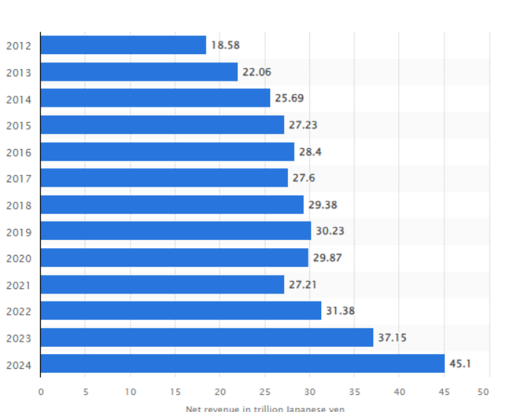
Introduction on TOYOTA
Toyota is a multinational company, and the headquarters of the concerned company is situated in Japan.
The mission of the concerned company is to develop better cars for the future and give freedom to everyone to move, which provides “happiness to all” (Toyota, 2024).
By the end of 2024, the revenue of Toyota will reach around ¥45.1 trillion, which is comparatively higher than the previous year (Carlier, 2024).

Slide 4
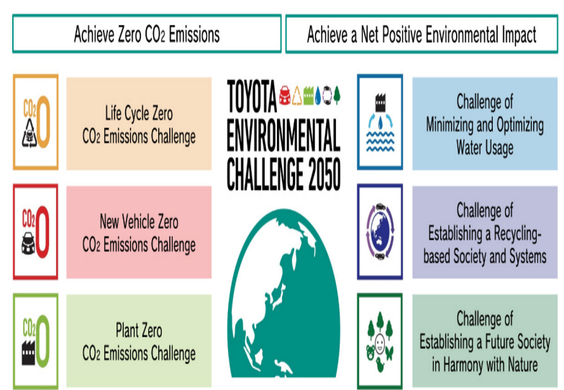
Strategic Goal of Toyota Company
● “Challenge 2050” has been set by the management of Toyota and this goal has been developed by mitigating negative impacts on the environment (Toyota, 2024b).
● 6 visionaries have been set by the concerned company, and the primary focus has been shifted by this company to manufacture new vehicles, which are carbon neutral.
● The primary focus areas of this company are carbon neutrality, maintaining biodiversity, reducing the waste of water, and responsible use of materials.

Slide 5
Job Analysis / Position
Position: Junior Project Manager
A Junior Project Manager is an entry-level professional who supports the planning, execution, and completion of projects under the guidance of senior project managers.
They coordinate tasks, communicate with stakeholders, monitor progress, and help resolve issues to ensure projects are delivered on time and within budget.

Slide 6
Job Description
A Junior Project manager is responsible for the direction, coordination, implementation, executive, control and completion of the project while remaining aligned with the strategy, commitments and goals of the organization.
Role and responsibilities:
Assist in planning, executing, and closing projects.
Support senior project managers in coordinating project activities.
Monitor project progress and update stakeholders.
Help manage project schedules and budgets.
Prepare project documentation and reports.
Facilitate communication among project team members.
Contribute to continuous improvement of project processes.

Slide 7
Person Specification
Qualification & Experience:
Bachelor’s Degree and At least three years of experience in a project manager or related role
The ability to communicate
Proven experience in project manager or related role.
Personal Attributes:
Leadership skills
Communication skills
Team-building skills
Problem solving skills
Delegation skills

Slide 8
Required skills
Communication Skills
Time Management
Team Collaboration
Problem Solving
Basic Financial Skills
Leadership Skills
Soft Skills

Slide 9
Pay and working Conditions
Pay:
The average salary ranges from £30,000 to £50,000 per year, depending on the location, and experience level.
Working Conditions:
Typically works in an office environment. May require occasional travel for client meetings or site visits. Standard full-time hours, with possible overtime during critical project phases.
Collaborative team setting, often involving coordination with multiple departments. High-paced and deadline-driven, requiring effective stress management.

Slide 10
Flexible working arrangement with justifications
Toyota offer’s flexible working arrangements, including remote work options and flexible hours
Typically work in an office environment, though they may occasionally need to be present at the project’s physical worksite
They spend their most of time at computer station sitting or standing for business project
Flexible hour’s can boost employee satisfaction, productivity and helps to attract top talent.

Slide 11
Conclusion
A Junior Project Manager plays a crucial role in ensuring the successful execution of projects by leveraging their skills in communication, organization, and problem-solving. With competitive pay and dynamic working conditions, this role offers a solid foundation for those looking to advance their careers in project management.
The experience gained in this position equips individuals with the necessary tools and knowledge to take on more senior roles in the future, making it an excellent entry point into the project management field.

Slide 12
References
https://www.projectmanager.com/blog/project-manager-job-description
https://www.indeed.com/career-advice/careers/what-does-a-project-manager-do#:~:text=Project%20managers%20typically%20work%20in,software%20and%20placing%20business%20calls

