Slide 1
Financial Management
Re-cap of last session:
What is accounting?
What are the differences between Management & Financial Accounting?
The Balance Sheet Equation:
  Assets = Equity + Liabilities

Slide 2
Financial Management
Introduction to Financial Statements
Accounting concepts and conventions
The Balance Sheet - terminology & explanation
The Profit and Loss/Income Statement
Atrill & McLaney chapters:
  Introduction to accounting & finance
  Measuring & reporting financial position

Slide 3
Financial Reporting Council
5 new Reporting Standards updated Sept 2016
FRS 100: Application of Financial Reporting Requirements
FRS 101: Reduced Disclosure Framework
FRS 102: The Financial Reporting Standard applicable in the UK and Republic of Ireland
FRS 103 Insurance Contracts
FRS 104: Interim Financial Reporting
FRS 105: The Financial Reporting Standard applicable to the Micro-entities Regime

Slide 4
Succinct Financial Reporting Standards that are:
Consistent with International Accounting Standards
Reﬂect up-to-date thinking and developments
Balance consistent principles for accounting with practical solutions
Promote efﬁciency within groups
Cost-effective to apply

Slide 5
The Financial Statements
Measure the financial health of the organisation
Balance Sheet/Statement of Financial Position
Profit & Loss Account/Income Statement
Cash Flow Statement/ Statement of Cash Flows
Statement of Comprehensive Income
Statement of Changes in Equity
Previously STRGL
Auditors Report
Chairman & Directors Report
Notes to the Accounts

Slide 6
Accounting Conventions (Rules)
Business Entity
Historic Cost
Prudence
Going Concern
Accruals/Matching/Dual Aspect
Consistency

Slide 7
BALANCE SHEET
Also known as the Statement of Financial Position
Financial Snapshot at a particular time
Shows what an organisation owns (Assets) and what it owes (Liabilities)
Assesses Liquidity
Assesses Solvency
ASSETS – LIABILITIES = EQUITY
Notes:
A measure of the extent to which a person or organisation has cash to meet immediate and short-term obligations, or assets that can be quickly converted to do this.
Accounting: The ability of current assets to meet current liabilities.
Solvency is the ability of a business to have enough assets to cover its liabilities. Solvency is often confused with liquidity, but it is not the same thing.

Slide 8
BALANCE SHEET EQUATION
ASSETS – LIABILITIES = EQUITY
means the same as.......
ASSETS = EQUITY + LIABILITIES
LIABILITIES
£100
LIABILITIES
£220
ASSETS
e.g. £300
ASSETS
£300
EQUITY
£200
EQUITY
£80

Slide 9
ASSETS
Assets are things you own
Fixed (or Non-Current) Assets
Long-term (held longer than 1 Year)
Workable for the business
Not intended for resale
Generate revenue for the business
Tangible, Intangible, Long-Term Investments
Notes:
Intangible assets are things like patents, goodwill.
Tangible assets are equipment, vehicles, property

Slide 10
ASSETS
Current Assets
Short-term (held less than 1 year)
Converted quickly into cash
Stock
Debtors (those who owe money to the business)
Cash

Slide 11
LIABILITIES
Liabilities are monies owed
Current Liabilities
Short-term (held less than 1 year)
Creditors (those that the business owe money to)
Taxation & VAT
Dividends
Overdraft

Slide 12
LIABILITIES
Long-Term (or Non-Current) Liabilities
Run longer than 1 year
Loans
Mortgages
Debentures

Slide 13
Top Half of a Balance Sheet
 |  | £m
Fixed Assets |  | 200
Current assets:
Stock | 40
Debtors | 50
Cash | 20
 | 110
Less Current liabilities | (40)
Total net current assets |  | 70
Less Creditors due after 1 year |  | (80)
Total Net assets |  | 190

Slide 14
CAPITAL EMPLOYED
Capital & Share Capital
  Capital is an investment of money invested by the owners of a business with the intention of earning a return.
  Share capital is the money invested in a company by the shareholders. Share capital is a long-term source of finance.
Reserves
  Reserves are funds set aside and may be specifically for a certain purpose or may be a general surplus or excess funds, and not to meet liabilities.
Profit C/F (Profit Carried Forward or Retained Profit)
  Profit C/F is the amount of profit kept by the company rather than paid as dividends to shareholders. It may be re-invested in the core business or used to pay debt.

Slide 15
Bottom Half of a Balance Sheet
 |  | £m
Owners Capital |  | 120
Retained profit |  | 70
SHAREHOLDERS FUNDS |  | 190

Slide 16
Put them together…
 |  | £m
Fixed Assets |  | 200
Current assets:
Stock | 40
Debtors | 50
Cash | 20
 | 110
Less Current liabilities | (40)
Total net current assets |  | 70
Less Creditors due after 1 year |  | (80)
Total Net assets |  | 190
Owners Capital |  | 120
Retained profit |  | 70
SHAREHOLDERS FUNDS |  | 190

Slide 17
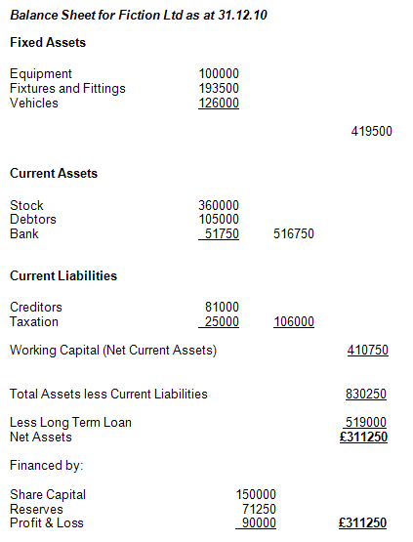
What does a Balance Sheet look like?

Slide 18
Profit and Loss Account
Also can be called an income and expenditure account ( Public Sector ), an Income Statement or the ‘management accounts’.
Measures historical information i.e. Previous month , Year to Date.
Measures profit generated over a time period
Reports how profit was made by detailing...
  Revenues
  Expenses
Shows the performance of the organisation.
  Profit (or loss) for the period = Total revenue for the period – Total expenses incurred in generating that revenue
  Profit = Revenues – Expenses

Slide 19
Profit and Loss Terminology
Sales/Turnover | Total Revenue
Cost of Sales | The cost of producing the goods/providing services
Gross Profit | Calculated by taking Cost of Sales (or cost of goods sold) from Sales/Turnover
Operating Expenses | Expenses incurred in generating Revenue
Operating Profit | Gross profit less Profit before Interest and Tax (PBIT)
Non-operating Expenses | Interest payable
Non operating Income | Interest received
Profit before Tax (PBT)
Tax | Corporate tax paid to Government
Profit after Tax (PAT) | Profit for the period
Retained Profit c/f | Remaining profit after payments of dividends to shareholders

Slide 20
Malik plc Statement of Comprehensive income for the year ended 31 July 2014
 | £m
Revenue | 97.2
Cost of Sales | (59.1)
Gross Profit | 38.1
Other Income | 3.5
Distribution expenses | (16.5)
Administration expenses | (11.2)
Other expenses | (2.4)
Operating Profit | 11.5
Finance charges | (1.8)
Profit before tax | (7.3)
Tax | (2.4)
Profit for year | 7.3
Other comprehensive income
Revaluation of property, plant and equipment | 6.6
Foreign currency translation differences for foreign operations | 4.0
Tax on other comprehensive income | (2.6)
Other comprehensive income for the year, net of tax | 8.0
Total comprehensive income for the year | 15.3

Slide 21
Recognising Expenses
Accruals & Prepayments are part of matching the expenses to the period they relate to
All expenses should be matched to the period they relate to
  Accruals: expenses which have been incurred in the accounting period, but for which no payment was received; it will be reported for the accounting period in which it was incurred as an accrual
  Prepayments: where money is paid out in the accounting period before the one to which the expense relates to; it will be reported in the accounting period when it was paid out as a prepayment
  Accruals: note Examples 3.4 & 3.5 in Atrill re: Domestic Ltd
  Prepayments: note Example 3.6 in Atrill re: Images Ltd

Slide 22
Accrued Expenditure Reproduced from Atrill & McLaney
Income Statement
Statement of Cash Flows
Sales Commission Expense £6000
Statement of Financial position at year end
Cash £5000
Accrual £1000

Slide 23
Prepaid Expenses Reproduced from Atrill & McLaney
Income Statement
Statement of Cash Flows
Rent Payable Expense £16,000
Statement of Financial position at year end
Cash £20,000
Prepayment £4,000

Slide 24
Depreciation
Reduction of value of an asset as a result of wear and tear, age or obsolescence
Methods applied to calculate depreciation
  Straight Line (Constant)
  Reducing Balance (Variable)
  Sum of the Digits (Variable)
The variable methods assume most value is lost in first few years of use
  Depreciation: note Example 3.7 and Activity 3.7 in Atrill

Slide 25
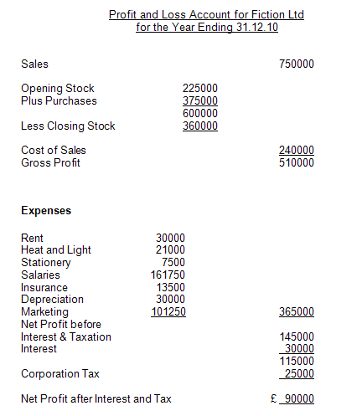
What does a P&L look like?

Slide 26
Useful Resources
Videos on Balance Sheet
  You Tube - lecture 1: balance sheets part 1
  You Tube - lecture 2: balance sheets part 2
By Next Week
Read Atrill & McLaney relevant chapters for Session 1 (if not already completed):
  Introduction to accounting & finance
  Measuring & reporting financial position
  Measuring and reporting financial performance

