Slide 1
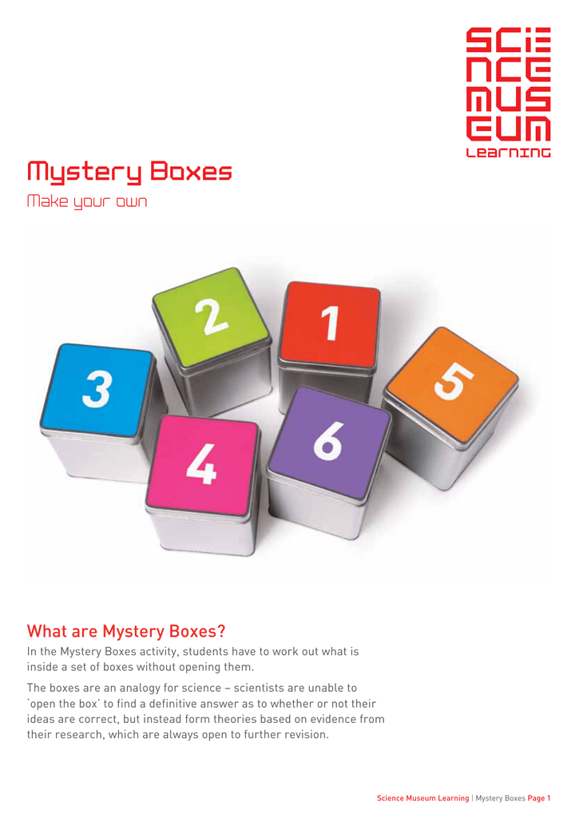
Mystery Boxes!
The mystery box challenge – explore the nature of science
https://www.scienceinschool.org/article/2022/mystery-box-challenge/
Video – What’s in the box?
https://youtu.be/hud8SPCcfu0
Suggested lesson plan
SMG-Academy-Mystery-Boxes.pdf (sciencemuseumgroup.org.uk)
https://learning.sciencemuseumgroup.org.uk/wp-content/uploads/2020/04/SMG-Academy-Mystery-Boxes.pdf
Notes:
How do we make informed decisions based on scientific evidence? Learning about the nature of science can help us with that challenge. The nature of science describes the values and underlying assumptions that are intrinsic to scientiﬁc knowledge. As such, understanding the nature of science is considered to be the core of scientific literacy.^{[1]}
Research shows that different aspects of the nature of science are important for high-school students and should be taught explicitly.^{[2,3]}
This activity teaches students the following:
scientific explorations are guided by scientific theories;
science is empirical and inferential;
science is creative;
science is tentative;
science is a social endeavour.
Mystery-box activities are a powerful educational tool for teaching nature-of-science concepts

Slide 2
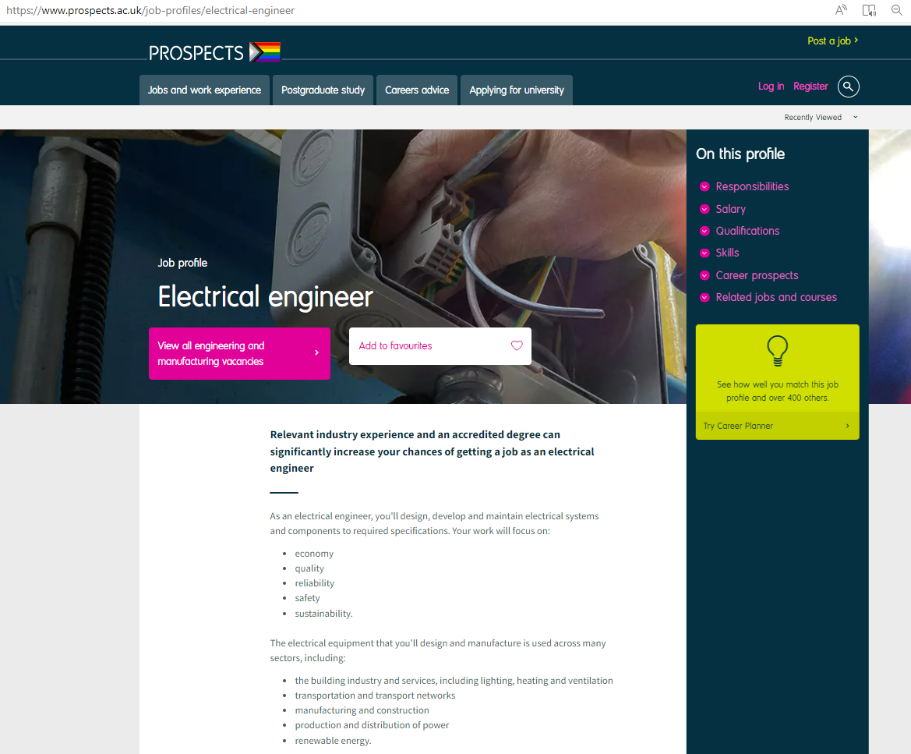
Opportunities for careers awareness raising
Collecting ambient energy
Collecting ambient energy | Case Study | Neon - Brilliant inspiration (neonfutures.org.uk)
Philex is an electrical engineer working in ecological friendly electronics, collecting energy from thin air!
Charged up | Case Study | Neon - Brilliant inspiration (neonfutures.org.uk)
Cars and road vehicles are responsible for almost a quarter of greenhouse gas emissions in the UK in 2012 and Steve Large hopes to make a dent in this figure working as an engineer to create electric car charging points.
Licence to drive
Licence to drive | Case Study | Neon - Brilliant inspiration (neonfutures.org.uk)
After finishing school, Josh Brough decided he wanted to earn and learn at the same time. He took an apprenticeship with Siemens and now works on the electronic and electrical devices that help drive rollercoasters!

Slide 3
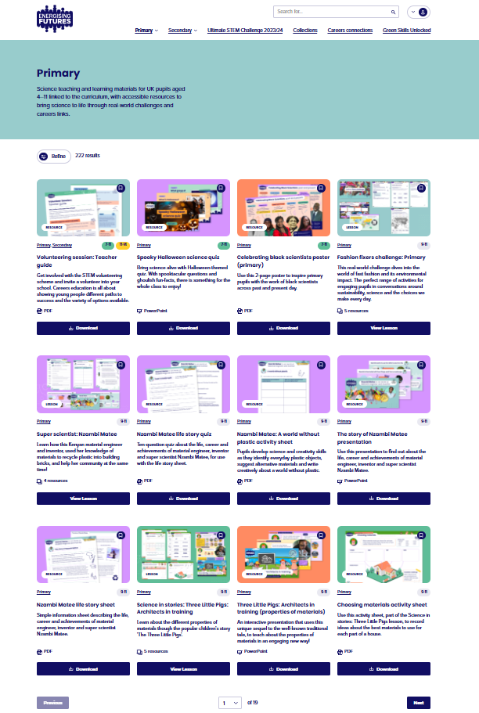

https://energisingfutures.co.uk/
Primary | Energising Futures
Primary
Science teaching and learning materials for UK pupils aged 4–11 linked to the curriculum, with accessible resources to bring science to life through real-world challenges and careers links.
Careers connections | Energising Futures

Slide 4

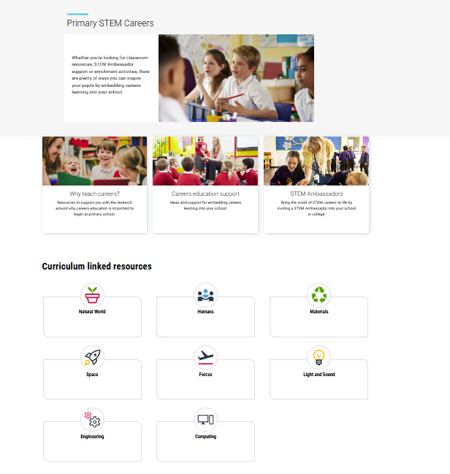
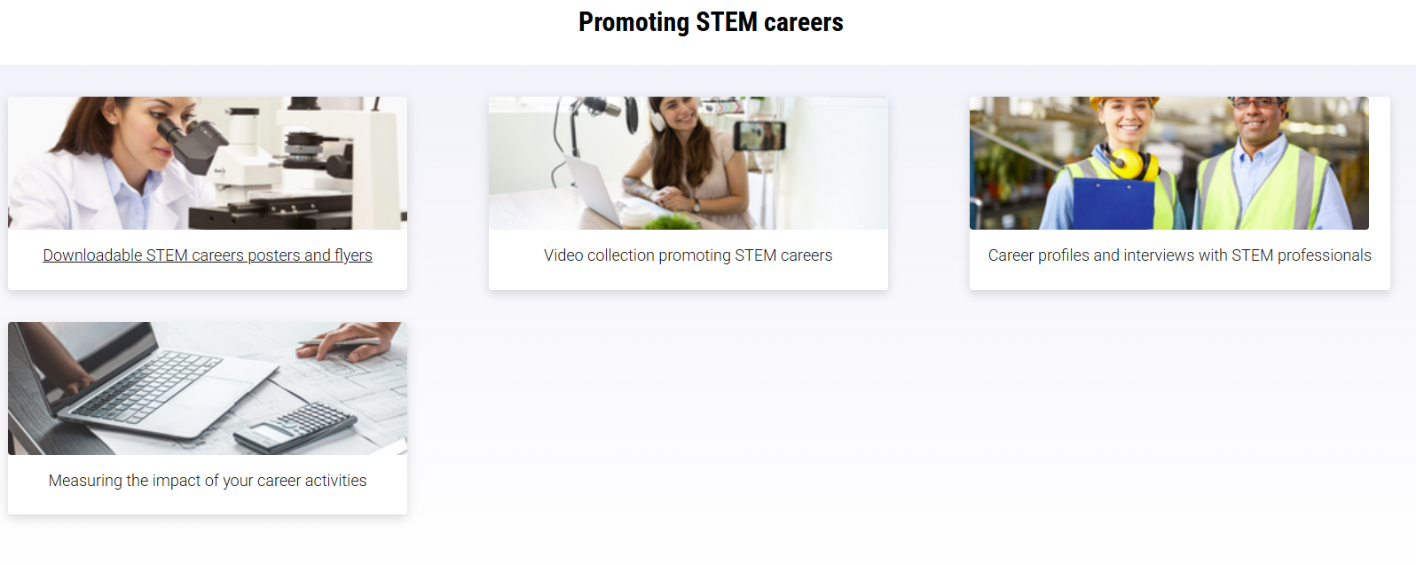
https://www.stem.org.uk/primary
Resources | Primary
STEM Learning resources house a comprehensive collection of over 14,000 freely available, quality-assured digital STEM education resources to help educators inspire young people about STEM.
Primary STEM Careers
STEM careers resources
https://www.stem.org.uk/primary/resources/stem-careers

Slide 5

https://pstt.org.uk/unique-resources/a-scientist-just-like-me/
A Scientist Just Like Me - Primary Science Teaching Trust
Introducing children to a diverse range of scientists and people who work in science-related jobs.
A Scientist Just Like Me is designed to raise awareness of diversity in science-related jobs and to provide illustrated examples of a wide range of science-based careers. It consists of a series of short slideshows, each one ‘telling the story’ of a particular scientist or person working in a science-related job.
The slideshows are intended to be used as discussion prompts, guided by a teacher. They can be used in different ways and for different purposes, for example:
to show children an example of someone from a particular ethnic background working in a science job
to challenge gender stereotypes about science jobs
as part of a science topic that relates to the work of the scientist
as stand-alone fifteen-minute discussion activities
with a small group or the whole class, or in a whole school assembly
Why primary science?
Research shows that children’s interest in and identity with science is shaped before they leave primary school.
While not all children will follow a science career, science literacy will influence their lives daily: for example, in managing their health, and understanding issues such as climate change. Good science teaching in primary schools is therefore of vital importance to the wellbeing of children, their communities and nations.
Resources - Primary Science Teaching Trust

Slide 6
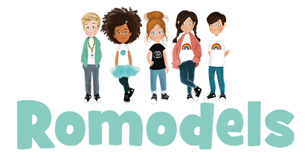
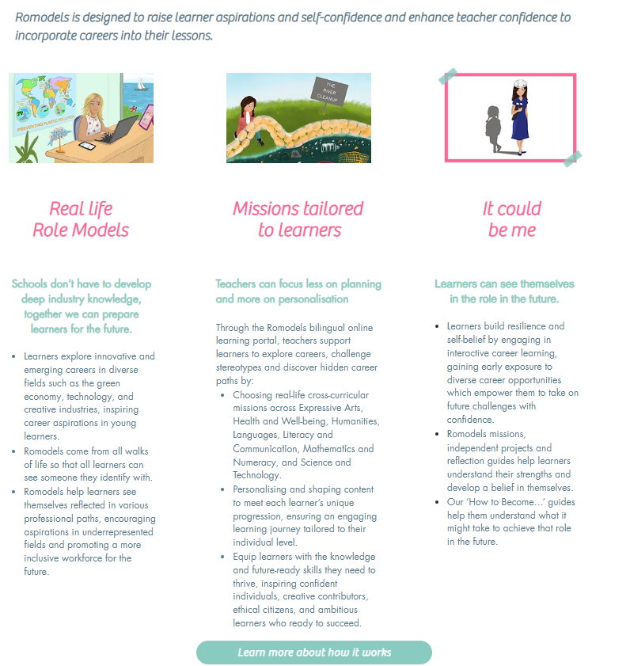
https://www.romodels.org/
Romodels | Role models
You can't be what you don't see...
Many children only imagine the roles in their day to day lives, not all the exciting possibilities in an ever-changing world. Career aspirations of students have frozen in the past twenty years whilst the economy has changed rapidly.
Stereotypes reduce a child's ability to dream...
By age 6, research shows that children further reduce their dreams for themselves due to stereotypes regarding gender, race/ethnicity, neurodiversity, or physical ability.
​
Late and limited exposure reduces opportunities
​​Children are frequently encouraged to explore career possibilities too late in their academic life, often in ‘one off’ events, with the careers they are exposed to limited to those that are ‘traditional’ in nature, led by professionals who do not ‘look like’ or ‘sound like’ them

