Slide 1
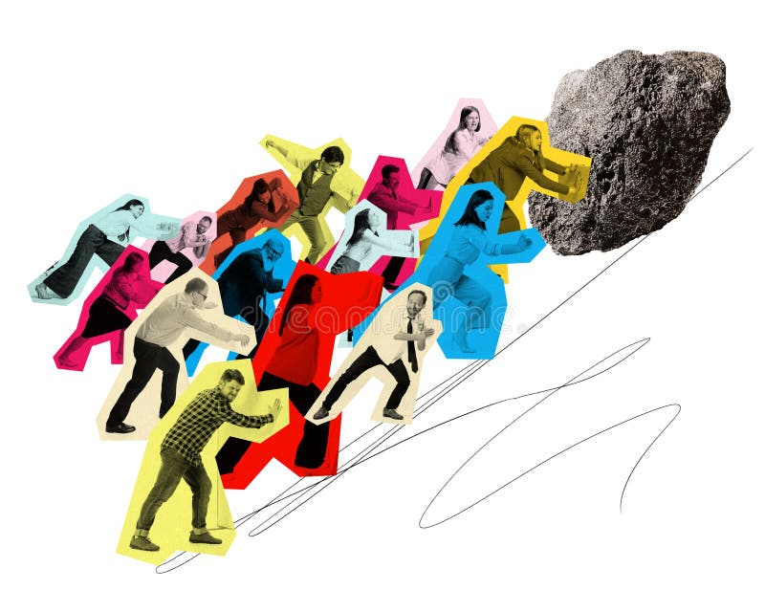
Liam Evans Contemporary challenges assignment one
Subtitle

Slide 2
Index of items
Page Contents | Word Count
P.1 - Portfolio Front Panel | N/A
P.2 - Index of Items | N/A
P.3 - Personal Introduction | 408
P.4 - Historical and current issues and their impact on today’s society Mind map | 602
P.5 - Infographic depicting International examples of contemporary challenges and/or innovative projects addressing them | 579
P.6 - Local (Wales, UK-based or from your country) examples of contemporary challenges and/or innovative projects addressing them | 291
P.7 - Collaborative piece | 314
P.8 - Reference list | Total= 2191

Slide 3
E-portfolio Personal Introduction
To begin it is important to establish what a portfolio is and how it will aid me in structuring and producing this assignment. According to The university of Queensland (2008), an E portfolio in this case is a constantly developing online resource that has the purpose of recording, archiving and maintaining the teachings and lessons learnt from studying ways to complete an assignment task. A portfolio will be a useful tool for me to complete this assignment as I can prove my competency as a learner, showing my ability to use multiple methods of sharing data to provide a clear and concise discussion.
Within this e- Portfolio I will use written and graphic elements to identify and evaluate historical and contemporary issues and their impact on today's global society.
To begin, when I tackle the historical and current issues and their impact on today’s society, I will create a mind map detailing the varying challenges as well as solutions organisations are putting into practice to combat them. When assessing the international examples of contemporary challenges, I will create an informative infographic covering the three issues of human displacement and migration, economic inequality, and healthcare access; Within the infographic, I will use both informative writing and visual displays of statistics such as pictograms and graphs. Thirdly, I will discuss contemporary issues within Wales in areas near me as well as projects in place to address them, I will do this by producing a short case study, using imagery from the website for ---- showing the actions they are taking to combat contemporary challenges. Lastly, within the assessment I will provide pictures from when I and several classmates discussed environmental contemporary challenges whilst we were planting an oak tree, providing insight as to what was spoken about and how we discussed doing something as simple as planting a tree can make a huge difference in facing contemporary challenges, finally discussing how what we did is a microcosm of other larger-scale solutions. The last slide will be an appendix guide providing links and references to any information used to discuss my points.
In all these slides I will aim to use a variety of recent and relevant data to support my points. I aim for each slide to contain multiple approaches to displaying data whether it be through formal writing, displaying relevant data through graphs, images, pictograms, pie charts etc. To accommodate for the varying ways in which people easily ingest data.

Slide 4
Humanity has been living alongside disease since its inception. Diseases such as cancer have been prevalent since at least 500,00 BCE (SciLeo, 2024). With such a persistent issue, there are organisations such as the European Centre for Disease Prevention and Control (ECDC) that take active measures against disease. Examples of these measures would be:
providing time-relevant information to communities and international organisations that are present in the field of public health practitioners and advice.
Spreading accurate information along with expert practices and arranging the development and utilisation of joint action, aiming toward a mainstream unified health approach, meaning that all organisations provide the same accurate health advice and practices.
Assess and release scientifically backed date, along with providing technical assistance, such as training. (European Centre for disease prevention and control, 2024)
As part of this global initiative to combat the issue of disease the ECDC also works in conjunction with:
The United States Centers for Disease Control and Prevention, Public Health Agency of Canada, The Chinese Center for Disease Prevention and Control, Secretariat of Health of the United Mexican States, UK Health Security Agency, Korea Disease Control and Prevention Agency and The Japanese Ministry of Health, with such a global unified approach, this is one of the key steps necessary to battle this contemporary challenge to my understanding.
Health Information
War is a major contemporary challenge. According to the Geneva Academy (2024), there are currently around 110 armed conflicts going on within the world. The most impacted areas are Africa and the Middle East. Current major wars would be Russia's invasion of Ukraine and the Israel–Palestine war. World leaders and organisations often provide statements and actions to act against war. Since the beginning of the Ukraine–Russia war, NATO (2024)"condemns Russia's brutal war of aggression against Ukraine, which is an independent, peaceful, and democratic country and a close NATO partner. NATO continues to provide Ukraine with unprecedented levels of support, helping to uphold its fundamental right to self-defense." There are a multitude of ways NATO supports Ukraine directly and indirectly, such as establishing severe sanctions, banning the purchase of gas from Russia, and starving a vital asset of their economy. (Timofeev, I, 2022) Many countries, including the US, EU, Britain, and Canada, have expanded their list of blocked Russian individuals from 250 to 1000 by June. This war is a microcosm of the constant historical issue of war and its modern implications.
Disease outbreaks
Through the evolution of human society, Health information has been an ever-changing set of standards and advice.
Several practices have remained consistent for years, such as treating broken bones. Other treatments have been proven to be ineffective, For example, according to Joseph Legan (2019), European medicine in the 14th century was based on a theory proposed by the Ancient Greek Galen.
His work was structured around the belief that the body was composed of four basic elements, each with a respective bodily fluid, otherwise known as humours. Galens's theory was widely adopted by historic Health practitioners, resulting in practices such as avoiding moist foods to prevent an imbalance within these four bodily liquids. "The theory of the humours was an accepted medical teaching until the Renaissance (the Renaissance lasted from the 14th to the 17th century)"(National Library of Medicine, 2022). This well-documented example speaks to the inaccuracy of historic health information and how the issue has been consistently worked on throughout history. For modern Health information, advice is evidence-based rather than based on religion or theory. "we strive to ensure that data is accurate and clearly presented and that editorial content meets users' needs, is clinically safe, and evidence-based" (NHS, 2022)
Historical and current issues and their impact on today’s society
War

Slide 5
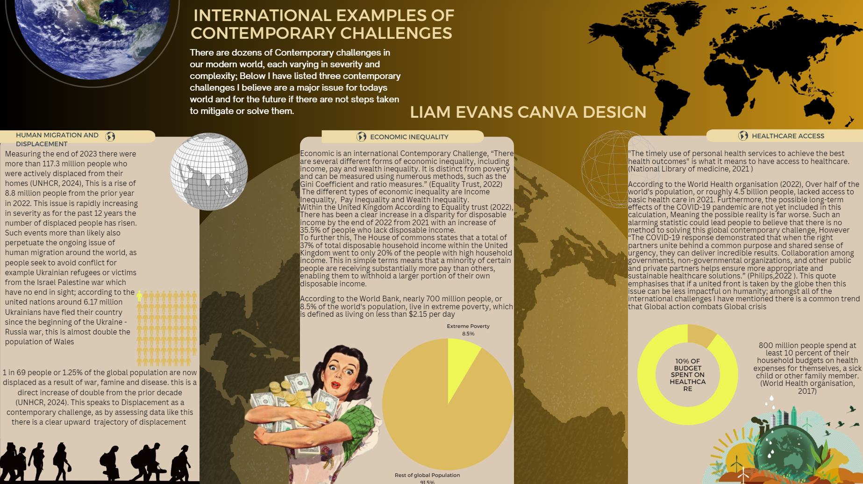

Slide 6
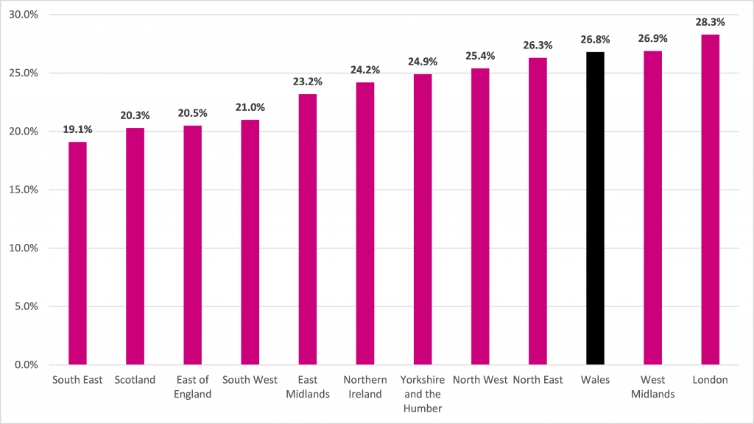
Local examples of contemporary challenges and/or innovative projects addressing them case study.
Like the rest of the World, Wales is not without its fair share of contemporary issues. For example, according to The Wales Centre for public policy "the poverty rate in Wales remains higher than in England, Scotland and Northern Ireland and has been the case for much of the past ten years."(2022) this is likely due to the overall economic performance of Wales, being lower than that of its UK Neighbours by a substantial margin, as well as poor housing and funding (Wales.gov, 2024)
The rate of Poverty in Wales is also dramatically higher among the youth, chronically ill disabled people, single parents, social and private renters, women and Black and Minority Ethnic people in Wales. (Wales Centre for public policy, 2022)
This Graph provided by Senedd (2021) speaks to the poverty level of Wales in comparison to other areas of the UK, with an astonishing 30% of people living in poverty. Personally, I find it unacceptable that an entire countries state of poverty is worse than that of smaller areas of England.
How can Wales fix its poverty?
The Welsh government states that they have 5 priorities when addressing poverty within the youth in particular, these being:
"Priority 1: entitlement (putting money in people’s pockets).
Priority 2: creating a Fair Work nation (leaving no one behind).
Priority 3: building communities (accessible, joined up services to meet community needs).
Priority 4: inclusion (kind, compassionate and non-stigmatising services).
Priority 5: enabling collaboration (at the regional and local level)." (Gov.Wales, 2024)
Figure one

Slide 7
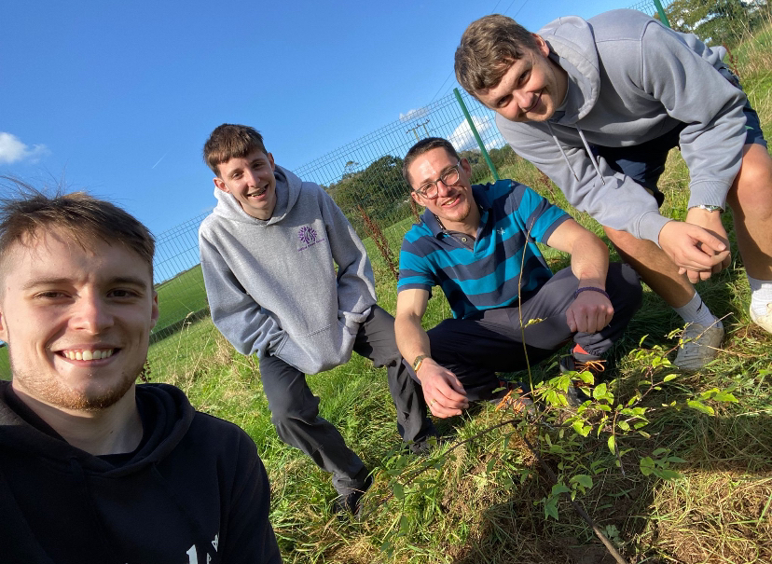
Collaborative piece
In this photo, Myself and my classmates: Lewis, Mathew and Lucas discussed the impacts of deforestation upon the globe and the sheer quantity of trees that are cut down for human use. Green service estimates that around 42 million trees are cut down each day, which amounts to around 15 billion trees a year. Whilst discussing the large scale of this contemporary challenge we were planting an Oak tree and learning about the care of trees; We then stated that if people started taking individual action on restoring nature, such as planting trees in our case then the world would not be so devasted by the effects of climate change. An example of an individual who took a large personal endeavor to restore the environment by planting trees would be Helio Da Silva, a Brazilian businessman who spent 20 years planting over 40,000 trees, transforming an area of derelict unused land into a thriving ecosystem (Daily mail, 2024). Whilst this is an extreme example it speaks to the power of individuals acting against contemporary challenges.
The benefits of everyone coming together in a community and planting trees would be the facilitation of a future forest, which according to Mike Gaworecki from Mongabay (2021) "Planting these new forests could store as much as 205 billion metric tons of carbon" which would help reduce the development of climate change. Upon my group discussion I decided to see what global organisations were doing. Currently, Belgium is pioneering the tree planting challenge in the EU having planted more than 5 million trees, followed by Czechia and Portugal. In 2023, France committed to plant 1 billion trees by 2030(united nations, 2024). In conclusion from our discussion, I learnt that both humanity must take global and individual action to mitigate the impact of contemporary challenges, something as simple as planting a tree can contribute to the larger picture at hand.

Slide 8
Appendix
Reference List: | Available at:
(The University of Queensland, 2008, e-portfolio: The University of Queensland) | https://elearning.uq.edu.au/staff-guides-original/eportfolio/what-eportfolio-original
(Legan, J. 2015, The Medical response to the black death: James Madison University scholarly commons) | https://commons.lib.jmu.edu/cgi/viewcontent.cgi?article=1023&context=honors201019
(The National Library of Medicine, 2022, Medicine from Galen to the Present: The National Library of Medicine) | https://pmc.ncbi.nlm.nih.gov/articles/PMC8939383/
(National Health Service, 2022, Information Policy: National Health Service) | https://www.nhs.uk/our-policies/content-policy/
(SciLEO, 2024, Malignant tumors affecting the head and neck region in ancient times: SciLEO) | https://www.scielo.br/j/bor/a/6sGqYXbRpbnNyq4bWYHsBdr/
(European Centre for disease prevention and control, 2024, What we do: European Centre for disease prevention and control) | https://www.ecdc.europa.eu/en/about-ecdc/what-we-do
(Geneva Academy, 2024, Todays armed conflicts: Geneva Academy) | https://geneva-academy.ch/galleries/today-s-armed-conflicts
(Timofeev, I, 2022, Sanctions on Russia: A New Chapter: Google Scholar PDF download) | Sanctions on Russia: a new chapter
(NATO, 2024, NATO's response to Russia's invasion of Ukraine: NATO) | https://www.nato.int/cps/en/natohq/topics_192648.htm
(United Nations, 2024, Ukraine: Over 6 Million Refugees Spread Across Europe: United Nations) | https://unric.org/en/ukraine-over-6-million-refugees-spread-across-europe/
(United Nations, 2024,Global Trends: United Nations) | https://www.unhcr.org/uk/global-
(Equality Trust, 2022, How is Economic Inequality Defined?: Equality Trust) | https://equalitytrust.org.uk/how-economic-inequality-defined/
(The House of commons, 2024, Income inequality in the UK: The house of commons ) | https://commonslibrary.parliament.uk/research-briefings/cbp-7484/
(The World Bank, 2022, Poverty: The World Bank) | https://www.worldbank.org/en/topic/poverty#:~:text=Poverty%20At-A-Glance,upper-middle-income%20countries.
(Philips,2022, 10 things to know about global access to healthcare: Philips ) | https://www.philips.com/a-w/about/news/archive/features/2022/20221129-10-things-to-know-about-global-access-to-healthcare.html
(National Library of medicine, 2021, ACCESS TO HEALTHCARE AND DISPARITIES IN ACCESS: National Library of medicine) | https://www.ncbi.nlm.nih.gov/books/NBK578537/
(The World health organisation, 2017, Half the world lacks access to essential health services: The World health organisation) | https://www.who.int/news/item/13-12-2017-world-bank-and-who-half-the-world-lacks-access-to-essential-health-services-100-million-still-pushed-into-extreme-poverty-because-of-health-expenses
(Green service,2022, Deforestation: Green service) | https://www.greenservicesdirect.co.uk/deforestation
(Foster, S, 2024, Man singlehandedly plants 40,000 trees in derelict city: Daily mail) | https://www.dailymail.co.uk/travel/article-13966667/Brazil-man-plants-40000-trees-Sao-Paulo-Helio-da-Silva.html
(Gaworecki, M,2021: Is planting trees good for the earth as everyone says?: Mongabay) | https://news.mongabay.com/2021/05/is-planting-trees-as-good-for-the-earth-as-everyone-says/
(united nations, 2024, Commission conference to boost effort to plant 3 billion trees by 2030 for more resilience against climate and environmental threats: United nations) | https://environment.ec.europa.eu/news/commission-conference-boost-effort-plant-3-billion-trees-2030-more-resilience-against-climate-and-2024-03-20_en#:~:text=So%20far%2C%20Belgium%20is%20the,1%20billion%20trees%20by%202030.
(Wales Centre for public policy, 2022, Poverty in Wales: Wales Centre for public policy) | https://www.wcpp.org.uk/wp-content/uploads/2022/09/Poverty-in-Wales-Policy-Briefing.pdf
(Welsh Government, 2024, Relative income poverty: Wales.gov) | https://www.gov.wales/relative-income-poverty-april-2022-march-2023-html
Figure one | https://research.senedd.wales/research-articles/poverty-in-wales-are-we-getting-the-full-picture/
(Welsh Government, 2024, Child Poverty Strategy for Wales 2024: Wales.gov) | https://www.gov.wales/child-poverty-strategy-wales-2024

