Slide 1
PRESENTATION
Dr Hart
Disappearence
Module Name: Academic Skills for the Digital Era (BMSW4013)
Student Name: Christos Rizos 2427458
Lecturer Name: Tristan Hawkins

Slide 2

Who is or was
Dr Hart
Dr Hart a Senior AI and Robotic Engineer
She worked on Machine Learning (ML), a system used for decision-making in health, military, and security.
She wrote an article on AI in the army and its ethical risks in real-world decision-making.
She suggested an ethical framework with transparency in AI development, human oversight, and compliance with global ethical standards in defense and daily life.

Slide 3

Investigations and Theories
Dr Hart disappeared without a trace. Her lab was in chaos, and witnesses had no answers. Rumors link her rival, Dr. Fox Alaric. A torn note found suggesting a threat or forced cooperation.
Dr. Hart orchestrated her own disappearance, refusing to work on artificial intelligence creations for ethical reasons, avoiding potential harm to humanity. Did she create any humanoids? Was there anyone who knew about her research? Her body has not yet been found.

Slide 4

Reccomendations
Re-examine the witnesses
Checking the security cameras and her electronic devices
Investigate personal and proffesional enviroment
Analyze the notice
Fingerprints
What happen with similar cases in worldwide.
All these investigations must be kept secret

Slide 5
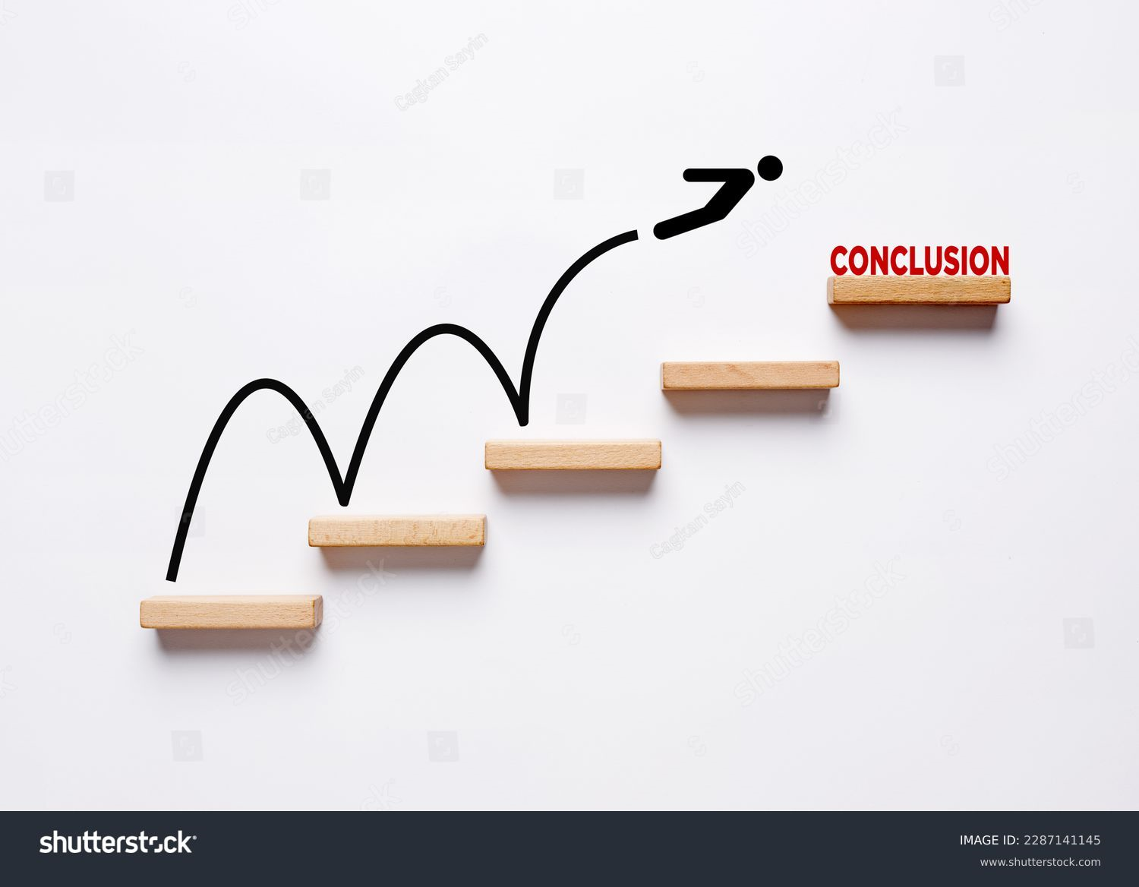
Her disappearance raises questions about the usefulness and ethical risks of AI technology today. It is also important to examine similar disappearance cases worldwide and consider how safe scientists feel in today's world.

Slide 6
References
Fink, K., Kenin, J. and Chang, A. (2025) ‘Scientist calls the disappearance of federal health data a "digital book burning"’, All Things Considered, 5 February. Available at: https://www.npr.org/2025/02/05/nx-s1-5286577/researcher-calls-out-trump-administration-for-a-digital-book-burning (Accessed: 22 February 2025).
Fry, S. (2025) New evidence we are close to extinction from AI. YouTube video, 23 February. Available at: https://www.youtube.com/watch?v=JSXosZDzpa0 (Accessed: 23 February 2025).
Solomon, D., 2020, Internal objections to virtue ethics. In: D. Statman, ed., Virtue ethics. Edinburgh: Edinburgh University Press. Available at: https://doi.org/10.1515/9781474472845-012 (Accessed: 22 February 2025).
Matthews, D. (2023) 'News in depth: Russian researchers disappear from academic conferences as isolation bites', Science|Business, 14 November. Available at: https://sciencebusiness.net/news/international-news/news-depth-russian-researchers-disappear-academic-conferences-isolation (Accessed: 22 February 2025).
Bartneck, C., Lütge, C., Wagner, A. and Welsh, S., 2020. An Introduction to Ethics in Robotics and AI. Cham: Springer.

