Slide 1
Cardiff and Vale Orthopaedic Centre
Joint School
Small service improvement project using a PDSA cycle.
Bev Pretty January 2024

Slide 2
PLAN
Aim to evaluate the quality of information the service provides to patients. Evaluate pts level of knowledge and preparedness before and after the session. Could pre-operative education improve outcomes ? Is it Patient centred enough
How, where and when? – Patient feedback (PREM) using MS Forms pre and post session. Same day of session.
Patients were awaiting hip and knee joint replacement surgery
A study by Jones,S. et al recognises the value of preoperative education for knee arthroplasty patients and their outcomes overall.
Do patients feel fully informed? Is the information clear and easy to understand?
Sample size of 25 patients
Use a standardised approach to look at making improvements by recording patient reported experiences

Slide 3
Do
2 short anonymised MS forms were devised. Maximum of 6 multiple choice questions (using plain English) -Same Q's used pre & post session.
Problems encountered- Slightly longer session time
Increased stress for non tech savvy individuals- Assistance was given
Poor Internet / network connection
Gathered qualitative data- Gelling (2014) refers to 'the importance of data to help healthcare professionals understand patient experiences of health and illness.'

Slide 4


1-Pre 2-Post
Links to surveys used

Slide 5
STUDY-Pre session survey responses
Do you know what to expect from your surgery?
Scale of 1-5 (unprepared-well prepared) indicates how prepared patients feel
Score No. of patients
Yes- 28% 7
No - 24% 6
Some idea- 48 % 12
Score No. of patients
1 40% 10
2 24% 6
3 20% 5
4 12% 3
5 4 % 1
Group Demographic
40% THRs- 10 56% Women
36% TKRs- 9 44% Men
16% UKR- 4
8% Bil TKR-2

Slide 6
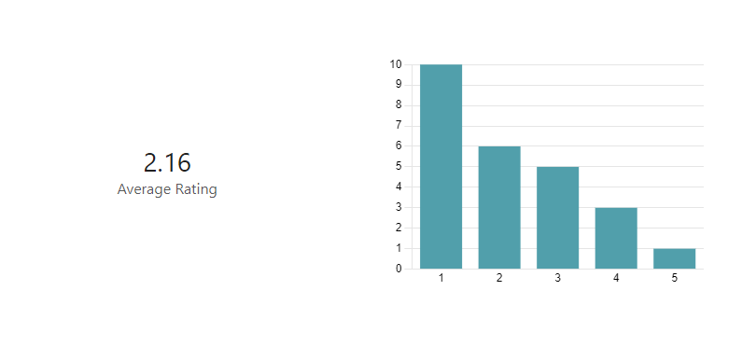
STUDY -Group level data
Pre- On a scale of 1-5 indicates how prepared you feel ( 1 being not prepared 5 well prepared) rate how prepared you feel at the moment?
The group level data shows pre- session the average rating of preparedness is 2.1
Over 40% of patients felt they were unprepared at the start of the session.
4% reported to feel prepared- likely they had previous experience of surgery or via a family member or friend.

Slide 7
STUDY post session survey responses
Do you know what to expect from your surgery?
Scale of 1-5 (unprepared-well prepared) indicates how prepared patients feel
Score No. of patients
1 0% 0
2 0% 0
3 16% 4
4 60% 15
5 24 % 6
Score No. Of patients
Yes- 92% 23
No – 0% 0
Some idea- 8 % 2

Slide 8
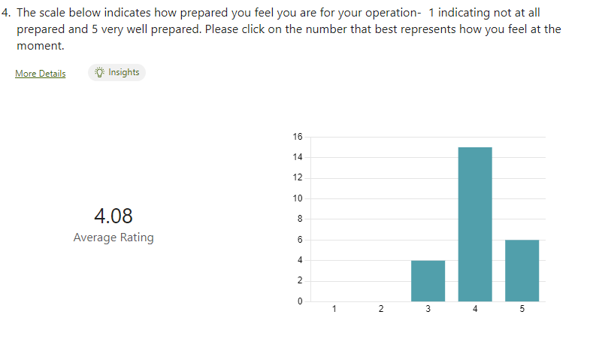
Group level data post rating

Slide 9
Analysis
Data comparison shows that over 92% who attended the education session had improved knowledge and confidence. An increase of 16% from initial data at the start of the session.
Average preparedness rating increased by 1.92 to 4.08 from the initial average rating of 2.16
Patient knowledge and expectations showed an improvement
The data was reassuring that we were providing good quality information.
Patient comments and feedback were also positive, to support this.
Reflection points to consider- Potential drawback/limitation- "Halo effect"
Cognition, stress and anxiety, not all patients were surveyed due to time constraints and technical issues.

Slide 10
What was learned? Questions raised & Next steps
The surveys were provided by staff members who were directly involved in the education session. Most patients were left to complete the survey independently, there may be an element of 'halo effect'. Were results therefore influenced by this?
It does have a positive effect on patient experience and psychological preparedness. Patient feedback indicates this.
Jones,S. et al acknowledge that the success and value of the sessions can be attributed to the face-to-face contact with the MDT- pts may develop trust in the team who are likely to be responsible for their care. Immediate feedback to their individual questions helps reduce anxiety and allay fears.
Trial sending a link via MS forms for patients to access at home prior to their session and then afterwards- also has limitations of accessibility, but would this provide better data?
Is a hospital the best place to deliver sessions? Focus group- patients viewpoint on accessing sessions virtually or in the community, leisure centres, community hubs.

Slide 11
References
Gelling, L. (2015) ‘Qualitative research’, Nursing Standard, 29(30), pp. 43–47. doi:10.7748/ns.29.30.43.e9749.
Jones, S. et al. (2011) ‘Pre-operative patient education reduces length of stay after knee joint arthroplasty’, The Annals of The Royal College of Surgeons of England, 93(1), pp. 71–75. doi:10.1308/003588410x12771863936765.

