Slide 1

Legacy of Innovation: Llanelli's Industrial Evolution and Cultural Transformation
Luisa Sovinschi

Slide 2
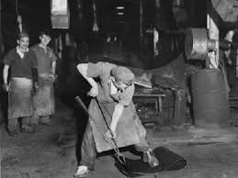
Foundations of Industry
Coal's Crucial Role: Llanelli's transition to industrial prominence began with deep mining innovations, significantly increasing coal production and setting the stage for broader industrialization.
Demographic Shifts: The burgeoning coal industry catalysed a demographic transformation, with a significant influx of workers leading to rapid urbanization.

Slide 3
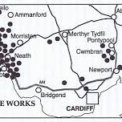
Tinplate Triumph
Manufacturing Mastery: Llanelli distinguished itself as a tinplate production titan by the 19th century, directly contributing to a substantial part of the global supply.
Export Excellence: The town's strategic focus on tinplate manufacturing enabled it to become a leading exporter, bolstering the local economy and securing its place on the world stage.

Slide 4
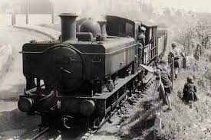
Pathways of Progress
Rails and Revolution: The establishment of the railway network in the 1830s was a game-changer for Llanelli, opening up new markets and facilitating the swift movement of goods.
The Steam Surge: Incorporating steam technology into production processes marked a significant advancement, increasing efficiency and output across industries.

Slide 5
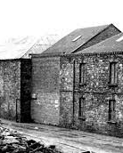
Echoes of Evolution
Changing Class Landscape: The industrial boom reshaped the social fabric of Llanelli, fostering a robust working-class community with emerging rights and representation.
Cultural Confluence: This era of economic transformation also led to a melding of cultures, as workers from diverse backgrounds contributed to a rich, multifaceted local culture.

Slide 6
REFERENCES LIST
Gibbs, F., 1950. The rise of the tinplate industry. I. The tinplate workers. Annals of Science, 6(4), pp.390–403. Available at: https://doi.org/10.1080/00033795000202071.
Jones, J.H., 1913. Dumping and the Tinplate Industry. The Economic Journal, 23(90), pp.182. Available at: https://doi.org/10.2307/2222134.
Jones, T. and Jones, J.H., 1915. The Tinplate Industry: A Study in Economic Organisation. The Economic Journal, 25(98), pp.224. Available at: https://doi.org/10.2307/2222180.
Newell, E. and Watts, S., 1996. The Environmental Impact of Industrialisation in South Wales in the Nineteenth Century: “Copper Smoke” and the Llanelli Copper Company. Environment and History, 2(3), pp.309–336. Available at: https://doi.org/10.3197/096734096779522248.
SYMONS, M.V., 1989. Growth of geological knowledge of the Llanelli Coalfield. Archives of Natural History, 16(1), pp.59–80. Available at: https://doi.org/10.3366/anh.1989.16.1.59.
https://www.facebook.com/TheHistoryOfWales/posts/tinopolis-llanellia-timeline-history-showing-how-coal-and-tinplate-production-re/2835818636538800/
https://www.llanellich.org.uk/files/54-llanellis-lead-and-silver-works
https://www.lovellanelli.co.uk/english/
https://llanellistandard.com/the-tinplate-industry/

