Slide 1

Presentation-Strategies for effective communication in a business setting
BMSW4002 Effective Teamworking and Communication
Sanda Eugen Bogdan Student ID: 2108537
Visan Bianca Elena Student ID: 2108538
Baltaret Nicoleta Student ID: 2107487

Slide 2
Table of content
Introduction | Slide 3
The benefits of effective communication for Microsoft business process | Slide 4
Microsoft Model of Communication | Slide 5 and 6
Communication Barriers with external stakeholders | Slide 7
Microsoft Communication Channels | Slide 8
Channels Recommendations for Microsoft in communication | Slide 9
Conclusion | Slide 10
Teamwork Evaluation | Slide 11
References | Slide 12

Slide 3
Introduction
Microsoft is an international Company with 40 years of success in the UK.
In this presentation Microsoft will be analysed regarding communication methods and look for improvement by using research.
In order to do that, this presentation will contain the benefits of effective communication; Models of communication; Barriers and Channels applied to Microsoft. (Microsoft, 2022)

Slide 4

The benefits of effective communication for Microsoft business process
The key of an successful business it will be always the communication, and that is because an effective communication can bring a lot of benefits to the organization like:
Build teams strong relationships in the organization
Increase the organization Productivity
Increase job satisfaction and employee loyalty
(IOS Press, 2017)

Slide 5
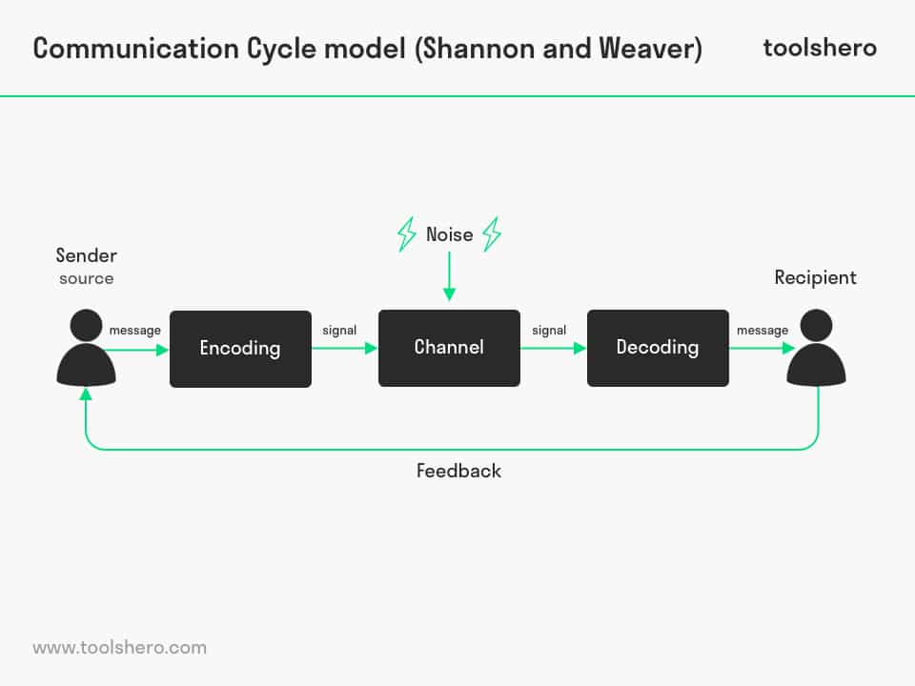
Microsoft Model of Communication
Microsoft not only understand the organizations needs for communication, but from research we could find an suitable model for the company:
-Shannon and Weaver Model
(Al-Fedaghi, 2012)

Slide 6
Continue…
The Shannon and Weaver Model explain that : for an effective communication is needed a minimum two people, one to send a message, and one to received, after the message is received the sender need to replay with a feedback regarding the sender message in order to avoid any communication barriers. (Al-Fedaghi, 2012)
Notes:
Bill Gates (Microsoft Founder 1)
Paul Allen ( Microsoft Founder 2)

Slide 7
Communication Barriers with external stakeholders
Continuing with the Shannon and Weaver model, they implement the feedback in the model in order to avoid any communication barriers.
For example a Microsoft employee and a customer (external stake holder) communicate with each other, but the background was too noise to understand each other.
The background noise in this case is the communication barrier.
And now the Microsoft Employee to be sure that the customer had receive all the information, will ask him for feedback.
Also been an international organization there can exist other barriers too like:
Language barrier
Not a suitable channel for the conversation type
(Lunenburg, 2010)

Slide 8

Microsoft Communication Channels
The communication channels are the platform/place where the communication have action.
For e better understanding, in Microsoft Organization there can be channels such as :
Written communication- Email
Verbal communication: Phone Calls
Face to face – meetings
Technological : Spike, Video conference.
(Dobos, 1992)

Slide 9
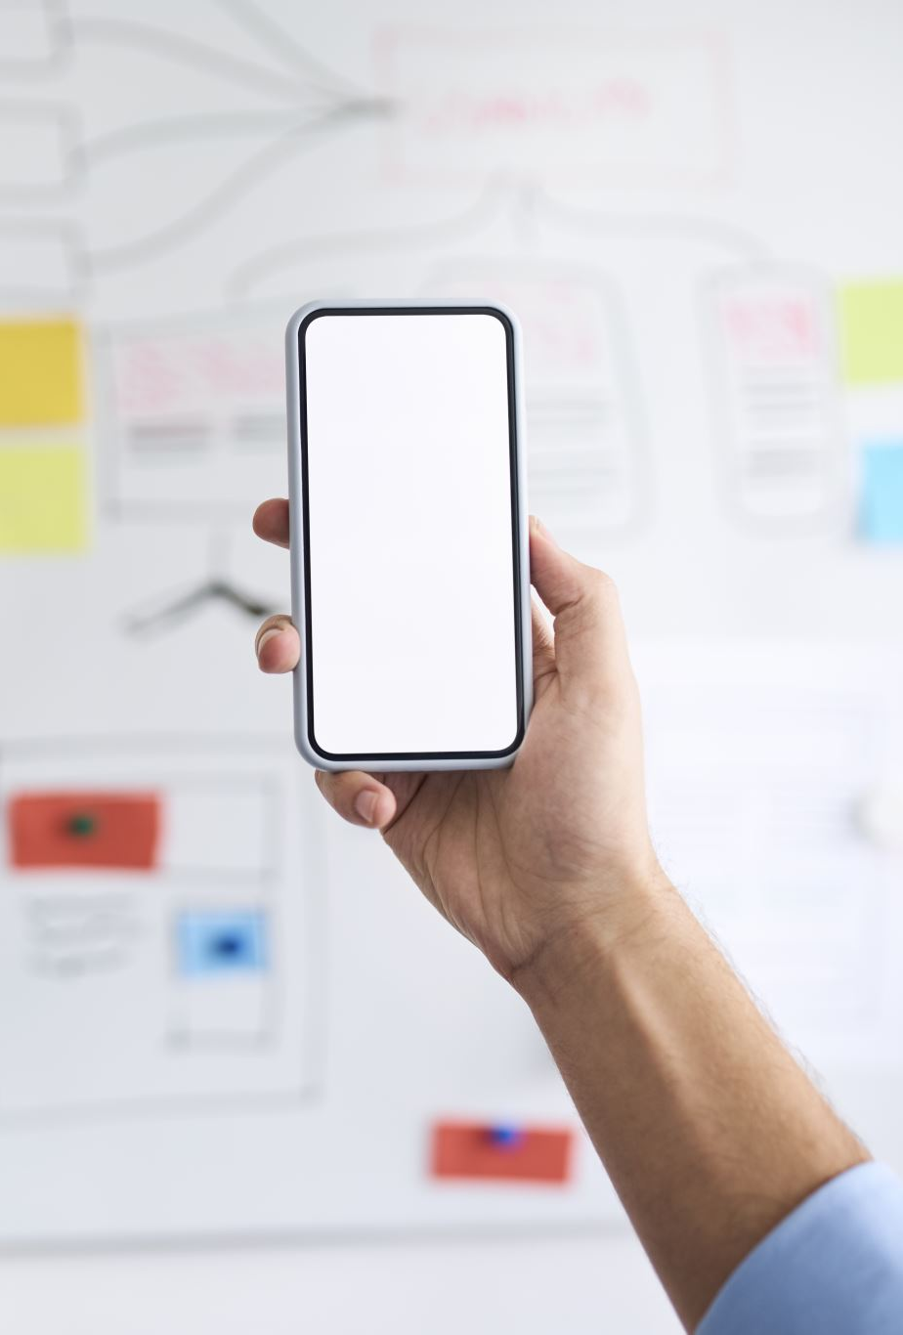
Channels Recommendations for Microsoft in communication
In order to avoid communication barriers, sometimes there is not enough the feedback to break that barrier. And Microsoft to avoid internal and external organization communication barriers they can:
Choose a quite room for meetings
Make sure that there is using a proper email platform and the email is clear
(Dobos, 1992)

Slide 10
Conclusion
Microsoft know how important is for an organization to have an effective communication and that is one of the reasons the company create online platforms such as Microsoft Teams and Outlook in order to increase the safety of an communication platform.
But same as any other organizations, every company need to make sure that they by they the employees are developing they communication skills and other skills.

Slide 11
Teamwork Evaluation
Teamwork Evaluation | Team Responses
Who was in your team? | Sanda Eugen Bogdan, Visan Elena Bianca And Baltaret Nicoleta
What were the key strengths of your team? | Good teamwork and coordination skills
What where the challenges that you overcome as team? | Having different working time schedules we need to make sure to find the right time for all the team members to participate and discus regarding the presentation
What would you different if you worked as a team again? | We will try to be better then las time and develop our skills more
How would you rate your team working? Out of 10? | 9 And that is because we know we could do better

Slide 12
References
Al-Fedaghi, S., 2012. A Conceptual Foundation for the Shannon-Weaver Model of Communication. International Journal of Soft Computing, 1(1).
Dobos, J., 1992. Communication Research. SAGE Journals, 19(1), pp. 29-51.
IOS Press, 2017. The effectiveness of communication channels in government and business communication. [Online]
Available at: https://content.iospress.com/articles/information-polity/ip415
[Accessed 1 03 2022].
Lunenburg, F. C., 2010. Communication: The Process, Barriers,. SCHOOLING, 1(1), p. 11.
Microsoft, 2022. About Microsoft. [Online]
Available at: https://www.microsoft.com/en-gb/about/
[Accessed 01 03 2022].

Slide 13


