Slide 1

LCLM 4004: Problem Solving & Decision Making
Week 7
Decision Making Tools – PMI analysis and Grid analysis

Slide 2
Learning objectives
1. To understand the importance of decision-making tools
2. To know how to conduct a PMI analysis
3.To know how to conduct a GRID analysis

Slide 3
Why do we need Decision making tools?
Useful for difficult or challenging decisions
These decisions can involve:
High risk consequences – the impact of the decision may be significant
Complexity – many factors to consider
Uncertainty – many of the facts be unknown
Alternatives – there may be various alternatives
Interpersonal issues – How will other people react?

Slide 4
PMI decision making tool
PMI (plus, minus, interesting) is a brainstorming, decision making and critical thinking tool.
It is used to encourage the examination of ideas, concepts and experiences from more than one perspective.
PMI was developed by Dr. Edward de Bono, a proponent of lateral and critical thinking. (Virtual Library, n.d.)
It helps to make decisions quickly by analysing and weighing the pros and cons of the available alternatives.

Slide 5
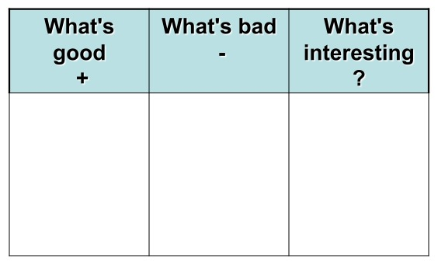
PMI – Decision Making Tool
Plus
Minus
Interesting
PMI stands for 'Plus/Minus/Interesting'. It is a valuable improvement to the 'weighing pros and cons' technique.
Notes:
This is most useful when you are considering a single decision and need to consider whether or not it is going to improve your individual situation

Slide 6
PMI – Decision Making Tool
PMI is a good way of weighing the pros, cons and implications of a decision. When you have selected a course of action, PMI is a good technique to use to check that it is worth taking.
To use the technique, draw up a table with three columns headed Plus, Minus and Interesting (Implications).
Within the table write down all the positive points of following the course of action, all the negatives, and all the interesting implications and possible outcomes.
If the decision is still not obvious, you can then score the table to show the importance of individual items. The total score should show whether it is worth implementing the decision or not.

Slide 7
PMI – Decision Making Tool
To complete you make a chart of three columns - “Plus”, “Minus” and “Interesting.”
Step 1. Consider the Plus Points
In this step, simply enumerate all of the positive things you can think of. Don’t critique yourself along the way, simply spill out all the positive points that you can think of.
Step 2. Consider the Minus Points
In this step, enumerate all of the negative things you can think of. Again, don’t critique yourself. Simply spill out all the negative points you can think of.
Step 3. Consider the Interesting Points of the Situation.
In this step, enumerate all the interesting points that you can think of. Rather than positive or negative, they are simply points of interest that you should direct your attention to.
Step 4. Make Your conclusion
In this step, you make your judgement because you’ve scanned and organised three important aspects: the positives, the negatives, and the interesting.

Slide 8
PMI – Example
Example:
A young teacher lives outside London. She is deciding whether or not to move to London.

Slide 9
PMI – Weighing the Pros and Cons of a decision
Plus | Minus | Interesting / implications
More events going on (+5) | Have to sell house (6) | Easier to find a new job (+1)
Easier to see most of her friends (+5) | More pollution (3) | Opportunity to meet more people (+2)
Easier to travel to holiday destinations (+3) | Less space (3) | More difficult to get own work done due to distraction (- 4)
 | No countryside (2)
 | More difficult to get to work as she works outside London (4)
Total = +13 | Total = -18 | Total = -1
Notes:
Note: The total score of the ‘Minus’ column should be subtracted from the total of the ‘plus’ column (see next slide) this is why a minus sign has been inserted behind 18 in the example here.

Slide 10
Results
She scores the tables as:
13 (plus)
-18 (minus)
-1 (Interesting / Implications)
Total = -6
The outcome:
It would be much better for the teacher to live outside London, but close enough to travel if necessary.

Slide 11
Grid Analysis
This is another important decision making tool
is used when making a choice where many factors must be balanced.

Slide 12
The rational decision process
Problem Identification
Implementation
Alternative generation and evaluation
Criteria definition

Slide 13
Criteria definition
Many problems are multidimensional →decision makers should identify the key factors (criteria) which can influence a decision.
Examples of common factors (criteria) that business decisions may consider are:
  - Price, Product / service quantity, quality of product/ service, implementation time, complexity of implementation, Cost of implementation, etc
Notes:
The factors written in this slide are not set in stone.

Slide 14
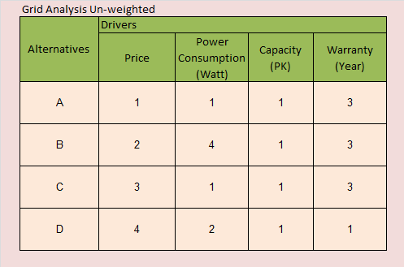
Grid Analysis
Grid analysis is a useful technique to use for making a decision
It is most effective where you have a number of good alternatives and many factors (criteria) to take into account (mba tools.co.uk, n.d).
It helps you to decide between several options where many factors need to be taken into account.

Slide 15
Steps in using the Grid Analysis
The first step is to list your options and then the factors (criteria) that are important for making the decision. Lay these out in a table, with options as the row labels, and factors as the column headings.
Next work out the relative importance of the factors in your decision. Show these as numbers. Rate each of the factors for relative importance, on a scale of 0-5, where 5 is the most important. It is fine to have factors with equal importance.
The next step is to work your way across your table, scoring each option for each of the important factors in your decision. Score each option from 0 (poor) to 3 (very good). You don’t have to have a different score for each option - if none of them are good for a particular factor in your decision, then all options should score 0.

Slide 16
Steps in using the Grid Analysis (Contd)
Now multiply each of your scores by the values for your relative importance. This will give them the correct overall weight in your decision.
Finally add up these weighted scores for your options. The option that scores the highest wins!

Slide 17
Grid Analysis – Worked example
A windsurfing enthusiast is about to replace his car. He needs one that not only carries a board and sails, but also that will be good for business travel. He has always loved open-topped sports cars. No car he can find is good for all three things.

Slide 18
Grid Analysis Example Continued…
Criteria that he wants to consider are:
Cost
Ability to carry surf board
Able to store sails and equipment
Comfort over long distance
Fun
Nice look and build quality to car
His options are:
Sports Car
SUV / 4x4
Family Car
Station Wagon
Notes:
Example:
A windsurfing enthusiast is about to replace his car. He needs one that not only carries a board and sails, but also that will be good for business travel. He has always loved open-topped sports cars. No car he can find is good for all three things.
His options are:
A four wheel drive, hard topped vehicle
A comfortable 'family car'
An estate car
A sports car
Criteria that he wants to consider are:
Cost
Ability to carry a sail board at normal driving speed
Ability to store sails and equipment securely
Comfort over long distances
Fun!
Nice look and build quality to car
Firstly he draws up the table shown in Figure 1, and scores each option by how well it satisfies each factor:

Slide 19
Example
Factors: | Cost | Board | Storage | Comfort | Fun | Look | Total
Weights:
Sports Car
4Wheel Drive
Family Car
Estate Car

Slide 20
Work out the relative importance of the factors in your decision. Show these as numbers.
Rate each of the factors for relative importance, on a scale of 0-5, where 5 is the most important. It is fine to have factors with equal importance.

Slide 21
Example
Factors: | Cost | Board | Storage | Comfort | Fun | Look | Total
Weights: | 4 | 5 | 1 | 2 | 3 | 4
Sports Car
4Wheel Drive
Family Car
Estate Car

Slide 22
Next step
The next step is to work your way across your table, scoring each option for each of the important factors in your decision.
Score each option from 0 (poor) to 3 (very good).
Note that you do not have to have a different score for each option
if none of them are good for a particular factor in your decision, then all options should score 0
good (low) price should have a high score

Slide 23
Example
Factors: | Cost | Board | Storage | Comfort | Fun | Look | Total
Weights: | 4 | 5 | 1 | 2 | 3 | 4
Sports Car | 1 | 0 | 0 | 1 | 3 | 3
4Wheel Drive | 0 | 3 | 2 | 2 | 1 | 1
Family Car | 2 | 2 | 1 | 3 | 0 | 0
Estate Car | 2 | 3 | 3 | 3 | 0 | 1

Slide 24
Next step
The next step is to multiply each of your scores by the values for your relative importance. This will give them the correct overall weight in your decision.
Finally add up these weighted scores for your options. The option that scores the highest wins!

Slide 25
Example
Factors: | Cost | Board | Storage | Comfort | Fun | Look | Total
Weights: | 4 | 5 | 1 | 2 | 3 | 4
Sports Car | 1 4 | 0 0 | 0 0 | 1 2 | 3 9 | 3 12 | 27
4Wheel Drive | 0 0 | 3 15 | 2 2 | 2 4 | 1 3 | 1 4 | 28
Family Car | 2 8 | 2 10 | 1 1 | 3 6 | 0 0 | 0 0 | 25
Estate Car | 2 8 | 3 15 | 3 3 | 3 6 | 0 0 | 1 4 | 36
Notes:
Here, the estate car has the highest total and should be bought based on the grid analysis.

Slide 26
Risk Analysis Template
Note: add as many rows as you need to provide an effective Risk Analysis
 | What could cause a risk? | What is the likelihood of the risk occurring? (1 – 5) | What is the impact of this risk? (1 – 5) | Risk Factor = Likelihood X Impact | What can you do to reduce this risk from happening? | If it happens – what can you do to minimise the impact?
1
2
3

Slide 27
Class Activity
In small groups, read the problem below then:
provide one solution
evaluate it using PMI analysis.
Problem: At UWTSD, students are arriving late for classes.

Slide 28
References
Mba tools.co.uk (n.d.) Decision making [Online] Available from: Grid Analysis (mbatools.co.uk) (Accessed: 26 March 2023)
Virtual Library (n.d.) PMI - Plus, Minus, Interesting [Online] Available from: PMI Plus, Minus, Interesting Strategy - Virtual ​Library (virtuallibrary.info) (Accessed: 26 March 2023).

Slide 29
In-class activity
Considering the problem discussed in your presentation,
Provide 2 solutions + evaluate them using PMI analysis and/or GRID analysis
Write 2-3 sentences of how each solution will help solve the problem
Conduct a basic risk analysis – say what might go wrong with the chosen solution (1 paragraph).

