Slide 1
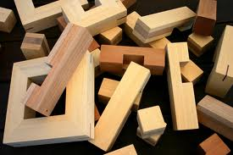
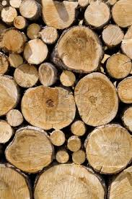
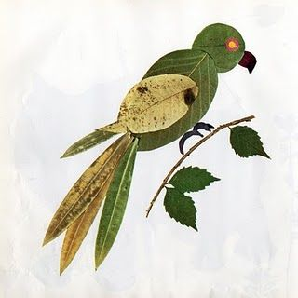
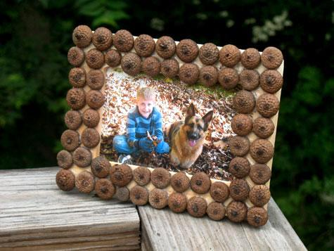
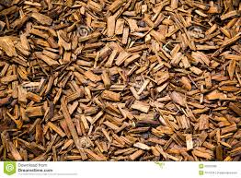
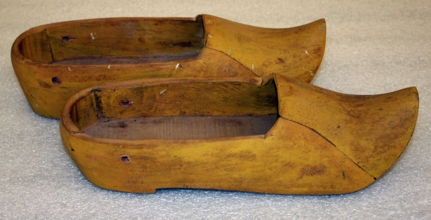
Gall pren fod yn wefreiddiol?
Can wood really be inspiring?
Slides created by Jennings, 2020.
Notes:
Amlsynhwyraidd Multi sensory

Slide 2
Dewch i feddwl? Let’s think?
Storiau / Stories
Caneuon / Songs
Themau / Themes
Cymeriadau / Characters
Notes:
Taflen fesul grwp Group task

Slide 3
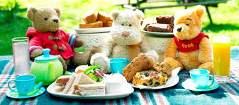
If you go down to the woods….
If you go down in the woods today you're sure of a big surprise
If you go down in the woods today you'd better go in disguise
For every bear that ever there was will gather there for certain
Because today's the day the Teddy Bears have their picnic.
Notes:
http://www.youtube.com/watch?v=uxFIGWm9M6w&feature=kp

Slide 4

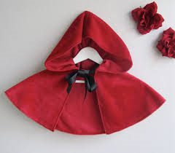
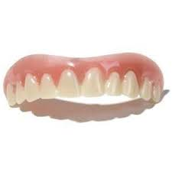
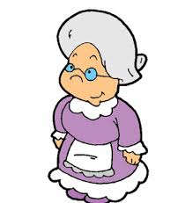

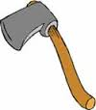
Beth yw’r stori? What’s the story?

Slide 5
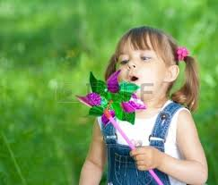
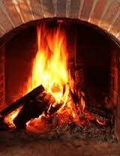
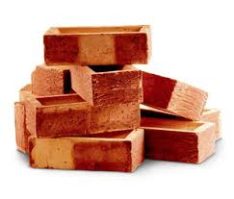
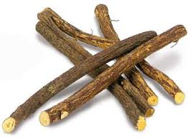
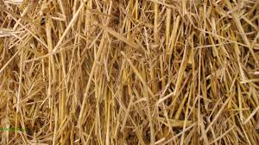
Beth yw’r stori? What’s the story?

Slide 6
Un tro…. Once upon a time…
Pwy? Who?
Beth? What?
Pryd? When?
Ble? Where?
Sut? How?
Pam? Why?
Notes:
Pasio’r pren o gwmpas Pass the wood

Slide 7
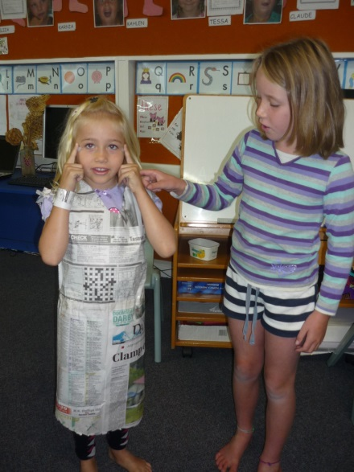
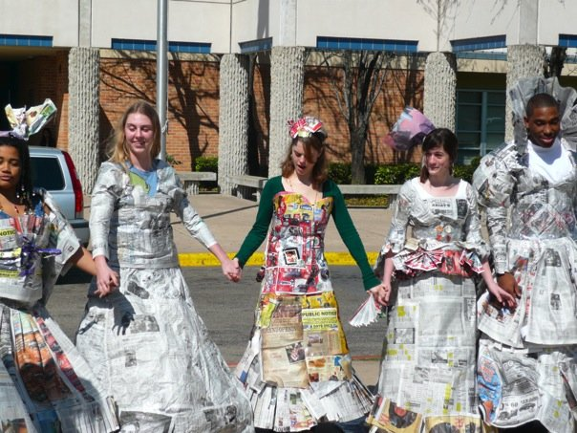

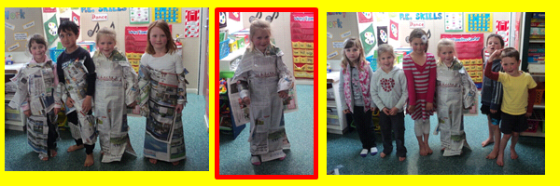
O ble daw papur?
Where does paper come from?
Notes:
Wythnos ail gylchu Eco Ysgolion

Slide 8

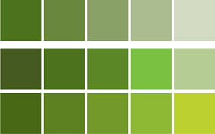

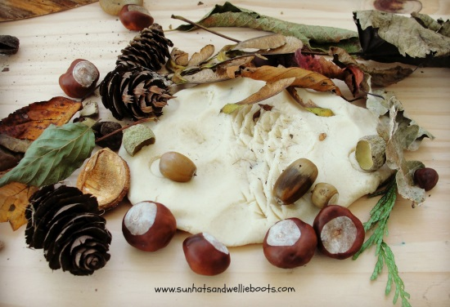
Y Tu Allan The Outdoors
Notes:
Casglu deunydd Collecting materials/ objects
FfLlaRh LNF

Slide 9
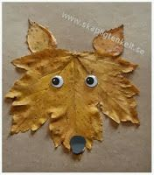
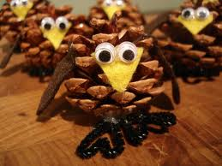
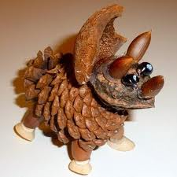
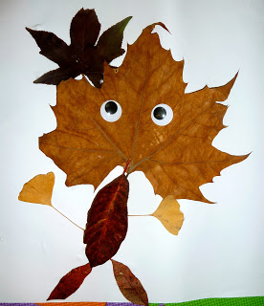
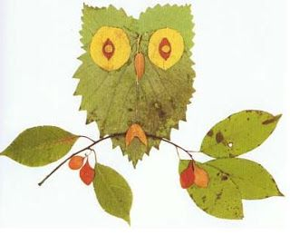
Pethau i’w gwneud… Things to make…

Slide 10
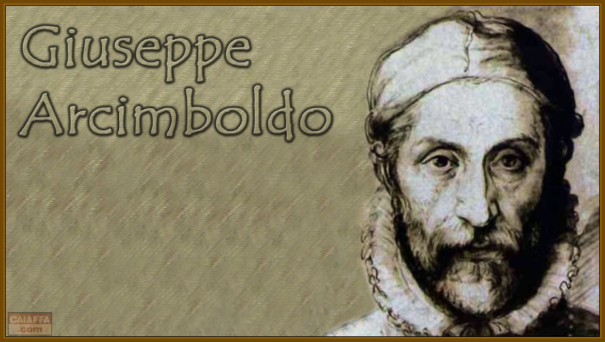
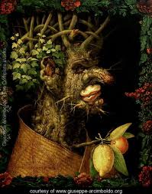
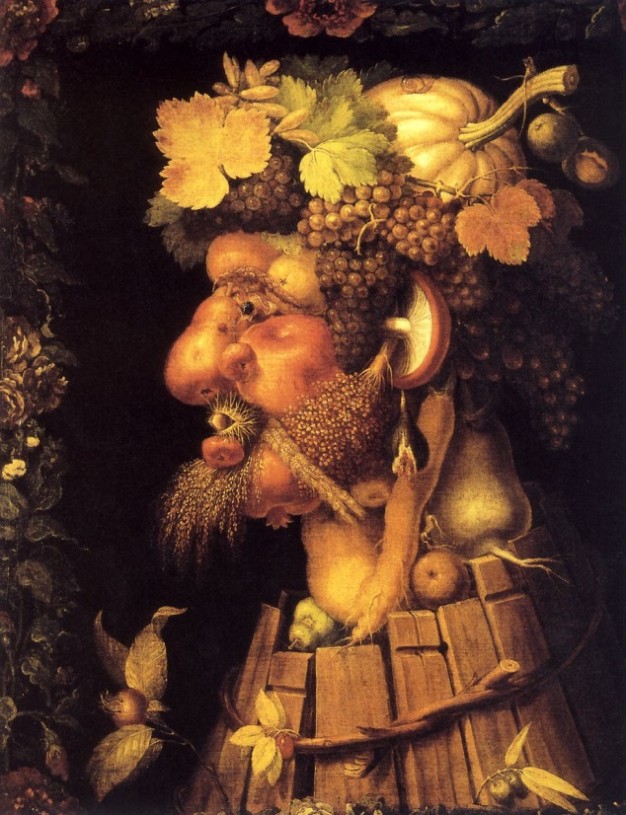
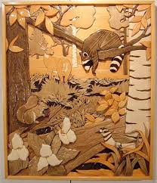

Slide 11
Dywed yr ymchwil…
The research tells us…
‘Nid rhywbeth i’w ychwanegu at y Cyfnod Sylfaen yw’r awyr agored: mae’r Cyfnod Sylfaen a’r awyr agored yn anwahanadwy.’ LlCC(2009:3)
‘The outdoors is not an extra to the Foundation Phase: the Foundation Phase and the outdoors are inseparable.’ WAG (2009:3)
Notes:
Llawlyfr Dysgu yn yr Awyr agored
Outdoor Learning Handbook

Slide 12
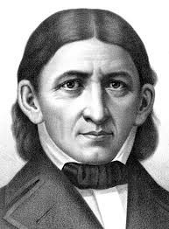
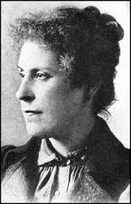
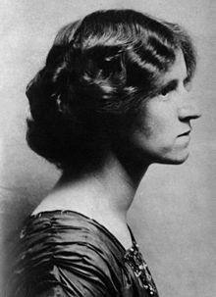
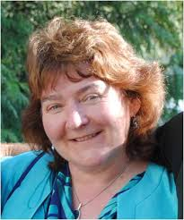
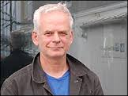
Froebel / McMillan / Isaacs
Notes:
Friedrich Froebel (1782-1852)
Friedrich Froebel, founder of the Kindergarten and inspired by Pestalozzi, strongly emphasized the significance of outdoor play. The name he gave the schools for young children he created, themselves testify of the latter. Kindergarten literally means 'garden for children', demonstrating Froebel's endeavor to highlight the importance of the 'outside world' and nature. Froebel's kindergarten was knwon to be tripartite and one of the three essential element consisted of a garden in which children and their educator grew plants, harvested and made something out of the harvested product. Not only did such activities stimulate young children's awareness of the natural world, they taught children the existing connections between the natural environment, food and health
Margareth Mc Millan (1860-1931)
In 1911 Margareth Mc Millan and her sister established an open-air nursery for poor children in Deptford, England. With a strong emphasis on children's health and well being, Mc Millan's theoretical and practical education of young children incorporated exercise and fresh air at the heart of children's play ventures (Young-Ihm Kwon, 2007).
Susan Isaacs (1885-1948)
Susan Isaacs, psychologist and teacher was highly influenced by Froebel's educational ideas. She believed outdoor play to be extremely important and beneficial to young children. The Malting House School, which first opened as an experimental nursery school, and of which Susan Isaacs was in charge, had a well equipped garden with a play house, sand pit, tool shed, plots for gardening and one of the first climbing frame in Britain (Pound, 2005 in Mickleburgh, 2007). Although such outdoor provision may seem banal and hence taken for granted nowadays, it was highly innovative and original then. She also organised occasional trips away for the children in her care, which again was not something common to do by then.
Jan White
Andy Goldsworthy

Slide 13
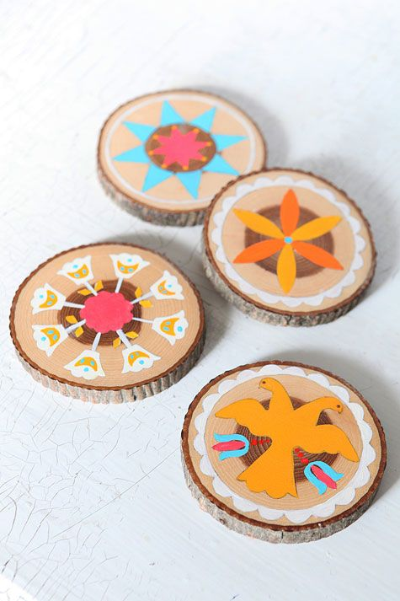
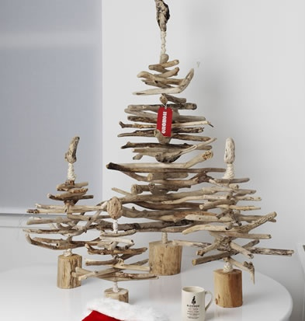
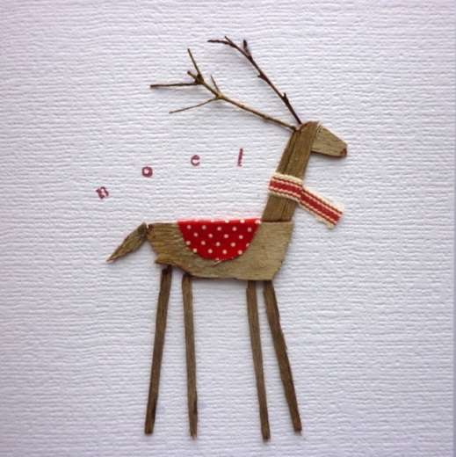
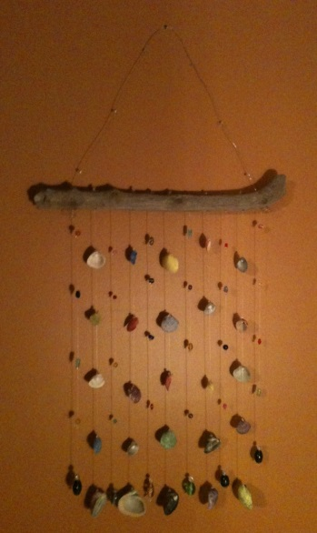
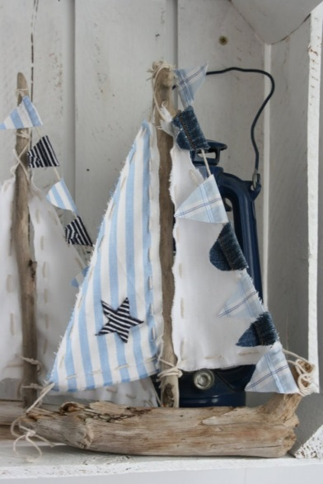
Syniadau Ideas

Slide 14
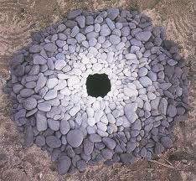
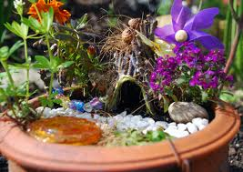
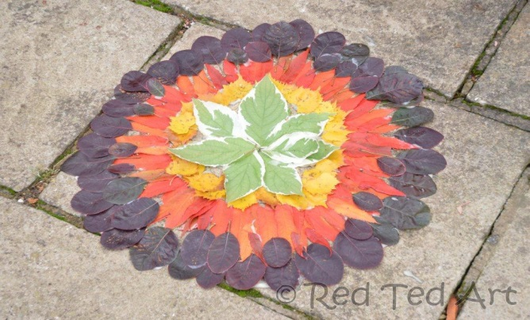
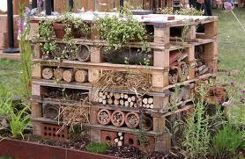
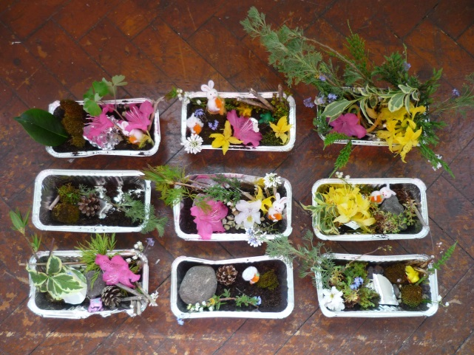
Rhagor o syniadau…
More ideas…

