Slide 1

Certificate in Higher Education Business Skills for the Workplace
Enterprise and Entrepreneurship (LCLM4006)
Individual Presentation Pitch
Dr Stephen Malone

Slide 2


Business Idea Overview
Kingsfish Bucharest is a small, friendly fish and chips shop set to open in central Bucharest in summer 2026, right near the University of Bucharest and Piata Unirii. We will serve proper British-style battered cod—or high-quality local white fish when imports are pricey—along with thick hand-cut chips, mushy peas, tartar sauce, and simple sides like coleslaw or curry sauce. Customers can enjoy generous portions either eat-in at 4–6 tables or as takeaway.
From day one, we'll be live on Glovo, Bolt Food, and Foodpanda for easy delivery.
The unique selling point is authentic British taste combined with big portions at affordable prices 45–55 RON (£9-£11) per meal—in a fun, welcoming setting with British seaside décor like Union Jack cushions and old UK beach photos. This fills a clear gap: Bucharest has plenty of fried food options, but almost nothing offers real British fish and chips.
My targets are students and young professionals aged 18–35, families, office workers, and tourists who want quick, tasty, value-for-money food.

Slide 3

Management Structure & Legal
Format
We will register as a Societate cu Răspundere Limitată (SRL), Romania's equivalent of a limited company. This structure offers limited liability, protecting my personal assets, and it's the most popular and cost-effective choice for small food businesses here because setup is quick and taxation is flexible.
Management will stay lean to control costs and maintain quality. As owner-manager, I (Alex Ismail) will work full-time in the shop every day for the first six months. We'll start with just two part-time staff: one chef/kitchen assistant and one cashier who also helps with cleaning and serving customers.
This flat structure keeps everything simple—everyone pitches in, wages stay low at around £2,000 per month total, and I stay in direct control to ensure fresh food and fast service. As sales grow, we can add more staff or a delivery driver.

Slide 4
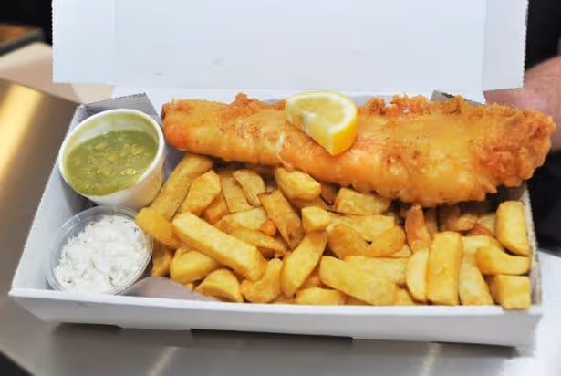
Signature Dish & Classic Menu
Signature Dish:
• Classic British Fish & Chips – battered cod (or local white fish), thick chips, mushy peas, tartare sauce
Classic Chippy menu:
• Battered or plain sausage
• Saveloy
• Fishcakes
• Pies (steak & kidney, chicken & mushroom, meat & potato, mince & onion)
• Chicken pieces or nuggets
• Chicken burgers

Slide 5
Three Important External Factors from PESTEL
From the PESTEL analysis, three key external factors stand out for Kingsfish.
Economical, Bucharest offers Romania's highest incomes and a growing middle class, with the fast-food market expanding rapidly—worth around €6.9 billion in 2026 according to IBISWorld. Customers still seek great value, so big portions at good prices will be essential amid inflation pressures.
Social, young Romanians are excited to try new international foods, and students plus office workers frequently order delivery or eat out. British culture—through football, music, and travel—is already popular here, so our themed setting should appeal strongly to locals, expats, and tourists.
Technological, food delivery apps like Glovo, Bolt Food, and Foodpanda dominate how people order, while Instagram and TikTok drive discovery of new spots. Contactless payments and QR menus are now expected, making these tools critical for reaching our customers quickly.

Slide 6
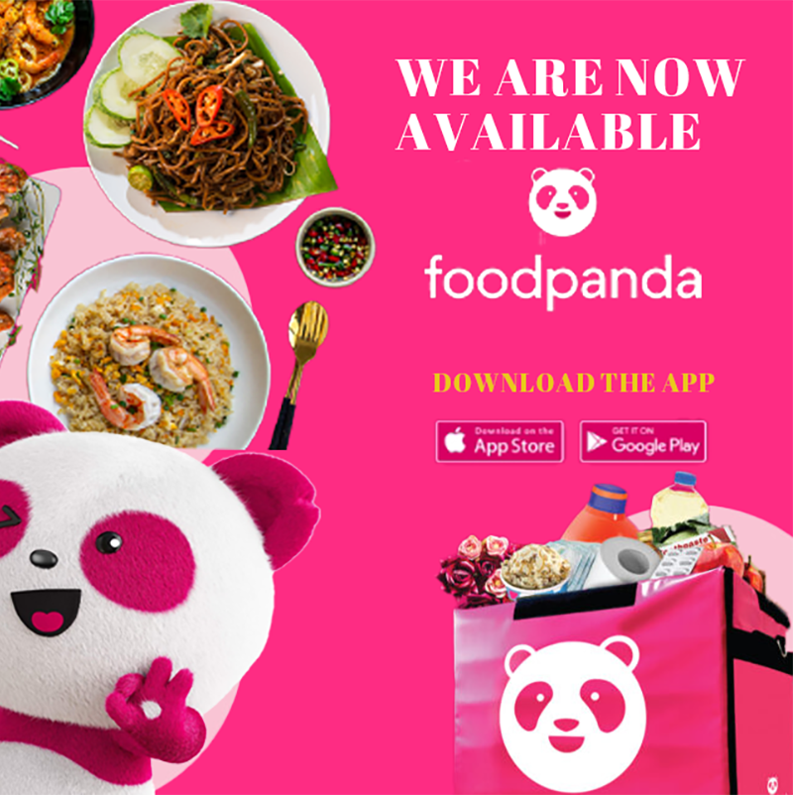

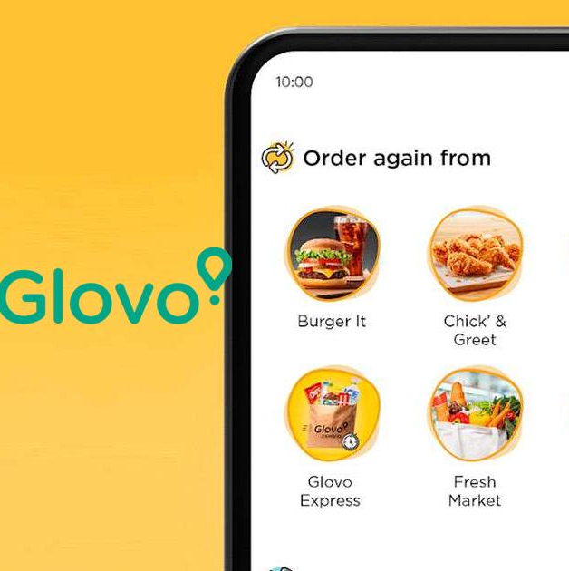

Two Major Marketing Strategies
First, social media will be central. We'll use Instagram and TikTok for short, engaging videos—showing fish being battered and fried, customer reactions, and behind-the-counter moments—with fun hashtags like #KingsfishBucharest and light British-Romanian jokes. We'll also invite 3–4 small Bucharest food bloggers (5k–20k followers) for free meals in exchange for honest reviews to build buzz organically.
Second, we'll leverage delivery apps and a loyalty scheme for repeat business. Full professional listings on Glovo, Bolt Food, and Foodpanda will include attractive photos and first-order discounts. A simple stamp card—buy 5 meals, get the 6th free—will encourage students and office workers to return regularly.

Slide 7
Funding Requirements & Allocation
Total start-up funding required: £20,000.
Sources:
£10,000: IMM Invest government-backed loan.
£5,000: Personal savings.
£5,000: Family contribution.
Key expenses/allocations (first month + start-up):
Rent: £2,000 (premises in central Bucharest).
Marketing: £1,000 (first-month push: ads, flyers, influencers, menus).
Wages: £2,000 (me + 2 part-time staff).
Cost of sales/ingredients: £800 (about 32% of estimated £2,500 first-month sales).
Utilities: £300.
Insurance: £150.
App commissions/delivery fees: £200.
Professional fees (SRL setup, accounting): £300.
Other (cleaning, packaging, etc.): £400.
Total cash outflows (first month): £7,550 (kept low for ramp-up phase).
Equipment (fryers, counters, fridges): Paid pre-opening from the £20,000 (not monthly).

Slide 8


Slide 9


Slide 10
References
Bankrate (2025) Pros and Cons of Bank Business Loans. Available at: https://www.bankrate.com (Accessed: 20 February 2026).
Euromonitor (2025) Consumer Foodservice in Romania. London: Euromonitor International.
IBISWorld (2026) Restaurants & Takeaways in Romania. Available at: https://www.ibisworld.com (Accessed: 25 February 2026).
National Institute of Statistics (INS) (2025) Tourism in Bucharest – First Five Months 2025. Bucharest: INS.
NerdWallet (2026) Advantages and Disadvantages of Business Bank Loans. Available at: https://www.nerdwallet.com (Accessed: 22 February 2026).
Petrescu, A. (2021) ‘Business Structures in Romania: Comparative Legal Overview’, Romanian Journal of Business Law, 9(2), pp. 153–169.
Romania Insider (2025) Harry Ramsden’s to open in Bucharest. Available at: https://www.romania-insider.com (Accessed: 24 February 2026).
Statista (2025) Quick Service Restaurants – Romania. Available at: https://www.statista.com (Accessed: 18 February 2026).
World Bank (2025) Romania Economic Update 2025. Washington, DC: World Bank.
https://pixelz.cc/wp-content/uploads/2018/11/united-kingdom-flag-uhd-4k-wallpaper.jpg
https://hotcore.info/act/kareff-032024p.html
https://ratecaptain.com/bolt-to-launch-food-delivery-service-to-compete-with-gokada-and-jumia-food/
https://cdn-www.bluestacks.com/bs-images/featured_com.glovo_2.jpg
https:/ /www.behance.net/gallery/178645195/Food-Panda-advertisement
https://www.cornwalllive.com/whats-on/food-drink/number-calories-fish-chips-could-1957926

