Slide 1
AI Acknowledgement
AI was used to generate images for my presentation

Slide 2

Narcissistic Personality Disorder (NPD) Conclusion
Joe Savile

Slide 3
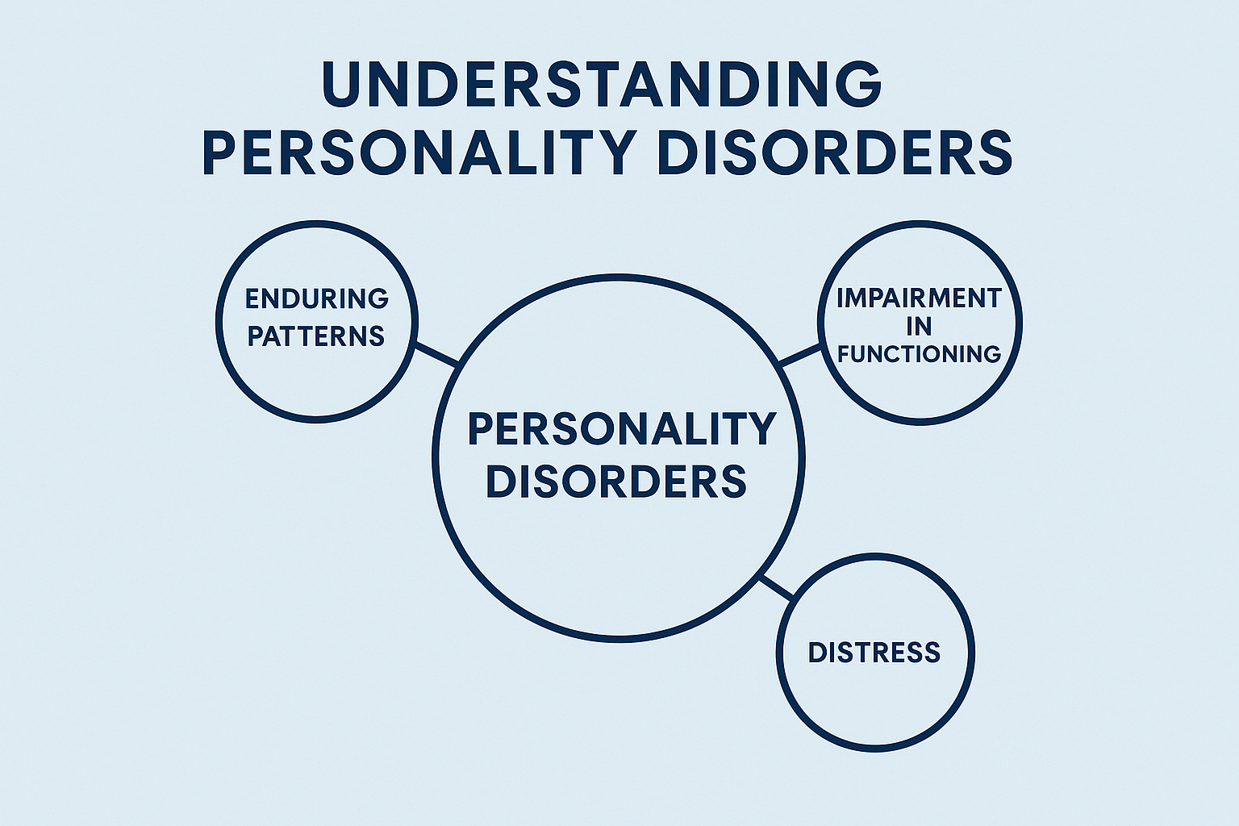
Personality Disorders
What are they?
Personality disorders are long-term patterns of thinking, feeling, and behaviour that differ from what is expected
These patterns are rigid and can cause problems in different areas of life (American Psychiatric Association, 2024)
They often lead to difficulties in relationships, work, and daily functioning (Mayo Clinic, 2023)
Personality disorders usually begin by early adulthood and remain consistent over time (American Psychiatric Association, 2024)
Notes:
They are generally long-term disorders, which effects patterns of thinking and behaviour that differs from what is expected
These patterns are usually rigid and can make it difficult for individuals to adapt to different situations in everyday life.
Causes strain and difficulty on relationships, both personal and in work, it also causes difficulty with daily functioning.
They usually develop by early adulthood and tend to remain consistent over time.
Understanding personality disorders is important, as it provides the foundation for understanding specific conditions such as Narcissistic Personality Disorder.

Slide 4
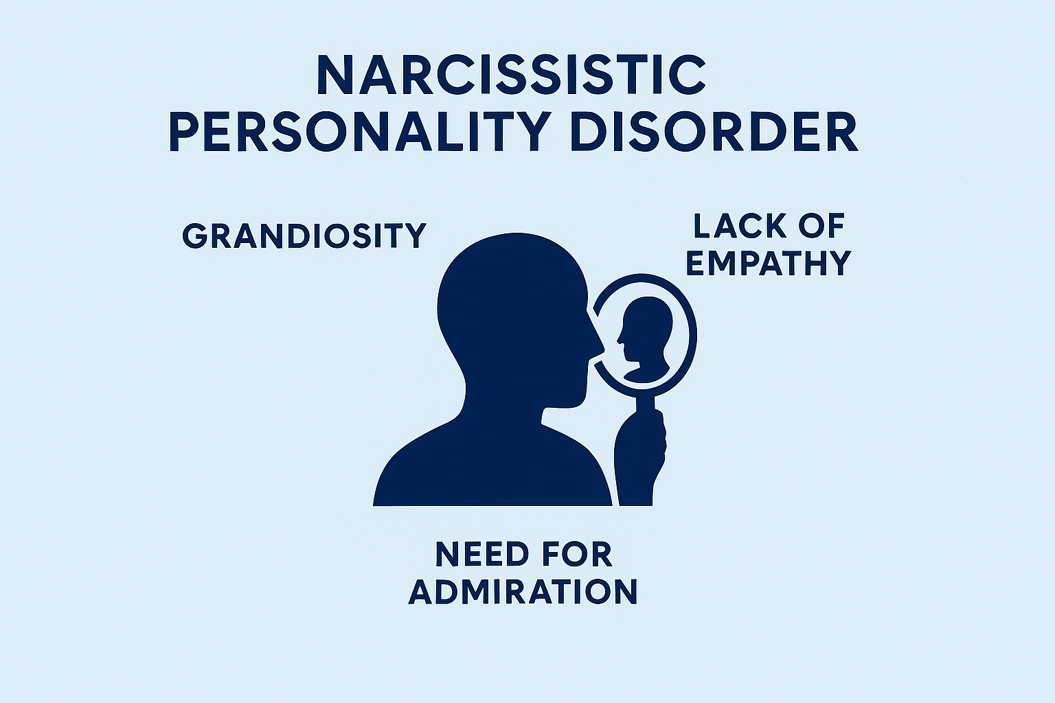
Understanding NPD
What is it?
Clinically recognised personality disorder characterised by patterns of grandiosity, a need for admiration, and lack of empathy (American Psychiatric Association, 2024)
The development of NPD is influenced by a combination of biological, psychological, and social factors (Zimmerman, 2026)
NPD symptoms can significantly impact interpersonal relationships and daily functioning (Mayo Clinic, 2023)
Treatment typically involves long-term psychological interventions aimed at improving emotional regulation and interpersonal functioning (Kacel et al., 2017)
Notes:
Narcissistic Personality Disorder, or NPD, is a clinically recognised personality disorder characterised by patterns of grandiosity, a strong need for admiration, and a lack of empathy towards others.
In terms of its development, NPD is understood as a multifactorial condition, influenced by a combination of biological, psychological, and social factors. These can include genetic predispositions, early life experiences, and environmental influences.
The symptoms associated with NPD can have a significant impact on an individual’s life, particularly in relation to interpersonal relationships and daily functioning. Individuals with NPD often experience difficulties maintaining healthy relationships and may struggle in social or in the workplace.
Finally, in terms of treatment, NPD typically requires long-term psychological intervention. Approaches such as psychotherapy aim to improve the symptoms.

Slide 5
Aetiology of NPD
What are the causes?
The development of Narcissistic Personality Disorder is influenced by a combination of biological, psychological, and social factors
Biological factors may include a genetic predisposition and heritable personality traits that contribute to emotional regulation difficulties
Psychological and environmental factors, such as early childhood experiences, including excessive criticism or overvaluation by caregivers, may contribute to the development of narcissistic traits
These interacting influences highlight the complexity of NPD and support a biopsychosocial understanding of its aetiology (Zimmerman, 2026)
Notes:
in terms of aetiology, as previously mentioned Narcissistic Personality Disorder is best understood using a biopsychosocial approach, meaning that biological, psychological, and social factors all play a role in its development.
From a biological perspective, there is evidence to suggest that genetic predisposition and inheritable personality traits can contribute to difficulties in emotional regulation and self-esteem.
Psychologically and environmentally, early childhood experiences are particularly important. For example, parenting styles that involve excessive criticism or, conversely, overpraise and overvaluation may contribute to the development of narcissistic traits.
Overall, it is the interaction between these different factors that helps explain the complexity of NPD, rather than any single cause alone.

Slide 6
Symptoms
Grandiosity - an exaggerated sense of self-importance and superiority
A strong need for excessive admiration and validation from others
A lack of empathy
A sense of entitlement
Exploitative interpersonal behaviour
Sensitivity to criticism
Notes:
Narcissistic Personality Disorder is characterised by several key symptoms that impact how individuals perceive themselves and interact with others.
One of the primary features is grandiosity, where individuals have an exaggerated sense of self-importance and may believe they are superior to others. This is often accompanied by a strong need for admiration and validation.
Another symptom is a lack of empathy, meaning individuals may struggle to recognise or understand the feelings and needs of others.
people with NPD often display a sense of entitlement and may expect special treatment. They can also engage in exploitative behaviour, using others to achieve their own goals.
despite appearing confident, individuals with NPD are often highly sensitive to criticism, which can lead to defensive or negative reactions.

Slide 7

Treatment
Treatment for NPD primarily involves long-term psychotherapy, which focuses on improving self-awareness and interpersonal functioning (Kacel et al., 2017)
Psychotherapy helps individuals develop healthier ways of relating to others and managing emotions (Mayo Clinic, 2023)
Individuals with NPD may be resistant to treatment or lack insight into their behaviour, making engagement challenging (Kacel et al., 2017)
Medication is not used to treat NPD directly but may be prescribed to manage related symptoms such as anxiety or depression (Mayo Clinic, 2023)
Notes:
In terms of treatment, Narcissistic Personality Disorder is primarily managed through long-term psychotherapy. This focuses on helping individuals develop greater self-awareness and improve their relationships with others.
Therapy can support individuals in recognising maladaptive patterns of behaviour and developing healthier ways of managing emotions and interpersonal situations.
treatment can be challenging, as individuals with NPD may have limited insight into their behaviour or may be resistant to seeking or continuing help.
successful treatment often requires long-term engagement and a strong therapeutic relationship.
While medication is not used to treat NPD directly, it may sometimes be prescribed to manage related symptoms such as anxiety or depression.

Slide 8
References
Zimmerman, M. (2026). Narcissistic personality disorder (NPD). MSD Manual Professional Edition. https://www.msdmanuals.com/professional/psychiatric-disorders/personality-disorders/narcissistic-personality-disorder-npd
National Center for Biotechnology Information. (n.d.). Article PMC5819598. U.S. National Library of Medicine. https://pmc.ncbi.nlm.nih.gov/articles/PMC5819598/
Mayo Clinic Staff. (2023). Narcissistic personality disorder: Symptoms and causes. Mayo Clinic. https://www.mayoclinic.org/diseases-conditions/narcissistic-personality-disorder/symptoms-causes/syc-20366662
American Psychiatric Association. (2024) What is narcissistic personality disorder? Psychiatry.org. https://www.psychiatry.org/News-room/APA-Blogs/What-Is-Narcissistic-Personality-Disorder

