Slide 1
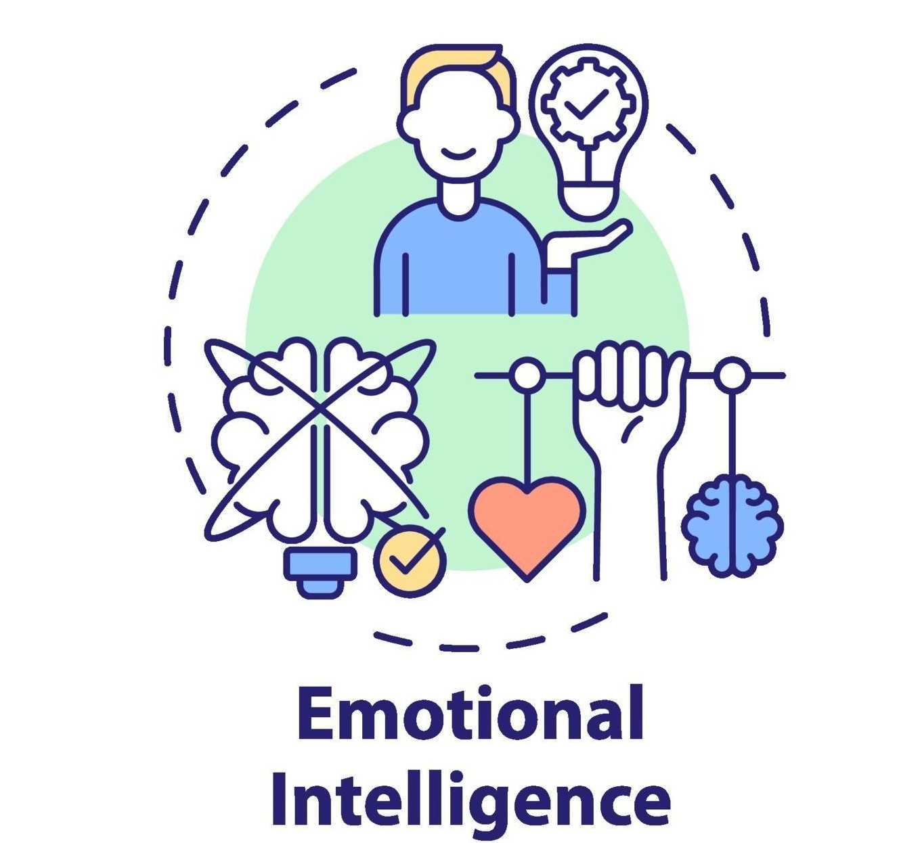
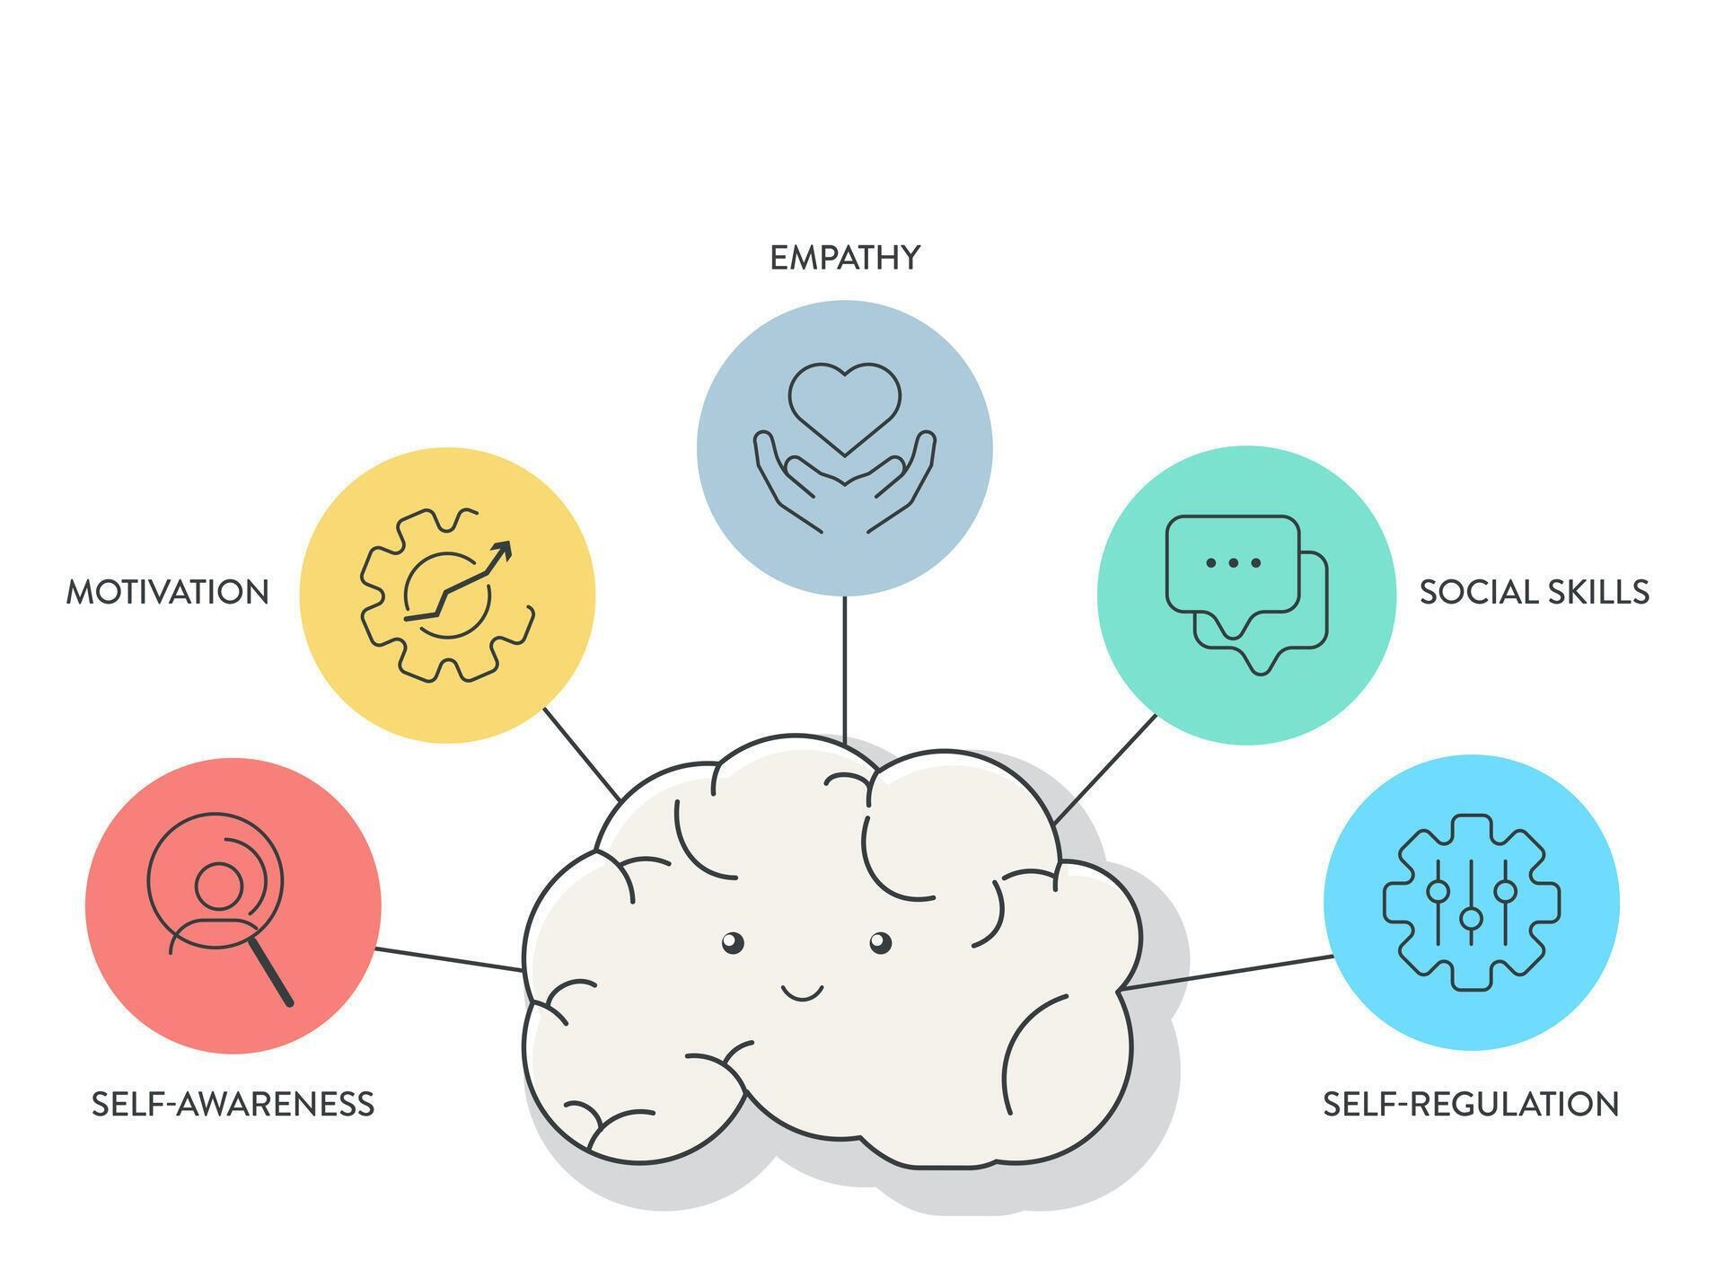
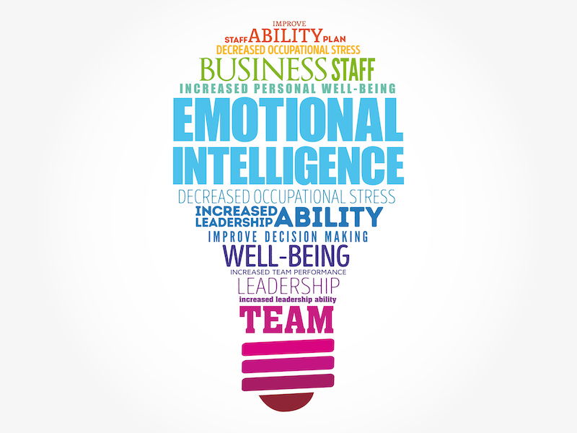
Benefits of Emotional Intelligence (EI)
Communication: The practice of EI leads me to active hearing and expressive communication, which prevents misunderstandings, thus fostering better connections with my colleagues.
Decision-making: Emotional intelligence helps to evaluate circumstances rationally before controlling my emotions to make smart choices based on facts (Chung et al., 2023).
Collaborative culture: Emotionally intelligent employees like me use my ability to build empathy and trust, which results in establishing positive collaborative relationships among team members.
Stress management: Through emotional intelligence, I can gain abilities to handle stress, which actively helps me to protect myself from work-related exhaustion and enhances my job contentment.
Employee retention: Workplaces that promote EI develop dedicated teams through higher motivation levels because of improved loyalty and long-term employee engagement (Kotsou et al., 2019).
Conflict management: Having elevated EI has supported me to have abilities so I can learn to resolve workplace conflicts with productive methods, which diminishes work-related tensions.
Key Skills of Emotional Intelligence (EI)
Self-awareness: The baseline of emotional intelligence enables me to detect my feelings, together with my influence on thinking and conduct.
Self-regulation: Self-regulation enables the ability to manage sudden emotional impulses as I learn methods to transfer strong emotions into beneficial responses (Lopes, 2016).
Empathy: Individuals who have EI can recognize and handle the feelings of others and build strong interpersonal bonds.
Motivation: I can keep my focus and resilience strong through the power of emotional insight, even when faced with challenging situations.
Social skills: The set of skills comprising communication and teamwork, along with leadership ability, constitutes social abilities. Effective relationships are built through leadership capabilities and teamwork promotion.
Improvement & Application of Emotional Intelligence (EI)
Active discussion with others: Active engagement in discussions and meaningful understanding of others and appropriate responses will improve my empathy towards people as well as my social consciousness.
Focusing on mental & physical wellness: To preserve emotional balance together with resilience, individuals should practice mindfulness methods as well as deep breathing techniques or participate in physical yoga activities.
Regular training Programs: Emotional intelligence improvement happens through attendance of EI training programs combined with literature reading about emotional intelligence and participation in professional development workshops (Ioannidou and Konstantikaki, 2018).
Being flexible: Smooth career advancement with professional development occurs when professionals demonstrate flexible behavior to remain resilient throughout uncertain times.
Setting long-term goals: The constant pursuit of measurable goals for emotional regulation, as well as empathy and adaptability development, helps achieve long-term professional success.
Reference
Chung, S.R., Cichocki, M.N. and Chung, K.C., 2023. Building emotional intelligence. Plastic and Reconstructive Surgery, 151(1), pp.1-5.
Ioannidou, F. and Konstantikaki, V., 2018. Empathy and emotional intelligence: What is it really about?. International Journal of caring sciences, 1(3), p.118.
Kotsou, I., Mikolajczak, M., Heeren, A., Grégoire, J. and Leys, C., 2019. Improving emotional intelligence: A systematic review of existing work and future challenges. Emotion review, 11(2), pp.151-165.
Lopes, P.N., 2016. Emotional intelligence in organizations: Bridging research and practice. Emotion Review, 8(4), pp.316-321.
Notes:
Emotional Intelligence functions as an essential competency for contemporary workplaces because it determines how people handle relationships as well as their teamwork and reaction to stressful situations. People with emotional intelligence understand their feelings and control them and they also recognize the emotions of others. Organizations that employ team members at a high EI level can expect their employees to create strong social connections while making superior choices that drive positive results for the organization.
Personal Reflection on Emotional Intelligence
My self-awareness stands out as the primary factor which allows me to understand and manage my feelings according to my observed Emotional Intelligence profile. The practice of observing my emotional reactions in different scenarios has improved my ability to comprehend my capabilities in addition to my weaker aspects. Stress occurs when I am in high-pressure situations because of which my capability to make quick decisions gets impacted positively or negatively. Through self-reflection, I have developed a deeper awareness of these emotions so I can create effective methods for their control. Through self-regulation, I have achieved composure in hard times. I now dedicate time to detect what I feel before selecting my response choice. My ability to maintain professionalism together with my interactions with peers and colleagues becomes stronger through this practice. My drive to reach personal and professional objectives forms the base of my motivational force. My success-oriented outlook towards long-term accomplishments helps me face challenges with resilience.
Understanding and Managing Emotions
My ability to recognize and analyze my emotions became crucial to developing better relationships with people. Through self-awareness of my emotional influence on thinking and reacting I transform my communication behavior depending on different encounters. I pay attention to team members' words and make an active attempt to understand their points of view when I work alongside others. The practice has improved my effectiveness at creating valuable partnerships as well as teamwork success with my colleagues. Understandably I have learned the essential role of managing both emotional triggers and stress properly. I have kept my emotions steady through the practice of mindful techniques such as breathing techniques and self-reflective practices. My proactive approach to stress management enables me to stay serene under intense situations and develop sound decision-making abilities. Further development of my emotional abilities became possible through mentor and peer feedback which revealed both my strengths and weaknesses in emotional response.
Improving and Capitalizing on Emotional Intelligence
I have established various approaches which will help me build up my emotional intelligence through improved emotional perception and social skills. My first strategy for emotional intelligence development will involve going through multiple EI training sessions and reading essential material on the subject. Gaining more expertise in this area will let me improve my understanding of myself combined with control of my emotions and empathy skills. Active listening will become a consistent practice for me through complete attention to conversations and careful examination of different viewpoints before I speak. My strong listening capabilities will help me create better relationships and develop valuable communication skills in my personal and professional life. I plan to create specific personal goals that include improving conflict resolution abilities alongside enhancing my adaptability to change situations. I will make the most of my emotional intelligence by implementing these skills when leading and working in teams. Through emotional intelligence, I will enable others to become more motivated which leads to a positive productive workspace. My ability to display empathy combined with social awareness and communication excellence will help me establish trust and teamwork throughout the team.

