Slide 1



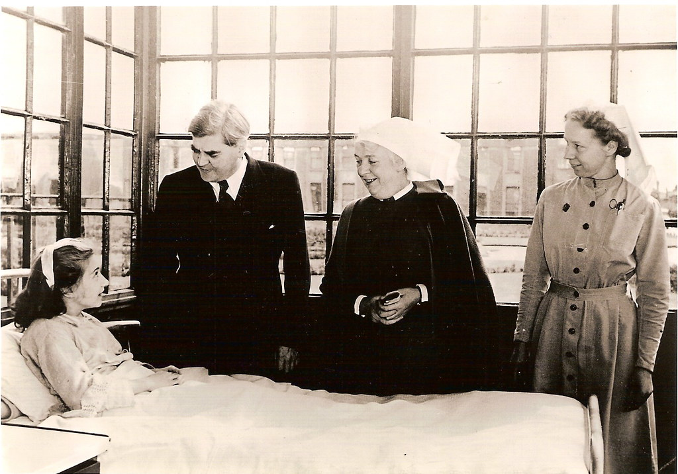


The Role of Welsh Culture, Language, and Identity in Healthcare and Social Care in Wales
Enhancing Patient-Centred Care through Cultural and Linguistic Integration
Language Use & Community Care in Welsh Healthcare
Welsh Language (Wales) Measure 2011 was introduced with the intention of ensuring bilingual healthcare services (Prys, Hodhes and Roberts, 2021, Prys and Matthews, 2022).Welsh government has adopted a community-based approach to healthcare to address rural health challenges and healthcare disparities in rural areas (Public Health Wales, 2018).
29.5% of Welsh speakers speak Welsh as their primary language (Bond, 2024) according to the 2021 Census. The social networks formed by rural communities are typically close ones that play a crucial role in providing care to members (Akarsu, Nazire Ezgi, 2024).A significant difference exists between patients who can communicate in their preferred language and those who cannot (Seung Heyck Lee et al., 2023)
15443284621_a767092e65_b.jpg (1024×418)
Legislative Framework for Welsh-Language Healthcare
There is the Welsh Language (Wales) Measure 2011 which grants Welsh official language status and mandates bilingual services in the public sector, including the health sector.Providing Welsh-language health and social care services without requiring patients to request them through the More Than Just Words Framework (2020).Well-being of Future Generations (Wales) Act 2015: Promotes linguistic and cultural identity integration in healthcare (Sarma, 2022).
Conclusion
Wales has pioneered a healthcare system that celebrates its unique cultural and linguistic identity through progressive policies like bilingual service mandates and proactive Welsh-language care delivery. These initiatives address critical challenges in rural access, aging populations, and health disparities while fostering patient-centered approaches. However, full implementation requires expanded bilingual staffing, improved digital resources, and enhanced rural service models. By strengthening these areas, Wales can ensure equitable healthcare access for all Welsh speakers while setting a global standard for linguistic and cultural inclusion in medicine. The future of Welsh healthcare lies in preserving its heritage while innovating to meet community needs - creating a system where language is never a barrier to quality care.
Challenges in Delivering Welsh-Language Healthcare
Rural Welsh-speaking communities are geographically isolated, which makes it difficult for them to access healthcare (Woods et al., 2021).Given the ageing Welsh-speaking population, multilingual services are essential (Hughes, 2023a).The provision of Welsh-language services has been hindered by the lack of multilingual healthcare workers (Lewis and Royles, 2022).The Function of Welsh in the Provision of Healthcare.
https://m.media-amazon.com/images/I/81DP+bU6ZJL._AC_SL1500_.jpg
Introduction
Welsh healthcare is shaped by its unique cultural and linguistic identity, which plays a key role in shaping health and social care (Reed et al., 2021). The Welsh language and its traditions play a vital role in both the public and private sectors in influencing patient experiences, accessibility to healthcare, and overall well-being. Welsh challenges include rural healthcare access, aging populations, and chronic illness rates (Ranasinghe et al., 2024) . In order to provide culturally competent healthcare that meets patients' linguistic needs, it is crucial to understand Welsh identity and healthcare delivery (Reeve and Lavery, 2023) . Welsh culture, language, and identity are explored in this poster. Policies and legislation support it.
The Critical Importance of Native-Language Healthcare
When patients receive care in their native language, they are more likely to have an improved sense of trust and confidence, reduce anxiety levels, and have a better understanding of what is happening in patient privacy. Language barriers in the medical field can result in incorrect diagnoses, treatment resistance, and lower patient satisfaction (Zhou et al., 2021).
Barriers to Welsh-Language Healthcare Access
The lack of healthcare providers who speak Welsh makes it challenging to get culturally appropriate treatment.Availability of Welsh-language health materials and digital resources is a major barrier to patient education and engagement in the healthcare system.Hesitation on the part of patients: Many patients are reluctant to request Welsh services, often assuming that they are not available (Morgan et al., 2022).
Devolution and Its Impact on Welsh Healthcare Policy
Devolution is the process of transferring powers from the UK government to the Welsh Parliament (Senedd Cymru), allowing Wales to develop policies specifically tailored to the needs of the Welsh people (Rawlings, 2022 and Tarrant, 2022).Since gaining legislative control over healthcare in 1999, Welsh policy has been creating a unique set of regulations with an emphasis on linguistic rights, cultural diversity, and community-based healthcare (Hughes, 2023). It also encourages culturally competent medical procedures.
240px-Flag_of_Wales_(1953–1959).svg.png (240×144)
https://static.wikia.nocookie.net/1df3d145-0ca1-43d1-9bdd-1e5fcc4d0189/scale-to-width/755
Policy Autonomy in Welsh Healthcare
Policy autonomy is the ability for the Welsh Government to develop policies independently of England, resulting in patient-centred care aligned with Welsh culture and language (Wasim, Sajan and Majid, 2023)
This Photo by Unknown Author is licensed under CC BY-SA
https://live.staticflickr.com/2935/14465908720_7664852c2f_b.jpg
330px-Map_of_Wales.svg.png (330×440)

