Slide 1
Footprinting and Reconnaissance
Lecture 2

Slide 2
Learning outcome
Upon completion of this material, you should be able to:
  Understanding Footprinting concepts
  Understanding different techniques
  Footprinting Tools
  Footpriniting countermeasures
  Overview of Footprinting Pen Testing

Slide 3
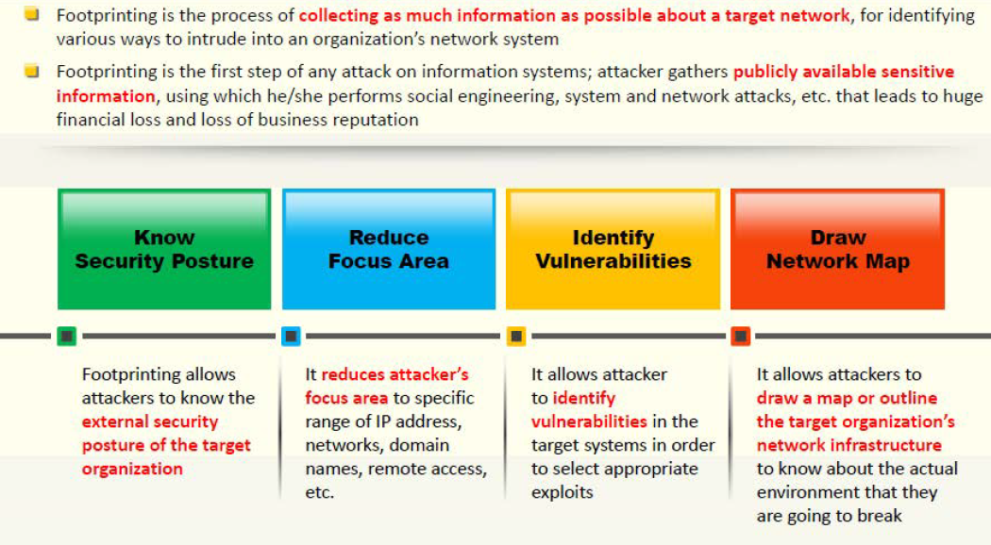
What is Footprinting?

Slide 4
Footprinting Methodology
Foot printing can be collected through the following:
  Through search Engines
  Using advanced Google Hacking techniques
  Website
  Email
  Competitive Intelligence
  Whois
  DNS
  Networking
  Social Engineering
Notes:
Attackers use search engine to extract information about a target such as technology platforms, employee details, login pages, Internet portals, etc. which helps in performing social engineering and other types of attacks.
Search engine caches and Internet archives may also provide sensitive information that has been removed from the World Wide Web (WWW)
You can search for target company’s external URL in a search engine such as Google, Bing, etc.
Restrictted URLs provide an insight into different departments and business units in an organization.
You may find a company’s restricted URLs by trial and error method or using a service such as http://www.netcraft.com
You can use the Netcraft tool to determine the Operating System (Oses) in use by the target organisation
Use SHODAN search engine that let you find specific computers (routers, servers, etc.) using a variety of filters.
Use Google Earth tool to get the physical location of the target.
Social networking sites are great source of personal and organisational information
Information about an individual can be found at various people search websites
The people search can return residential addresses and email address, contact numbers, Dob, photos and social networking profiles, blog URLs, satellite pictures of private residencies, upcoming projects and operating environment.
Financial services provide a useful information about target company such as market value of a company’s shares, company profile, competitor details, etc.
You can gather company’s infrastructure details from job postings
Alerts are the content monitoring services that provide up-to-date information based on your preference usually via email or SMS in an automated manner.
Groups forums and blogs provide sensitive information about a target such as public network information, system information, personal information etc.

Slide 5
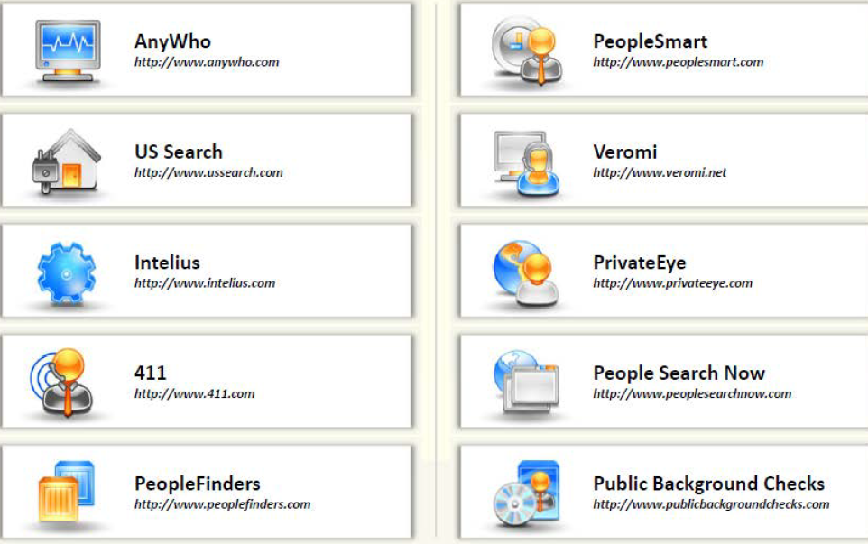
People Search Online Services

Slide 6
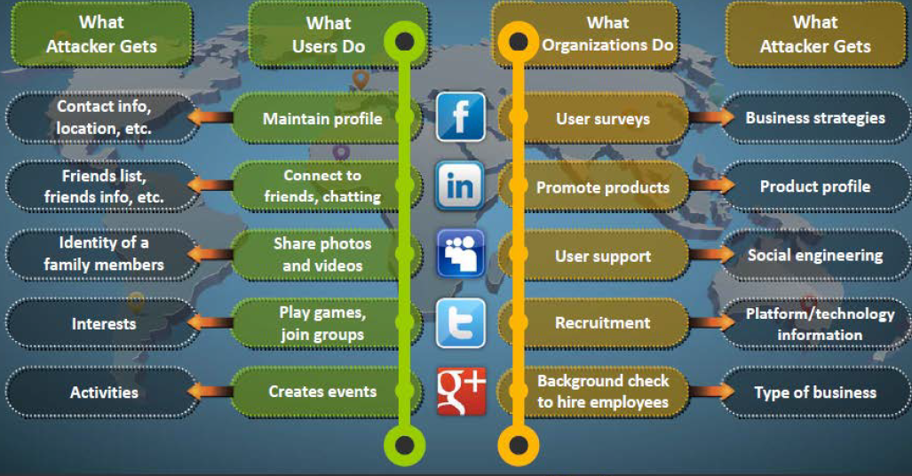
Information Available on social networking Sites

Slide 7
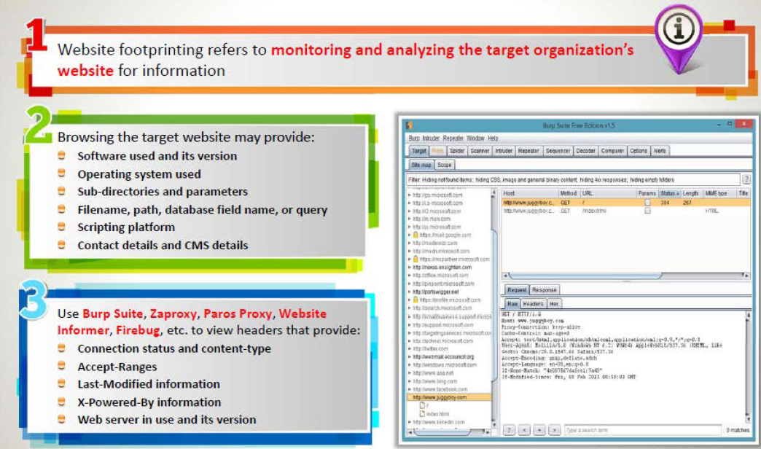
Website Footprinting
Notes:
Examining HTML source for comments in the source, contact details of web developer or admin, file system structure, script type
Examining cookies may provide, software in use and its behaviour, scripting platforms used
Web Spiders may be used. It performs automated searches on the target website and collect specified information such as employees names, email addresses, etc. Attackers use these to perform further footprinting and social engineering attackers.
Mirroring an entire website onto the local system enables attackers to browse website offline; it also assists in finding directory structure and other valuable information from the mirrowed copy without multiple requests to web server.
Internet Archive’s Wayback Machine allows you to visit archived versions of websites.
Website-Watchers automatically checks web pages for updates and changes.

Slide 8
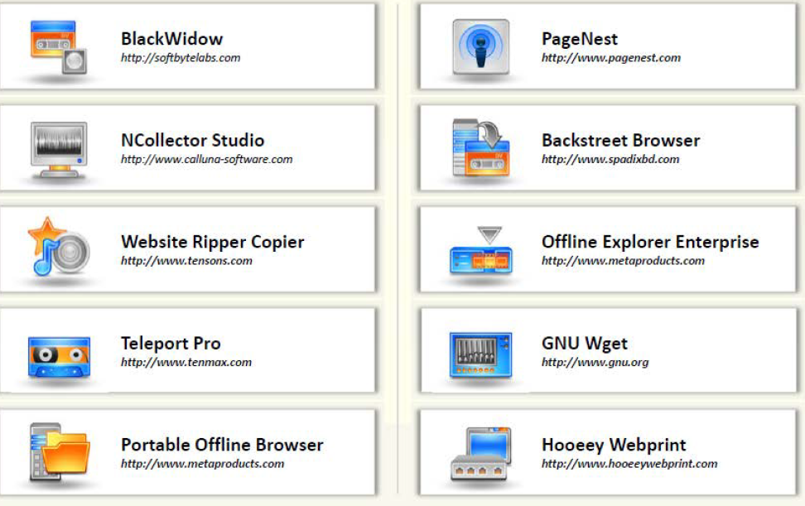
Website Mirroring Tools

Slide 9
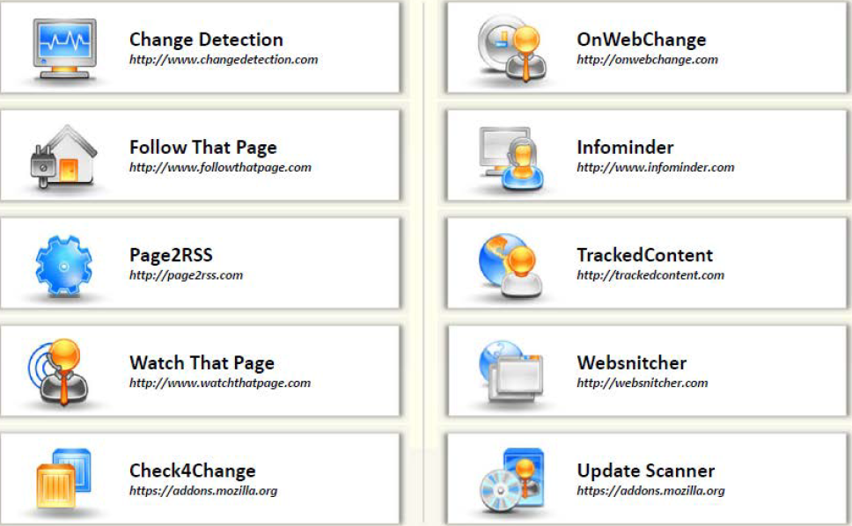
Web Updates Monitoring Tools

Slide 10
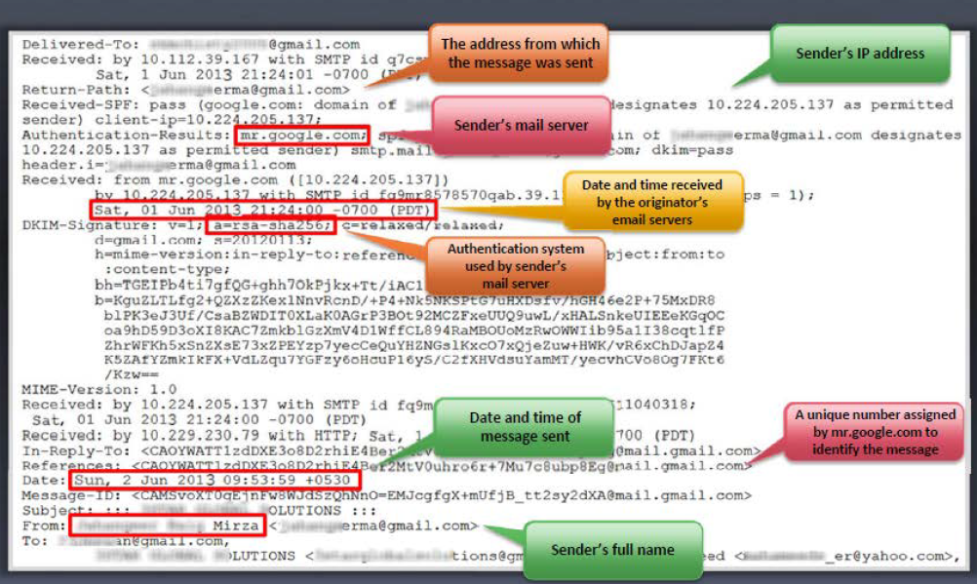
Collecting Information from Email Header

Slide 11
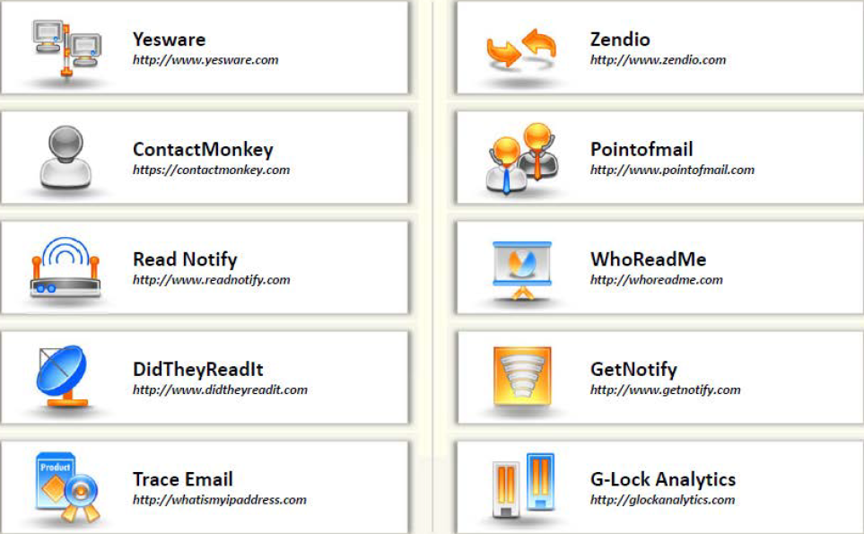
Email Tracking Tools

Slide 12
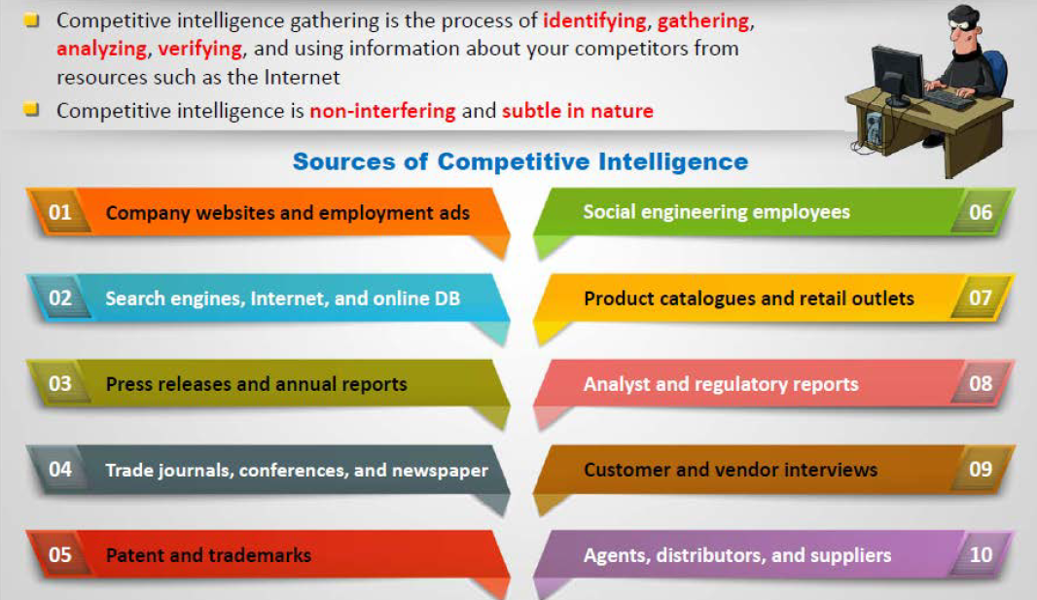
Competitive Intelligence Gathering
Notes:
It looks at when the company begins, where it is located, how did it develop, who leads it?
what are the company’s plans?
What experts opinions say about the company?
Monitor website traffic of target company
Track online reputation of the target

Slide 13
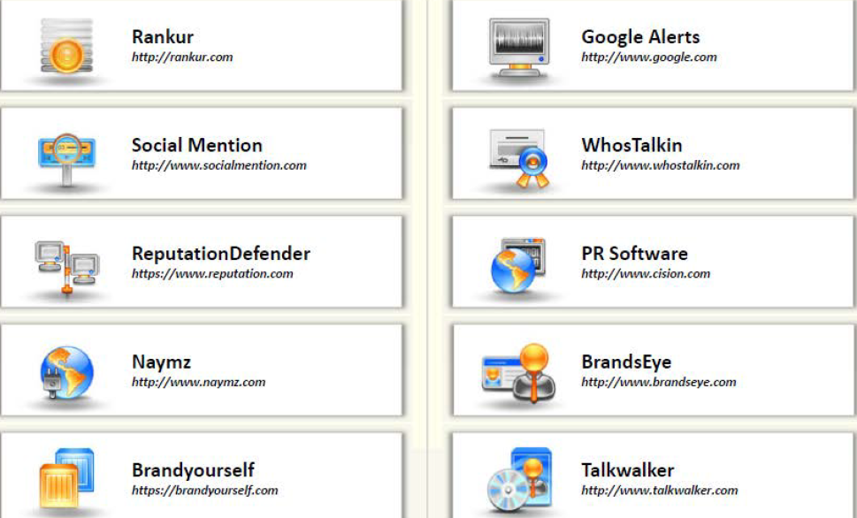
Tools for Tracking Online Reputation of the Target

Slide 14
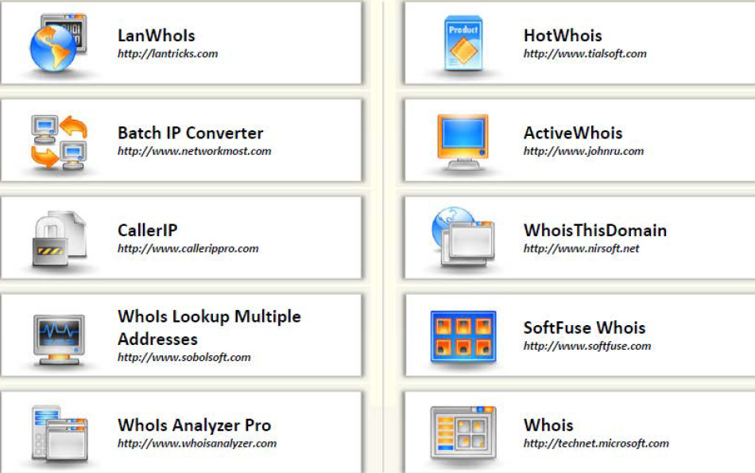
Whois Lookup Tools
Notes:
Whois databases are maintained by Regional Internet Registries and contain personal information of domain owners.

Slide 15
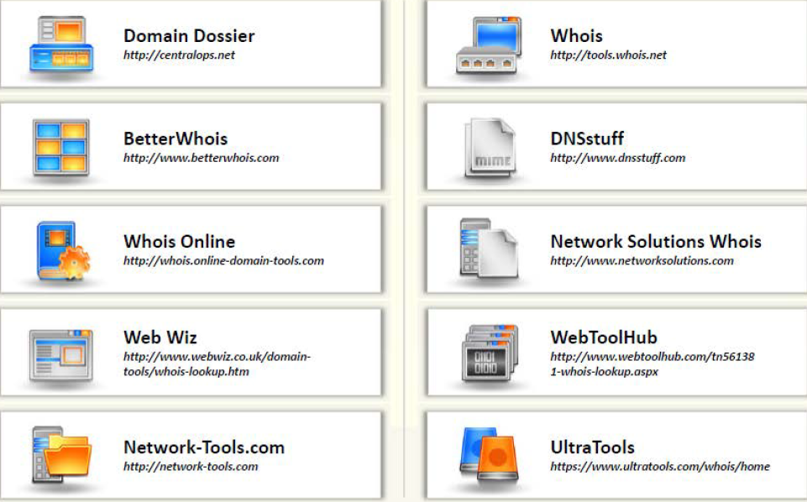
Whois Lookup Tools
Notes:
Whois databases are maintained by Regional Internet Registries and contain personal information of domain owners.

Slide 16
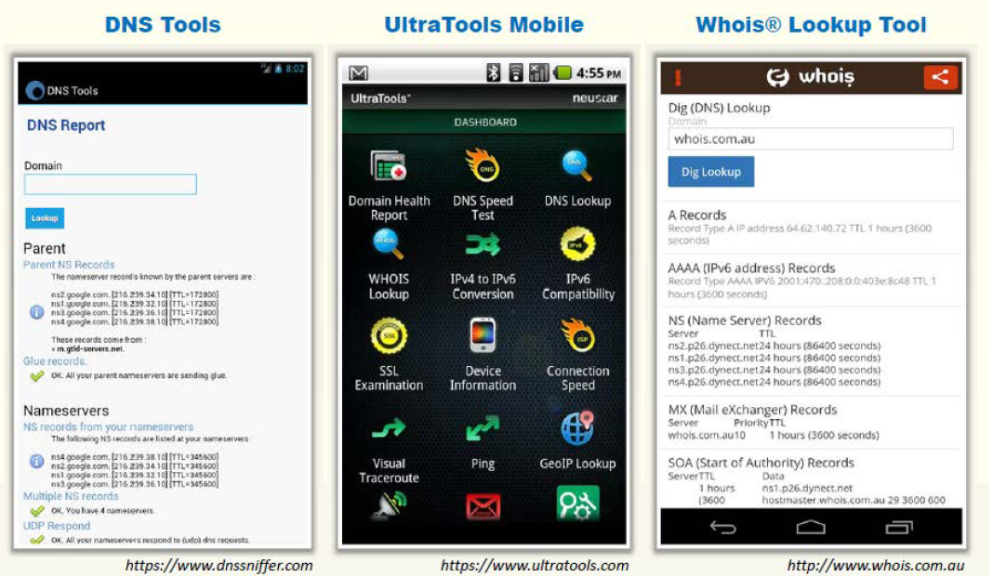
WHOIS Lookup Tools for Mobile

Slide 17
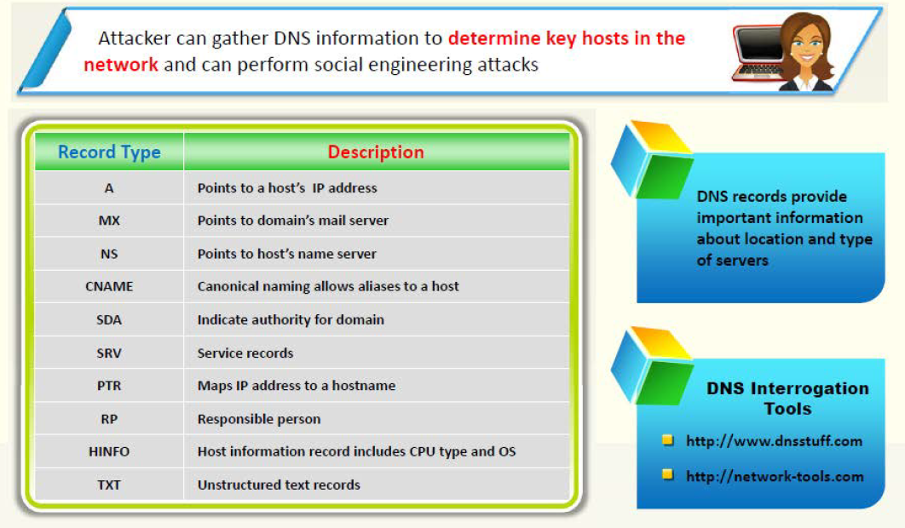
Extracting DNS Information

Slide 18
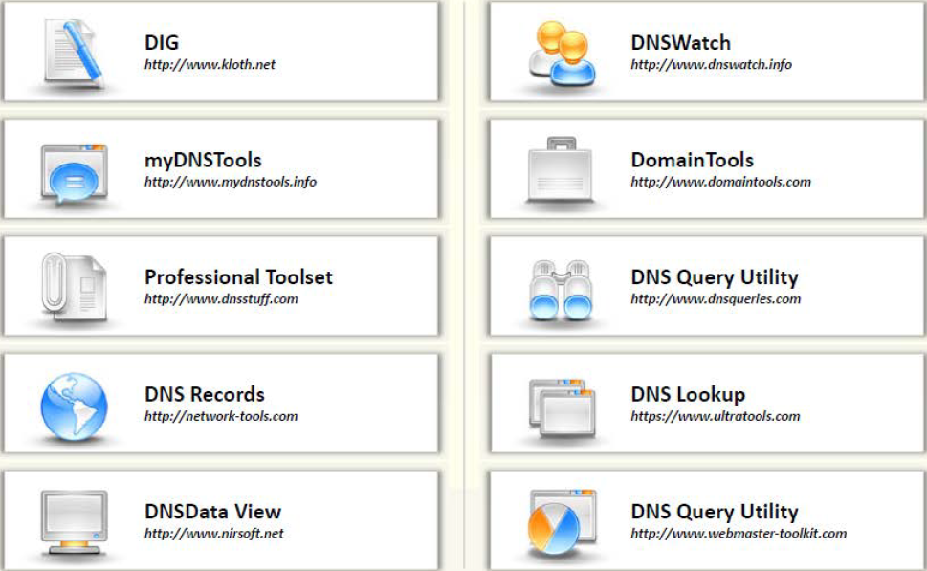
DNS Interrogation Tools

Slide 19
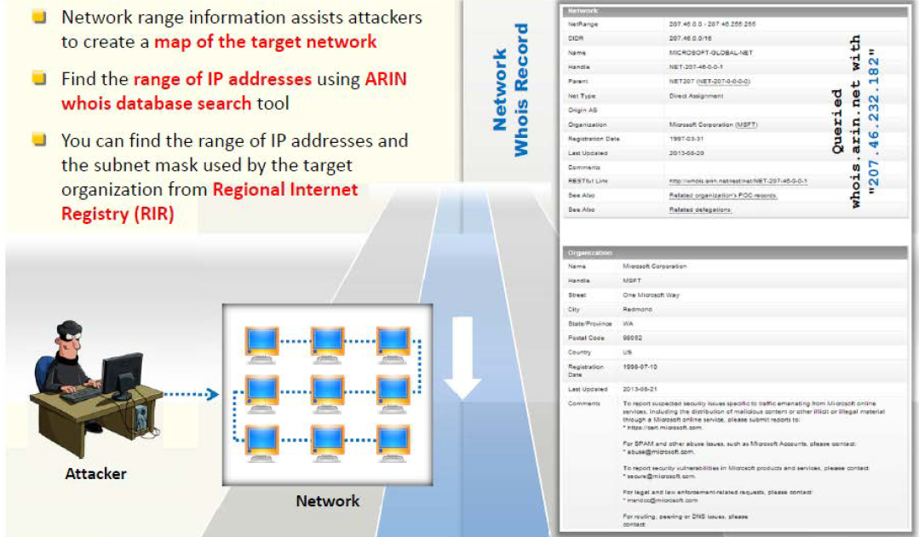
Locate the Network Range
Notes:
Traceroute: This program work on the concept of ICMP protocol and use the TTL field in the header of ICMP packets to discover the routers on the path to a target host.
Attackers conduct traceroute to extract information about: networking topology, trusted routers and firewall locations. By running several traceroutes an attacker might obtain information of each hop and put it together to draw the network diagram.

Slide 20
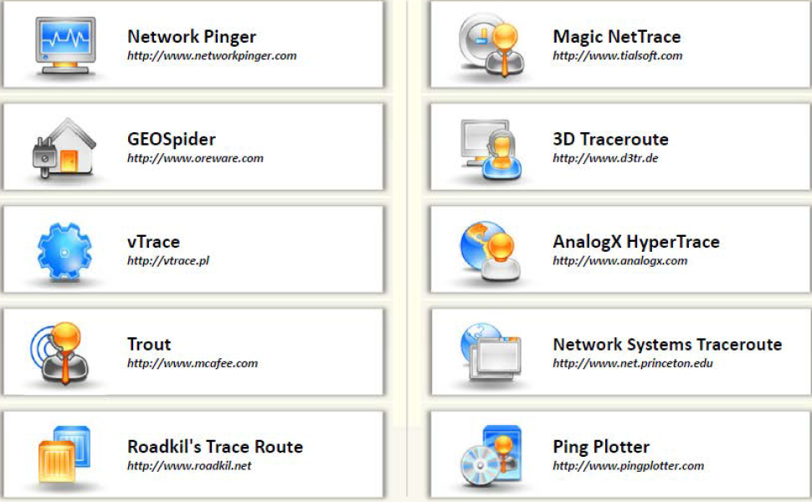
Traceroute Tools
Notes:
Other tools:
Path Analyzer Pro
VisualRoute

Slide 21
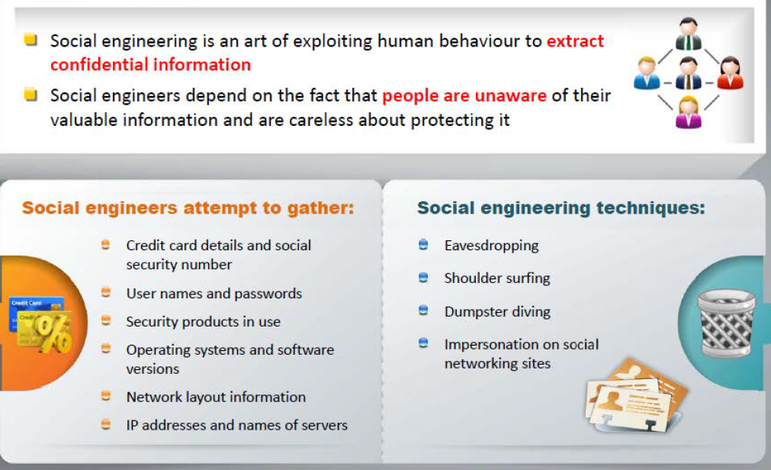
Foorprinting through Social Engineering

Slide 22
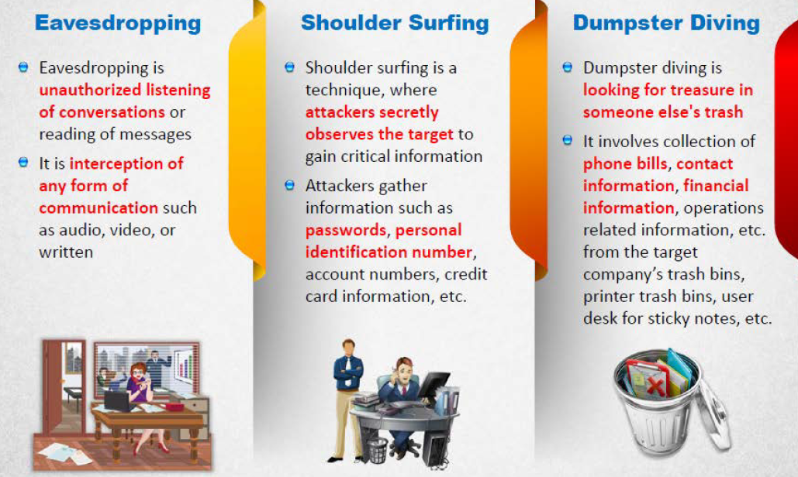
Collecting Information Using Eavesdropping, Shoulder Surfing and Dumpster Driving

Slide 23
Footprinting tools
Maltego
Recon-ng
FOCA
Notes:
Maltego is a program that can be used to determine the relationships and real world links between people, groups of people (social networks), companies, organisations, websites, Internet infrastructure, Phases, documents and files.
Recon-ng is a web reconnaissance framework with independent modules, database interaction, built in convenience fuctions, interactive help and command completion, that provides and environment in which open source web-based reconnaissance can be conducted.
FOCA (Fingerprinting Organizations with Collected Archives) is a tool used mainly to fine metadata and hidden information in the documents its scans. It is possible to undertake multiple attacks and analysis techniques such as metadata extraction, network analysis, DNS snooping proxies search, fingerprinting, open directories search, etc.

Slide 24
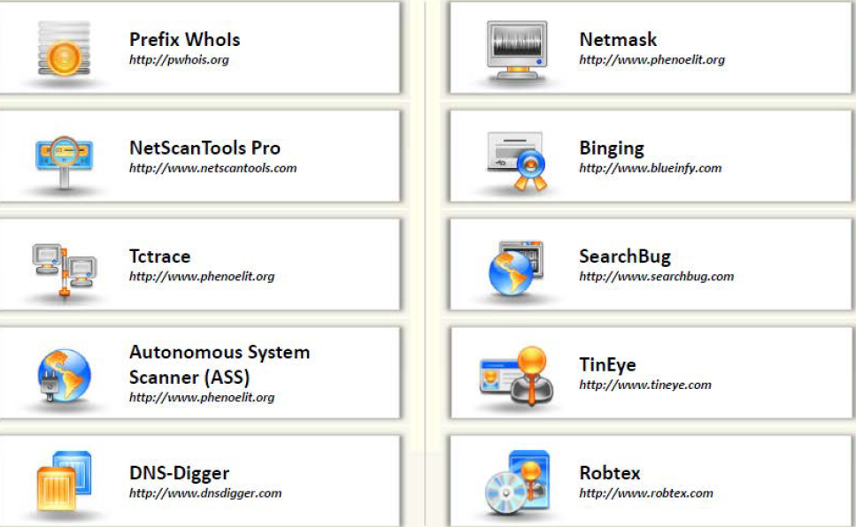
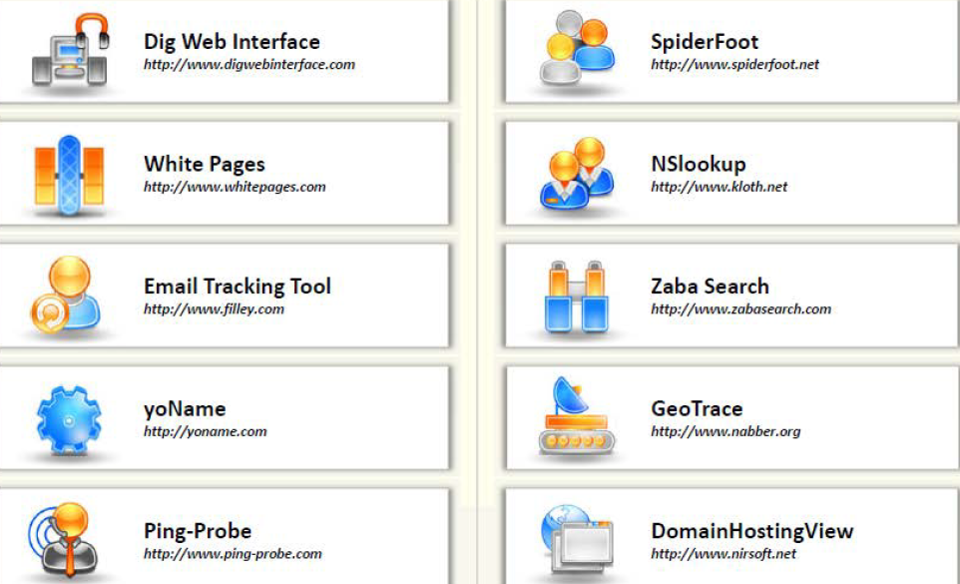
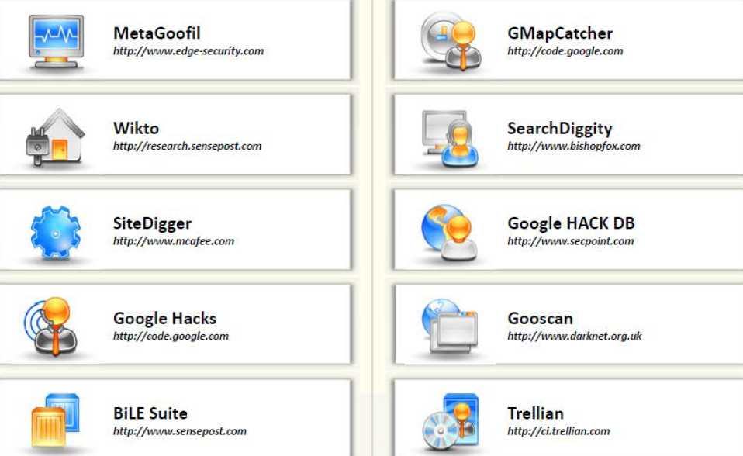
Additional Footprinting Tools

Slide 25
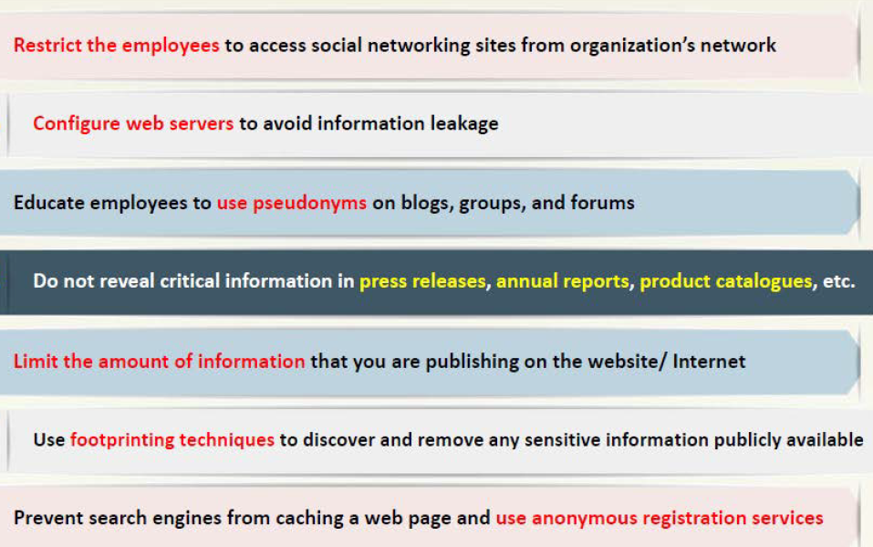
Footprinting Countermeasures

Slide 26
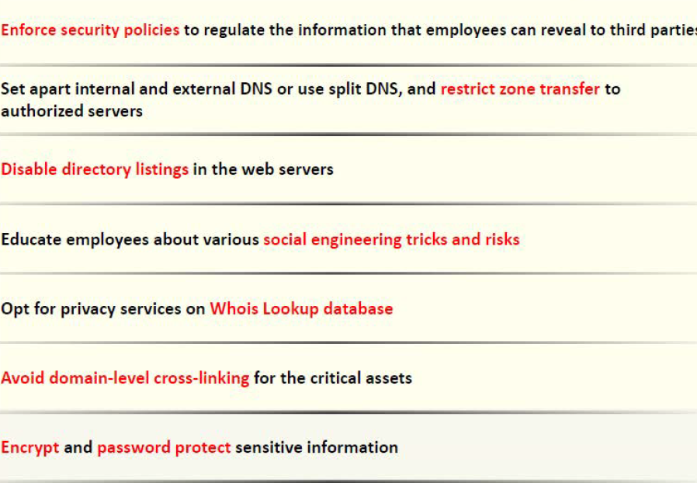
Footprinting Countermeasures

Slide 27
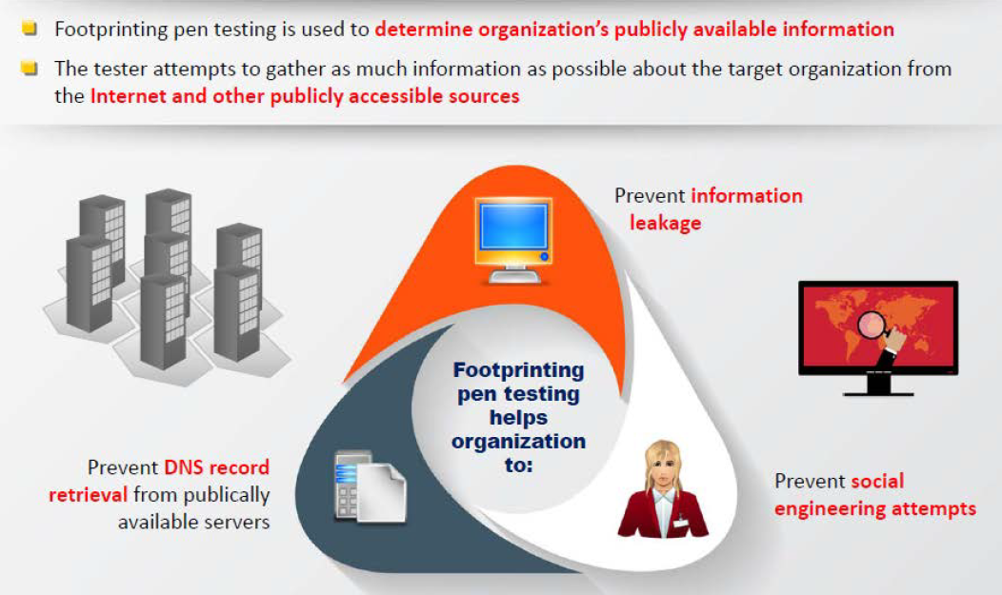
Footprinting Pen Testing

Slide 28
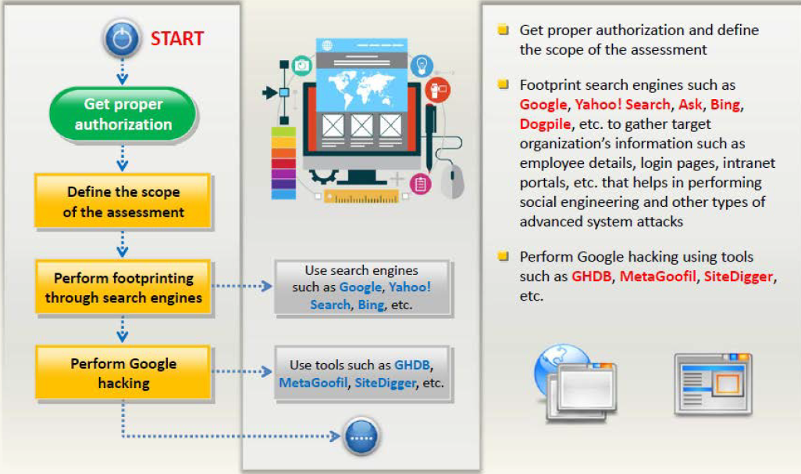
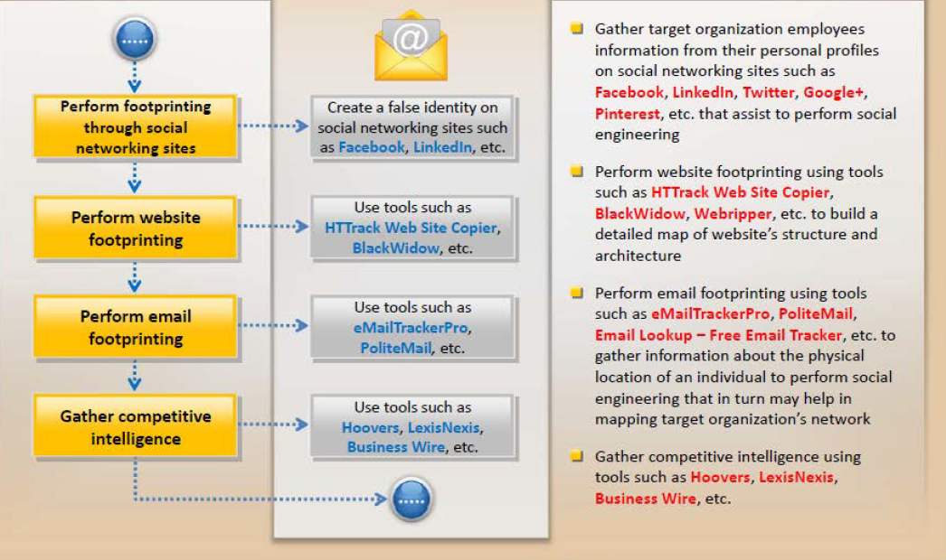
Footprinting Pen Testing

Slide 29
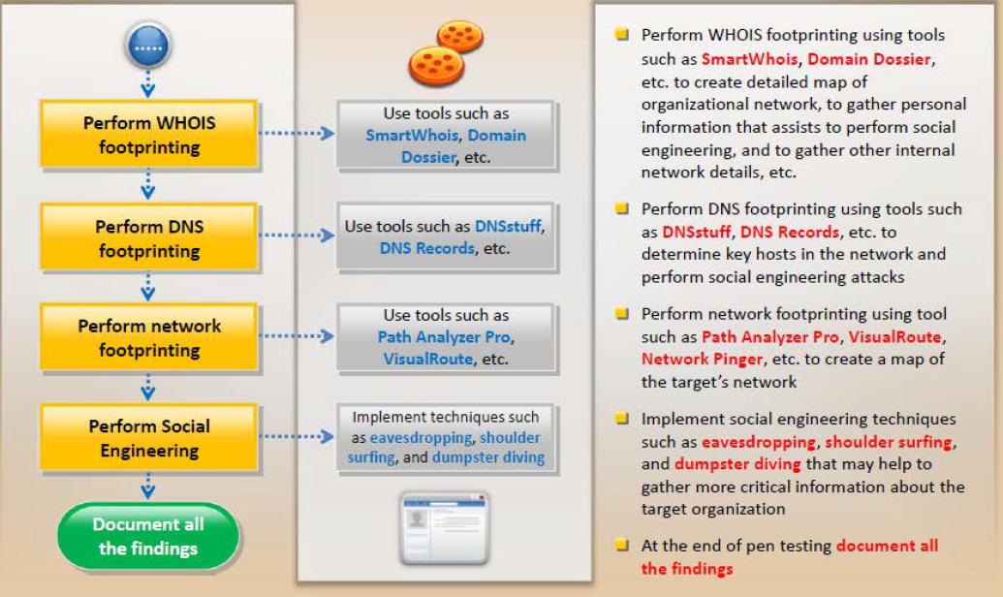
Footprinting Pen Testing

Slide 30
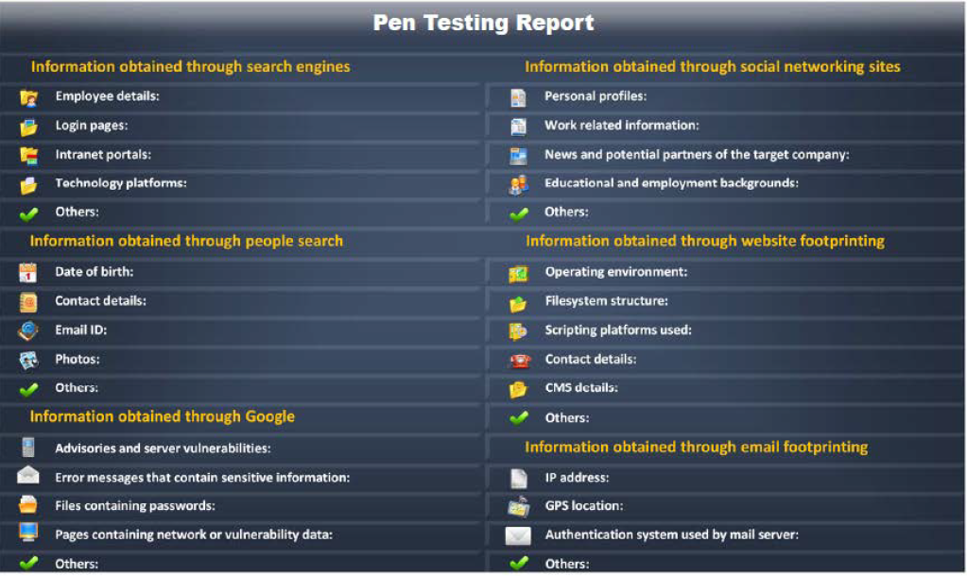
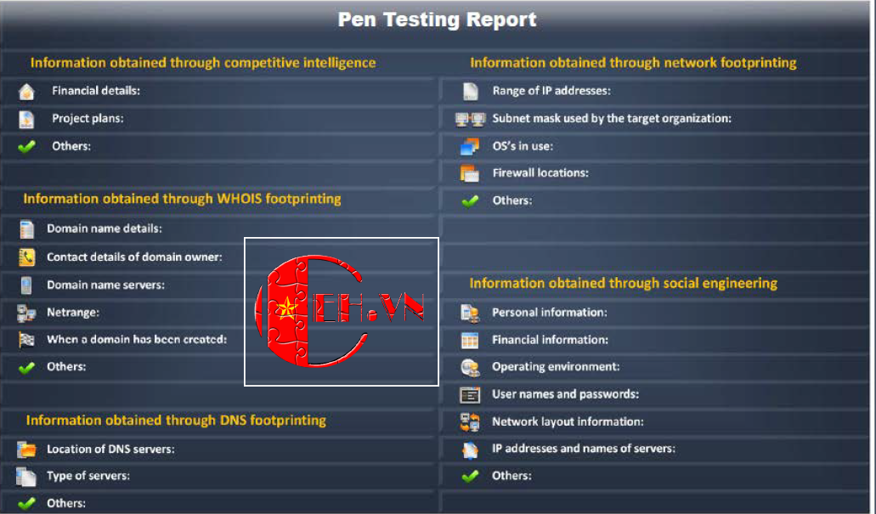
Footprinting Pen Test Report Templates

Slide 31
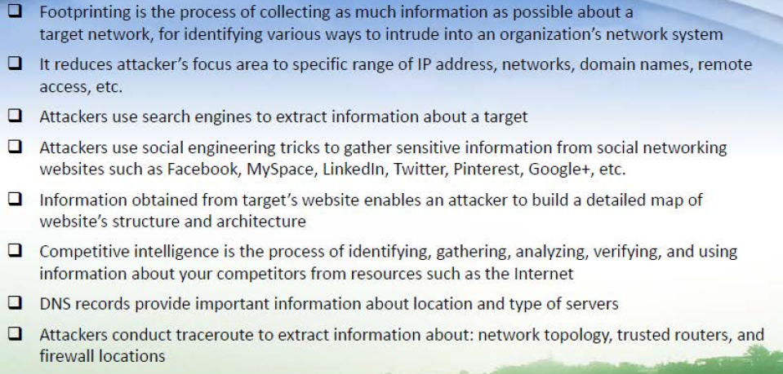
Summary

Slide 32
Questions

Slide 33
References
M. T Simpson, K. Backman, J. Corley, Hands-On Wthical Hacking and Network Defence, Cengage Learning, 2nd ed 2011.
http://ceh.vn/
https://aspen.eccouncil.org/
http://www.symantec.com/security_response/publications/threatreport.jsp

