Slide 1

Academic Study Skills (ECGE4001R)
FIRST AID COURSE
By Sofie Hopkins

Slide 2
AIMS
What first aid is
The history of first aid
What a first aid course is
The contents of the course
What the Heimlich Manoeuvre is and its value
To discuss the importance of first aid on professional development skills

Slide 3
140,000 people die each year in the UK from incidents where first aid could have possibly saved their lives.
(The First Aid Zone, 2015)

Slide 4

WHAT IS FIRST AID?
According to St John Ambulance (2015), first aid is the medical assistance given to someone who is injured or unwell, to keep them safe from further harm until they can get more advanced medical treatment by seeing a health professional or go to a hospital.
(First Aid Clipart, n.d)

Slide 5

THE HISTORY OF FIRST AID
First aid dates back to 1099
Knights were trained to administer medical treatment
Specialized in the treatment of battlefield injuries during the crusades.
("History of First Aid in Brief", 2015)

Slide 6
WHAT IS A FIRST AID COURSE?
Designed to help individuals attain first aid skills and techniques
Many types of first aid courses include, for example:
A baby first aid course,
A sports first aid course,
A mental health first aid course,
A basic first aid course,
An essential and basic first aid course.
(St John Ambulance, 2015)

Slide 7
AN ESSENTIAL AND BASIC FIRST AID COURSE
Combines elements from both a basic and essential first aid course
Covers emergency support techniques for injuries, such as:
- Bites and stings
- Burns
- Severe and minor bleeds
- Chest pains
(St John Ambulance, 2015)
- Sprains and strains
- Choking
- Fainting

Slide 8
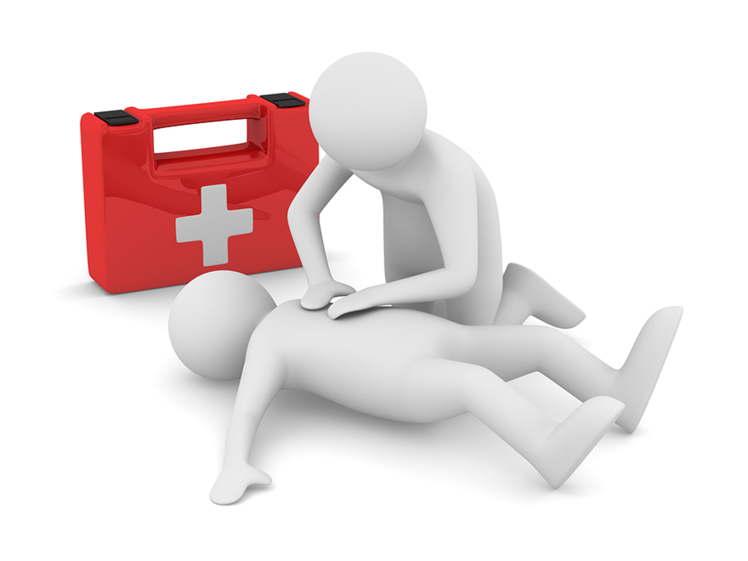
TECHNIQUES
Techniques taught in the essential and basic first aid include:
- How to use a first aid kit
- How to apply a bandage
- How to apply a dressing
- How to make an arm sling
- Recovery position
- The Heimlich manoeuvre
- Resuscitation (CPR)
(St John Ambulance, 2015)
(CPR clipart, 2017)

Slide 9

A blocked airway can kill someone in three to four minutes, but it can take more than eight minutes for an ambulance to arrive.
(The First Aid Zone, 2015)

Slide 10
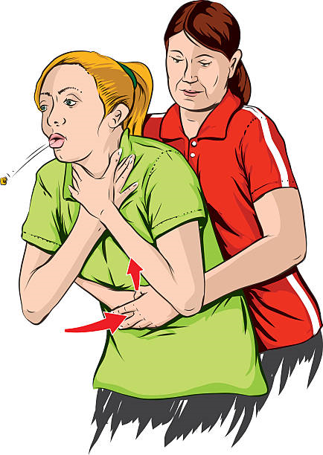
THE HEIMLICH MANOEUVRE
Named after Henry Heimlich (1970)
A procedure typically used on those who are choking when food has “gone down the wrong way” (Lewis, n.d.)
The procedure aims to dislodge an obstruction from a person’s windpipe through applying a strong pressure to their abdomen ("The Definition of Heimlich Manoeuvre", 2012)
https://www.youtube.com/watch?v=7CgtIgSyAiU
(Heimlich Manoeuvre, 2015)

Slide 11
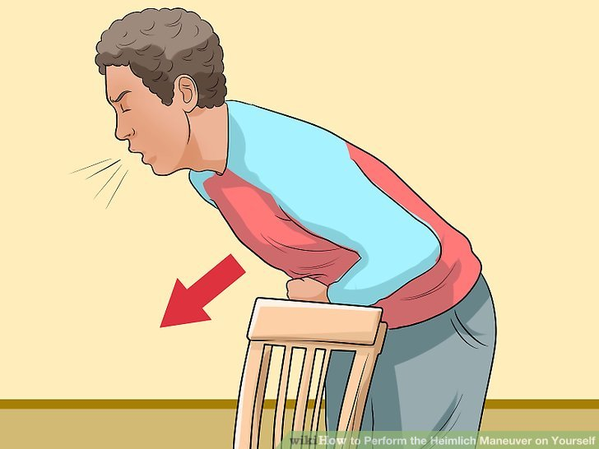
HEIMLICH MANOEUVRE ON YOURSELF
Apply force using a stable object, e.g. a chair
(Lewis, n.d)

Slide 12
FIRST AID TRAINING AND ITS IMPACT ON PROFESSIONAL DEVELOPMENT: A CASE STUDY
Who? Australian construction workers
What? A 24-week experiment monitoring the participants’ occupational health and safety motivation and risk control behaviour
Why? To assess the affect of first aid training on professional development
How? Through direct observations of the participants’ working manner as well as interviews before and after the first aid training
(Lingard, 2002)

Slide 13
RESULTS
Overall, a positive effect on participants occupational health, safety and behaviour
More aware of risks
(Lingard, 2002)

Slide 14
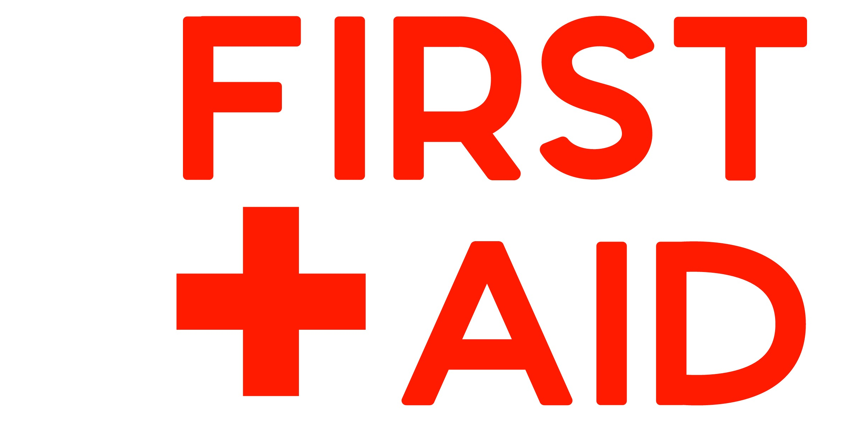
CONCLUSION
First aid training is responsible for saving the lives of those in need
Many benefits to having first aid training:
A fundamental skill for emergencies anywhere, not just in the workplace
Raises self-awareness
- Boosts confidence
Expands knowledge

Slide 15
REFERENCE LIST
5 Reasons Why Basic First Aid Knowledge is Essential. (2016). Retrieved from https://www.emergencyfirstresponse.com/5-reasons-why-basic-first-aid-knowledge-is-essential/
CPR Clipart. (2017). [Image]. Retrieved from http://www.headwaywestkent.org/shop/emergency-first-aid-work-course/
Essential and Basic First Aid - St John Ambulance. (2015). Retrieved from http://www.sja.org.uk/sja/training-courses/courses-for-the-general-public/essential-and-basic-first-aid.aspx
First Aid Clipart. (2018). [Image]. Retrieved from https://pilatesmatwork.co.uk/event/level-2-emergency-first-aid-at-work-develop/
First Aid Facts: Important Information about First Aid. (2015). Retrieved from http://www.thefirstaidzone.co.uk/first-aid-facts?doing_wp_cron=1542895592.7436439990997314453125
First Aid Training Courses for Work & Schools - St John Ambulance. (2015). Retrieved from https://www.sja.org.uk/sja/training-courses.aspx
First Aid Tips, Information & Advice - St John Ambulance. (2015). Retrieved from http://www.sja.org.uk/sja/first-aid-advice.aspx
The Role of a First Aider – St John Ambulance. (2015). Retrieved from http://www.sja.org.uk/sja/first-aid-advice/what-to-do-as-a-first-aider/the-role-of-a-first-aider.aspx

Slide 16
Heimlich manoeuvre. (2015). [Image]. https://blog.uvahealth.com/2015/01/22/patricia-conant-saves-choking-victim-performing-heimlich-maneuver/
History of First Aid in Brief. (2015). Retrieved from http://www.magnifiedts.com/history-of-first-aid-in-brief/
Howcast. (2012). How to Give the Heimlich Maneuvre - First Aid Training [Video]. Retrieved from https://www.youtube.com/watch?v=7CgtIgSyAiU
Lewis, H. Heimlich Manoeuvre on Yourself [Image]. Retrieved from https://www.wikihow.com/Perform-the-Heimlich-Maneuver-on-Yourself
Lewis, H. (n.d.). How to Perform the Heimlich Maneuver on Yourself. Retrieved from https://www.wikihow.com/Perform-the-Heimlich-Maneuver-on-Yourself
Lingard, H. (2002). The Journal of Safety Research. The effect of first aid training on Australian construction workers’ occupational health and safety motivation and risk control behavior. 33(2). 209-230.
The Definition of Heimlich Manoeuvre. (2012). Retrieved from https://www.dictionary.com/browse/heimlich-manoeuvre

