Slide 1
Sport on Television

Slide 2
Sport & TV
Sports programming dominates the list of the most watched telecasts of all-time
Broadcast elements are a key driver of major business decisions in sport, due to its ability to:
  Drive revenues for sport properties
  Build relationships with consumers
  Create awareness
  Platform for technology development
Multiple startup sporting leagues have failed to survive when they failed to generate content that broadcasters were interested in paying sizeable dollars to show

Slide 3
The NFL’s Super Bowl

Slide 4
Super Bowl is dominant programming in absolute audience size
US Audience Data

Slide 5
Super Bowl is dominant programming in relative audience size
Millions of US Viewers
US Audience Data

Slide 6
Alterative Models of Delivering Sports Content

Slide 7
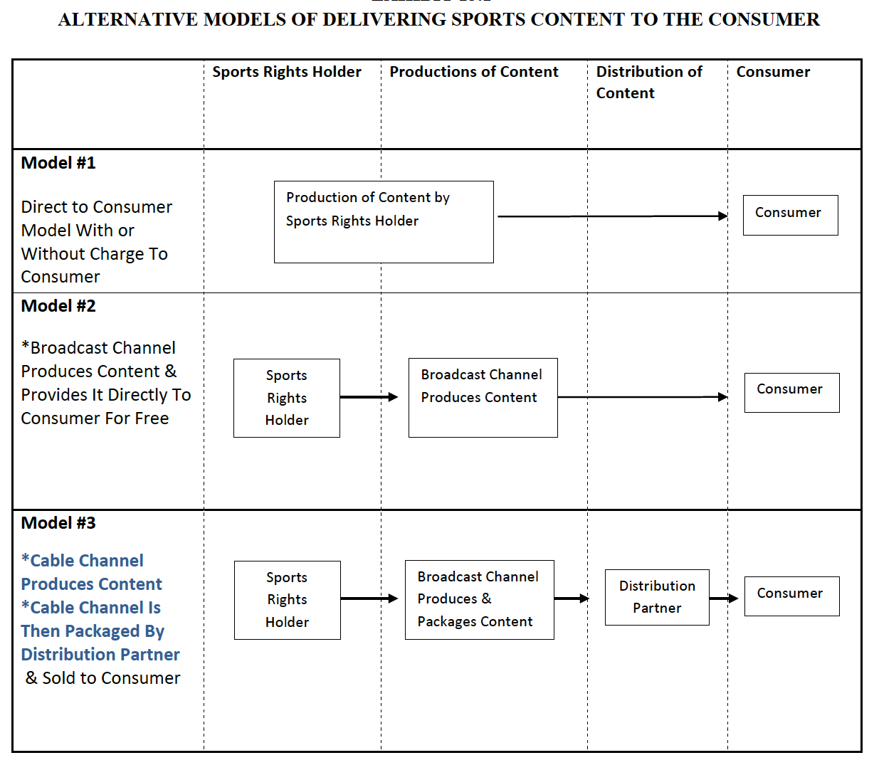

Slide 8
Model 1: Direct to Consumer Model
Simplest broadcast model
The sports rights holder produces a live broadcast (often with subcontractors) for delivery to consumers via the internet
Revenue sources for the rights holder:
  Payments from consumers (subscriber fee to access the content)
  Payments from advertisers (place promotions in/around the content)
  Payments from sponsors (to associate with the broadcast)
Example #1: WWW Network (see Box 15.1 in text)

Slide 9
Model 1: Direct to Consumer Model
Example #2: NFL Broadcasts Regular Season Game on October 25, 2015 (Jacksonville Jaguars versus Buffalo Bills) from London, England free to consumer on Yahoo!
Yahoo! Reported to pay NFL $17M to $20M to carry NFL game live

Slide 10
Model 2: Partner with Broadcasting Channel
The ‘traditional’ model before cable television and during cable television
Consumer can access the channel without paying a fee: “free to air”
Two main revenue sources (for networks)
  Advertising: payments for commercial slots (normally 30 seconds) during the telecast
  Government Support: government support for public television stations such as PBS in the US, CBC in Canada, BBC in the U.K., and ABC in Australia
Broadcast channels now negotiating with cable distributors to receive “redistribution fee revenue,” a third revenue source. Most viewers now access broadcast channels via a cable package.

Slide 11
Model 3: Via a ‘Double Set of Partnerships’
The dominant method of broadcast today
Double Partnership
  Sports Rights Holder partners with Cable Channel/Producer
  Cable Channel partners with a Distributor who delivers content
Distributors: Source of Revenues to Sports Cable Channels
  Receive per subscriber fee under ‘long term’ contracts
Consumers/Subscribers: Source of Revenues for Distributors
  Monthly payments to cable distributor for packages of channels
  Single event payments (pay-per-view events)
Examples of Cable Channels
  US: ESPN, FOX Sports 1, YES Network
  Canada: TSN, Rogers Sports Network
  Australia: FOX SPORTS
Examples of Cable Distributors
  US: Comcast, Time Warner, DirecTV, DISH Network
  Canada: Rogers, Bell
  Australia: FOXTEL

Slide 12
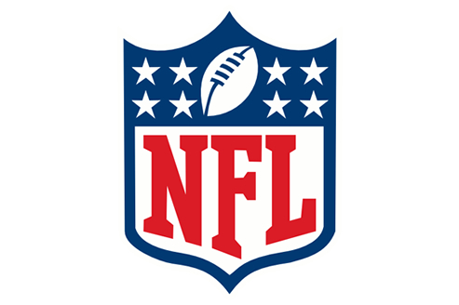


The Model 3 Revenue Chain
Sports Rights Holder
Cable Station
THE STORY
In 2015, ESPN pays NFL $1,900 million annually for Monday Night Football (2014-2021 Contract)
Time Warner in 2015 pays ESPN $6.64 for every Time Warner subscriber
Consumer in 2015 pays Time Warner cable $39.99 per month for 70+ channel package that includes ESPN
Cable Distributor
Consumer/Subscriber

Slide 13
Consumer Options
Consumers can simultaneously access sports content by the three models
For example, a consumer can:
  Access pay-per-view internet content (Model 1)
  Receive free over-the-air broadcast (Model 2)
  Subscribe to cable for a set of sport channels (Model 3)

Slide 14
Broadcast Revenues as a Key Source for Many Sport Properties

Slide 15
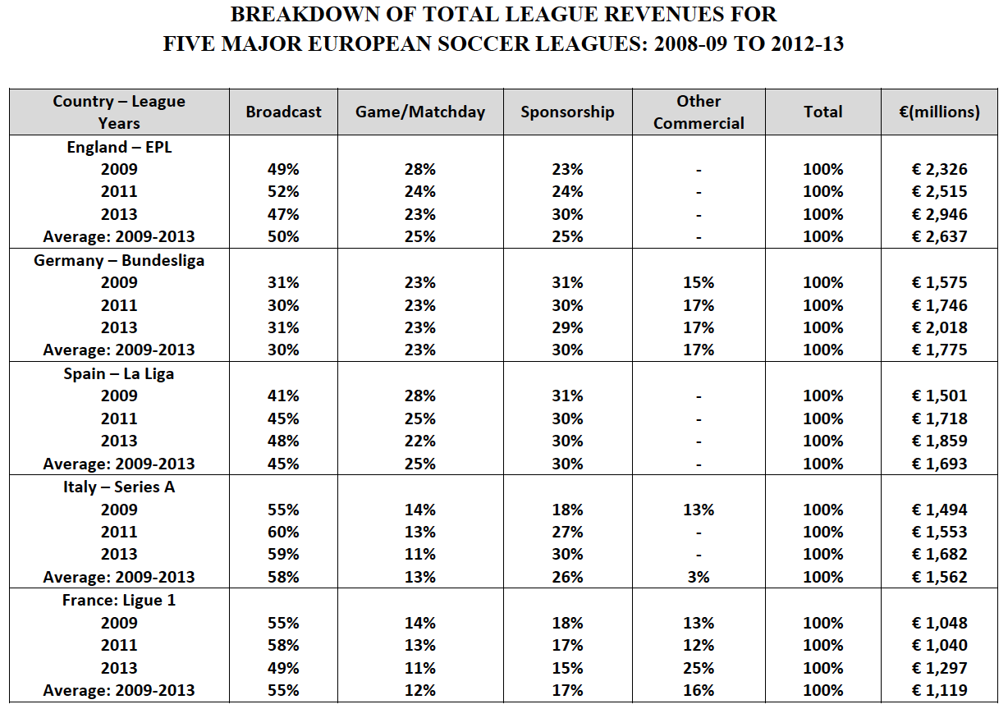

Slide 16
History of Broadcasting in Sports

Slide 17
Timeline
Late 1800’s – film industry showing sports events
1910 – MLB and move industry deal
1936 – Olympic Games in Berlin, Germany
1937 – BBC – boxing match to 20,000 UK homes
1938 – Wimbledon
1939 – Columbia/Princeton baseball game
1960 – Winter Olympics (Squaw Valley) and CBS
1964 – Tokyo Olympic Games – global broadcast
1980’s – satellite/cable arrive/growth

Slide 18
Storytelling on TV
Wide World of Sports – ABC in the US
David Hill (FOX) – “emotional connections”
On-screen personalities
  Examples on following slides

Slide 19
Bob Costas

Slide 20
Don Cherry & Ron Maclean

Slide 21
Terry Bradshaw & Howie Long

Slide 22
Stephen A. Smith

Slide 23
Howard Cosell

Slide 24
John McEnroe, Patrick McEnroe, Chris Evert, Hannah Storm

Slide 25
Changing Landscape

Slide 26
Broadcasters Often Seek On-Screen Personalities Who Evoke Either Positive or Negative Emotions
Don Cherry
“I've been trying to tell you for so long about the Russians. What kind of people they are and you just love them in Canada with your multiculturalism."
Controversial comment during 2002 Olympic Games after two Russian cross country skiers tested positive for drug use.
Stephen A. Smith
“They might not have wanted to mess their hairdo”
Controversial comment during FIFA 2015 Women’s World Cup

Slide 27
Current trends
Digital Revolution
  Mobile access
  Proliferation of devices
  Desire for instant content everywhere
24/7 News Cycle
  Continual flow of information (as opposed to specific times)
Video/Pictorial Content Growth
  YouTube, etc.
Increase in Social Media options
  Myriad of platforms
Content On Any Device At Any Time In Any Place

Slide 28
Example: NBA League Pass

Slide 29
Example: NBA League Pass
NBA League Pass is a full access service, that includes:
  Live On Demand Games
  Various Subscription Options, including:
    Access All Teams - $199.99 (season)
    Access Single Team - $119.99 (season)
    Access Single Game - $6.99
  On Your Favorite Device
    Tablets
    Smart Phones
    Laptops

Slide 30
Decisions in Broadcasting

Slide 31
Decision Making by Sports Rights Holders
Diverse/Varied Content by Rights Holders
  Global Federations, Regional Sport Bodies, Leagues, Clubs, Conferences, Events, Facilities.
Varying Objectives by Rights Holders
  Maximize Financial Returns
  Seek Broadest Possible Reach
  Control the Presentation/Showcase of a Sport
  Build a Fan Base
  Protect the Game Day Experience for Live Spectators

Slide 32
Negotiation & Conflict
Sources:
  Rights Holders seek higher fees
  Cable Stations seek higher subscriber fees
  Consumers view cable fees as too high and seek a la carte pricing
Examples of high profile conflicts typically occur when a cable station wants distribution on basic cable (broadest distribution) versus cable distributor who counters with distribution on a sport tier (package) with a much lower distribution.
  YES Network versus Cablevision 2002
  NFL Network versus Cablevision/Time Warner 2003-2009/2012
  Pac-12 Network versus DirecTV (2012 to present)

Slide 33
Global Broadcasting Example: IOC

Slide 34
Media Revenues Now Largest Revenue Source for the IOC

Slide 36
NFL Broadcast Strategy
The NFL is the dominant sports programming content on all major national networks in the United States

Slide 37
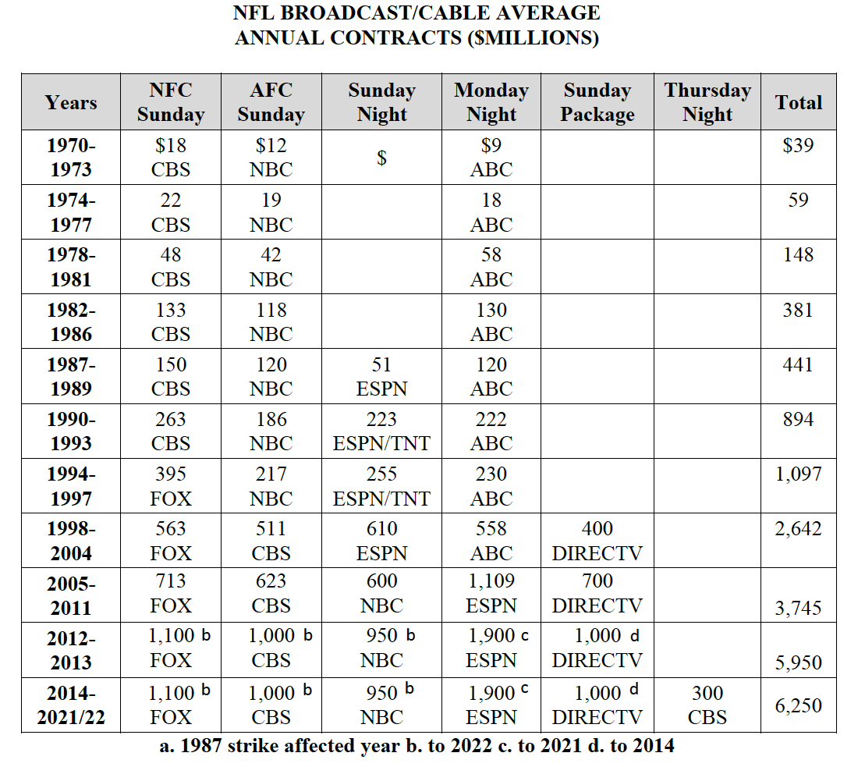

Slide 39
NFL Broadcasting
Expanding Number of Broadcasting Partners
  1970 – 1986: 3 broadcaster station partners
  1987 – today: ESPN added as a partner
  1994 – today: FOX added as a partner
  1998 – today: DirecTV added as a partner
  2003: NFL Network launches, live games start in 2006
Expanding number of time slots/nights
  1970 – 1986: 2 Sunday slots / 1 Monday night game (Monday Night Football (MNF))
  1987 – today: Sunday Night Football (SNF) added
  2006 – today: Thursday Night Football (TNF) added

Slide 40
Questions?

