Slide 1
BMHP6009 - Living With Care: The Older Person
Week 3: Person-Centred Practice and Advocacy

Slide 2
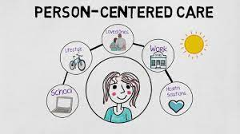
What is Person Centred Practice?
In groups, discuss the phrase Person Centred Practice.
Have you come across it in your work?
What do you think it means?

Slide 3

Person Centred Practice (PCP)
‘a process for continual listening and learning, focusing on what is important to someone now and in the future, and acting upon this in alliance with their family and friends’
(Department of Health, 2001)

Slide 4

PCP Requirements
Should be a flexible and responsive approach to meet peoples changing circumstances
The person is always at the centre
The person is listened to, and respected

Slide 5
Person Centred vs System Centred
Let’s watch this video about this topic:
https://www.youtube.com/watch?v=y77y7XW8GtE

Slide 6
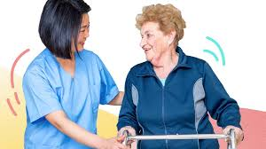
What is person Centred Care
Being person-centred is about focusing care on the needs of individual. Ensuring that people's preferences, needs and values guide clinical decisions, and providing care that is respectful of and responsive to them.

Slide 7
Key Premises of Person Centred Care
  Therapeutic Relationships
  Rapport
  Expertise
  Patient Responsibility
  Knowing the ‘Person’
  Positive Relationships
  Communication (Sharma et al. 2015)

Slide 8
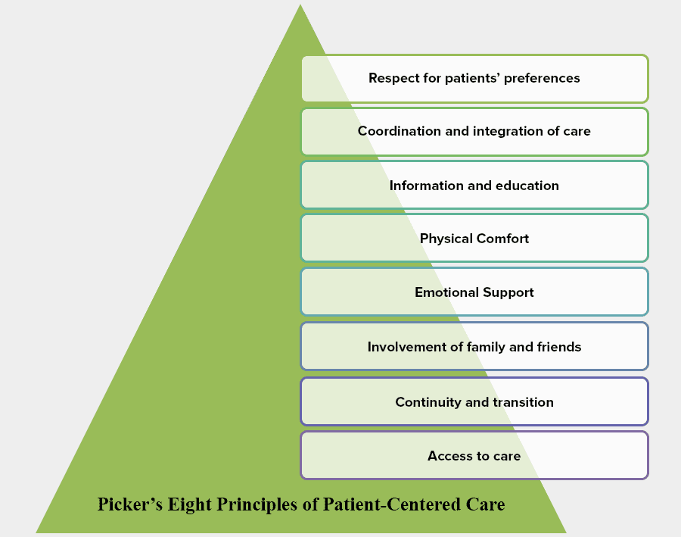
Eight Principals of person centred care

Slide 9
Discuss this study in class
The Fundamentals of Person-Centered Care for Individuals With Dementia
Fazio, S., Pace, D., Flinner, J., & Kallmyer, B. (2018).
The Gerontologist, 58(suppl_1), S10–S19.
https://doi.org/10.1093/geront/gnx122

Slide 10
Class Exercise
20 minutes
Have you ever been in a situation when you felt you could not speak up/ stand up for yourself?
How did that make you feel?
What was the outcome of that situation?

Slide 11

What is Advocacy?
Supporting and empowering disadvantaged individuals so that their views and concerns are heard in order to secure enhanced rights and entitlements”
(The King’s Fund, 2004)

Slide 12

Advocacy is….
A process of supporting and enabling people to:
express their views and concerns
access information and services
defend and promote their rights and responsibilities
explore choices and options
(Mind 2018)

Slide 13

Who Needs Advocacy?
“certain groups of people are at great risk of exclusion and ill-treatment, not only from society at large, but also from the very service systems which are designed to care for them”
(Henderson & Pochin, 2001, p. 3)
13

Slide 14

Why advocacy with older people?
The goal of advocacy is to promote change – changes in attitudes, policies and actions.
Older people’s issues have been a low priority for government and non-government bodies at a time when older people have become increasingly marginalised from their families, communities, and the development process for a variety of reasons.
This means that advocacy and awareness-raising with older people needs to promote changes to a variety of audiences – the public, service providers, NGOs, government, and even older people themselves.

Slide 15
Examples of goals of advocacy with older people
Ensure inclusion of older people in the mainstream activities of communities, government and non-government organisations.
Develop strong and effective older peoples’ organisations which facilitate their empowerment and the development of a powerful, co-ordinated voice for older people’s issues.

Slide 16
Examples of goals of advocacy with older people
Develop and disseminate information and images of older people that raise awareness of their capacities and contributions, as a means of challenging stereotypes of older people as disabled, unproductive and dependant.
Increase awareness and understanding of ageing issues and the ageing process across the community, and in particular with service providers, as a means of reducing misunderstanding and misconceived ideas about the nature of support required by older people.

Slide 17

What other goals of advocacy can you think of?
Discuss in your group

Slide 18

Advocacy and Policy environment
Race Relations Act 2000
Special Educational Needs and Disability Act 2001
The Health and Social Care Act 2001
The Adoption and Children’s Act 2002
The Mental Capacity Act 2005
Mental Health Act 2007
Valuing People Now 2007
Equality Act 2010
Care Act 2014
Social Services and Wellbeing (Wales) Act 2014.
18

Slide 19

Good Practice in Advocacy
The ability to be clear thinking and focussed on the service users agenda
Non-judgemental approach towards service users
Good listening skills, communication skills and patience
Ability to keep one’s own agenda firmly to one side
Good support network for off-loading and use as a sounding board

Slide 20

Advocacy- Key Issues…
Funding
  Inadequate and unreliable funding
  Funding from public bodies could challenge the independence of the service
Lack of training and development
No UK-wide standards or guidelines for organisations
Lack of opportunity for evaluation
  - advocacy organisations often lack resources or capacity to see what works and what doesn’t

Slide 21

Advocacy Charter
Published in 2002
By Action for Advocacy
Established in 2001, working in England and Wales to be the leading authority on the development of effective advocacy services for vulnerable and disempowered people
www.actionforadvocacy.org.uk
21

Slide 22

What has advocacy in UK achieved?
Energetic movement with considerable growth
Movement shares goals of empowerment and challenging social inclusion
emerging new political culture
Highly regarded activity
Shaped ideas about care in UK
22

Slide 23

What has advocacy in UK failed to achieve?
Different or competing forms of advocacy - fuzzes the definition
Tensions: Training? Payment? Vs Volunteer? Quality?
Not understood by general public
Lack of identity and ability to develop good practice across the sector
23

Slide 24

What does person centred advocacy mean ?
People-centred advocacy is a set of organised actions aimed at influencing public policies, societal attitudes, and socio-political processes that enable and empower the marginalised to speak for themselves.
Its purpose is social transformation through the realisation of human rights: civil, political, economic, social, and cultural.
People centred advocacy is by the people, of the people, and for the people. Hence, it is the spirit of democracy that drives the very idea of people-centred advocacy.
https://qualityadvocacy.org.uk/wp-content/uploads/2018/05/Code-of-Practice-1.pdf

Slide 25
References
HSE, (2016) Person-Centred Principles and Person-Centred Practice Framework Available at: https://www.hse.ie/eng/staff/resources/changeguide/resources/person-centred-principles-and-person-centred-practice-framework.pdf (Accessed 1 February 2020).
Henderson, R. & Pochin, M. (2001) A Right Result? Advocacy, justice and empowerment. Bristol: Polity Press.
McCormack, B. and McCance, T. (2017) People’s Needs Defining Change – Health Services Change Guide Available at: https://www.hse.ie/eng/staff/resources/changeguide/resources/person-centred-principles-and-person-centred-practice-framework.pdf (Accessed: 1 February 2020).
Price, B. (2019) Delivering Person Centred Care in Nursing. UK: Sage.
Sanderson, H. (2000) Person Centred Planning: Key Features and Approaches Available at: http://www.familiesleadingplanning.co.uk/documents/pcp%20key%20features%20and%20styles.pdf (Accessed 1 February 2020).
Sharma, T., Bamford, M. and Dodman, D. (2015) Person-centred care: an Overview of Reviews. Available at: https://www.ncbi.nlm.nih.gov/pubmed (Accessed: 1 February 2020).

