Slide 1
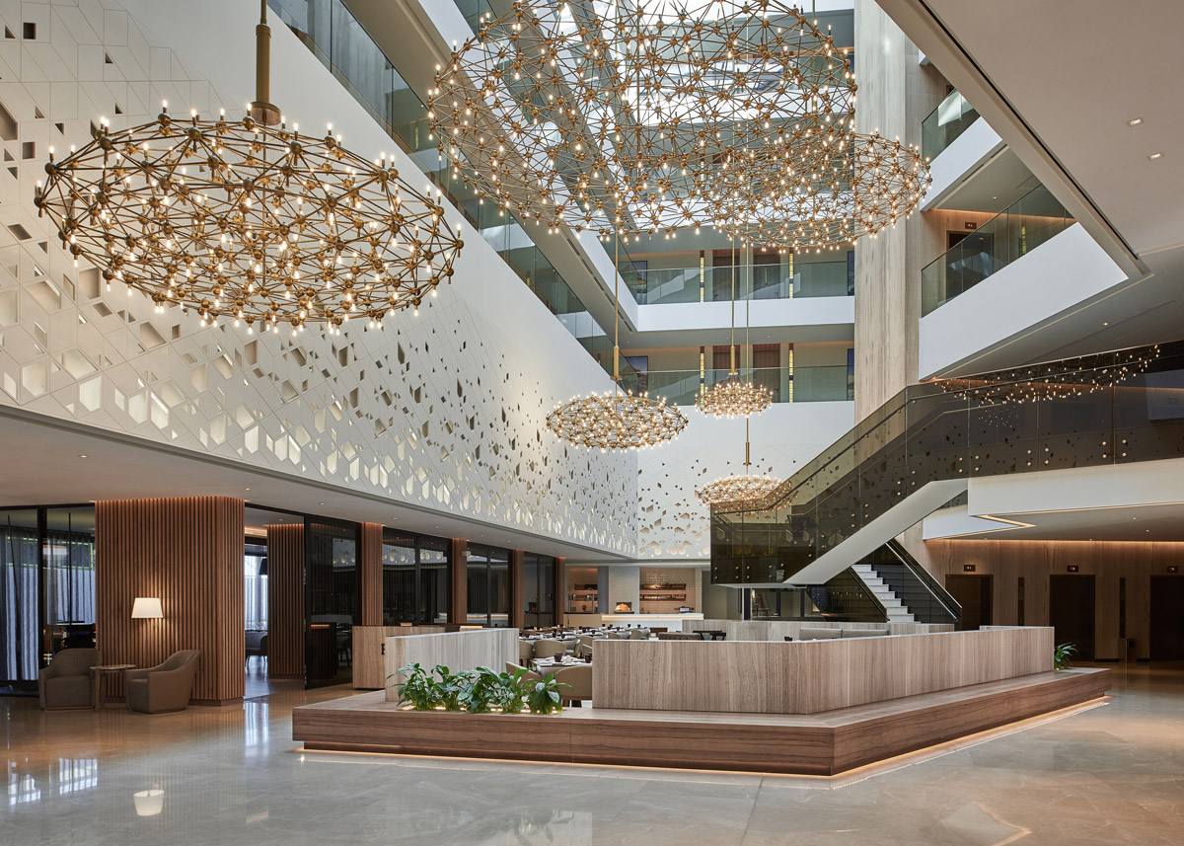
Contemporary Themes in the Hotel

Slide 2
Your Name:
Date:

Slide 3
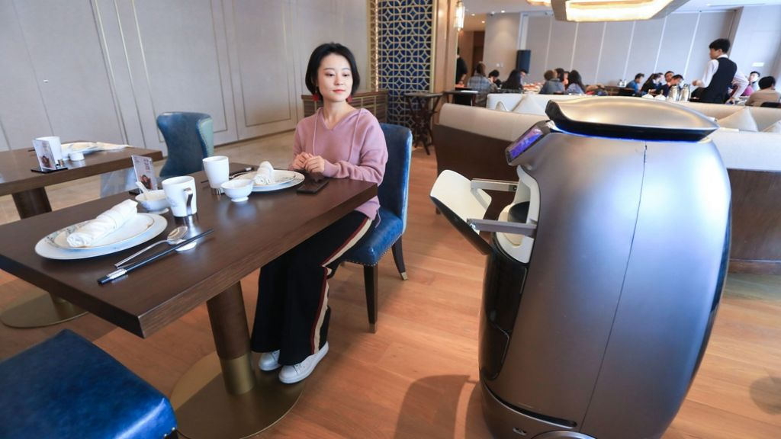
Introduction
Hello and welcome to the hospitality technology future presentation.
We will examine the importance of technology in hospitality and provide managerial and policy solutions in this session.
The hospitality industry relies on technology to improve guest experiences, operational efficiency, and strategic decision-making.
Technical progress and its future effects must be considered as we navigate this ever-changing sector.
In this presentation, we will discuss how hospitality firms may innovate to become more competitive and sustainable.
https://webmobtech.com/
Notes:
Good morning, everybody. We have to understand the importance of this topic as we move ahead to the future of hospitality technology. Technology has revolutionised customer service and operations, making it important to the hospitality industry. Technology is changing the industry and enabling new developments like online booking systems and AI-powered chatbots (Gursoy, 2018).
In today's presentation, we'll discuss how technology has revolutionized the hotel sector and how this will affect managers and policymakers' decisions. If we adopt technology as a game-changer, it improve customer experience and generate long-term growth. This session will focus on proactively adopting technological advances and tackling potential issues.

Slide 4
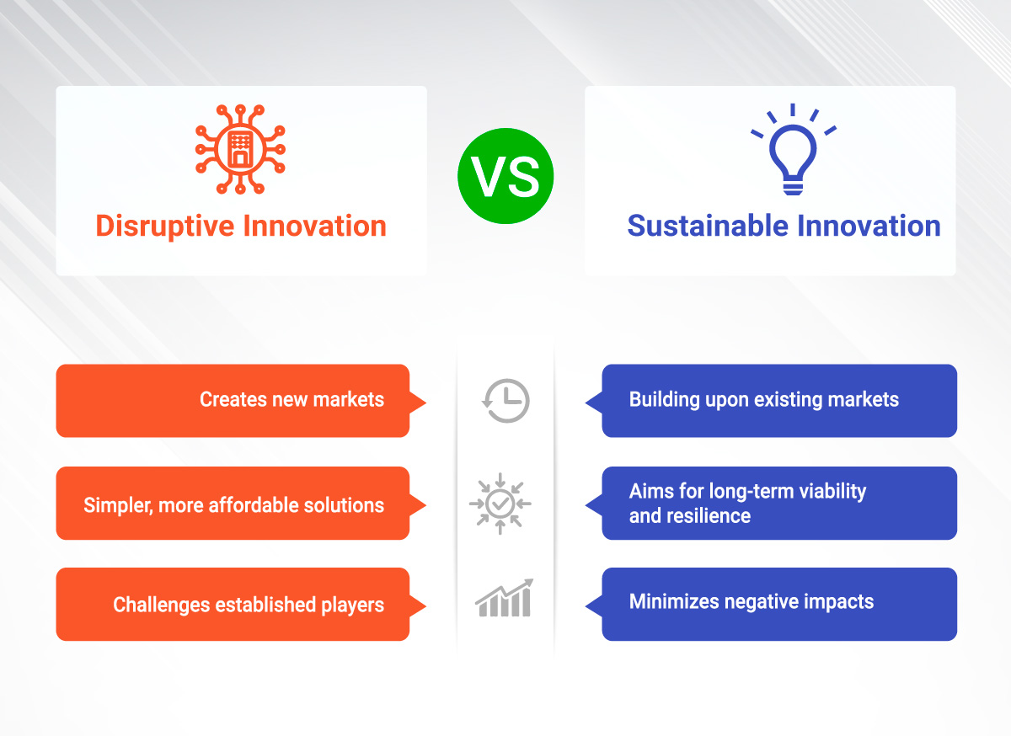
Overview of Literature
Disruptive Innovation
Technology Acceptance Model (TAM)
Service Dominant Logic (SDL)
Digital Transformation
https://ideascale.com/
Notes:
Clayton Christensen's disruptive innovation thesis states that new technologies can disrupt markets and corporate structures by offering simpler, cheaper or more convenient alternatives. Internet booking platforms, peer-to-peer housing services and smartphone apps have disrupted the hotel industry and forced long-standing firms to shift (Strömberg & Thorman, 2019).
Fred Davis's Technology Acceptance Model (TAM) states that technology acceptance and utilisation depend on its perceived utility and simplicity. Knowing how hotel guests feel about new technology can help organisations provide better guest experiences (Silva, 2019).
SDL emphasises service providers and customers collaborating to produce value. This philosophy emphasises the need of integrating technology in hospitality to create interactive and individualised visitor experiences. Technology-driven co-creation can differentiate hospitality organisations and deepen visitor relationships (Grönroos & Gummerus, 2014).
Digital technology' widespread use has caused "digital transformation"—a significant change in how firms operate and give value to customers. Moving property management software to the cloud, employing data analytics to target marketing campaigns, and linking guest rooms with IoT devices are examples of hotel digital transformation. Digital transformation is helping hospitality organisations adapt to the changing industry and improve customer experience (Kraus et al., 2021).

Slide 5
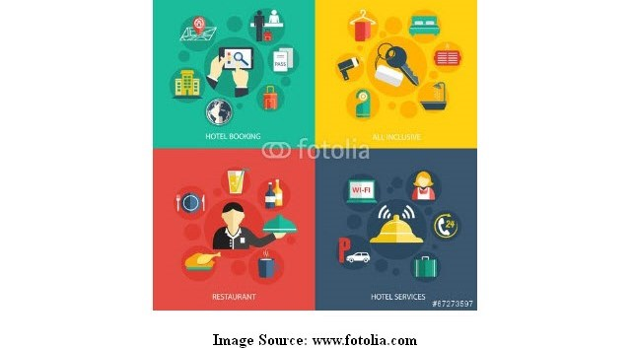
Impact of Technology on Guest Services
Automation of arrival and departure through online check-in and check-out has reduced wait times and enhanced visitor satisfaction.
AI-powered chatbots answer guest questions instantly, improving communication and services.
Individualised recommendation engines tailor in-room amenities and restaurant selections to guests' preferences.
Notes:
Modern technology has transformed guest services in the hospitality business. Internet technology makes check-in and check-out easy and fast for guests. This streamlines operations, eliminates paperwork and makes guests feel welcome right away.
AI-powered chatbots have transformed hotel guest and employee communication. These virtual assistants answer tourists' quick questions by making reservations and proposing local activities. By delivering 24/7 efficient and personalised service utilising machine learning and natural language processing, chatbots can boost customer satisfaction and loyalty (Kansakar et al., 2019).
Personalised recommendation engines are another example of how technology has changed guest services. Complex algorithms personalise experiences based on guests' demographics, hobbies, and past behaviours. Personalised recommendations, such as room amenities based on past stays or dietary-friendly restaurants, are loved by guests. This helps customers feel special and distinctive, making them more inclined to return and promote it (Lee, 2021).

Slide 6

Management Responses
Mobile concierge apps
Staff training
Data analytics
https://blog.pressreader.com/
Notes:
Mobile concierge apps make hotel services and amenities more available to guests' phones. Staff must be well-trained to use new technology and create excellent guest experiences. Analysing visitor preferences can help management improve services and develop more focused marketing campaigns.

Slide 7
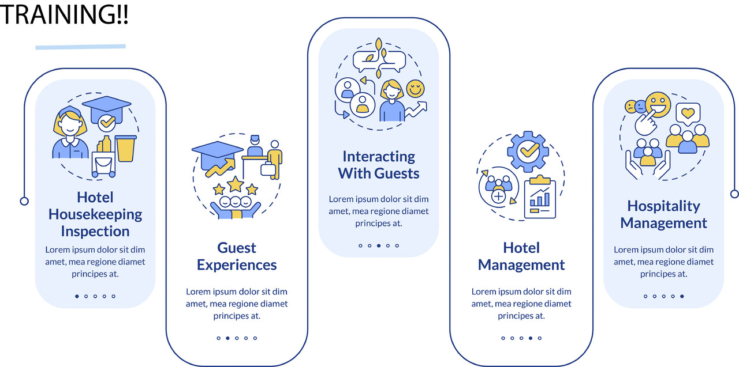
Evaluation of Management Responses
Technology-enabled guest services for efficiency and satisfaction.
Unique and customised experiences gave a competitive edge.
Overreliance on technology that excludes customisation and humanity may erode client loyalty.
Technology can be too expensive for smaller hospitality companies to invest in and maintain.
https://www.linkedin.com/
Notes:
Strengths
Enhanced guest services using technology to boost efficiency and happiness. Provided personalised service to customers to gain a competitive edge. Better data use improves strategic planning and decision-making.
Limitations
If organisations rely too much on technology and neglect personalisation, customer loyalty could drop. Smaller hospitality firms may find technological solutions too expensive to purchase and maintain. Privacy concerns with guest information gathering and use require clear policy and regulation compliance (Gursoy, 2018).

Slide 8

Recommendations for Future Policy
Maintain robust data governance principles to ensure ethical and transparent data use and guest privacy.
Create a hotel AI ethics code and enforce it.
Set up extensive compliance procedures to ensure hotels obey all technological integration laws and regulations.
Fund ongoing training and development for hotel workers to help them use technology effectively.
Encourage hotels and technology businesses to collaborate on responsible and sustainable technology integration.
https://www.linkedin.com/
Notes:
First, hotels must implement solid data governance guidelines. These policies should prioritise guest privacy and ethical and transparent data use. To protect sensitive data and prevent breaches, data anonymization, access limitations, and approval protocols are needed. Hotels may gain customers' trust and demonstrate ethical data practices by implementing strong data governance structures.
Second, ethical requirements for AI deployment in hospitality must be established to protect guests' rights and act ethically. These guidelines should address fairness, accountability, openness, and algorithm biases. Ethical AI principles can help hotels reduce discrimination and properly use AI-driven technology to improve the experience of visitors.
Compliance processes with technological regulations are as crucial as ethics to ensure hotels adhere to them. Regular audits, compliance checks, and GDPR compliance are needed to protect visitor data and reduce legal risks. By staying current with new regulations and being proactive, hoteliers can navigate the complex regulatory environment and promote technology innovation and improvement.
Hospitality personnel need ongoing training and development to use technology effectively. Training programmes should cover AI basics, data protection, and customer service to help employees adapt to new technology and give outstanding service. By giving staff the tools they need, hotels can serve guests more efficiently and creatively (Khatri, 2019).
Hotels and technology suppliers can collaborate to integrate technology responsibly and sustainably. Working with reliable IT companies streamlines implementation, reduces risks and provides cutting-edge solutions. These partnerships can boost development, innovation, and visitor satisfaction by strategically using technology.
Lastly, public education campaigns about hospitality technology's benefits and hazards are essential. Informing guests on our data privacy standards, AI-driven services, and contactless hospitality options might help them feel more comfortable with technology. Hotels should be open and communicative to attract customers and ensure everyone benefits from technology (Hon & Lui, 2016).

Slide 9
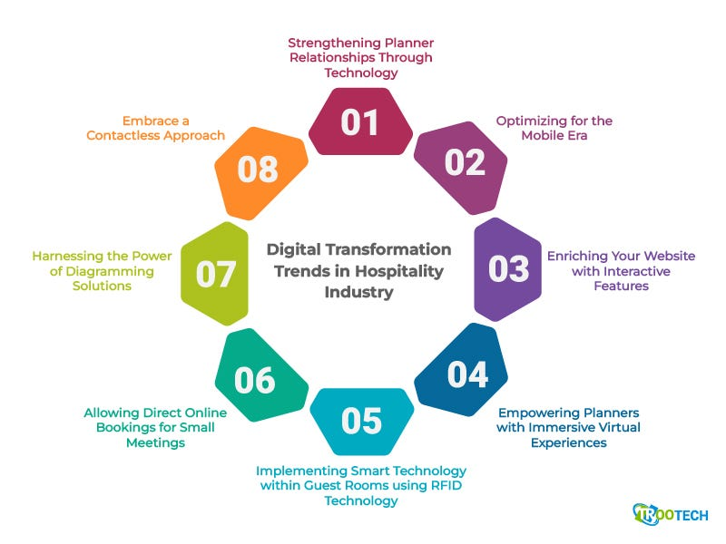
Recommendations for Management Options
Prioritise continual training and development to ensure personnel are tech-savvy.
Form partnerships with reputable tech firms to get cutting-edge solutions and speed deployment.
Managers must be flexible and adaptable to keep up with technology.
Make smart marketing, visitor experience, and budget decisions with data analytics.
Consider AI-powered chatbots and customised recommendation engines as guest experience-enhancing technologies.
https://medium.com/
Notes:
Prioritise training and development to ensure your staff knows how to use technology. Hotels may train staff on AI basics, data privacy, and customer experience to maximise technology use. Continuous training helps staff meet consumer needs by staying current on technology.
Another suggestion is to collaborate with reputable tech companies to gain creative ideas and make deployment easy. Partnering with IT specialists helps hotels use new technologies, improve service, and predict market trends. Collaborations allow hotels to share information and innovate, keeping them competitive in a changing market.
Hotel management should be receptive to new technology ideas and practices. Today's fast-paced digital industry requires openness to change and new ideas. Hotels may adapt to technology changes and capitalise on expansion opportunities by fostering flexibility. Technology solutions that hotels use must adapt to changing market conditions and guest needs (Ashton, 2017).
Modern efficient management requires data-driven decision-making. Data analytics may help hotels understand guests, the market, and how to streamline operations. Hotels can use data to improve resource allocation, marketing, and guest experiences. Hotels can increase client satisfaction, streamline operations, and customise offerings using data-driven insights.
Lastly, hotel management should prioritise technology-driven guest experience advances. Use AI-powered chatbots, virtual assistants, and recommendation engines to improve visitor interactions and personalise offerings. Hotels should improve visitor experience to stand out in a crowded market and build loyalty (Rather et al., 2021).

Slide 10
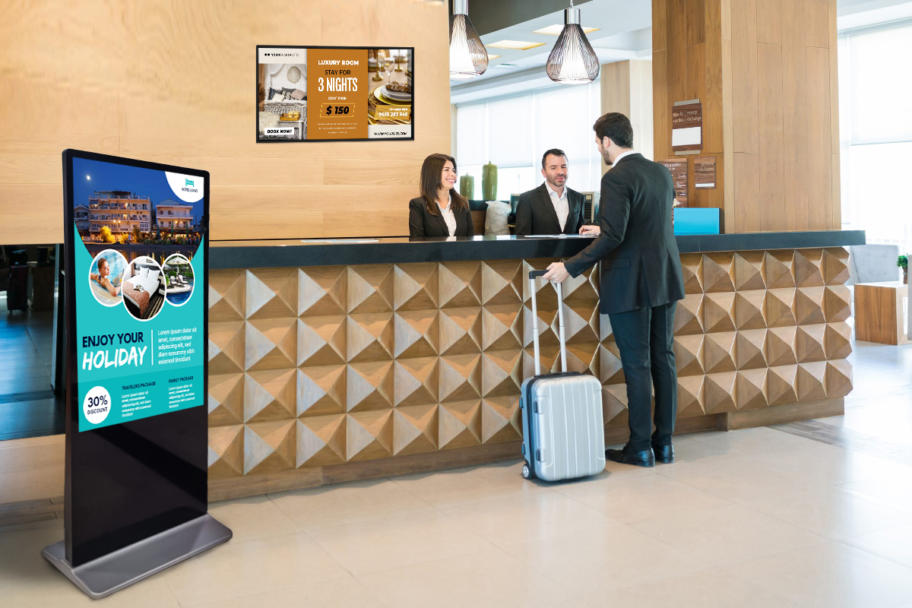
Conclusion
Staff training and development should be a focus to ensure technology proficiency.
Develop partnerships with reputable tech firms to acquire cutting-edge technologies and streamline deployment.
Flexibility and adaptability are needed to keep up with technology and meet visitor needs.
Data-driven decision-making helps comprehend client preferences, industry trends, and operational efficiency.
Prioritise guest-enhancing technology like AI.
Focus on improving guest experiences with AI-powered solutions.
https://firstouchkiosk.com/

Slide 11
Reference
Ashton, A.S. (2017) ‘How human resources management best practice influence employee satisfaction and job retention in the Thai Hotel Industry’, Journal of Human Resources in Hospitality &amp; Tourism, 17(2), pp. 175–199. doi:10.1080/15332845.2017.1340759.
Grönroos, C. and Gummerus, J. (2014) ‘The service revolution and its marketing implications: Service logic VS service-dominant logic’, Managing Service Quality, 24(3), pp. 206–229. doi:10.1108/msq-03-2014-0042.
Gursoy, D. (2018) ‘Future of hospitality marketing and management research’, Tourism Management Perspectives, 25, pp. 185–188. doi:10.1016/j.tmp.2017.11.008.
Hon, A.H.Y. and Lui, S.S. (2016) ‘Employee creativity and innovation in Organizations’, International Journal of Contemporary Hospitality Management, 28(5), pp. 862–885. doi:10.1108/ijchm-09-2014-0454.
Kansakar, P., Munir, A. and Shabani, N. (2019) ‘Technology in the hospitality industry: Prospects and challenges’, IEEE Consumer Electronics Magazine, 8(3), pp. 60–65. doi:10.1109/mce.2019.2892245.
Khatri, I. (2019) ‘Information Technology in Tourism & Hospitality Industry: A Review of ten years’ publications’, Journal of Tourism and Hospitality Education, 9, pp. 74–87. doi:10.3126/jthe.v9i0.23682.
Kraus, S. et al. (2021) ‘Digital Transformation: An overview of the current state of the art of research’, SAGE Open, 11(3), p. 215824402110475. doi:10.1177/21582440211047576.
Lee, M. (2021) ‘Evolution of hospitality and Tourism Technology Research from journal of hospitality and tourism technology: A computer-assisted qualitative data analysis’, Journal of Hospitality and Tourism Technology, 13(1), pp. 62–84. doi:10.1108/jhtt-10-2020-0276.
Rather, R.A. et al. (2021) ‘Customer brand identification, affective commitment, customer satisfaction, and Brand Trust as antecedents of customer behavioral intention of loyalty: An empirical study in the hospitality sector’, Consumer Behaviour in Hospitality and Tourism, pp. 44–65. doi:10.4324/9781003181071-4.
Silva, P. (2019) ‘Davis’ Technology Acceptance Model (TAM) (1989)’, Information Seeking Behavior and Technology Adoption, pp. 205–219. doi:10.4018/978-1-4666-8156-9.ch013.
Strömberg, J. and Thorman, P. (2019) Disruptive innovation theory in the paper- and packaging industry: Applying Clayton Christensen in a new context, DIVA. Available at: http://uu.diva-portal.org/smash/record.jsf?pid=diva2%3A1342911&dswid=3020 (Accessed: 21 February 2024).

