Slide 1

COMPLEX PROBLEM IN A WORK PLACE
Student Name: Lekan Ahmed Nureni
Student Number: 1815860
Lecturer: Syed Jaffery
Module Name: Problem Solving and Decision Making
Module Code: BMSK4004
Notes:
On a fuzzy Tuesday morning, I got to work and met a car at the gate of my work place, the owner was just a random African lad who got his key locked in the car but was in a hot argument with one of our Supervisor who couldn’t drive in because of the obstruction, the supervisor got really mad and started using some offensive words which the guy recorded on phone though after talking to him, he deleted but the supervisor eventually lost his job due to this encounter and we were all warned about discriminative conducts which many have encountered but didn’t bother to report to the boss as the supervisor had been in this act for a while. The management made it clear that the act is not as simple as many of us look at it that could lead to a big law suit against the company.

Slide 2

Defining Complex Problem, Scope and Impacts
Notes:
Complex problems are inevitable with organisation, though it cannot be totally eradicated in an organisation but can be managed to its minimal capacity; this makes it a fundamental part of every organizational role in finding solutions to them so that the organisation’s set goals can be achieved.
Complex problems are obstacles that affect daily activities of an organisation, impacting directly on individuals with numerous interdependencies and multiple causes, both the Employee and the employers or the clients are not left out which makes difficult to define because it involves people from different background, culture, previous experiences and educational background.

Slide 3
Defining Complex Problem, Scope and Impacts
Notes:
Even though the Equality Act 2010 makes it unlawful for an employer to discriminate against an individual on the grounds of 9 different “protected characteristics”; age, disability, gender reassignment, pregnancy and maternity, race, religion or belief, marital status, sex, sexual orientation.
According to the Universal Declaration of Human Rights "Everyone has the right to work, to free choice of employment, to just and favourable conditions of work and to protection against unemployment. Everyone, without any discrimination, has the right to equal pay for equal work."
Discrimination in work is one major complex problem that has led to many others apart from lawsuits. It develops into some many things from physical to mental issues which affect work flow as there could be breakdown in communication, underperformance, Poor work atmosphere, leading to work load, interpersonal conflict a times leads to domestic violence, loss of clients or customers even attempts to take life as things become more hostile.

Slide 4

Problem
Notes:
Since there are 9 major grounds of discrimination in work according to the Equality Act 2010 the discriminative factors at work will be analysed based on these 9 grounds, discriminations happens when an employee or client (customer) is treated unfairly based on age, disability, gender reassignment, pregnancy and maternity, race, religion or belief, marriage and civil partnership, sex and sexual orientation.
Age discrimination: telling a particular employee or client that they are not entitled to certain things like training because of their age.
Gender reassignment: when you change your gender to another gender and you are being treated or victimised on such grounds probably because the other person doesn’t see it fit, so based on this you are refused a job or refused to be attended to in a mall.
Disability: less treatment of a person because of their health issues or physical appearance or to take advantage of them because of their health or physical challenges.
Race: when a person is treated based on their, origin, place of birth ethnicity, skin colour rather than what they can offer. This happens in anywhere even on a football pitch, why some players want to walk off the field even while the game is on after being subjected to racism. Football games have been altered and can even be ended before stoppage time if the act is not controlled and fans have been banned from watching games in the stadium for getting involved in the act.
Religion or Belief: when a person is less treated because of his or her faith, not wanting to give a job applicant the job after emerging as the best candidate, not wanting to attend to a client because he or she belongs to a particular religious group.
Sex: when a particular gender is favoured over other gender based on their gender and not what can bring to the table, if the female deserves the promotion ahead of the male but instead chose the chose the male over the female or paying the female well over the male offering same services.
Sexual Orientation: declining to be on a shift with a colleague or do an assignment together because of their people of the same sex
Marriage and civil partnership: Being treated less in work place because you are single or being a single mother or father making your employee think you are not responsible enough to take promotion or given a job. Being denied a role because you are married and won’t pay attention or be dedicated enough for a job despite being the best candidate.
Pregnancy and Maternity: women have suffered from being promoted or pay rise because someone feels when they get pregnant they can’t offer their best or tend to go on maternity leave and are deprived of certain things for this.

Slide 5
Problem
Notes:
The reasons behind discrimination in work can’t really be identified to one particular reason because it varies but majorly an organization is where people of different backgrounds conduct business to achieve a set goal, so it could be assumed to be influenced by certain things which the management are responsible for:
Ignorance of the law of the Equality Act 2010 & Universal Declaration of Human Rights and its implications, most workers are not aware of the laws and even if they do, they are not aware of its implications or don’t take it serious.
Inadequate trained personnel that just do their work without basic knowledge of work ethics brings lack of professionalism and knowingly and unknowingly commits discriminative acts.
Poor recruitment process can damage everything the organization has worked for if they don’t do proper investigations on applicants, check their qualifications and its authenticity could mean the wrong person is being employed leading to series of crisis such as discrimination in work place.
Poor Record history means poor documentations of employees work report and activities in work place.
Toxic working environment leads to lots of bad habits.
Lack of complaints procedure & channel means the company has not created or give room to make complaints on discriminative acts.
Ineffective policies is when even their set rules to guide but they are not put to use.
Unresolved Complaints when management take complaints for granted and don’t give it attention due lack of attention to personal conflicts between individuals not settled could lead all sorts of harassment.
Excessive freewill when people have too much freedom they tend to abuse it
Effects Of Discrimination
Law Suits
Low Productivity
Loss of Clients, Customers and staffs
Mental Illness
Suicide & Murder in retaliation sometimes
Bullying
Poor communication and working environment

Slide 6
Solutions
Provide sustainable Knowledge of the Equality Act 2010 & Universal Declaration of Human Rights and its implications to all the employers
Proper Orientation on discrimination in work place for all employers
Structured employment process is due so that the right people can be employed
Swift response to complaints by looking into it as soon as possible
Swift disciplinary actions for violating the Equality Act 2010
Consistent and Effective policies to guide the activities within and outside the organization

Slide 7
Solutions
Resolving and Monitoring personal conflicts
Occasional Psychotherapy sections for stakeholders
Keeping a good record history
Do campaigns by educating not just the internal public but also the external public about the act of discrimination
Encourage proper and honest whistle blowing
Create a proper complaint structure & channel

Slide 8
Plan Implementation
Stage One
Prepare for the Change
Educating Everyone/ Orientation
Inform them why and how to go about it
Ask for everybody’s opinion
Appoint or nominate those to lead the campaign
Stage Two
Implementation
Provide adequate Resources
Roll out the policies
Training
Providing Guides & help
Encourage feedback
Rewards and Encouragements
Leading by example
Stage Three
Permanency
Create a sustainable environment
Evaluate with performance indicator
Rewards & Encouragements
sanction
Monitor & Review

Slide 9
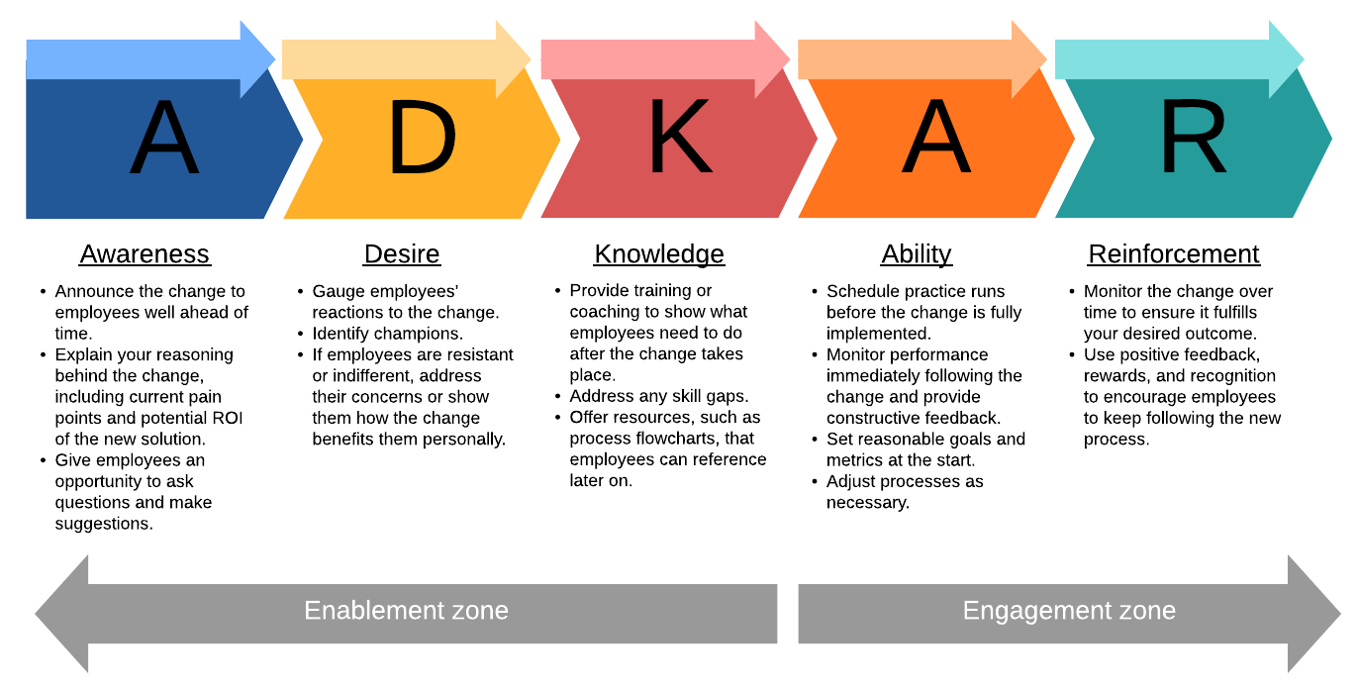
Dissemination of Plans to Stakeholders
ADKAR MODEL will be adopted to help the people involved understand and accept the change that is about to be implemented, so organizational goals and objectives can achieved without unnecessary drama.
Notes:
The Prosci ADKAR® Model is a goal-oriented change management model that guides individual and organizational change. Created by Prosci founder Jeff Hiatt, ADKAR is an acronym that represents the five tangible and concrete outcomes that people need to achieve for lasting change: awareness, desire, knowledge, ability and reinforcement

Slide 10
Dissemination of Plans to Stakeholders
Awareness of the need to change
Desire to participate and support the change
Knowledge about how to change
Ability to implement new skills and behaviours
Reinforcement to keep the change in place
Notes:
Awareness: for people who already have a particular pattern or way of behaviour to change, they must be presented with good information about what is about to be implemented will have a good impact, why a season ticket football fan has been ban for life for chanting racism thoughts despite being a season ticketer. So communicate in the simplest manner, show them companies and individuals slammed with lawsuits for engaging in Discriminative acts, show them the bright side, how a black man saved white children, how a woman made it to top management and ensure all other employees became shareholders, how a gay person impacted knowledge on a colleague who eventually got promoted.
Desire: After informing, demonstrate how previous involvement in Discrimination act in work place made a company lose their could be biggest deal, led to personal conflict within the office, made a customer angry and led to domestic violence, those who witnessed the scenes could relate and see there’s a need for change, prepare the best line managers in the work place that could influence other staffs about discrimination in work place.
Knowledge: Training, Sensitization, Orientation on how to legitimately use Equality Act 2010 to protect themselves even from the employers, clients, customers and colleagues, how they can take a good advantage of the act, what to do and how to go about it
Ability: once they have a good knowledge of the law that protects them or that could make them face the law, so they can definitely act on the knowledge gathered from the law as guides that regulate their activities with everyone encountered at work and outside work. They can also reach out to the management for questions or help when they are not sure of what to do.
Reinforcement: Sanctions and Rewards will be available to encourage and discourage those who abide and those who don’t. Keep the same energy from the implementation stage that the discriminative act in work place could end career, lead to fine, jail term and that the company is not in support or not liable to pay for offenders if caught in the act. Line managers must ensure they identify and celebrate those who act accordingly o keep morale high and create additional momentum

Slide 11
Monitoring Techniques
Report: Reviewing the activity records of the employees daily, weekly, monthly and annually report in order to keep track of their activities
Meetings: keeping tab on their interactions, suggestions, observations, tone of conversations during staff meetings, or their interactions with colleagues.
Recommendation: what customers and clients think of an employee’s while transacting with them, what the line manager think or suggest of the employees under his or her supervision.
Personal encounter: what and how things transpire when working together on an assignment
Survey: observing and directly interviewing an employee to hear their view or reaction toward an issue.
Progress Report: just like the report card that shows and gives remarks on grades, it entails how employees have carried out given tasks at work
Feedback: reviewing the states of things or information collected from together with the stakeholders and learning to improve from it , correct, reward and sanction if it is necessary.
Impact Assessment: measures the effectiveness and significance of the implemented change
Training/ Sensitization/ Orientation: Continuous training, sensitizing and orientating employees can expose them better, discover their strengths, weaknesses and can work on it to get better at the same time serve as an avenue to test them from what they have learnt to know if they have improved and where they need to improve

Slide 12
REFERENCES
Hash, K. M., & Ceperich, S. D. (2006). Workplace issues. In D.F. Morrow, & L. Messinger (Eds.), Sexual orientation and gender expression in social work practice: Working with gay, lesbian, bisexual, & transgender people. New York: Columbia University Press.
Head, B. W. (2008). Wicked problems in public policy. Public Policy, 3(2), 101-118. Available from https://www.researchgate.net/publication/43502862_Wicked_Problems_in_Public_Policy
Maine.gov: Human Rights Act
http://smallbusiness.cho.com/prevent-discrimination-workplace-2853.html
https://www.prosci.com/adkar/adkar-model

